Slide 1
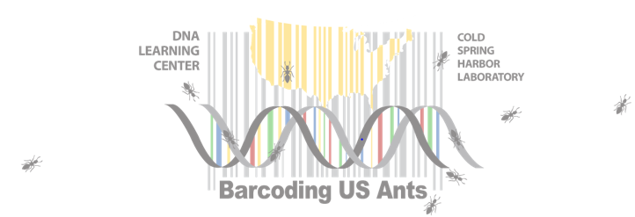
US Ants – Where to Start?

Slide 2
Project Goal
Increase the number of novel barcodes for US ant species

Slide 3
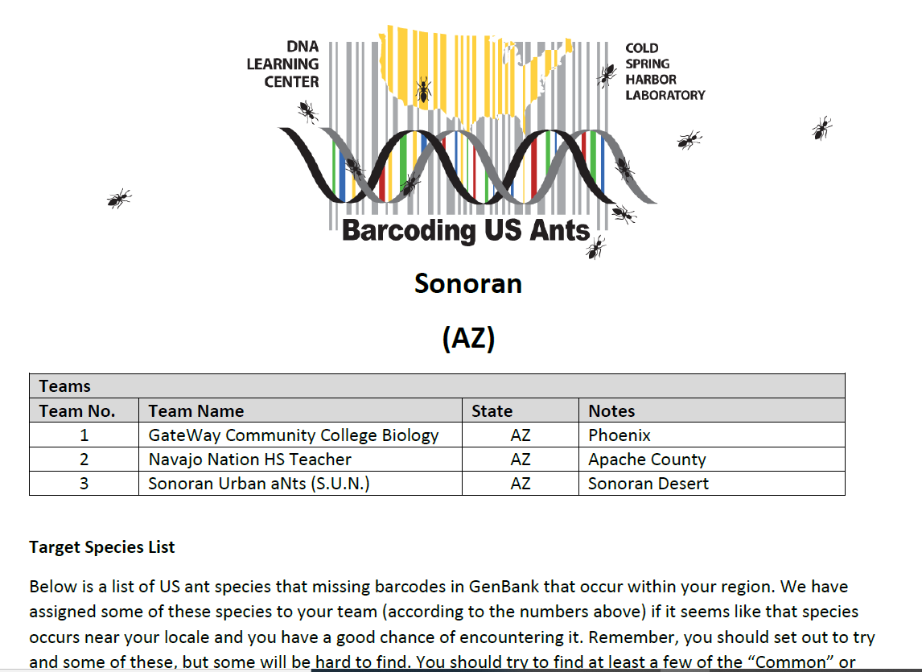
Project Goal
Increase the number of novel barcodes for US ant species
Refer to Your Regional Target Species List

Slide 4
Pick some target species
Research the species that you may want to try and collect

Slide 5
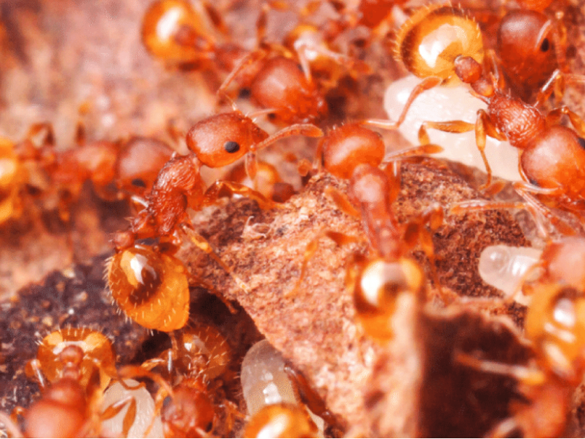
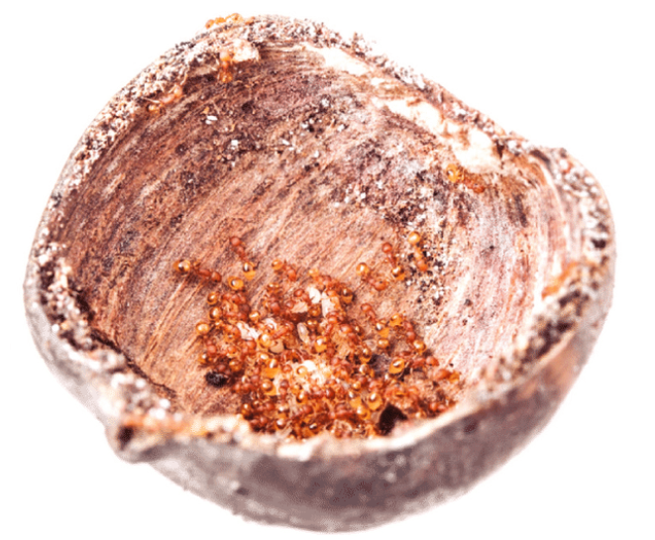
Pick some target species
Research the species that you may want to try and collect
If I were an ant, what would I be doing right now?
Karlik et al. 2016

Slide 6
Pick some target species
Research the species that you may want to try and collect
Important Considerations:
Where (location, latitude/longitude) have my species been collected in the past?
What type of habitat do my species prefer (i.e., desert, plains, pine forest, etc.)?
What type of lifestyle do my species lead (i.e., predators, seed-eaters, farmers, inquilines, xenobionts, etc.)?
Activity, location of colony, elevation, soil type, etc…

Slide 7
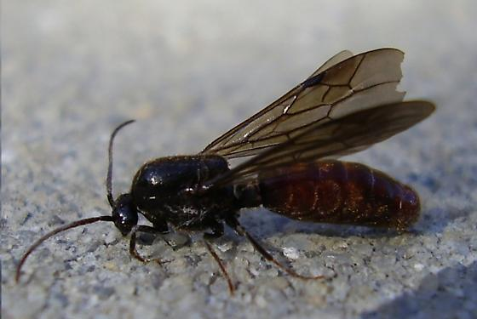
Pick some target species
Research the species that you may want to try and collect
Choose a collection methodology. Always think outside the box!
Neivamyrmex spp. Alates might be collected from porchlights/blacklights, for example
Machele White, Bugguide.com 2005

Slide 8
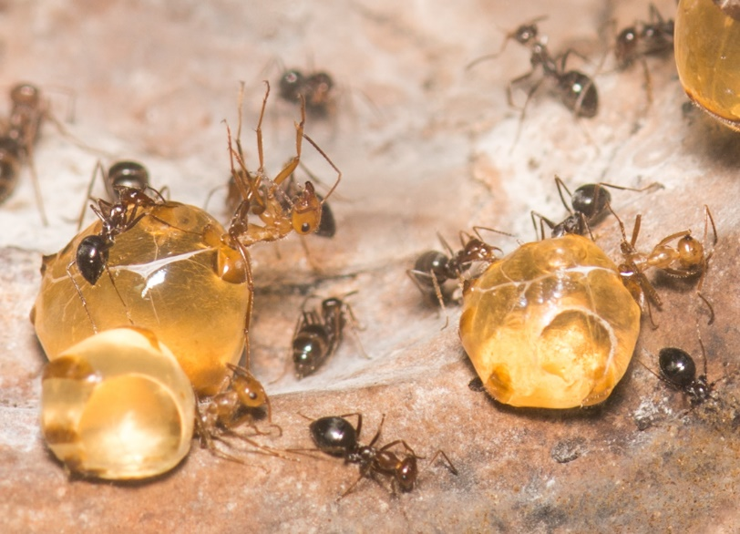
Pick some target species
Research the species that you may want to try and collect
Choose a collection methodology. Always think outside the box!
Collect with an eye toward the future.
Collect series (perhaps 5-10) specimens
Record field notes (date, time, soil type, etc.
CAREFULLY CURATE AND SAVE YOUR SPECIMENS

Slide 9
Pick some target species
Research the species that you may want to try and collect
Choose a collection methodology. Always think outside the box!
Collect with an eye toward the future.
Remember that even if DNA Extraction fails, you may have collected a very interesting specimen and your notes on where/when/how you find it may provide valuable insight into the biology of rare/uncommon species

