Slide 1
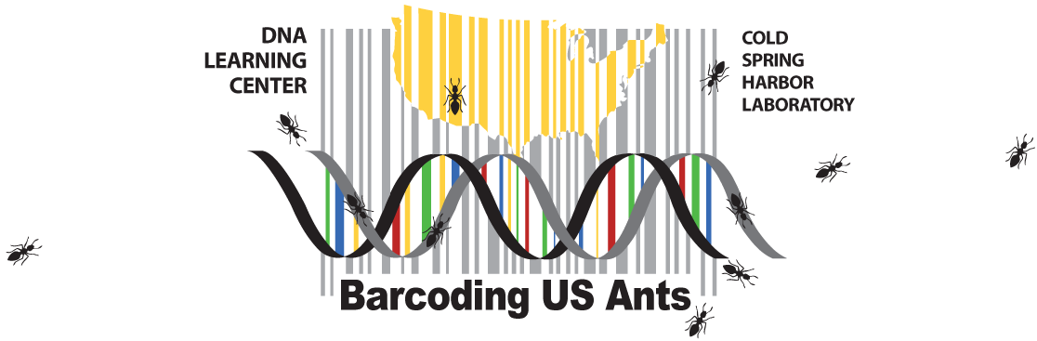
Orientation Zoom Conference
July 9, 2020
Dave Micklos

Slide 2
Today’s Event
Dave Micklos
Project funding
Project goals
Background on DNA Learning Center
Introduction to DNA barcoding
Shawn Dash and Jeffry Petracca
Ants of the US
(Bio)geographical regions
Collection strategy
“Hit List”
Break-out Rooms, with DNALC staff members
  Introductions
  Assess readiness and needs

Slide 3


Slide 4
Goals of the Project
Add 100 new ant barcodes to the Genbank database with you as co-authors
Contribute to range maps that can help us understand how ants are reacting to global climate change and habitat loss
Have fun doing it
Allow everyone to find a comfortable pace and level at which to participate

Slide 5
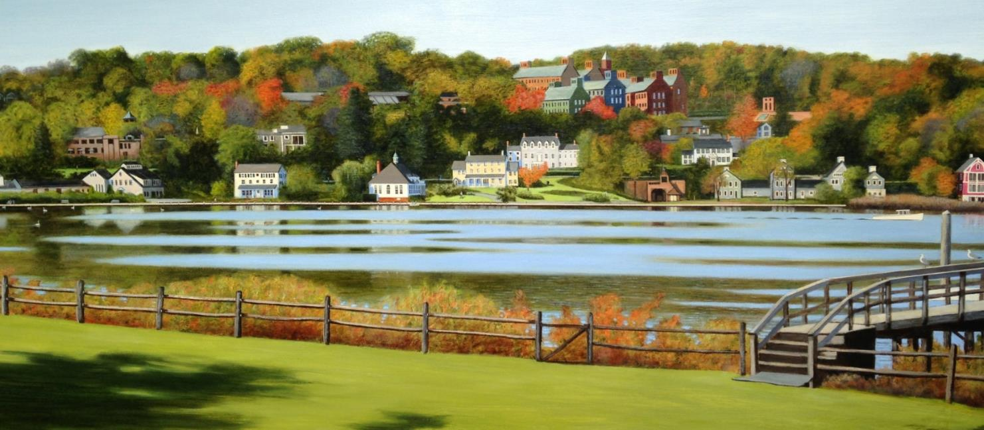
Cold Spring Harbor Laboratory

Slide 6
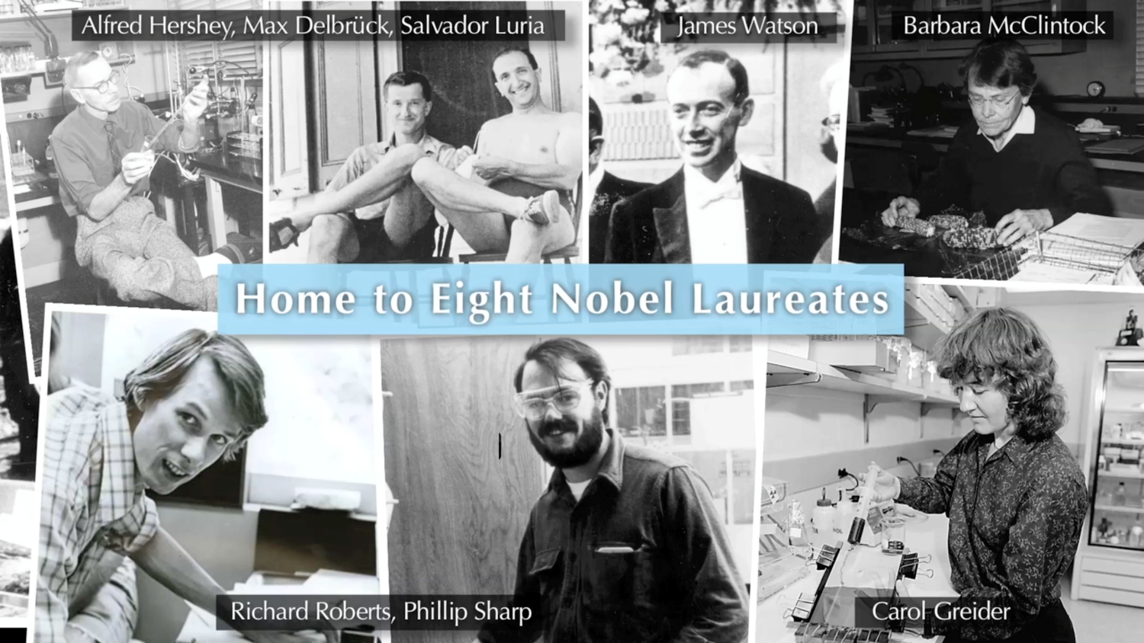
Cold Spring Harbor Laboratory

Slide 7

Impactful Science
Citation impact in genetics and genomics
 | Institution | Citations per Paper
1 | Cold Spring Harbor Laboratory | 69.52
2 | Broad Institute | 69.34
3 | Howard Hughes Medical Institute | 59.00
4 | Wellcome Trust Sanger Institute | 56.80
5 | Salk Institute | 52.46
6 | Dana-Farber Cancer Institute | 45.76
7 | European Molecular Biological Laboratory | 45.60
8 | Rockefeller University | 45.50
9 | Harvard University Medical Affiliates | 44.91
10 | MRC Laboratory of Molecular Biology | 44.50

Slide 8
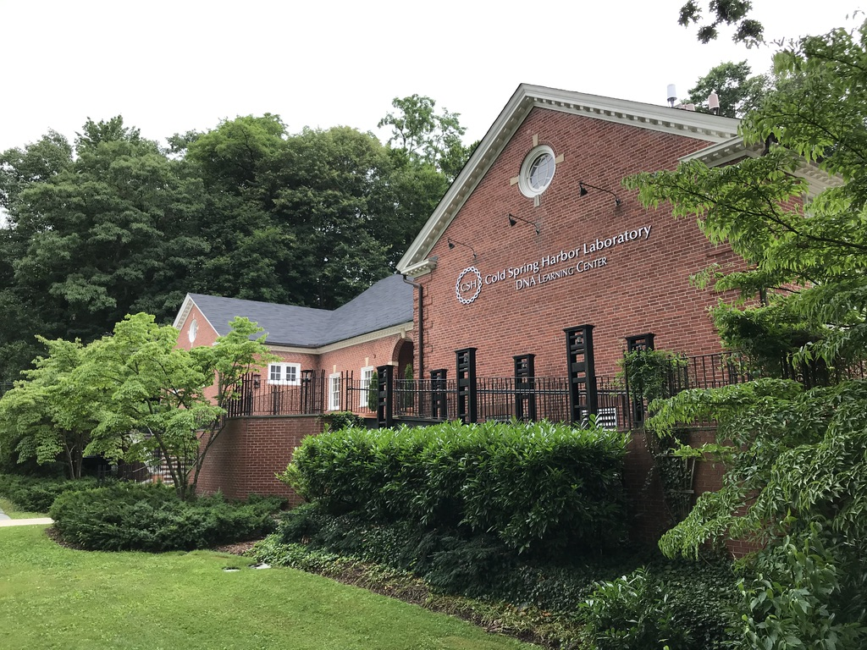

Slide 9
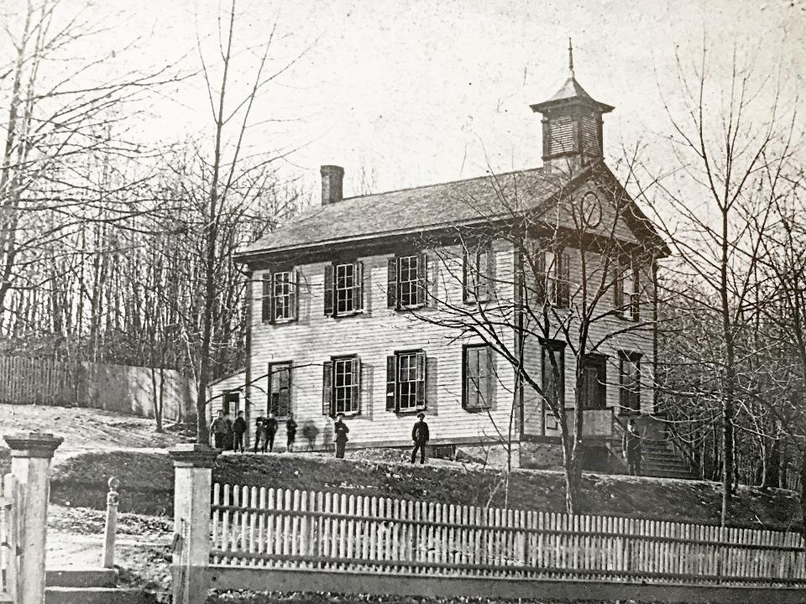
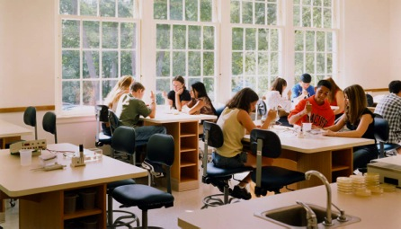
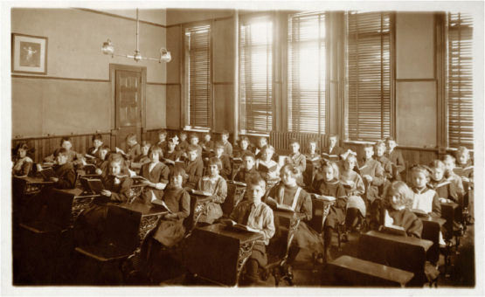
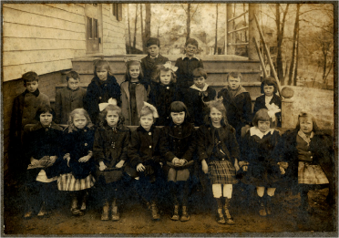
East Side School 1870-1924
DNA Learning Center 1988

Slide 10
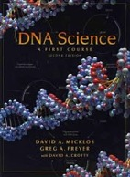
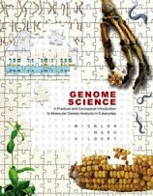
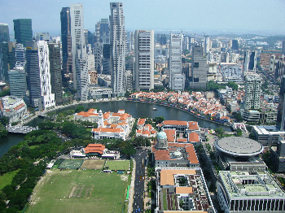
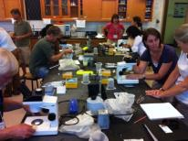
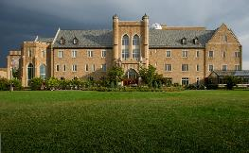
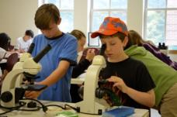

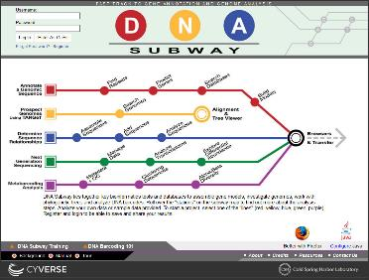
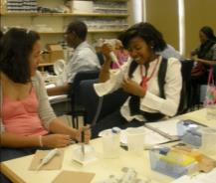
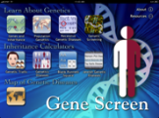

Vertical Integration in Genetics
A successful formula developed over 25 years
Curriculum Development
L
Licensing
Teacher Training
Student Enrichment & extended research
Internet Multimedia and Computational Infrastructure

Slide 11

Focus on Lab Experiences
569,738 Annual Student Lab Exposures
31,064
1,347
369
109,931
364,218
62,809
DNALC Lab
Field Trips
DNALC
summer
Campers
Extended Student Research
Labs at Licensed
and Modeled
Programs
Worldwide
DNALC
commercial
Kits
Online DNALC
Sequence
Analysis

Slide 12
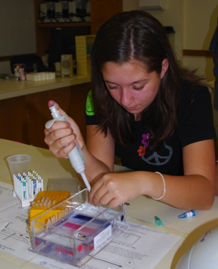
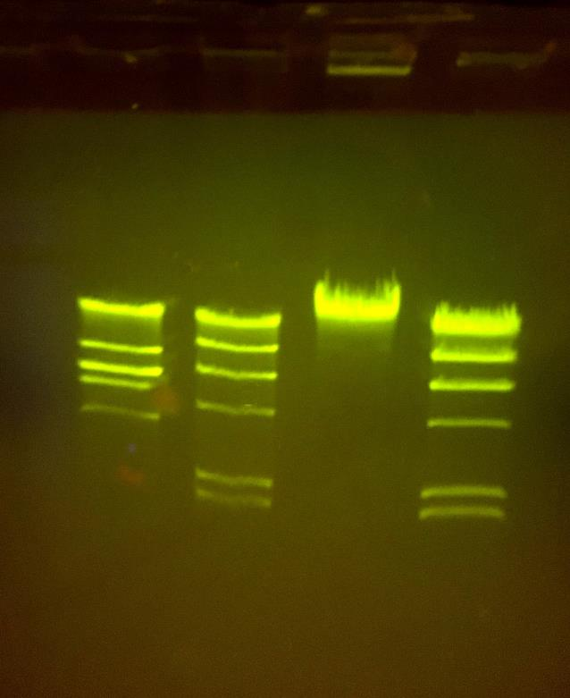
DNA Restriction Analysis

Slide 13
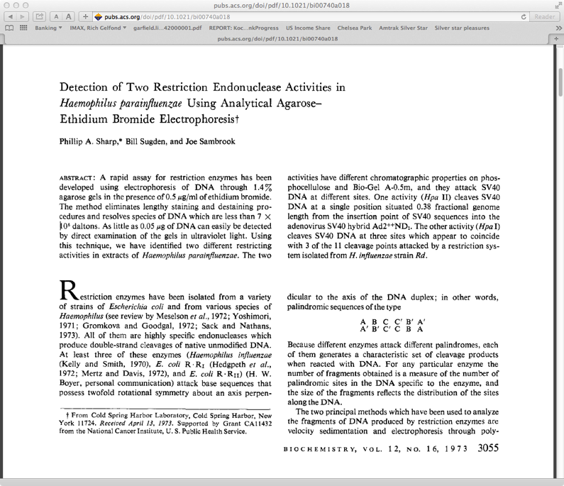
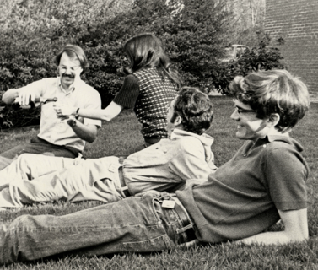
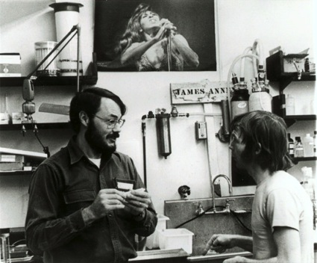

Slide 14
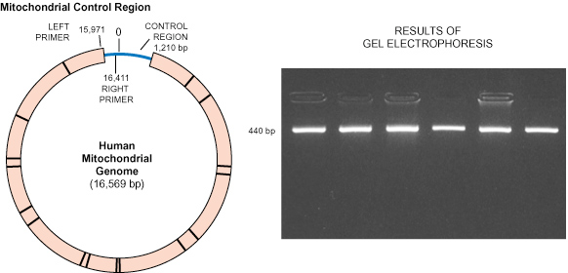
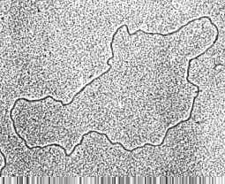
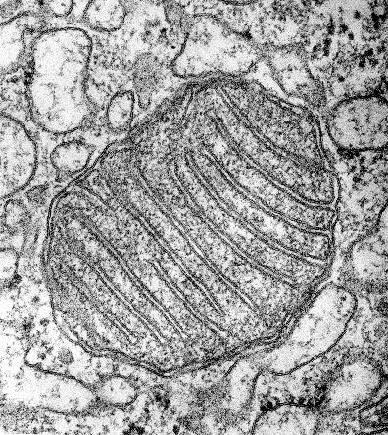
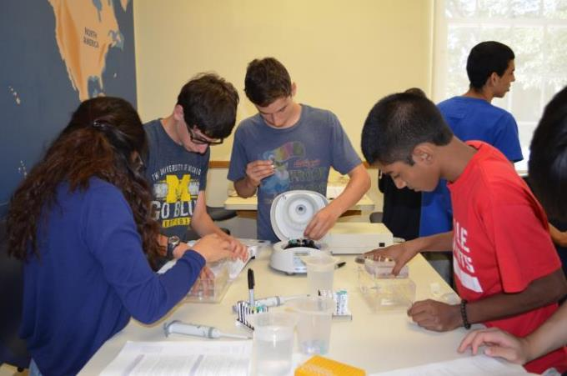
Human Mitochondrial DNA Sequencing (1997)
110,000 student sequences, 1.6 million user sessions

Slide 15
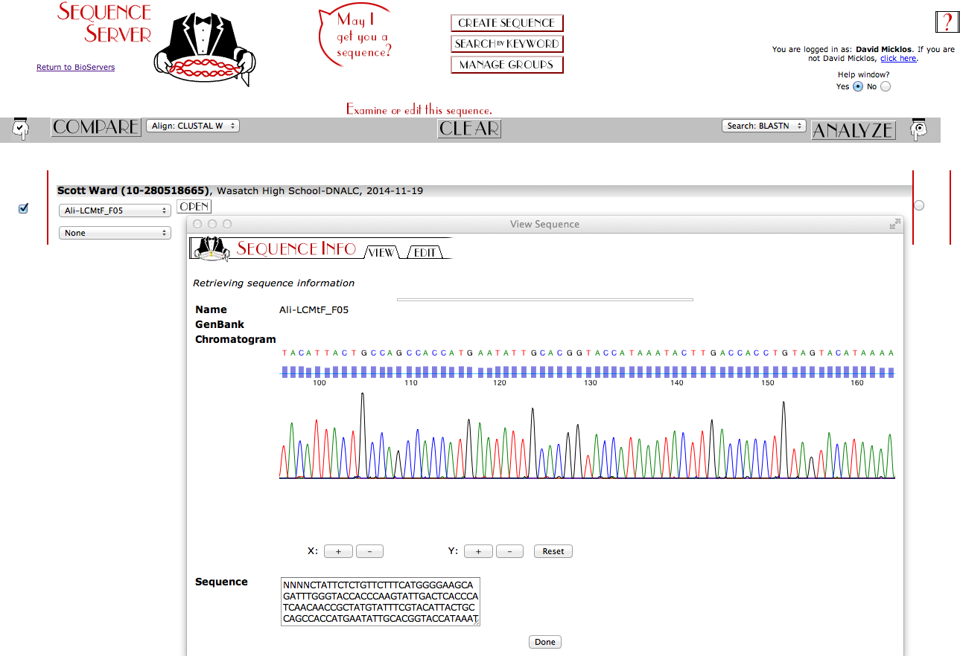

Slide 16
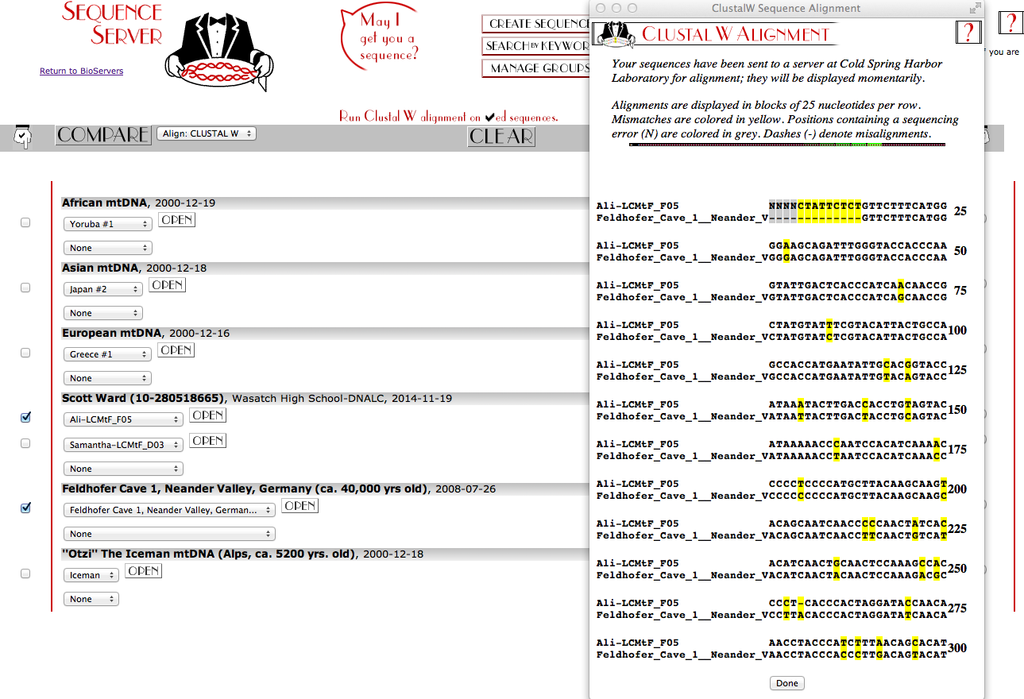

Slide 17
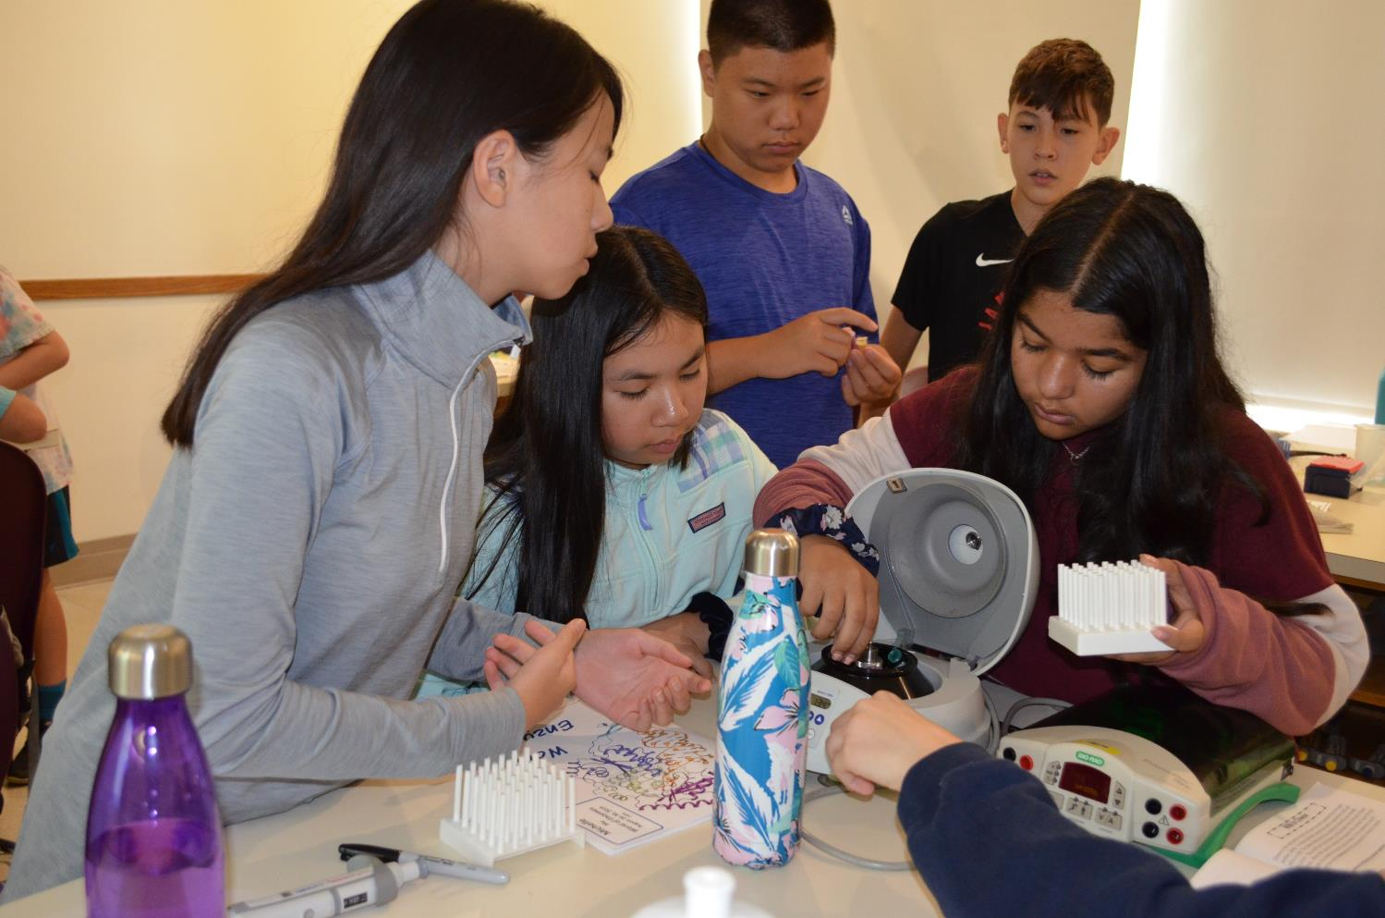

Slide 18
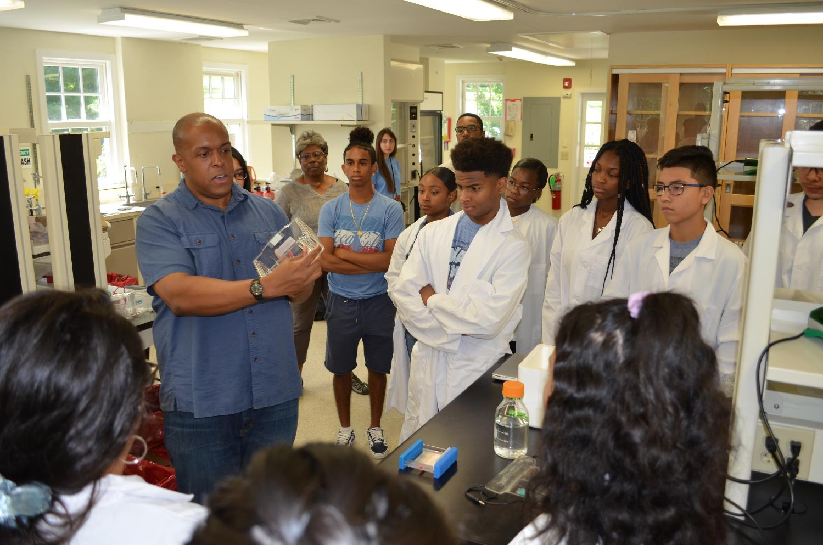

Slide 19
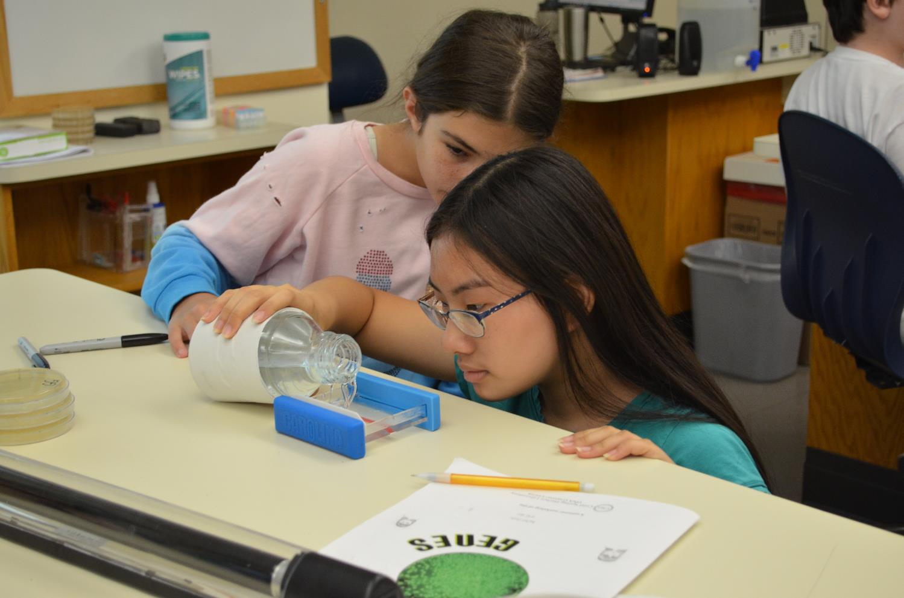

Slide 20
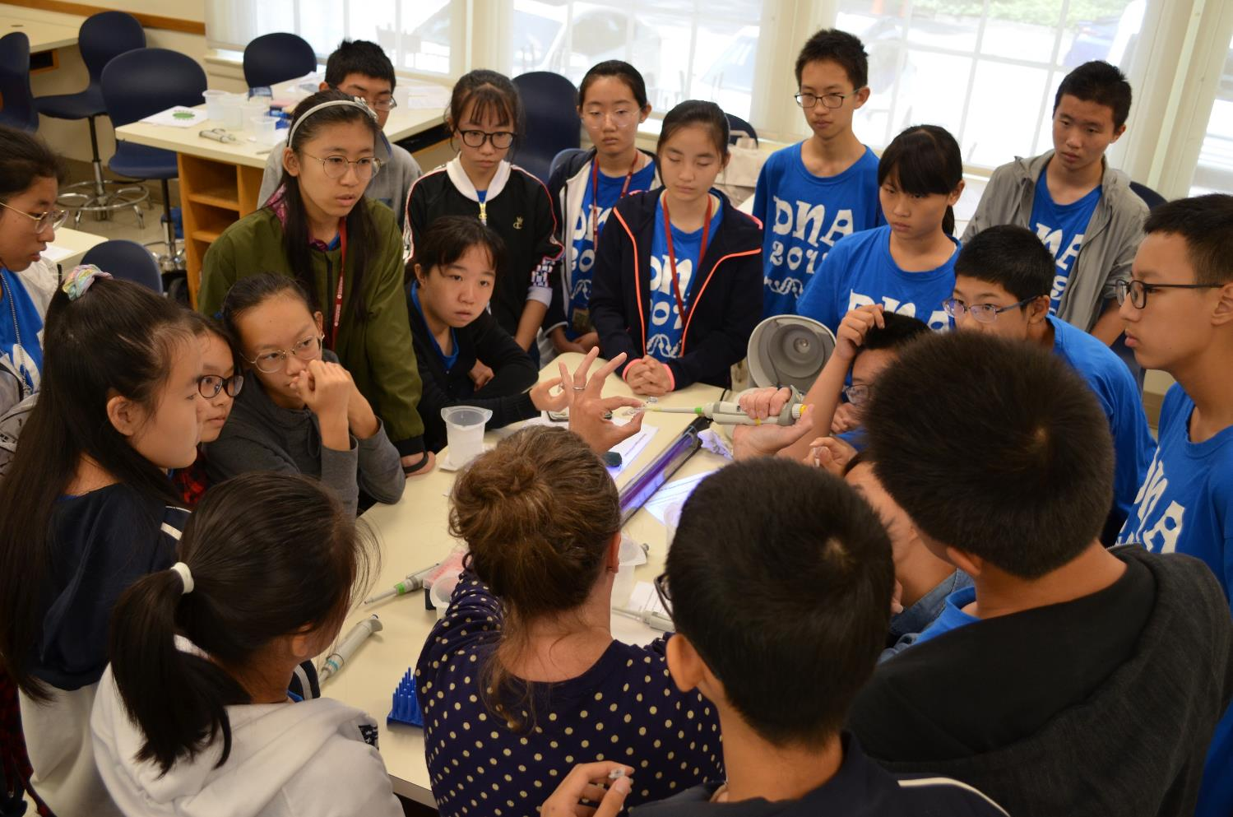

Slide 21
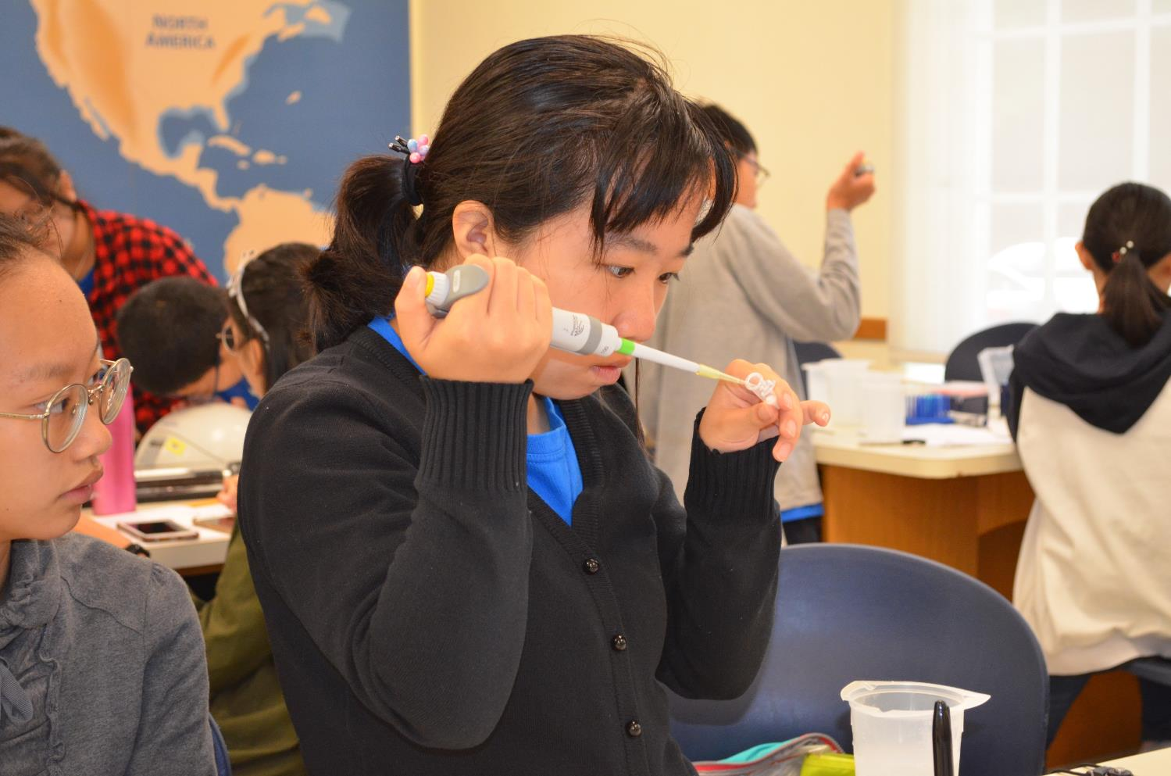

Slide 22
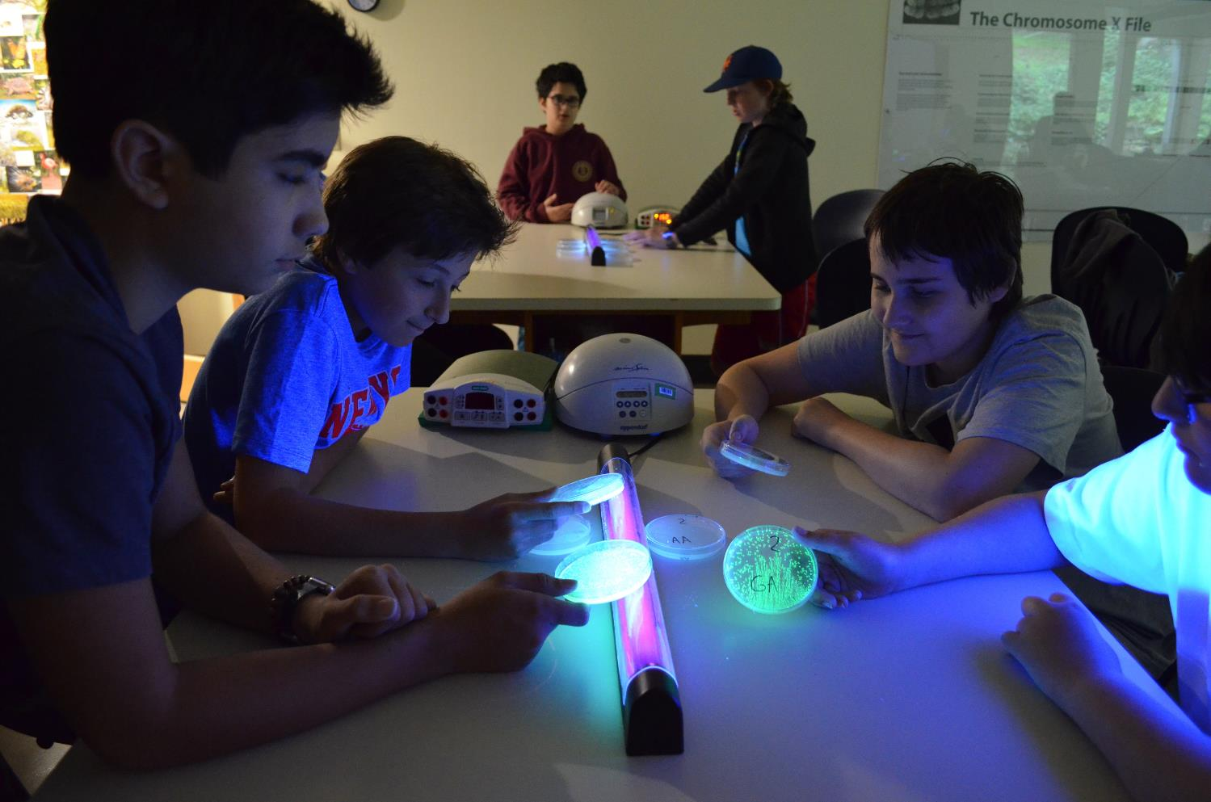

Slide 23
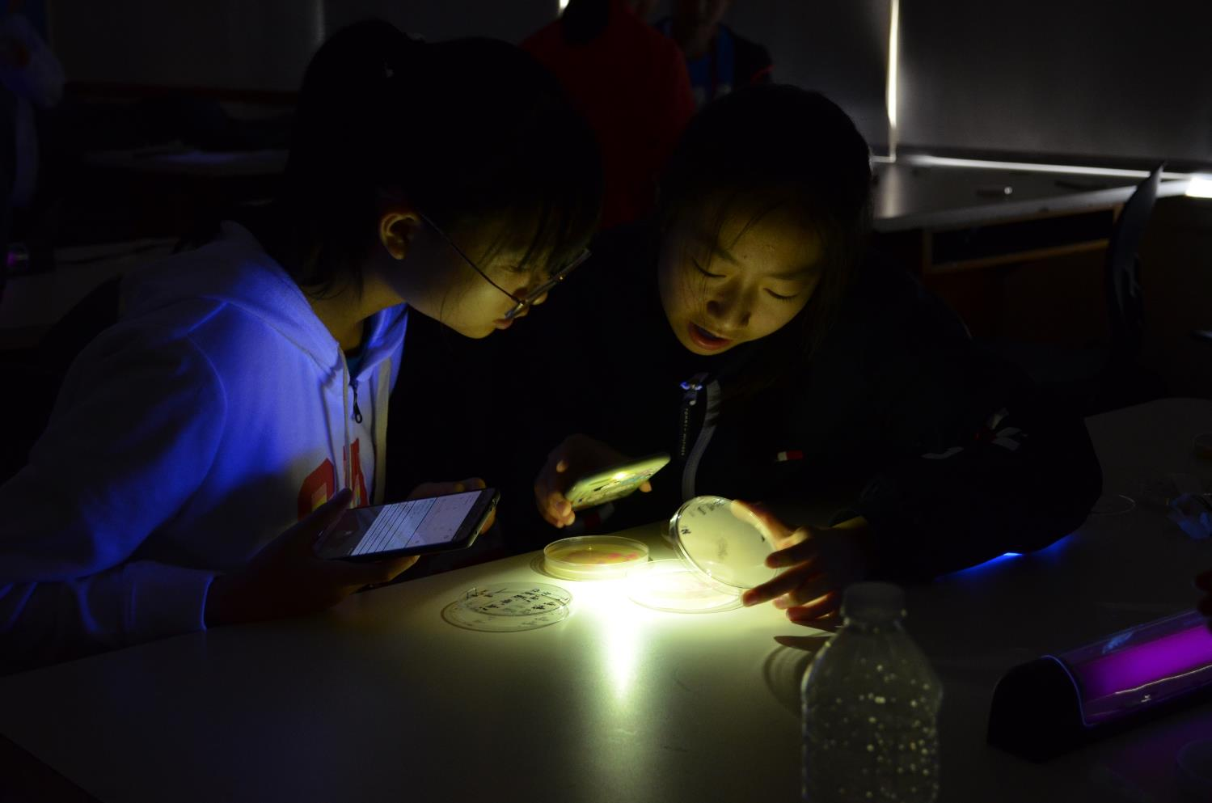

Slide 24
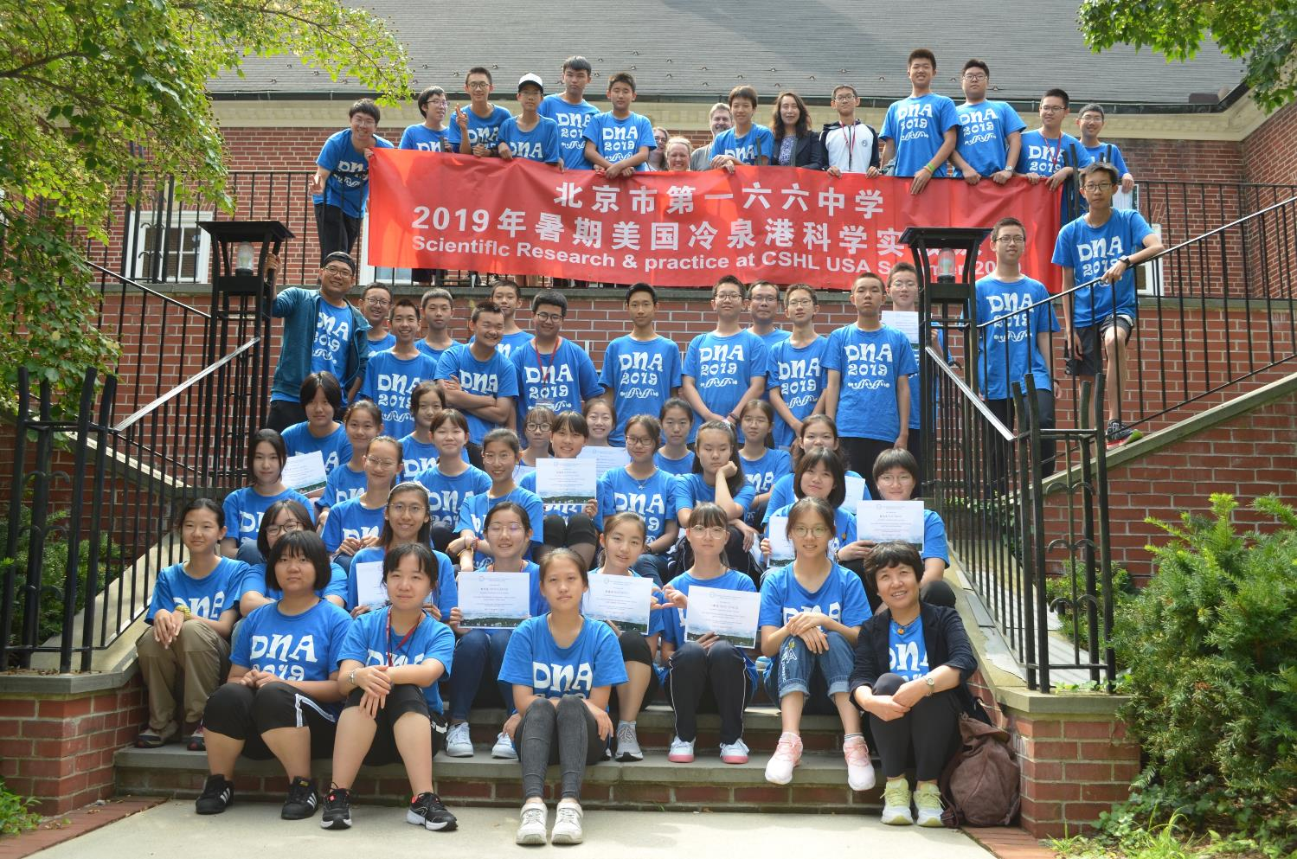

Slide 25
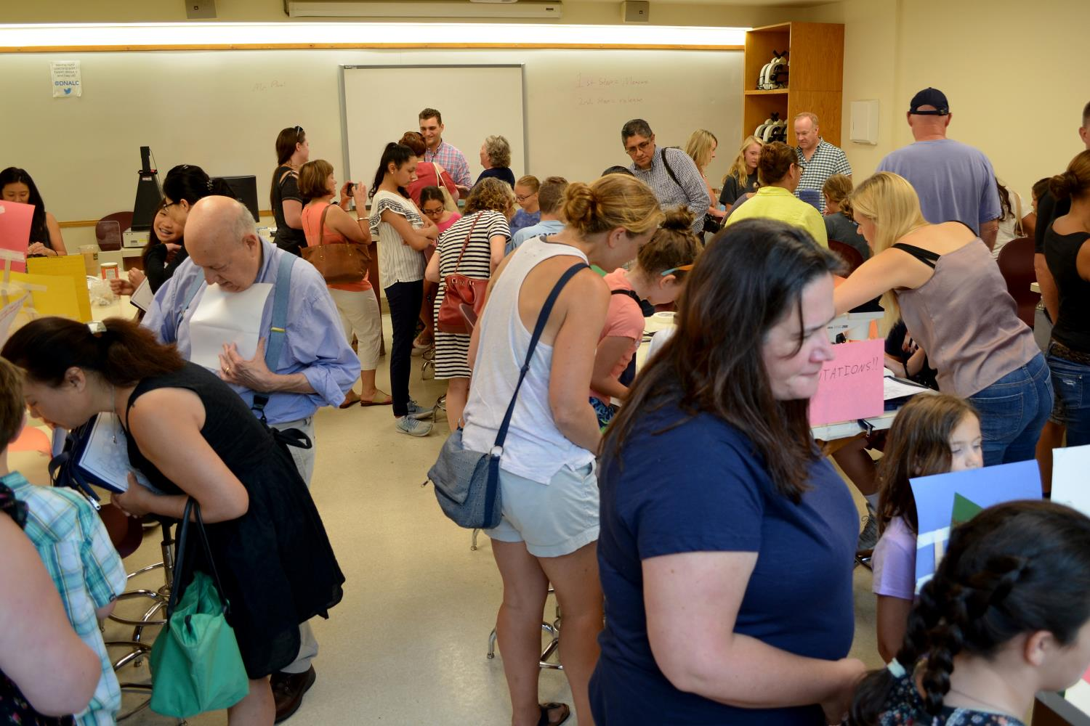

Slide 26
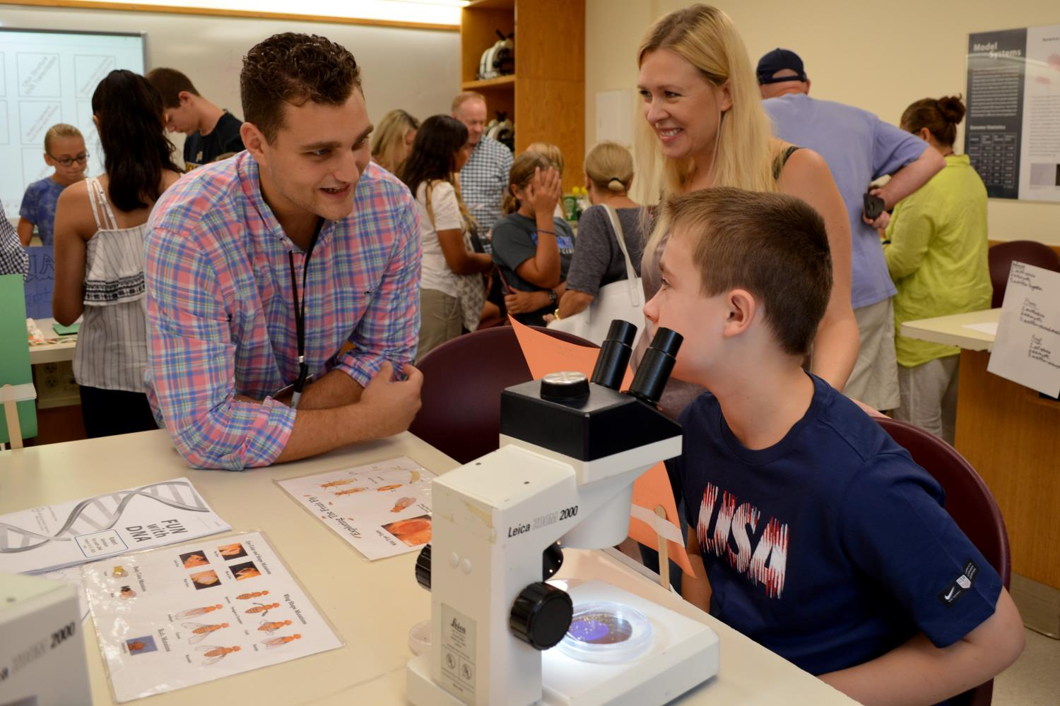

Slide 27
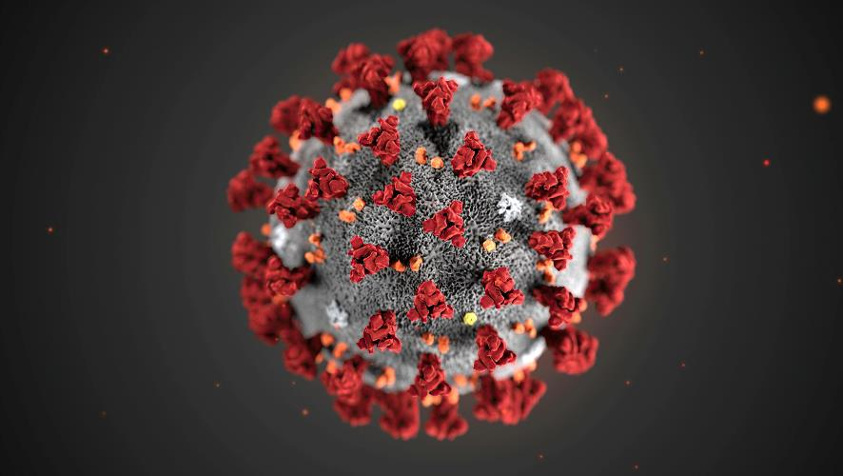

Slide 28
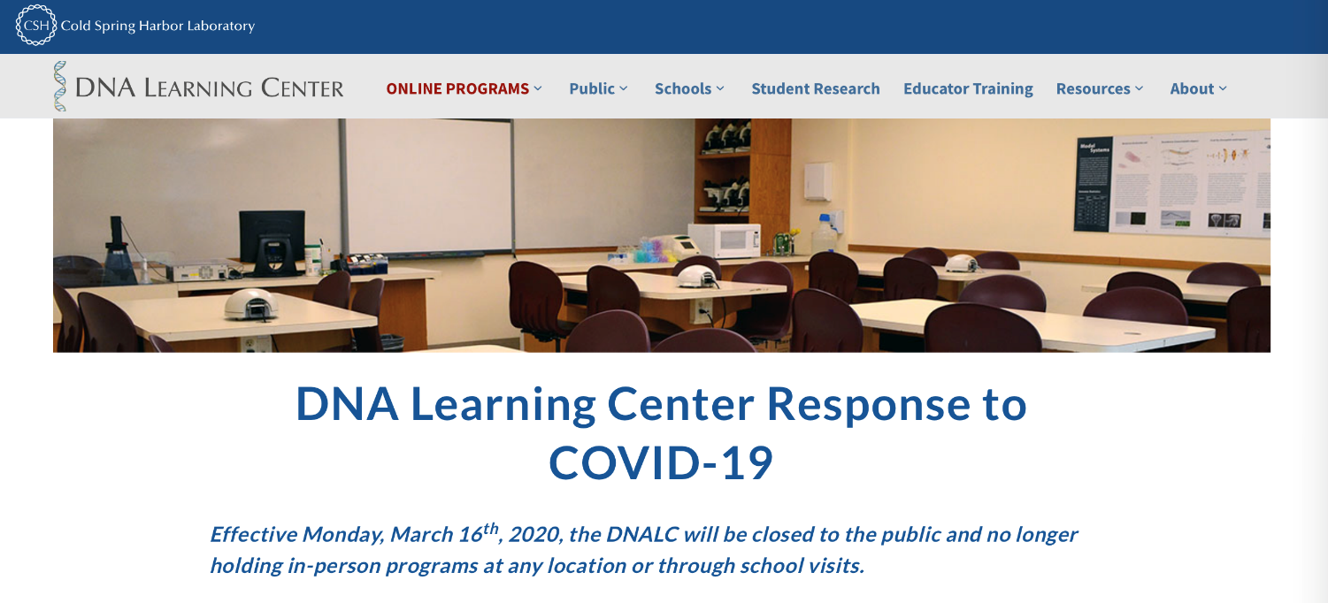

Slide 29
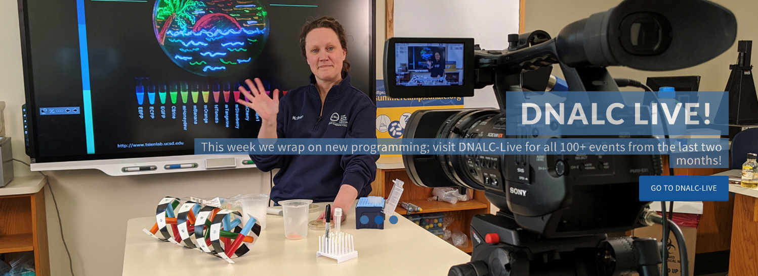

Slide 30
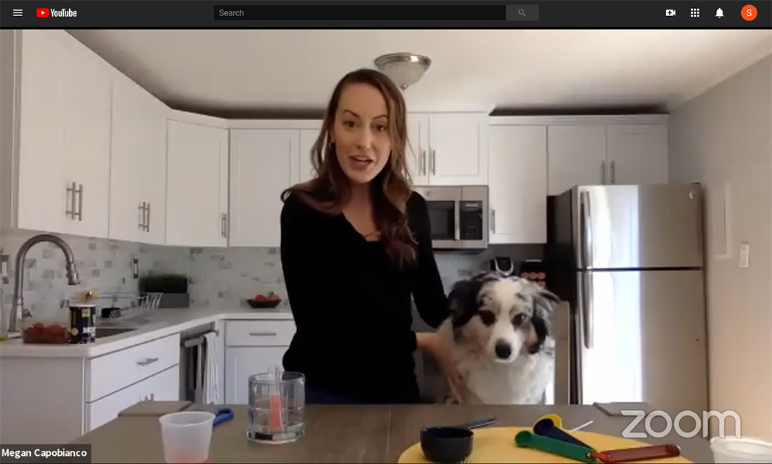
DNALC LIVE!
Launched March 20 on YouTube
Online labs with moderated chats stood in for lab field trips
Museum tours, multi-part courses, teacher chats, and series shorts
10-12 live events per week broadcast mainly from instructors homes
Kitchen DNA extraction with “Chief”

Slide 31
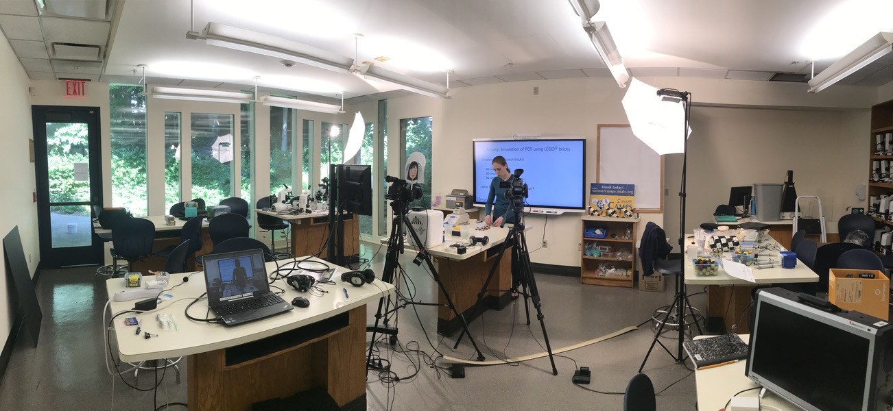
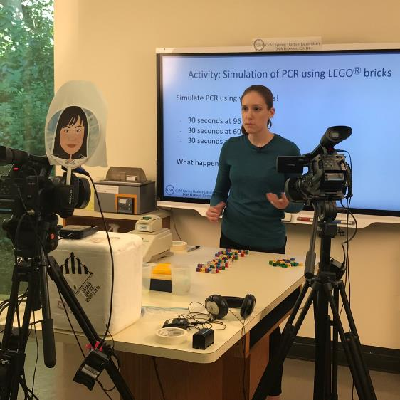
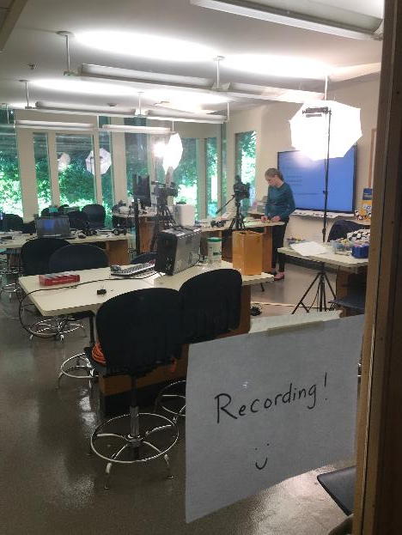

Slide 32
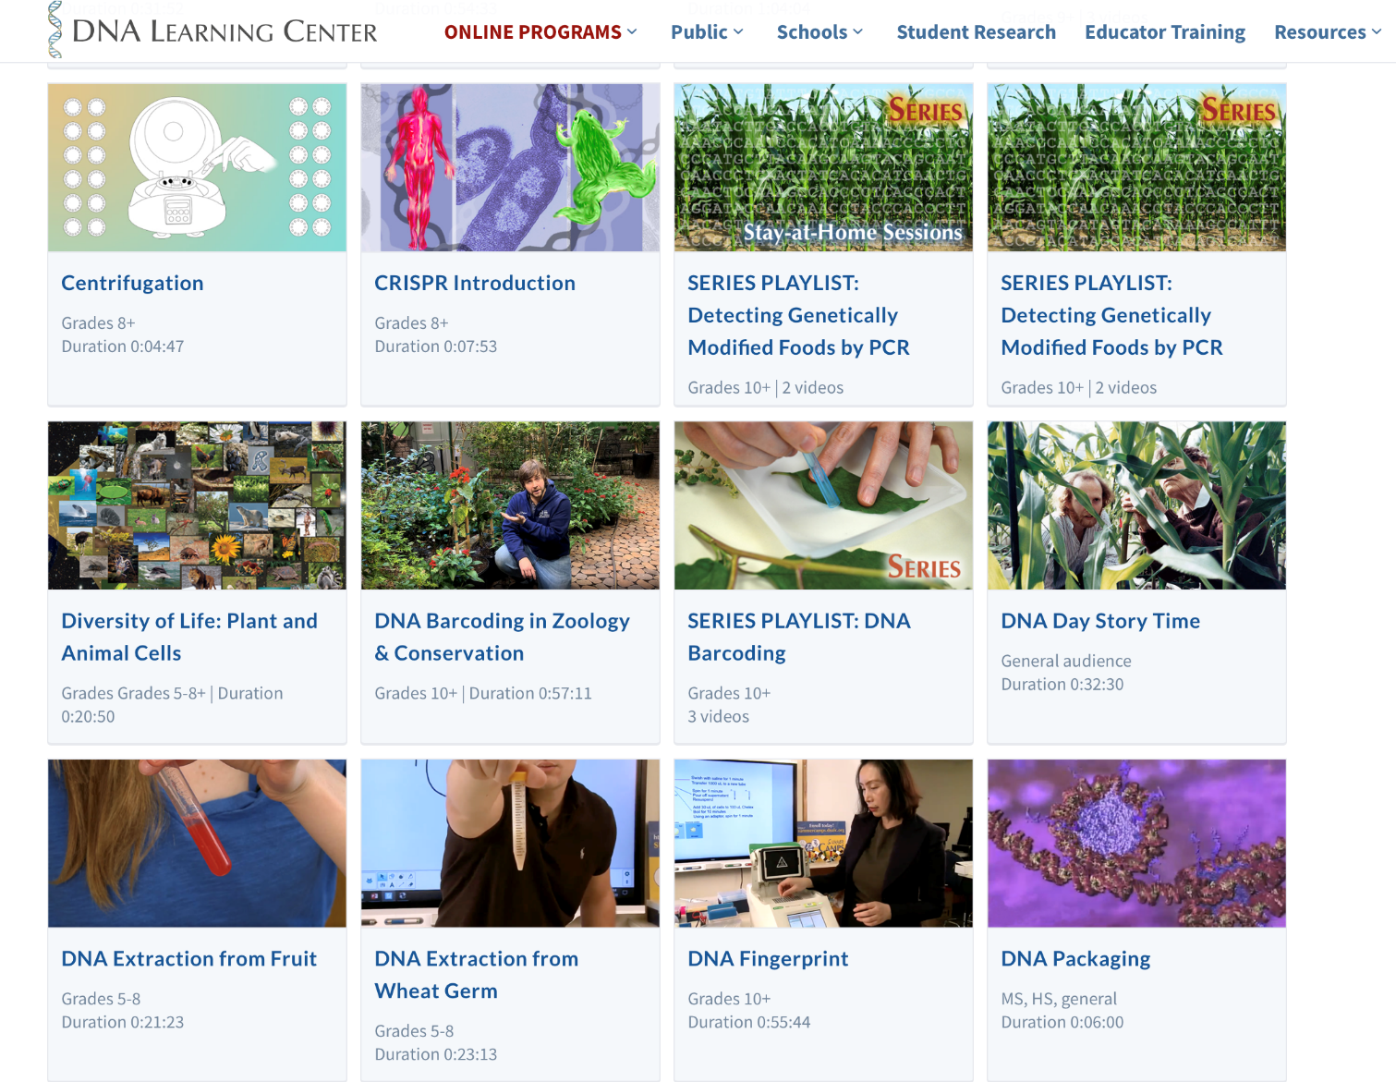

Slide 33
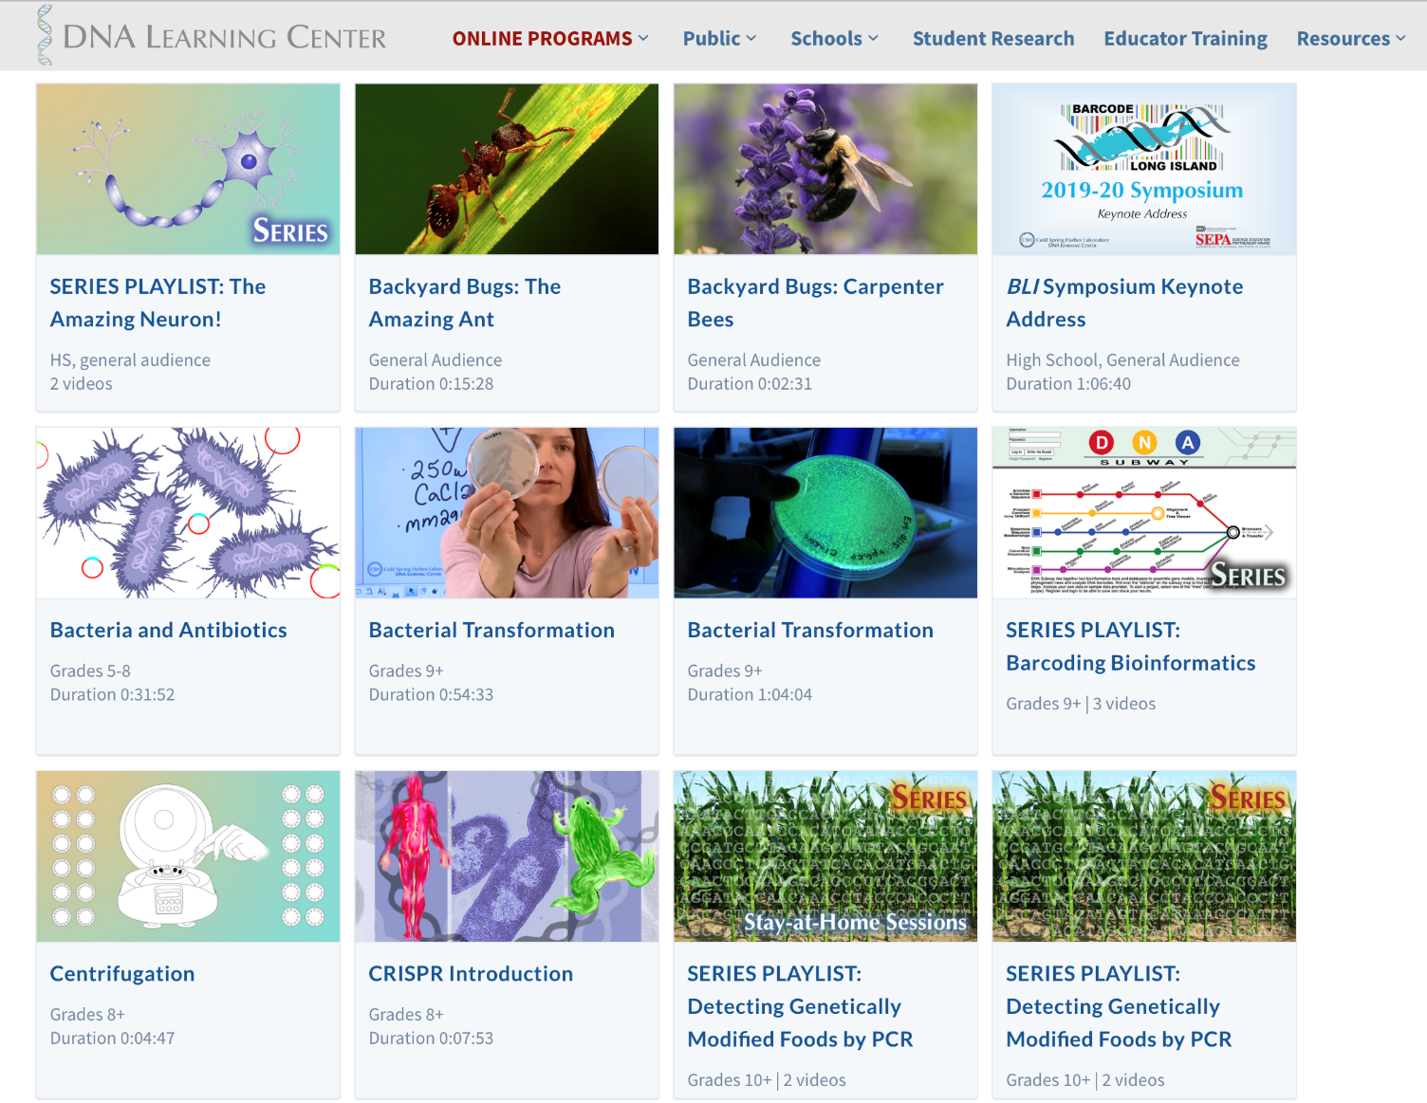

Slide 34
Weekly YouTube Channel Views

Slide 35
Institution | Location | Videos Uploaded 3/1/20 - 6/12/20 | Channel Subscribers | All-Time Channel Views | In-Person Annual Visitation
DNA Learning Center | Cold Spring Harbor, NY | 129 | 33,700 | 8,822,627 | 26,400
Perot Museum of Nature & Science | Dallas, TX | 94 | 880 | 450,658 | 950,396
California Academy of Science | San Francisco, CA | 55 | 130,000 | 16,269,343 | 1,300,000
Liberty Science Center | Jersey City, NJ | 49 | 1,600 | 1,208,869 | 750,000
American Museum of Natural History | New York, NY | 16 | 251,000 | 65,502,616 | 5,000,000
Museum of Science & Industry | Chicago, IL | 8 | 8,200 | 10,733,273 | 1,400,000
New York Hall of Science | New York, NY | 0 | 177,000 | 482,159 | 500,000

Slide 36
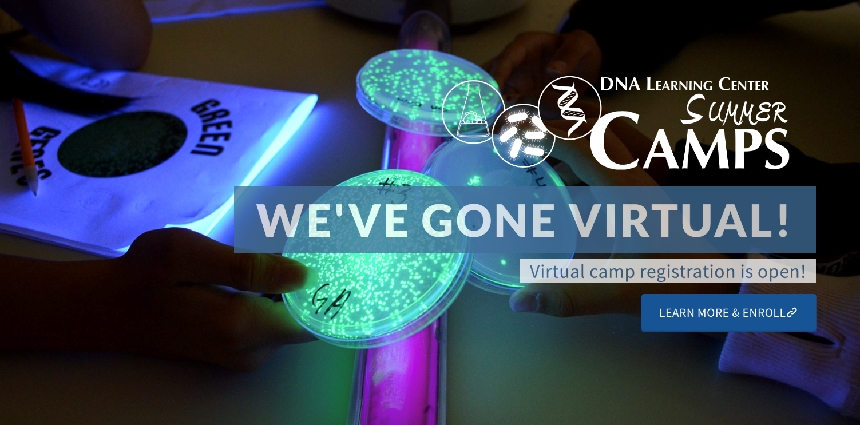

Slide 37
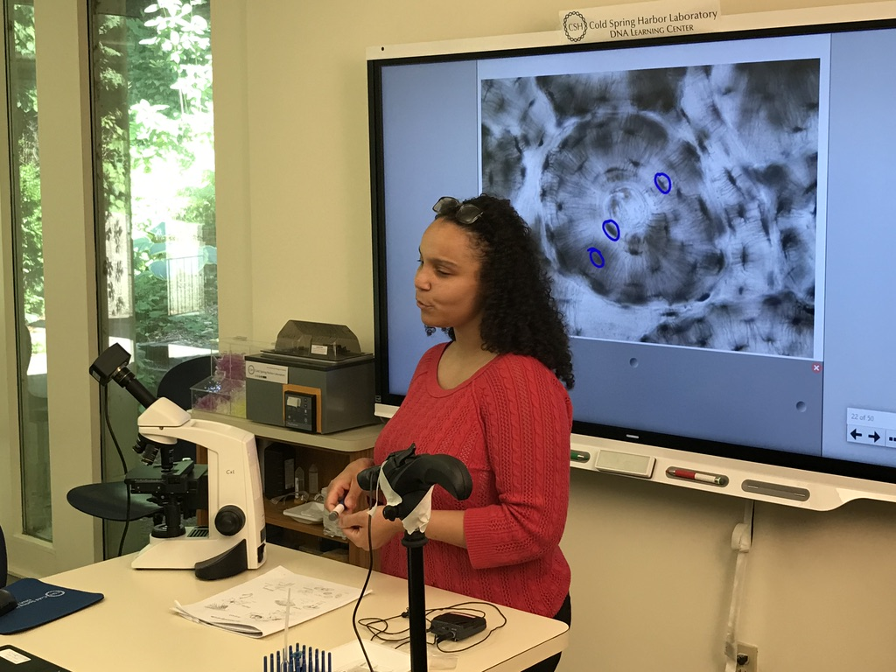

Slide 38
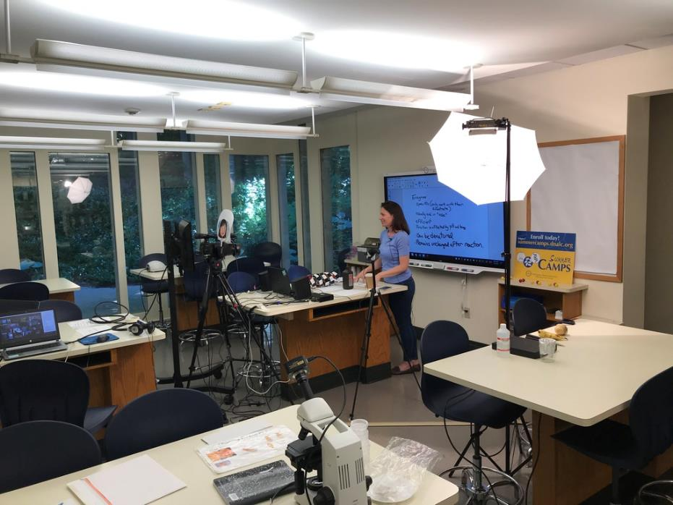


Slide 39


Slide 40


Slide 41


Slide 42


Slide 43


Slide 44



Slide 45




Slide 46



Slide 47



Slide 48




1986-87

Slide 49
Teachers Trained by DNALC Staff
1985–2018, 50 states, D.C., Puerto Rico and 18 countries

Slide 50


Carolina Biological Supply Company
Contract initiated in 1986
First kits available in 1988
Currently 20 kits and variations
~$1 million annual sales

Slide 51
Students Using DNALC Kits 1988 - 2018

Slide 52


5 CSHL Centers
8 Licensed Centers
10 Modeled Programs
Dolan DNALC, 1988
DNALC West, 2002
Harlem DNA Lab, 2008
Regeneron DNALC, 2019
DNALC NYC, 2020
Singapore, 2003
Clemson, SC, 2003
Vienna, Austria, 2006
Notre Dame, IN, 2013
Beijing, China, 2014
Suzhou, China, 2016
Enugu, Nigeria, 2019
Mexico City, Mexico (in Development)
Stony Brook, NY, 1995
San Francisco, CA, 1996
Nimes, France, 1998
Berlin, Germany, 1999
Parkville, Australia, 2000
Turin, Italy, 2000
Cambridge, MA, 2002
Newcastle upon Tyne, UK, 2002
Milan, Italy, 2004
New York, NY, 2007
CSHL
Licensed Centers
Programs Modeled on the DNALC
Teacher Training Sites (US States and Countries)

Slide 53


Science Centre Singapore (2003)

Slide 54

(2006)

Slide 55
American Museum of Natural History, NY (2007)

Slide 56




(2013)

Slide 57




Beijing 166 School (2014)

Slide 58




Cold Spring Harbor Asia DNALC, Suzhou (2016)

Slide 59



City University of New York (CUNY) Temp Lab (2019)

Slide 60




Regeneron DNALC (2019)

Slide 61



DNA Learning Center Nigeria, Enugu (2020)

Slide 62



Harlem DNA Lab (2008-19)
  32,883 8th–11th students attended lab field trips.
  67% were from Title 1 schools and received scholarships totaling $532,475.
  61% were URMs.
  This compared to 20% URM at the Long Island facilities.
< Chancellor Walcott visited DNA Science course with students of 17 nationalities from one school in Queens, NY.

Slide 63

Regeneron DNALC
Dolan DNALC
Harlem DNA Lab
DNALC West
DNALC NYC

Slide 64


DNALC NYC @ City Tech
City University of New York (CUNY)
DNALC at City Tech
Vision: All New York City students will have the opportunity to look at their own DNA – to better understand their own uniqueness, the implications of personalized medicine, and their shared genetic heritage with other people in America’s melting pot.
9

Slide 65

Problem 1: No one know how many species there are.

Slide 66
Vertebrates | Species
Mammals | 5,490
Birds | 9,998
Reptiles | 9,084
Amphibians | 6,433
Fishes | 31,300
Total | 62,305
Invertebrates | Species
Insects | 1,000,000
Mollusks | 85,00
Crustaceans | 47,000
Corals | 2,175
Arachnids | 102,248
Total (+others) | 1,305,250
Plants | Species
Angiosperms | 281,821
Gymnosperms | 1,021
Ferns and Allies | 12,000
Mosses | 16,236
Green & Red Algae | 10,134
Total | 321,212
~1.7 million named plants and animals
5-50 million plant and animal species
Less than 2 million described species
100-1,000 species per million go extinct each year
(500-50,000 HIGH DEGREE OF UNCERTAINTY!)
1/3 of of all species are threatened
Accurate range maps only for “charismatic” vertebrates, and readily identified or economically important species

Slide 67

Problem 2: Lack of agreement on what is a “species.”

Slide 68

Cryptic Species
Skipper butterfly: Astraptes fulgerator
1775: 1 species

Slide 69

Crytpic Species
Skipper butterfly: Astraptes
2004: 10 species!

Slide 70
Problem 3: Classical taxonomic methods cannot
capture vanishing biodiversity.

Slide 71


Classical Taxonomy is Hard (and boring?)
Leaves alternate proximally, opposite and ultimately decussate distally, 6–16 × 4–13 cm; petiole ca. as long as blade, winged, base clasping, basal lobes stipulate, growing as extensions of wings, less than
1 mm wide; blade 5–7-veined, ovate, glabrous, base typically sagittate, margins entire, apex acute to acuminate. Staminate inflorescences axillary, 1–2 per axil, paniculate, fasciculate; panicles bearing flowers singly,bracteolate, in a zigzag pattern along rachis, internodes less than 2 mm; rachis to 25 cm, secondary axes 1–3(–6), fasciculate, less than 3 cm, each subtended by deltate-ovate bracteole shorter than 1 mm. Pistillate inflorescences solitary, 4–8(–20)-flowered, 6–35 cm, internodes ca. 1 cm
The body form ranges from hemispherical (e.g., Cleidostethus) to elongate oval (e.g., Clypastraea) to latridiid-like (e.g., Foadia). Corylophids are typically dull brown, but some species have contrasting yellowish-brown patches on the pronotum or elytra. The integument is often densely punctured and may be glabrous or bear short, fine recumbent setae. Most corylophid adults can be diagnosed using the following morphological features: Maxilla with single apical lobe; Mesotrochanter short and strongly oblique; Head usually covered by pronotum; Frontoclypeal suture absent; Antennae elongate with 3-segmented club; Procoxal cavities closed externally; Tarsal formula 4-4-4; Pygidium exposed
Immature or larval forms, damaged and incomplete specimens
may be impossible to identify.

Slide 72

Classical Taxonomy is Hard (and boring?)
Leaves alternate proximally, opposite and ultimately decussate distally, 6–16 × 4–13 cm; petiole ca. as long as blade, winged, base clasping, basal lobes stipulate, growing as extensions of wings, less than 1 mm wide; blade 5–7-veined, ovate, glabrous, base typically sagittate, margins entire, apex acute to acuminate. Staminate inflorescences axillary, 1–2 per axil, paniculate, fasciculate; panicles bearing flowers singly,bracteolate, in a zigzag pattern along rachis, internodes less than 2 mm; rachis to 25 cm, secondary axes 1–3(–6), fasciculate, less than 3 cm, each subtended by deltate-ovate bracteole shorter than 1 mm. Pistillate inflorescences solitary, 4–8(–20)-flowered, 6–35 cm, internodes ca. 1 cm
Complex and
somewhat objective
Simple (A,T,G, or C) and more
objective
>Dioscorea alata (matK) gene, partial
ATTTAAATTATGTGTCAGATATATTAATACCCCATCCCATCCATCTGGAAATCCTGGTTCAAATACTTCAATGCTGGACTCAAGATGTTTCCTCTT
TGCATTTATTGCGATTCTTTCTCCACGAATATCATAATTCGAAT AGTTTCATTACTCCGAAAAAACCTATTTACGTGATTTCAATTTCAAAAGAAA
ATAAAAGATTTTTTCGAT TCCTATATAATTCTTATGTATTTGAATGTGAATTTGTATTAGTTTTTTTTCATAAGCAATCCTCTTATTT ACGATCAA
GGTCCTCTGGAGTCTTTCTTGAGCGAACACATTTCTATGGAAAAATGGGGCATTTTTTAGTAGTGTGTTGTAATTATTTTCAGAAGACCCAATG
GTTCTTCAAAGATCCTTTTCTGCATTATGTTCGATATC AAGGAAAAGCAATTCTGGTGTCAAAGGGAACTCGTCTTTTGATGAGGAAATGGAGA
TCTTACCTTGTCCATTTTTGGCAATATTATTTTCAATTTTGGTCTCATCCGCATAGGATTCATATAAACCAATTATCAAATTATTCCTTCTGTTTTC
TGGGTTATCTTTCAAATGTACTAATAAATTTTTCCGTGGTAAGGAGTCAAATGTTAGAAAATTCATTTGTAATAGATACTCTTACTAAGAAATT
TGATACCAGAGTTTCAGTTATTGCTCTTATTCG ATCATTGTCTAAAGCGAAATTTTGTACCGTATCCGGGCATCCTATTAGTAAGTCAATATGGA
CAAATTTC TCAGATTTGGATATTATTCATCGATTTGGTTGGATATGTAGAA

Slide 73









DNA Barcoding Begins:
CSHL Banbury Center Meetings 2003
L-R: Paul Hebert, Winnie Hallwachs, Dan Janzen, John Marchioni
L-R: Mark Stoeckle, Scott Federhen, Richard lane
L-R: Mitch Sogin, Jesse Ausubel
L-R: Donal Hickey, Alfried Vogler, Paul Hebert
L-R: Mark Graham, Scott Miller, Winnie Hallwachs, James Edwards
NB – Scott Miller is CBOL Meeting Chair
L-R: Giselle Caccone, Kerry Shaw, Keith Crandall

Slide 74


Just as the unique pattern of bars in a universal product code (UPC) identifies each consumer product, a short “DNA barcode” (about 600 nucleotides in length) is a unique pattern of DNA sequence that can potentially identify each species

Slide 75






Animals,
Mitochondrion
Universal? DNA Barcodes
Plants,
Chloroplast
rbcL
CO1
matK
Fungi, Nucleus
ITS

Slide 76



The Inspiration:
Mark and Kate Stoeckle

Slide 77
DNA Barcoding
The “Do Everything” Research Experience
Iconic, simple laboratory
Distributed projects
Subsumes many important biological concepts
Integrates genetics with ecology and conservation biology
Combines lab experimentation with bioinformatics
Opportunities for student discovery and publication of novel sequences
Citizen science monitoring of climate change impacts
Notes:
77

Slide 78


DNA extraction
and PCR
Import
sequences
Assemble
sequences
Add additional
sequences
Sequence
Analyze
sequences
Collect
samples
Export
sequences
Wet-lab

Slide 79




DNA extraction
and PCR
Import
sequences
Assemble
sequences
Add additional
sequences
Sequence
Analyze
sequences
Collect
samples
Export
sequences
Samples are collected from organic materials:
Foods
Herbal medicines
Living specimens

Slide 80





DNA extraction
and PCR
Import
sequences
Assemble
sequences
Add additional
sequences
Sequence
Analyze
sequences
Collect
samples
Export
sequences
DNA is extracted using a safe, cost-effective
kits and equipment
DNA extraction ~ 1 hour
PCR and Electrophoresis ~1.5 - 2 hours

Slide 81
DNA extraction
and PCR
Import
sequences
Assemble
sequences
Add additional
sequences
Sequence
Analyze
sequences
Collect
samples
Export
sequences
DNA is extracted using a safe, cost-effective
kits and equipment
X
DNA extraction ~ 1 hour
PCR and Electrophoresis ~1.5 - 2 hours

Slide 82




DNA extraction
and PCR
Import
sequences
Assemble
sequences
Add additional
sequences
Sequence
Analyze
sequences
Collect
samples
Export
sequences
GENEWIZ provides low-cost sequencing with
DNA barcode sequences available within 24-48 hours

Slide 83

DNA extraction
and PCR
Import
sequences
Assemble
sequences
Add additional
sequences
Sequence
Analyze
sequences
Collect
samples
Export
sequences
Bioinformatics
Walk…

Slide 84

DNA extraction
and PCR
Import
sequences
Assemble
sequences
Add additional
sequences
Sequence
Analyze
sequences
Collect
samples
Export
sequences
Bioinformatics
Ride!

Slide 85


DNA extraction
and PCR
Import
sequences
Assemble
sequences
Add additional
sequences
Sequence
Analyze
sequences
Collect
samples
Export
sequences
DNA Sequence from GENEWIZ
is directly pushed to DNA Subway

Slide 86





DNA extraction
and PCR
Import
sequences
Assemble
sequences
Add additional
sequences
Sequence
Analyze
sequences
Collect
samples
Export
sequences
1. View sequence data
2. Trim ends
4. Generate and edit consensus
3. Pair forward/reverse reads

Slide 87




DNA extraction
and PCR
Import
sequences
Assemble
sequences
Add additional
sequences
Sequence
Analyze
sequences
Collect
samples
Export
sequences
2. Import additional
sequences
Search GenBank for matches with BLAST
(enhanced with photos and links)
3. Add reference sequence data

Slide 88





DNA extraction
and PCR
Import
sequences
Assemble
sequences
Add additional
sequences
Sequence
Analyze
sequences
Collect
samples
Export
sequences
Select data to build tree
2. Create sequence alignment
3. Build a neighboring joining or
maximum likelihood tree with PHYLIP

Slide 89


DNA extraction
and PCR
Import
sequences
Assemble
sequences
Add additional
sequences
Sequence
Analyze
sequences
Collect
samples
Export
sequences

Slide 90
MANY SETTINGS & QUESTIONS

Slide 91



DNA Barcoding: Extended Research Projects
Students | 1,562 | 1,375
Teams | 563 | 483
Mentors | 114 | 80
Schools Academic Institutions | 88 27 | 61
DNA Samples | >9,600 | >4,900
DNA Sequences | >16,000 110 million NextGen sequencing reads | >5,600 ~22 billion bp and 75 mil reads from microbiome projects
Sequences in GenBank | 119 novel 15 with polymorphisms 33 with GPS data | 41 novel 92 with polymorphisms 400 with GPS data
Years Active | UBP 2011-2020 UBRP 2014-2020 | 2014-2020

Slide 92






Student Symposium
Cold Spring Harbor Laboratory
174 students, 21 mentors, and 50+ guests

Slide 93





Student Symposium
New York Academy of Medicine
170 students, 45 mentors, and 30+ guests, including Jesse Ausubel, (Rockefeller, Sloan)

Slide 94


Hundreds of GenBank publications with
student authors

Slide 95

Shark Fin Soup
Novel Sequences (2012)
Authors:
Emily Atlas, Stuyvesant High School
Andrew Jorquera, Bronx High School of Science
Noah Burg, American Museum of Natural History
Oscar Pineda-Catalan, DNA Learning Center, CSHL
Location
Country: USA
State: New York
City: New York
Exact Site: Flushing Meadows China Town, Queens
Date Collected: 09/04/2012

Slide 96


Shark Fin Soup
Novel Sequences (2012)
Winter Skate (Leucoraja ocellata)
GenBank ascension numbers
Winter Skate 1: KC109830
Winter Skate 2: KC290954

Slide 97





First Published Pleurogonius malaclemys Barcode(2016)
Leah Shokrian and Savannah Kile- Long Beach High School
A parisitic trematode of terrapins
Photo by Jason Williams & Russell Burke
Hofstra University
Photo by Irit Altman, Georgia Coastal Ecosystems LTER
Notes:
Leah Shokrian and Savannah Kile- Long Beach High School
The project goal was to identify parasites that produced cysts on aquatic mud snails (Ilyanassa obsoleta) collected in the Western Bays. Using DNA barcoding, they identified a the parasite to be a trematode, Pleurogonius malaclemys, which is an intestinal parasite of the Diamondback Terrapin turtle (Malaclemys terrapin). Students determined that there was a correlation between the size of the snail, and the presence of the Pleurogonius malaclemys cyst. Students also used the identified Pleurogonius malaclemys cysts as an indirect measure of terrapin abundance in Western Bays, a survey technique supported by the literature, as the snails feed on the Pleurogonius malaclemys eggs found in terrapin feces, and act as an intermediate host for terrapin infection. Students used a trematode specific primer (18S rRNA) for their work, and published a novel sequence to GenBank after the trematode was identified by Dianna Padilla at Stony Brook University. Savannah Kile presented this research at the New York State Science and Engineering Fair (NYSSEF) and was awarded 3rd place.

Slide 98





DNA Barcoding Brooklyn (2014-16)
First Biodiversity Assessment of Marine Park by Citizen Scientists
PLoS ONE article with 32 high school student and teacher authors
Identified 110 species (1 fungus, 71 animals and 116 plants) at restored and unrestored sites in Marine Park, Brooklyn, NY
9.8% of animal and 12% of plant species introduced
5.2% of plant species invasive
12 novel DNA barcodes published on GenBank
B
Notes:
The study presented here provides the first assessment of Marine Park (Brooklyn, New York, USA) biodiversity using DNA barcoding. New York City citizen scientists (high school students and their teachers) who were trained to identify species using DNA barcoding during two–week long workshops.

Slide 100

Scaling DNALC Barcode Infrastructure (2017)
Two semester sequence
Replaced intro bio
~900 students/semester, culminating in poster presentation
Bio majors (~60%)
20 instructors (mostly adjunct faculty and masters students)

Slide 101

https://www.coursesource.org/courses/cure-all-large-scale-implementation-of-authentic-dna-barcoding-research-into-first-year

Slide 102

Ginkgo Product Fraud
(2012)
Mary Acheampong, Bobby Glover, and Marisa VanBrakle
Mentor: Allison Granberry
Hostos-Lincoln Academy of Science, The Bronx
2012 UBP Grand Prize Winners

Slide 103



Ginkgo Product Fraud
(2012)

Slide 104


Ginkgo Product Fraud Revisited
NY Attorney General Cease and Desist Order (2015)

Slide 105



Bird’s Nest Soup
(2013)
Maximum Likelihood tree shows that soup contains Swiftlet DNA!

Slide 106



Bird’s Nest Soup Revisited
Hong Kong Airport 2015

Slide 107

Bird’s Nest Soup Revisited
Hong Kong Airport 2015

Slide 108


Bird’s Nest Soup Revisited
Hong Kong Airport 2015

Slide 109

Bird’s Nest Soup Revisited
Hong Kong Airport 2015

Slide 110





DNA Barcoding of Microscopic Organisms
Damien Edeled, Christopher Jannotta, and Joseph Orenstein, Eastport-South Manor HS
DNA barcodes from individual crustaceans isolated with forceps and microscope.
Daphnia magna
~0.5 mm
Physella acuta
~3 mm
Cypridopsis sp.
<0.5 mm
Notes:
Damien Edele, Christopher Jannotta, and Joseph Orenstein from Eastport-South Manor HS used a microscope to sort small organisms from their collection of aquatic invertebrates from the Peconic Estuary. Students were able to successfully barcode organisms <1 mm in size.

Slide 111








DNA Barcoding in the Bronx River (2017)
Jessica Fong Ng, High School for Construction Trades and Architecture; Lina Liu, Manhattan Center for Science and Mathematics; and Elizabeth Alter, York College
Sample ID | Sequence 5’ → 3’ | Common Name | Scientific Name
09_Pumpkin Seed | CAGAGCTCAGTCAACCCGGCGCCCTCCTTGGGGATGACCAAA | Pumpkin Seed | Lepomis gibbosus
04_Large Unknown Fish | CTTAGTCAACCCGGATCACTTCTAGGTGATGACCAAATTTAC | Goldfish Carassius auratus OR Prussian Carp | Carassius auratus OR Carassius gibelio
04B_Small Unknown Fish | TGGATCACTCTTAGGAGATGACCAGATTTATAATGTTATCGTC | Eastern blacknose dace | Rhinichthys atratulus
08_Common Carp | GGTCGCTTCTAGGTGATGACCAAATTTATAACGTTATCGTCA | Common carp Cyprinus carpio | Cyprinus carpio
80_Unknown Flounder | GCAGAACTCAGCCAACCCGGGGCTCTCCTGGGAGACGATCAA | American Plaice | Hippoglossoides platessoides
81_Butterfish | CTGAACTAAACCAACCAGGCGCCCTTCTTGGGGACGACCAGA | Butterfish | Peprilus triacanthus
2017 UBRP Best Poster
Identified one unknown sample as American Plaice, a species that is not known to occur in the Bronx River.
Notes:
Students created a specific database of Bronx River fish comparing 12S and 16S DNA barcodes

Slide 112

Ant Diversity in a Bronx Park
2012-14

Slide 113



Ant Diversity in a Bronx Park
2012-14

Slide 114









Ant Diversity in a Bronx Park
2012-14
T. caespitum
P. imparis
L. claviger
C. pennsylvanicus
L. alienus
F. fusca
M. floricola
Seven different species were identified using DNA barcodes

Slide 115


Ant Diversity in a Bronx Park
2012-14
…..and two novel barcodes, potentially a novel species

Slide 116

DNA Barcoding Brooklyn (2014-16)
First Biodiversiy Assessment of Marine Park by Citizen Scientists
Ants campaign
Students identified 8 ant species of the the Formicidae family, 3 previously unreported in NYC parks (Monomorium viridae, Nylanderia parvula and Liometopum microcephalum).
A subset were ID’d by a taxonomist. In all cases, amateur high school taxonomists were able to use DNA barcoding to identify the same genus as the trained taxonomist
In one case DNA barcodes identified samples to the species-level when morphology was ambiguous (KHN-009, Aphaenogaster rudis)
Marizzi et al., PLoS ONE (in press)

Slide 117
Range Mapping
The Role of Citizen Scientists
What are the data sources?
Who collects them?
How are data integrated?
What do they say about climate change?

Slide 118

Range Mapping
Student Observations on Long Island: Ant

Slide 119

Range Mapping
Student Observations on Long Island: Mosquito

Slide 120
(Bio)Geographical Regions
Break-out Rooms
Northern Rockies/Pacific Coast (MT, WA, AK), 5 teams: Dave Micklos
San Francisco Bay (CA), 3 teams: Bruce Nash
Great Basin (NV, UT), 3 teams: Catherine Zhang
Sonoran (AZ), 3 teams: Jeffry Petraca
Texas, Puerto Rico, 3 teams: Shawn Dash
Ozarks (AR, MO), 4 teams: Cristina Fernandez-Marco
Great Lakes (NY, IL, IN, MI), 5 teams: Allison Mayle
Northern Coastal Plain (NY, NJ, MA, RI), 6 teams: Sharon Pepenella
Southern Piedmont and Appalacia (MD, WV, NC, GA), 4 teams: Louise Bodt
Jennifer Hackett, floater

Slide 121
(Bio)Geographical Regions
Break-out Rooms
Introduce one another
Discuss interesting habitats you can access
Discuss lab methods
Gauge current lab resources you have
Discuss your level of expertise and comfort with lab methods

Slide 122
Follow-up After this Meeting
Participant contact list
Profiles of teams and participants by region
“Hit list” of un-barcoded species for your region
Collection procedures and Metadata
Specific instructions
Live clinics
Lab methods: DNA extraction, PCR, and gel electrophoresis
Specific instructions
Live clinics
Bioinformatics Analysis (later!)
  Specific instructions
  Live clinics
Continuing Support
Access to mentors
Office hours

