Slide 2
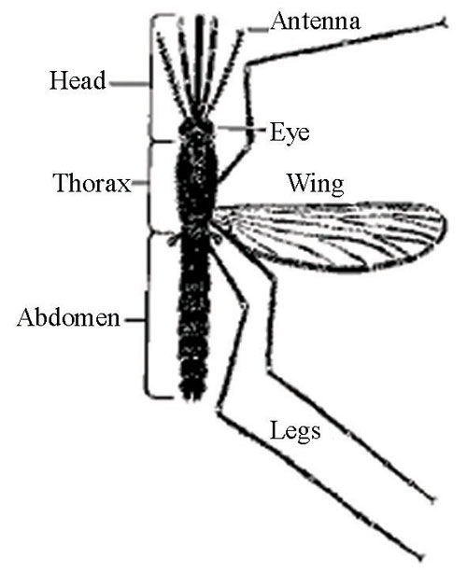
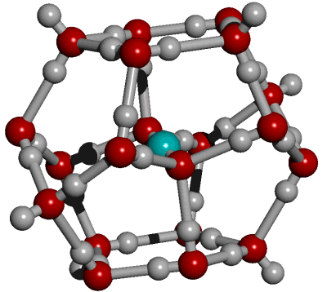
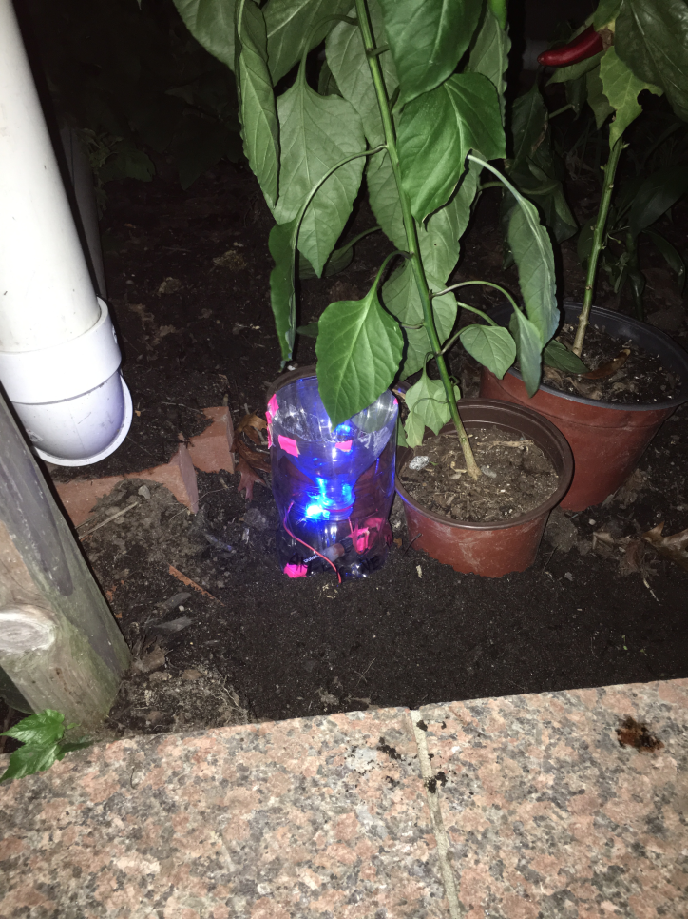
Abstract
Mosquitoes rapidly spread vector-borne illnesses, including malaria, the West Nile virus, and the Zika virus. Among 3,500 species of mosquitoes, 175 species reside in the US. This study tests the effectivity of five different types of mosquito attractants, including blue or violet LED lights, KCl, seltzer water, and a sugar and yeast solution. Traps were set up in two different locations in Queens. Trapped insects were documented and identified by DNA Barcoding using CO1 sequence. The results further showed that carbon dioxide and lights were effective attractants to mosquitoes. The sugar and yeast traps caught the largest variety of organisms. Out of all the insects trapped, the most common was Aedes albopictus (Asian Tiger Mosquito) and Drosophila Suzukii (spotted wing drosophila). Interestingly, KCl, a major component of sweat, did not attract any mosquitoes. This suggests that mosquitoes may be attracted to a different component of sweat, instead. In the future, we hope to develop traps that could target the mosquitoes in one particular area in order to catch the pests more effectively.
Purpose
To investigate the species caught by different mosquito attractants
Could potentially lead to the development of simple and inexpensive traps
Introduction
Mosquitoes
Culex, Anopheles, & Aedes are most common species
Females live 2-4 weeks and begin feeding on blood (to produce up to 1000 eggs) ~2 days after reaching adulthood
Eggs are laid on stagnant water surface during warm seasons and can stay dormant for 10 to 15 years
The female mosquito sucks blood using her labrum, as her saliva is injected into the host’s tissue (Life Science, 2012)
Mosquitoes are also well known for carrying and spreading harmful diseases such as malaria, yellow fever, and dengue fever, vertical transmission in mosquitoes may occur
West Nile virus is transmitted by Culex mosquitoes (Life Science, 2012)
http://www.open.edu/openlearncreate/pluginfile.php/4704/mod_oucontent/oucontent/138/none/none/hyg_env_health_session6_fig2.jpg
A female mosquito in flight.
https://static1.squarespace.com/static/53569847e4b007661e348fc0/t/54012845e4b096fd0b9b16e3/1409362057865/mosquito+in+flight.jpg?format=1500w
Carbon Dioxide
Mosquitoes are extremely attracted to carbon dioxide (CO₂)
Companies like Mosquito Magnet and Koolatron have developed traps that lure mosquitoes using CO₂ (Mosquito World, 2017)
Although mosquitoes detect hosts using heat and CO₂, the attractant is so strong that even dry ice will attract them (Newhouse, et al., 1966)
Molecular structure of dry ice. http://www1.lsbu.ac.uk/water/images/co2_hydration.gif
Others
Blue LED lights have been found to be the most efficient type of light that could be used (Newhouse, 1966)
Red and yellow lights are known to have no effect or at times even repel mosquitoes (Montez de Oca, 2016)
KCl is a major component in human sweat
It is greater than all the other chlorides found in human sweat
Blue LED light trap in the yard.

Slide 3
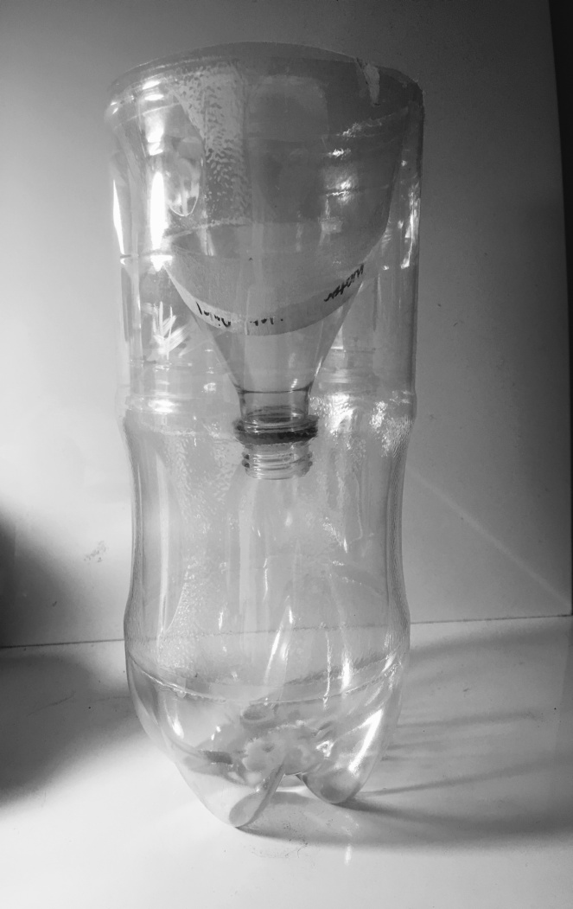
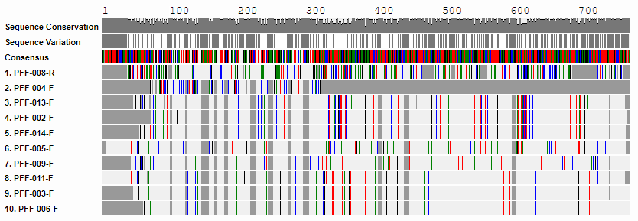
Method
Cut a 2-liter plastic bottle 20 cm from the bottom and twist the bottle cap off.
Insert the top part of the bottle into the bottom of the bottle and gentle duct tape the two parts together. (Figure 1.)
Add attractants to the traps according to Table 1. All liquids will use 60 mL of liquid.
Obtain materials, label all traps with group names and attractants.
Isolate DNA and perform PCR according to standard procedures.
Save all photos and store all specimen in bags at -20º C for at least 24 hours.
Use forceps to transfer each trapped mosquito from the trap into a bag. Take photographs from 3 different views next to a quarter.
Make Traps accordingly to Table 1.
Table 1. Traps
Table 2.
Interpret data using DNA subway and create charts using excel.
Potassium Chloride | Weigh 1.8 g of KCl and add it into the labeled bottle. Add 1.5 L of deionized water into the bottle to create 16 mM concentration. Add 60 mL of Kl solution to the trap.
Seltzer Water | 1. Using a graduated cylinder, transfer 60 mL of seltzer water into the trap.
Sugar and Yeast | Measure 7 g of yeast and add 43 g of sugar into weighing boat. Put sugar and yeast into trap. Add 60 mL of water into trap.
LED Lights | Place 2 1. volt batteries and place next to each other. Connect LED lights with 2 electric wires. Place other side of wires onto batteries Place into trap.
ID Number | Scientific Name | Common Name
PFF-002 | Aedes Albopictus | Asian tiger mosquito
PFF-003 | Drosophila Suzukii | Spotted wing drosophila
PFF-005 | Coboldia Fuscipes | Fly
PFF-006 | Drosophila Suzukii | Spotted wing drosophila
PFF-008 | Drosophila Repleta | Dark eyed fruit fly
PFF-009 | Calliphora Vicina | Blue bottle fly
PFF-011 | Drosophila Suzukii | Spotted wing drosophila
PFF-013 | Aedes Albopictus | Asian tiger mosquito
Figure 1. Mosquito Trap
20 cm
Figure 2. Amount of Sequenced Organisms
Out of all the insects trapped, the most common were Aedes Albopictus (Asian Tiger Mosquito) and Drosophila Susukii (Spotted wing Drosophila). It can be concluded that the sugar and yeast traps used in this experiment caught a greater variety of insects compared to the other traps.
Figure 3. Amount of Organisms Trapped by Different Attractants
Based on the results, the most effective attractant was sugar and yeast because it trapped the most organisms. The least effective attractant, KCl, did not trap any organisms. Since no organisms were trapped by the control, the results are more accurate.
Figure 4. The ML Phylogenic Tree From Sugar and Yeast Trap
The tree shows how genetically distant many of the four individual species caught with the Sugar and Yeast Trap. The Calliphora Vicina (Bluebottle blowfly) evolved a separate branch because it lacks genetic relations to the other species.
Figure 5. NJ Phylogenetic Tree from Sugar and Yeast Trap
Based on distances for COI DNA sequences from the four individual species, three out of four of the species are closely related. This could suggest this trap is more effective for catching Drosophila susukii (Fruit fly).
Figure 6. ML Phylogenetic Tree From the Light Traps
The tree shows how genetically far apart many of the four individuals species caught with the Light Trap. Aedes Albopictus (Asian tiger mosquito) evolved a separate branch because it lacks genetic relations to the other species.
Figure 7. NJ Phylogenetic Tree from Light Trap
Based on distances for COI DNA sequences from four individual species, Coboldia Fuscipes (fly) evolved a separate branch because it lacks genetic relations to the other species. Two of the insects were Aedes Albopictus (Asian Tiger Mosquitoes).
Figure 8. Alignment of the samples Samples were utilized as well as BLAST results with the least mismatch scores.

Slide 4
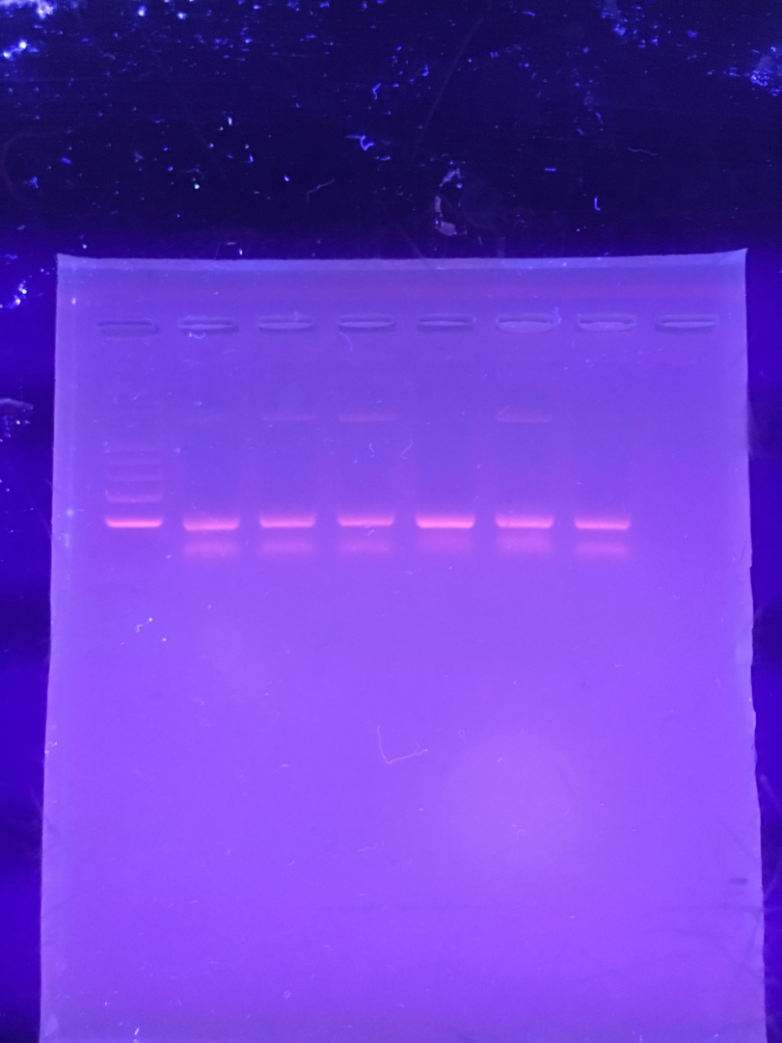
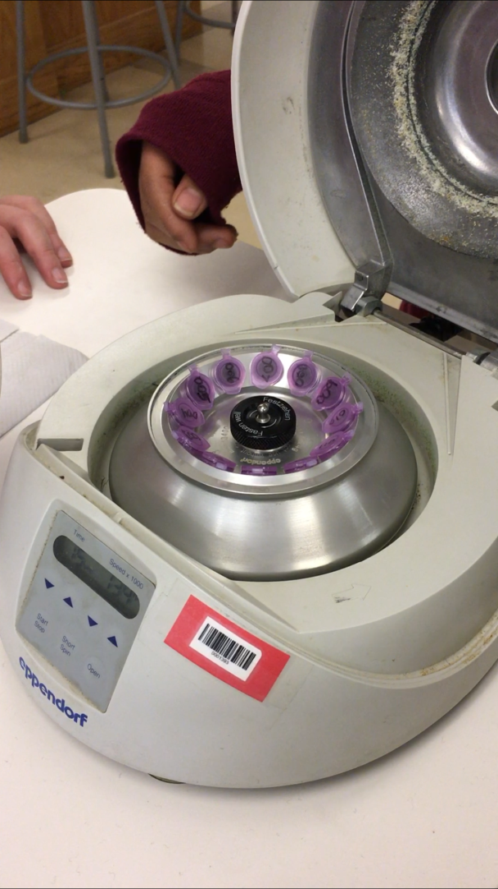
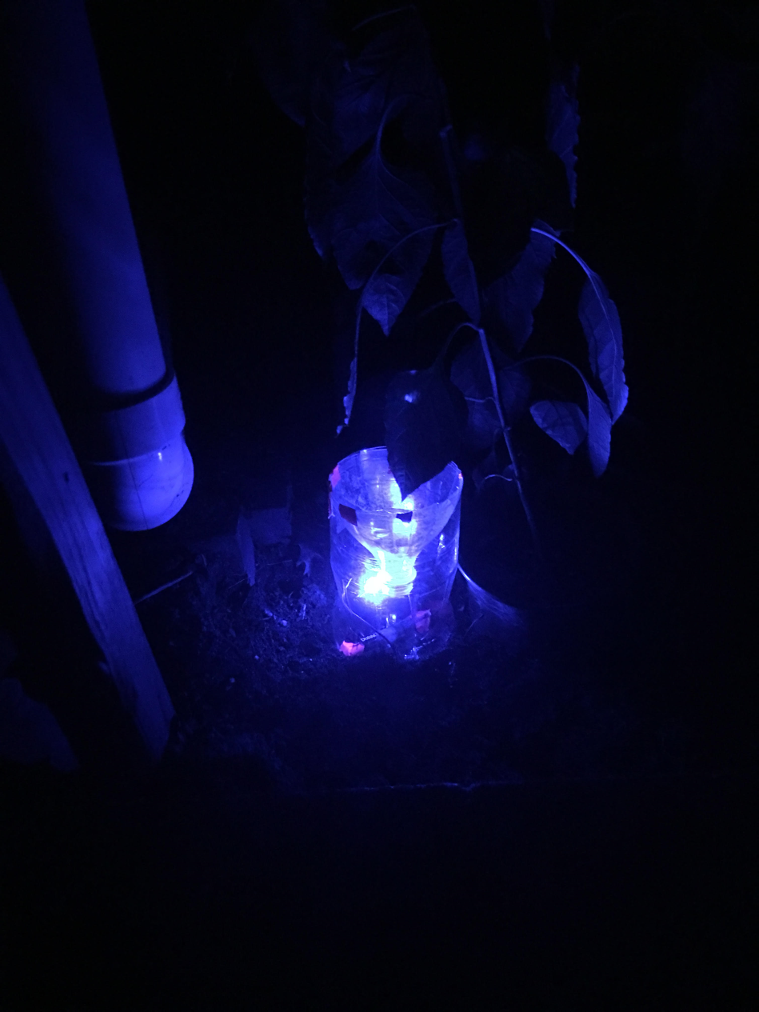
Discussion
The CO₂ and light traps were both effective attractants
Larger sample size is needed to validate the experiment
Traps should be placed at more than 5 different locations in long island
The samples were collected in the fall. Summer is a better season for sample collection
Sugar-yeast traps not only produce CO₂, but also produce odor, which may attract insects other than mosquitoes.
Not all the species were barcoded. Some were identified by observation, which may cause errors.
Conclusion
Gel electrophoresis of PCR results.
This experiment further showed that carbon dioxide and lights were effective attractants to mosquitoes
The sugar and yeast traps caught the largest variety of organisms
Out of all the insects trapped, the most common was Aedes albopictus (Asian Tiger Mosquito) and Drosophila Suzukii (spotted wing drosophila)
Culex, northern house mosquito, was not caught in the experiment
Future Work
DNA in the micro-centrifuge
Combine carbon dioxide and light in one trap
Try to use a black tape that will stay on the trap so the light only comes out of the top
Go to different parks around Queens to catch a more diverse sample
Take more samples for DNA sequencing
Conduct another trial
Mosquito caught from light trap.
Acknowledgements
Dr. L. Wang
Dr. J. Cohen
Mrs. N. Jaipershad
Mr. Z. Liang
Dr. R.X. Lin
Mrs. R. DiPietro
Dr. D. Marmor
Mrs. C. Rastetter
Mr. R.M. Ally
DNA Barcoding Long Island
Francis Lewis High School
References
Schwartz, I. L., J. H. Thaysen, 1956. Excretion of sodium and potassium in human sweat. The Journal of clinical investigation, 35 (1): 114-120.
Hadler, N. M., J. R. Gill, J. D. Gardener, 1972. Impaired renal tubular secretion of potassium, elevated sweat sodium chloride concentration and plasma inhibition of erythrocyte sodium out flux as complications of systemic lupus erythematosus. Arthritis & Rheumatology, 15 (5): 515-523.
Thomas, C. J., A. Callaghan, 1999. The use of garlic (Alliumsativa) and lemon peel (Citrus limom) extracts as Culex pipiens larvacides: Persistence and interaction with an organophosphate resistance mechanism. Chemosphere, 39 (14): 2489-2496.
Life Science Staff (August 17 2012). 5 Things You Need to Know About West Nile Virus. Life Science, Received from https://livescience.com/22491-5-things-you-need-to-know-about-west-nile-virus.html
Montes de oca, (May 19, 2016), Do LED lights Attract bugs.
Mosquito Trap Reviews. (n.d.). Retrieved August 30, 2017, from
Patel, H. [Hilten Patel] (2013, April 01). Mosquito Trap. Retrieved August 30, 2017, from https://www.youtube.com/watch?v=pNjyLRQutXs.

