Slide 1
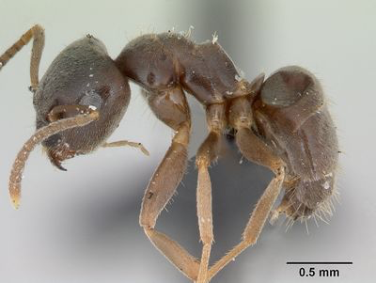
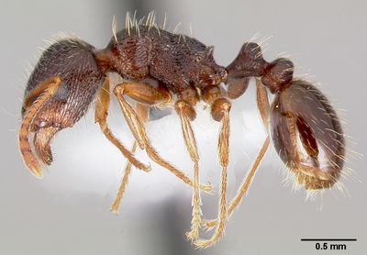
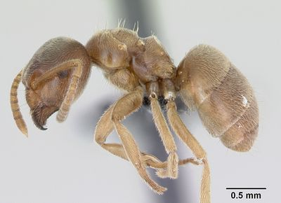
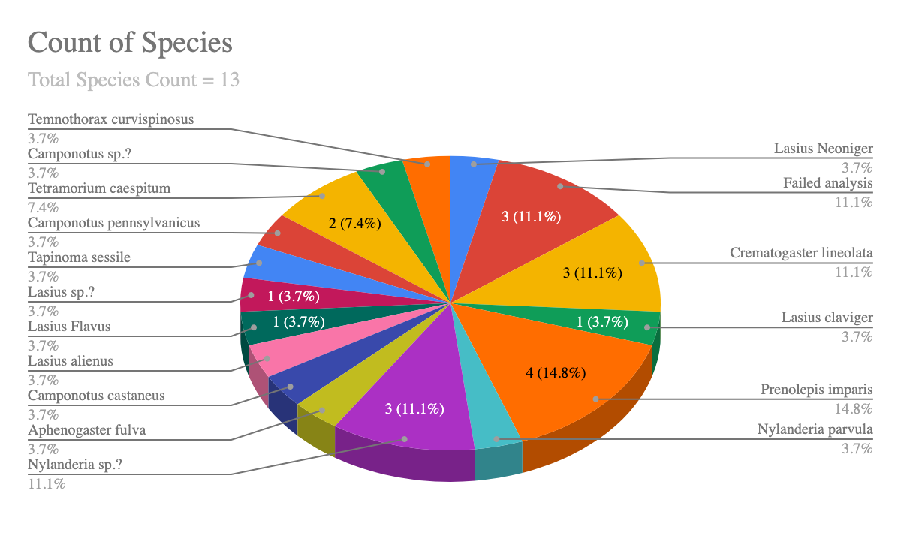
Biodiversity of Ants in Van Cortlandt Park
Zoe Ravera, Daniel Silverstein, Onnie Woods & Howard Waldman
Funded by the
Thompson Family Foundation
Ethical Culture Fieldston School
Abstract
This study created a rough profile of the ant species in Van Cortlandt Park. Twenty-eight samples were collected and analyzed using the Urban Barcode Project’s Silica DNA Isolation method. The sequencing identified 13 species, three of which were invasive to the state of New York.
Introduction
Ants play a vital role in any ecosystem, and each species contributes to and helps their ecosystem flourish by recycling nutrients and enriching the soil. Ants also play an important role in seed dispersal, carrying seeds back to nests to feed and leaving the remains of the seeds, which often sprout (Ecological Importance). Friends of Van Cortlandt Park suggested several unfound invasive ant species may be present in the park. The goal of this project was to investigate this hypothesis by gathering general data about ant species in the park, and to determine if any of the ants collected were invasive.
Materials & Methods
Samples were collected mid-October within about 200 meters of a park path. Samples were taken from ground near leaf detritus with no visible nearby nest and transferred into Eppendorf tubes which were then filled with ethanol to preserve the tissue.
UBP’s Silica DNA Isolation method was used to isolate DNA, which was then amplified by PCR then electrophoresis was performed.
Results
The DNA analysis of 23 samples contained 13 different species of ants, the majority of which are species that are native to New York and North America. However, the Lasius alienus, the Lasius flavus, and the Tetramorium caespitum are non-native to the area.
Discussion
Three invasive species were found. Lasius flavus is native throughout Europe, Asia, and Morocco, and Lasius alienus is native throughout Alberta, CA, Europe, and Asia. Tetramorium caespitum ants may serve as a competitor or threat to species native to New York, but it is highly likely that native species have adapted to coexisting with T. caespitum. Lasius flavus (Lasius Flavus), or “yellow meadow ant,” is native to Europe and is also found in some locations across, Asia, North Africa, and North America. Lasius alienus has been found in Asia, Europe, and the Middle East. Lasius alienus and Lasius flavus are both nuisances to homeowners because they tend to tear up soil in order to build their nests. Each of these species is dubiously documented in New York state (AntWiki).
References
Ants. (2018, September 24). Retrieved from https://www.nationalgeographic.com/animals/invertebrates/group/ants/
Ecological Importance. (n.d.). Retrieved from https://harvardforest.fas.harvard.edu/ants/ecological-importance
Lasius alienus. (n.d.). Retrieved from
http://www.antwiki.org/wiki/Lasius_alienus
Lasius flavus. (n.d.). Retrieved from
http://antwiki.org/wiki/Lasius_flavus
Tarkington, L. (n.d.). Tetramorium caespitum. Retrieved from
https://animaldiversity.org/accounts/Tetramorium_caespitum/
Tetramorium caespitum. (n.d.). Retrieved from
http://www.antwiki.org/wiki/Tetramorium_caespitum
The Ecological Importance of Ants. (n.d.). Retrieved from http://m.espacepourlavie.ca/en/ecological-importance-ants
Using DNA Barcodes to Identify and Classify Living Things. [PDF]. Retrieved from https://www.dnabarcoding101.org/files/using-dna-barcodes.pdf
Yellow Meadow Ant species - Lasius flavus. Facts, Identification. (n.d.). Retrieved from https://antark.net/ant-species/yellow-meadow-ant-lasius-flavus/.
Acknowledgements
We acknowledge Mr. Waldman and Alex Byrne for all of their help and assistance throughout this process!
Lasius alienus
Tetramorium caespitum
Lasius flavus

