Slide 1
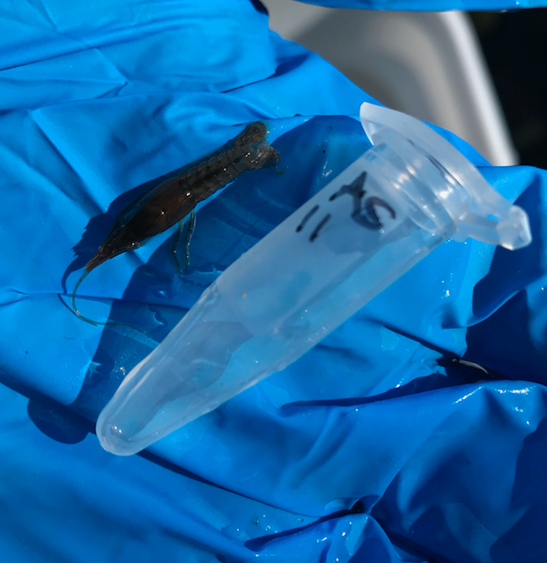
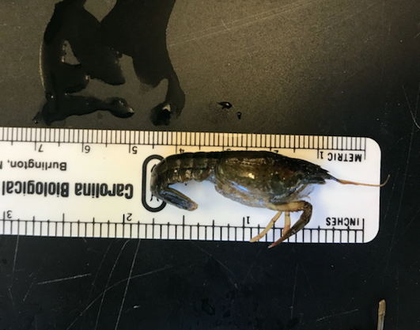
ke
The Biodiversity of Crayfish Compared to the Water Quality in Van Cortlandt Park Lake
Ana Sanchez de Lozada, Sadie Schlesinger & Howard Waldman
Funded by the
Thompson Family Foundation
Ethical Culture Fieldston School
Abstract
There are roughly 500 discovered species of crayfish, over half of which are found in North America. Crayfish have the ability to survive in a wide range of conditions yet have a low tolerance to pollution. We chose to collect crayfish in Van Cortlandt park and compare the diversity of species to water quality in specific areas. Our objective was to make a connection between species and the level of pollution in different areas of the park. We extracted using Silica method IIb and the rapid disk extraction method, and used gel electrophoresis to observe our results. We found two species of Crayfish, Procambarus clarkii and Faxonius limosus. We could not come to any conclusion about the water quality’s influence on the biodiversity of crayfish in Van Cortlandt Park Lake; however, we did find that the rapid disk extraction method of extracting DNA, is not ideal for crayfish.
Introduction
Crayfish, also known as crawfish, are freshwater crustaceans, many from the genus Cambarus. They have a hard, jointed exoskeleton that provides protection and movement but, can limit growth. Due to this, the process of moulting, when the exoskeleton is shed and a new, larger grow in its place, occurs six to ten times during their first year of life, and three to five times after that. While they are aquatic animals, they surprisingly, cannot swim very efficiently, instead use their tails to propel them in the water. This is useful in evading predators, commonly, many types crocodiles, turtles, birds, and otters (Crayfish). There are also susceptible to parasites and disease that affects their eyes, gills, exoskeletons and intestines. However, this usually does little to no harm unless another factor is already causing stress.
Crayfish live in ponds, streams, and rivers, that do not freeze to the bottom, often under logs or rocks, which they use as shelter from predators. In general crayfish are relatively tough creatures, they can survive in a wide range of water temperatures and salinities, making it relatively easy to adapt to natuoneral, environmental changes (Fitzgerald, 2006). However, they are extremely intolerant of human-made pollution (Crayfish) and they also often die due to low oxygen levels. (2018) Due to this intolerance, a strong crayfish population is often a sign of a healthy body of water. They’re also an extremely important factor of their ecosystems, in and out of the water, due to feeding and burrowing, which helps maintain a good water quality (Fitzgerald, 2006).
The purpose of this experiment is to find the diversity of crayfish species in Van Cortlandt Park, and to find a correlation between these data and the water quality of Van Cortlandt Park Lake. Because of their abilities to survive in a wide range of water temperatures and salinities and their low tolerance to pollution, we compared the species found in different areas of the park, to the water quality tests we take and attempted to make a connection between the two.
Materials & Methods
In order to collect the crayfish specimen, we used a net to scrape up vegetation growing on the bottom of the lake, where crayfish can be easily found if the algae is looked through carefully. The specimen were then photographed and transferred to a -20 degree celsius freezer.
To extract DNA using the first method (method IIb) we began by removing crayfish tissue and combining it with 300 μL of lysis solution in a 1.5 mL tube. These tubes were incubated for ten minutes in a water bath and then 3μL of silica resin were added. After a second water bath at 57 degrees celsius the sample was centrifuged to pellet the resin and all supernatant was removed. 500μL of wash buffer was added to resuspend the silica buffer, repeating the previous step twice. Finally, 100 μL of distilled water was added and incubated at 57 degrees C for five minutes. The solution was centrifuged and supernatant was removed, this supernatant contained the DNA that would later be amplified. (Using DNA barcodes to classify and identify and classify living things, 2018)
To extract DNA using the rapid disk extraction method we removed some tissue from the samples and ground it in a tube with 50 μL of lysis solution. We added one 3-mm diameter disc of Whatman No. 1 Chromatography paper to the lysed extract of each sample and soaked it for one minute. We then removed the disc into a fresh tube containing 200 μL of wash buffer and mixed it, allowing it to soak for one minute. Then we dragged the disk out of the tube to dry for 2 minutes to evaporate ethanol. Once dry, we transferred the disc to a tube containing 30 μL of TE and soaked it for 15 minutes.
To amplify the extracted DNA the ready to go PCR bead was used and 2 μL of the DNA were amplified with this bead. We then placed the PCR tube in a thermal cycler that was been programmed with the appropriate PCR protocol to amplify the DNA. (Using DNA barcodes to classify and identify living things, 2018).
Finally we used gel electrophoresis to analyze the PCR product created earlier in our procedure. We first added biotium Gel green to the agarose solution before pouring. After pouring the agarose solution into the electrophoresis chamber and waiting for it to solidify we padded 1× TBE buffer that covers the surface of the gel. Then we used a micropipette to transfer 5 μL of each PCR for each sample into a well, and 5 μL of 100-bp marker in an additional well as a control. After running the gel for 40 minutes at 130V we observed and photographed our results.
Results
Discussion
We found two species of Crayfish in Van Cortlandt park, Procambarus clarkii and Faxonius limosus. The majority of the crayfish we found, five out of seven samples, were Procambarus clarkii, a species native to northern México and southern United States. They are invasive in other parts of the US, including Van Cortlandt park (Procambarus clarkii). We found one Faxonius limosus, also known as Orconectes limosus, a species native to the east coast of the United States, from Maine to Virginia (Spiny-Cheek Crayfish (Orconectes limosus). All of our crayfish were collected at sites A and B. These sites have almost identical water quality reports to each other and the sites we did not find any crayfish at so, we cannot come to any conclusions about how the water quality affects the crayfish population. However, we did find more crayfish at site A, the site with the more acidic pH; this could mean the crayfish survive better in a more acidic environment. But, site C also had a pH of 6 and we did not find any crayfish so, it may be simply a coincidence we found more crayfish at site A. Because Crayfish are known to be very susceptible to pollution, we can speculate that because we barely found any Crayfish, Van Cortlandt Park Lake is not extremely polluted.
We attempted two methods of DNA extraction, method IIb and Rapid Disk Extraction. We found method IIb successful getting hits on six out of our seven samples. However, the rapid disk extraction method was not successful. Interestingly, another group in our class also used the second extraction method on isopods; however, they found that this method was successful. Perhaps this method is simply not good for Decapod Crustaceans but, works for other animals.
In the future we would love to attempted this experiment again with a larger sample size in order to be able to determine more about the biodiversity of the lake.
References
Crayfish (Decapoda). Retrieved from http://www.dec.ny.gov/animals/87955.html
Crayfish. (n.d.). Retrieved from https://www.sciencedaily.com/terms/crayfish.htm
Crawfish water quality and management. (2018, November 02). Retrieved from https://thefishsite.com/articles/crawfish-water-quality-and-management
Fitzgerald, A. (2006). Species Page: Crayfish. Retrieved from https://www.psu.edu/dept/nkbiology/naturetrail/speciespages/crayfish.htm
Procambarus clarkii. Retrieved from https://nas.er.usgs.gov/queries/greatlakes/FactSheet.aspx?SpeciesID=2
Spiny-Cheek Crayfish (Orconectes limosus). (2015, June). Retreived from https://www.fws.gov/fisheries/ans/erss/highrisk/Orconectes-limosus-ERSS-revision-June-2015.pdf
(2018) Using DNA Barcodes to Identify and Classify Living Things. Retrieved from https://www.dnabarcoding101.org/files/using-dna-barcodes.pdf
“Low Cost Water Monitoring.” June 7th, 2016. Retrieved October 4, 2018, from https://earthforce.org/.
Acknowledgements
We would like to thank Mr. Howard Waldman for guiding and supporting us through this project and also John Butler and Alex Byrne from the Friends of Van Cortlandt Park organization.
Table 1: Results from Method One
Note: NM= No Match, no species match was found.
Note: NA= Not Applicable.
Sample Number | Species | Site | Bit Score | Alignment Length | Mismatches
001 | NM | A | NA | NA | NA
002 | Procambarus clarkii | A | 1232 | 690 | 1
003 | Procambarus clarkii | A | 1238 | 689 | 1
004 | Procambarus clarkii | A | 1229 | 690 | 2
005 | Faxonius limosus | A | 1187 | 658 | 0
006 | Procambarus clarkii | B | 1238 | 689 | 1
007 | Procambarus clarkii | B | 1077 | 606 | 2
Table 2: Results from Method Two
Note: NM= No Match, no species match was found.
Sample Number | Species | Site | Bit Score | Alignment Length | Mismatches
008 | NM | A | NA | NA | NA
009 | NM | A | NA | NA | NA
010 | NM | A | NA | NA | NA
011 | NM | A | NA | NA | NA
012 | NM | A | NA | NA | NA
013 | NM | B | NA | NA | NA
014 | NM | B | NA | NA | NA
Table 3: Water Quality of Various Sites
Note: NC= Not Collected, no specimen/no measurement was collected from this site.
Site: | Dissolved Oxygen (ppm): | pH Level: | Nitrate (ppm): | Phosphate (ppm): | Coliform (yes/no): | Turbidity (JTV): | Water Temp (C):
VCL South (A) | 4 | 6 | 5 | 0 | YES | 0 | 14
VCL North (B) | 4 | 7 | 5 | 0 | YES | 0 | 14
Tibbetts Brook (C) | 4 | 6 | 5 | 0 | NC | NC | 14
Tibbetts Brook 2 (NC) | 4 | 7 | 20 | 2 | NC | NC | 16

