Slide 1
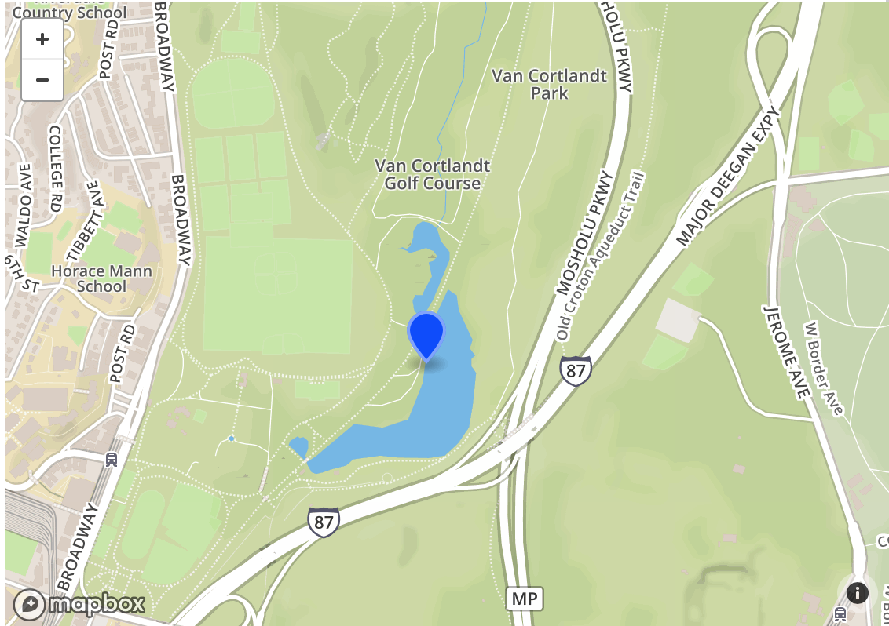
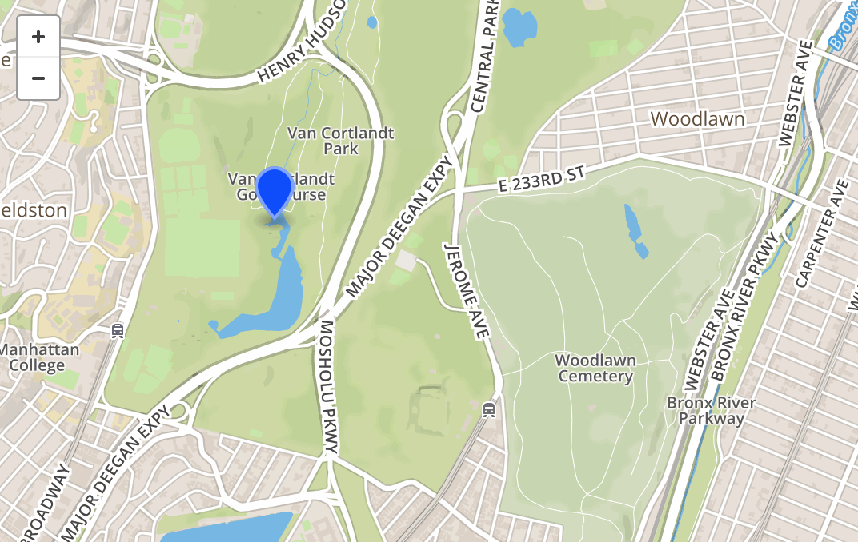
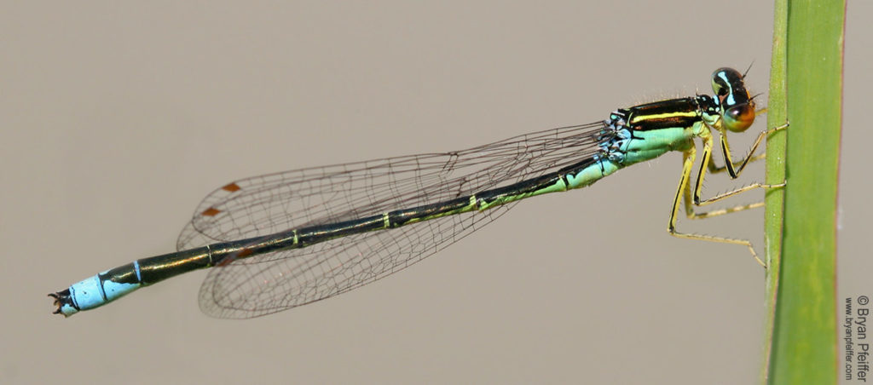
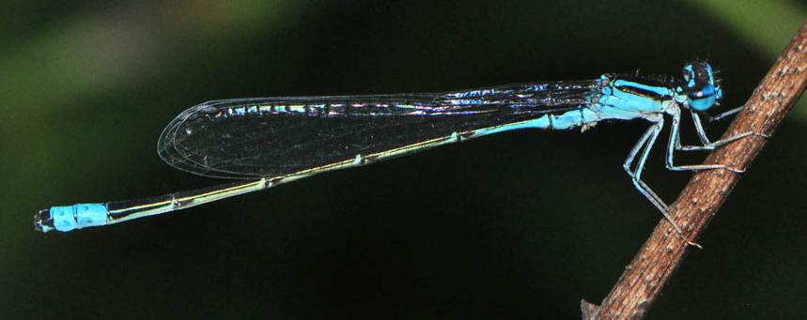
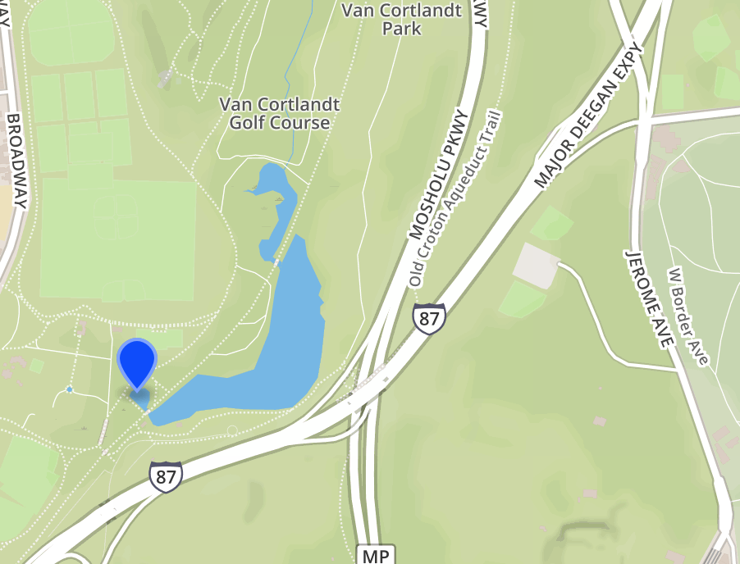
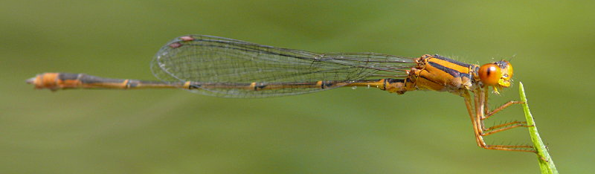
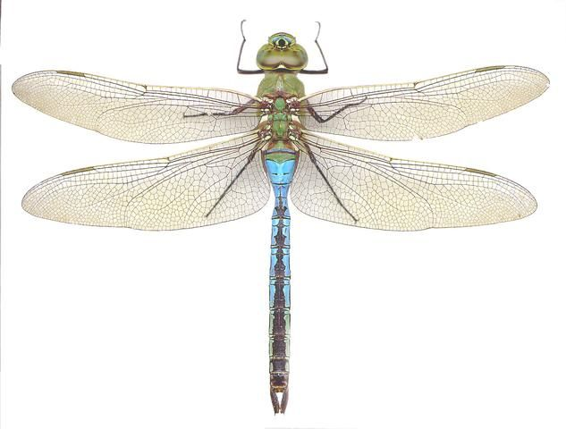
The Odonate Fauna of Van Cortlandt Lake
Lawrence Heller¹, Spencer Lott¹, & Howard Waldman¹
Funded by the
Thompson Family Foundation
The Ethical Culture Fieldston School
Abstract:
This project sought to survey the odonate diversity of Van Cortlandt Lake in Van Cortlandt Park, Bronx, New York. Odonates often play a key role in the ecosystems of ponds and the surrounding areas; the aquatic nymphs and flying adults are important predators of invertebrates, while both adults and nymphs are prey to a variety of other species. By surveying the Odonate diversity of Van Cortlandt Park, using DNA barcode identification techniques, the Urban Barcode Project will provide a window into the biodiversity of this urban environment. The morphology of specimens were examined and the DNA of select specimens extracted and amplified. The extracted and amplified DNA fragments were sent to the lab for sequencing. Identified were Libellilulid sp., Enallagma divagans, Enallagma antennatum, Enallagma signatum, Anax junius.
Introduction:
This project sought to survey the odonate diversity of Van Cortlandt Lake. Odonata, or dragonflies and damselflies, are a familiar part of this region’s insect fauna that are common throughout Van Cortlandt Park. Odonates typically spend most of their lives as aquatic nymphs, before emerging as the flying adults (Waggoner, Sabet-Peyman 2000). Throughout their life cycles odonates are predators of other invertebrates, making them an important component of invertebrate communities (Ecology and Conservation of Dragonflies and Damselflies, 1). The Bronx has a fairly high odonate diversity, with 32 species recorded as of 2009. Furthermore, Tibbetts Brook and Van Cortlandt Lake as shallow, weedy still and slow moving water bodies, make good habitats for a wide variety of odonate nymphs (Waggoner, Sabet-Peyman 2000).
Due to odonates’ dependence on freshwater bodies for the completion of their life cycle, odonate species are prone to become threatened or endangered as these habitats are altered and destroyed by human activity (Ecology and Conservation of Dragonflies and Damselflies, 1). Out of the 32 odonate species recorded in the Bronx, three are listed as being of “greatest conservation need” by the New York State Department of Environmental Conservation the and/or on the “Active Inventory List” of the NY Natural Heritage program (Novak 2010, 23). Because of its number of at-risk species and species count, providing a complete inventory of the Park’s odonate fauna is an important contribution to the understanding of its biodiversity.
Materials & Methods:
Forceps, Eppendorf Tubes, Tube Racks, Knife, Ethanol (95%), Centrifuge, Centrifuge Tubes, Pestles, Silica Resin, Cell Lysis Solution, Primers, PCR, -20 Degrees Celcius Freezer, Taq Polymerase, Pipettes (various sizes), Nucleotides, Two Water Baths, Distilled Water, Vortex, GuHCl, Gel Cassette, Negative + Positive Electrode, Agarose Gel, Buffer, DNA Ladder, DNA Control.
These bodies of water are filled with damselflies and dragonflies of many different species. To collect our specimens we looked for emergent and aquatic vegetation throughout the bodies of waters, as that is where dragonflies and damselflies typically reside. Specimens were collected by wading with fine-meshed dip nets A sweep net was also brought for collecting mature odonates. The GPS coordinates of collection sites and the estimated radius from which specimens were recorded. Specimens were labeled, stored in vials of 95% ethanol, and then identified morphologically with as much specificity as possible. DNA was then extracted from the specimens at the Ethical Culture Fieldston School using the standard Silica Resin technique as specified by the NYC Urban Barcode Project. To produce enough DNA for barcoding and to confirm that the DNA fragments were present, we utilized two separate processes: a Polymerase Chain Reaction and Gel Electrophoresis. Finally, we submitted the DNA to Genewiz, where the species were identified (Amplifying DNA, 1).
Results:
Discussion
Anax
The Green Darner (Anax junius) is a large dragonfly common throughout much of North America
A. junius is migratory and adults travel long distances, meaning that our confirmation of A. junius nymphs from Van Cortlandt Lake were necessary to confirm that A. junius breeds in the park
All 3 specimens identified as A. junius were collected from site 3, which was characterized by shallow (~ 1 foot deep) water and extensive mats of invasive water chestnut (Trapa natans)
An abundance of eastern mosquitofish (Gambusia affinis) and several large tadpoles (Rana sp.) were noted at the collection site, potentially providing food to the nymphs, which are known to prey on fish and tadpoles
Enallagma
3 specimens were identified as belonging to 3 species of Enallagma, the bluet damselflies; Enallagma signatum, the Orange Bluet, Enallagma divagans, the Turquoise Bluet, and Enallagma antennatum, the Rainbow Bluet
These 3 species, and no others of the genus, have previously been recorded in the Bronx
It was noted that the nymphs of each Enallagma had distinctive patterns on their caudal lamellae, opening the possibility to future surveys of abundance and habitat use by the three species based on nymph morphology. See Figures ()
Sympetrum vicinum
A specimen of an adult Sympetrum vicinum was also collected and identified by its morphology.
Further Research
Although this study adds to our understanding of Van Cortlandt Park’s odonate fauna, the relatively small number of usable sequences produced mean that more surveys are needed to gain a complete understanding of the odonate communities in the Park
Further studies might look at the odonates of Tibbetts brook, which was not covered by this study. The marked difference between the habitat and odonate nymphs found throughout the lake (i.e. all Anax specimens, including those not identified by sequencing, were found at Site 3) suggest that differences between odonate faunas of different microhabitats throughout the park also warrant investigation.
References
“Amplifying DNA.” NYC Urban Barcode Project, Cold Spring Harbor DNA Laboratory, www.dnabarcoding101.org/lab/protocol-2.html.
Cold Spring Harbor Laboratory. “Biology Animation Library.” DNALC Blogs, DNA Learning Center, www.dnalc.org/resources/animations/gelelectrophoresis.html.
“Common Green Darner.” Encyclopedia of Life, Encyclopedia of Life, eol.org/pages/131866/details#migration.
“Ecology and Conservation of Dragonflies and Damselflies.” Xerces Society for the Conservation of Invertebrates, The Xerces Society, xerces.org/ecology-and-conservation-of-dragonflies-and-damselflies/.
Erckmann, Lynn. “Caudal Lamellae of Carolina Zygoptera.” Savanna · University of Puget Sound, University of Puget Sound, www.pugetsound.edu/academics/academic-resources/slater-museum/biodiversity-resources/dragonflies/image-collection/caudal-lamellae-of-carolina-zy/.
Ferrer, Willa, et al. The Damselflies of Van Cortlandt Park. NYC Urban Barcode Project, 2017.
Holub, Emma, Lender, Avery Dragonflies in Van Courtlant [sic] Park. NYC Urban Barcode Project, 2017.
Huggins, Donald G. "Description of the Nymph of Enallagma Divagans Selys (Odonata: Coenagrionidae)." Journal of the Kansas Entomological Society 51, no. 1 (1978): 140-43. http://www.jstor.org/stable/25083009.
“Isolating DNA.” NYC Urban Barcode Project, Cold Spring Harbor DNA Laboratory, www.dnabarcoding101.org/lab/protocol-2.html.
Khan Academy. “Polymerase Chain Reaction (PCR).” Khan Academy, Khan Academy, www.khanacademy.org/science/biology/biotech-dna-technology/dna-sequencing-pcr-electrophoresis/a/polymerase-chain-reaction-pcr.
Keller, Tamara S., et al. “Atlas of the Dragonfly Larvae (Class Insecta: Order Odonata: Suborder Anisoptera) Recorded at the Old Woman Creek National Estuarine Research Reserve and State Nature Preserve, Ohio.” Ohio Department of Natural Resources, Mar. 2007, wildlife.ohiodnr.gov/portals/wildlife/pdfs/public%20areas/OWCAtlas_Dragonfly.pdf.
Laurilla, Ansi, et al. “Different Antipredator Behaviour in Two Anuran Tadpoles: Effects of Predator Diet.” Behavioral Ecology and Sociobiology, vol. 40, no. 5, May 1997, pp. 329–336., doi:https://doi.org/10.1007/s002650050.
“New York Dragonfly and Damselfly Survey Handbook for Workers” New York Damselfly and Dragonfly Survey, New York Department of Environmental Conservation, www.dec.ny.gov/docs/wildlife_pdf/nyddshandbk.pdf.
New York State Museum. Documents of the Senate of New York. vol. 14, New York State Senate, 1904, books.google.com/books?id=aJUlAQAAIAAJ&dq=enallagma+signatum+nymph&source=gbs_navlinks_s.
Novak, Paul G. “The New York Damselfly and Dragonfly Survey 2005-2009: Distribution and Status of the Odonates of New York.” New York Damsefly and Dragonfly Survey, New York Department of Environmental Conservation, Apr. 2010, ftp://ftp.dec.state.ny.us/dfwmr/nynhp/nydds/nyddspublicreport.pdf.
Taylor, Christina. “25 Species That Call Tibbetts Brook Home.” Friends of Van Cortlandt Park, Friends of Van Cortlandt Park, 15 Feb. 2017, vancortlandt.org/25speciestibbettsbrook/.
Waggoner, Ben, and Jason Sabet-Peyman. “Introduction to the Odonata.” Odonata: Dragonflies and Damselflies, University of California Museum of Paleontology, 16 July 2000, www.ucmp.berkeley.edu/arthropoda/uniramia/odonatoida.html.
Waldman, H. (Presenter). (2017, October). Personal Communication of Odonate Diversity. Speech presented at Ethical Culture Fieldston School, NY.
Acknowledgements
We would like to thank Mr. Howard Waldman, Dr. Anne Kloimwieder, Alex Byrne and John Butler from Friends of Van Cortlandt Park, GENEWIZ, the Ethical Culture Fieldston School, the Cold Spring Harbor Laboratory DNA Learning Center for facilitating this project.
QSK # | Most Specific Taxon | Number of Mismatches | E Value | Collection Site | Bit Score
006 | Cyanea tzetlini | 0 | 2e-11 | Van Cortlandt Lake, Site 1 | 73.4
009 | Libellulidae sp. | 17 | 0.0 | Van Cortlandt Lake, Site 1 | 967
019 | Enallagma divagans | 3 | 0.0 | Van Cortlandt Lake, Site 1 | 1067
022 | Enallagma antennatum | 49 | 0.0 | Van Cortlandt Lake, Site 2 | 773
026 | Cyanea tzetlini | 0 | 2e-11 | Van Cortlandt Lake, Site 2 | 73.4
028 | Acisoma variegatum | 74 | 0.0 | Van Cortlandt Lake, Site 2 | 740
033 | Anax junius | 35 | 5e-130 | Van Cortlandt Lake, Site 2 | 471
035 | Enallagma signatum | 18 | 0.0 | Van Cortlandt Lake, Site 2 | 1036
038 | Anax junius | 7 | 0.0 | Van Cortlandt Lake, Site 3 | 1153
039 | Cyanea tzetlini | 0 | 7e-11 | Van Cortlandt Lake, Site 2 | 73.4
040 | Anax junius | 4 | 0.0 | Van Cortlandt Lake, Site 3 | 1168
041 | Acisoma inflatum | 86 | 0.0 | Van Cortlandt Lake, Site 2 | 782
Table #1: This table expresses the most specific taxons of the odonate samples collected from Van Cortlandt Park. The table also displays each sample’s QSK Identification Number, their mismatch count, E value, their specific collection site, and the bit score of their extracted DNA. QSK 006, 026, and 039 were loosely identified as Cyanea tzetlini, a species of Lion’s Mane jellyfish. This error is attributed to the minute size of the submitted DNA strain, and is further exemplified with the low bit score, representing minimal biological significance. Successfully, QSK 009 was identified as Libellulidae sp., QSK 019 was identified as Enallagma divagens, and QSK 022 as Enallagma antennatum. QSK 028 was identified as Acisoma variegatum, QSK 033, 038, and 040 as Anax junius, and QSK 035 as Enallagma signatum. Lastly, QSK 041 was identified as Acisoma inflatum. The specimens identified as belonging to the genus Acisoma were treated simply as Libellulid sp. due to the fact that the genus is not found in North America and the high number of mismatches in each of those identifications.
Tables and Figures:
Figure 1: Lateral (a) and Medial (b) caudal lamellae of Enallagma divagans (Huggins 1978).
Figure 2: Lateral Lamella of Enallagma signatum (Erckmann 1966)
Site 1: A shallow area on the lakeshore flanked by stands of arrow arum (Peltandra sp.), bottom with some submerged vegetation
Site 3: A shallow (max depth app. 1 ft.) embayment near the outflow of Tibbetts Brook into Van Cortlandt Lake, extensive mats of water chestnut (Trapa natans) were present throughout the embayment, while the surrounding shoreline was dominated by phragmites (Phragmites sp.) and cattail (Typha sp.)
Figure 4: Nymph of Enallagma antennatum, uniform dark coloration of the gills and white, pointed tips are visible (Documents of the Senate of the State of New York, 1904).
Figure 5: Lateral (above) and Medial (below) caudal Lamellae of damselfly Morphotype 4
(Enallagma antennatum).
Figure 3: Lateral (left and right) and medial caudal lamellae of damselfly Morphotype 2 (Enallagma signatum).
Site 2: A partially enclosed embayment containing stands of arrow arum (Peltandra sp.), bottom with some submerged vegetation. Near the outflow of Van Cortlandt Lake to the sewer system.
Enallagma antennatum
Enallagma divagans
EEnallagma signatum
Anax junius

