Slide 1
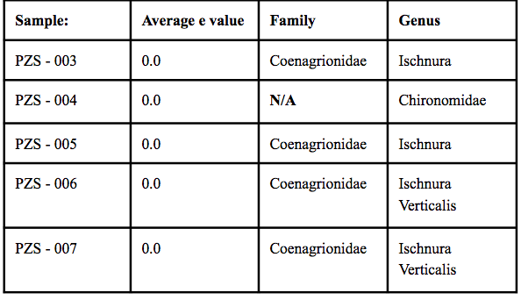
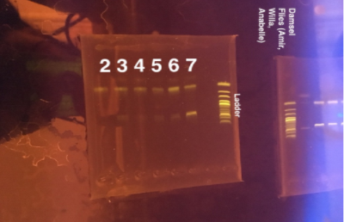
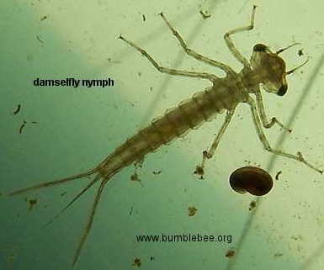
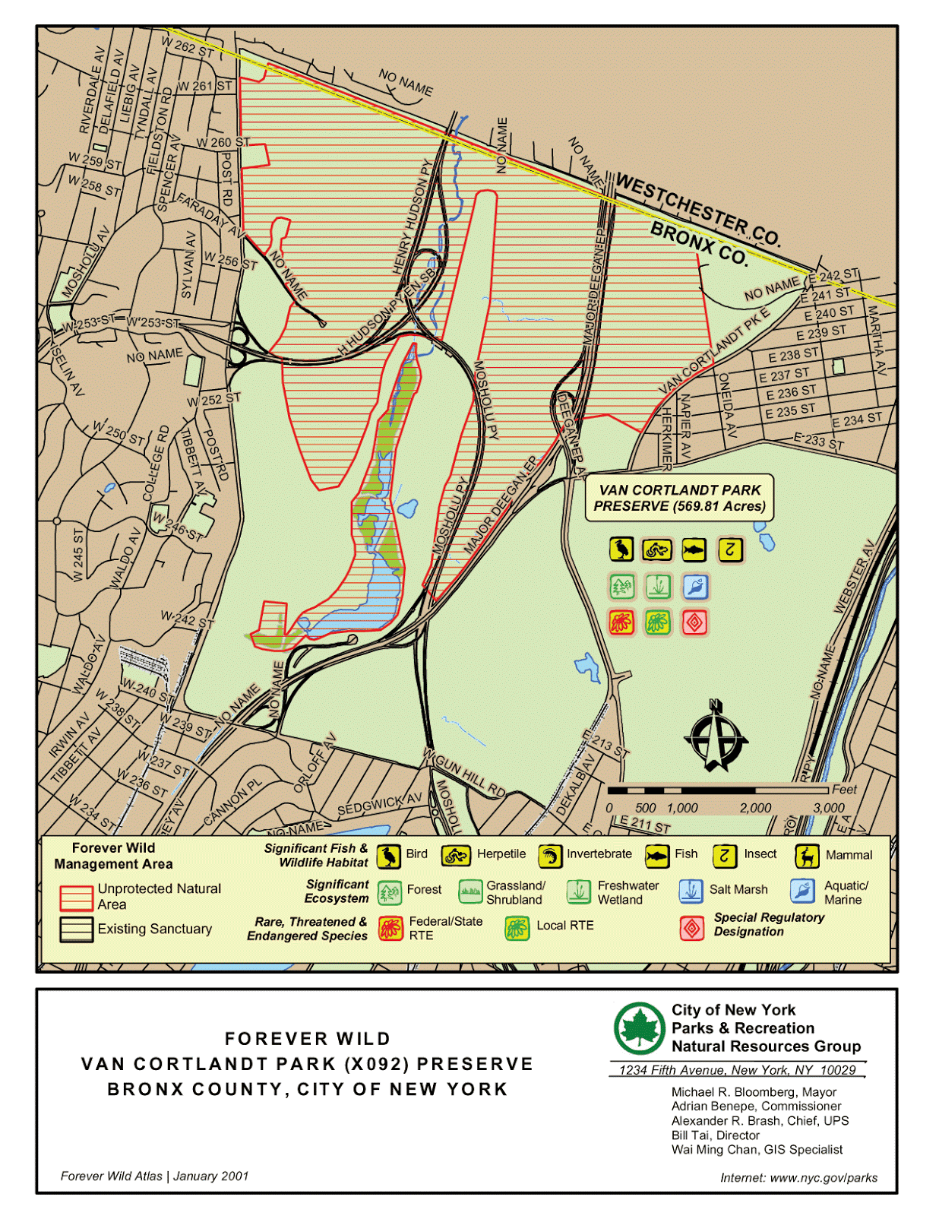
Diversity of Damselflies:
The Damselflies of Van Cortlandt Park
Willa Ferrer, Amir Mustefa, Anabelle Wright, Mr. Howard Waldman
Funded by the
Thompson Family Foundation
Ethical Culture Fieldston School, Bronx NY
Abstract
Damselflies are found in the most shallow parts of water in Tibbets Brook of Van Cortlandt Park. Although they look a lot like dragonflies, they can be distinguished by the way they hold their wings at rest and their slender bodies. By collecting a series of samples of Damselfly larvae, the diversity of Damselflies within the park can be determined. To collect these larvae, nets and containers were used in different parts of the park. The larvae were then placed in 1.5mL tubes along with ethyl alcohol to preserve the DNA, which were then placed in a refrigerator. The sample size is seven, which is very small and makes it hard to draw significant conclusions. Of the 5 samples, PZS 003 and 005 are of the Damselflies are of the genus Ischnura and the family Coenagrionidae. The other two, PZS 006 and 007, are of the genus Ischnura Verticalis and the family Coenagrionidae. Our fifth sample, PZS 004, is of the genus Chironomidae, which is not a Damselfly. The data collected shows that there is not a large range of Damselflies within Van Cortlandt Park.
Introduction
This question this experiment concerned the biodiversity of damselfly species in Van Cortlandt Park. This park is New York City’s third largest park takes up well over 1,000 acres of land. With 100’s of acres of meadows, forests and various bodies of waters, Van Cortlandt park serves as a habitat for thousands on thousands of animals with a variety of different flora. Beyond its biological feats, the park has great history imprint on the Bronx. The forests throughout the park have flourished for well over 17,000 years beginning around the end of the Wisconsin glaciation. In fact, the first human beings to ever inhabit this park were the Wiechkoske Lenapes, a small Native american population indigenous to the Northeastern woodlands. Fast forward to today, this park serves as community space and public area to many North bronx communities including the Ethical Culture of Fieldston school.
With a park as large as Van Cortlandt, it is important to keep track of the biodiversity in the park. This is done thanks to the efforts of the New York's department of parks and recreation, Van Cortlandt parks conservancy and a small organization called Friends of Van Cortlandt. In tandem with this program data was collected from various bodies of water around the park. The purpose of this experiment was to determine the species of the damselflies in the park and the pros and cons they bring to Van Cortlandt Park. The East Coast has a large population of damselflies and Van Cortlandt Park has suitable environment for these damselflies to thrive. At this immature stage they live in water and prey on freshwater organisms including mosquito larvae and other small aquatic insects. Adults prey on flies, mosquitoes and moths. At a reasonable population damselflies are extremely important to keep a cap on the amount of other insects, particularly mosquitoes in the given environment. If we are able to discover the specific type of damselflies present, it will give Van Cortlandt a partial picture of insects present in the park
Materials & Methods
The experimental team took one trip to Van Cortlandt Park, Bronx, NY in October of 2016. There the scientist collected samples of damselfly nymphs in one or both of Van Cortland’s ponds.. To increase the chance of discovering diversity even more, they collected the nymphs in different areas of each pond. Careful observations of the environment in which the samples were collected were recorded (i.e how much plant life and algae, human interaction/waste and trash, etc). Different methods of capturing nymphs were used including nets and containers. Immediately after collection the nymphs were placed in 1.5mL tubes (one per tube). At each location one ziploc bag was used to store all of the samples from seid location. They were stored this way until a few hours later when the experimental team returned to Fieldston and placed them in new tubes with ethyl alcohol 95% and labels. After submerging each damselfly in alcohol, they were then all placed in a refrigerator to further preserve the damselfly.
Over the next few months the scientists performed the entire DNA extraction protocol on all of their samples. In the end, five samples were sent for DNA sequencing.
Results
Out of thirteen recorded samples the scientists successfully obtained DNA sequences from five. Two gels were run; the first with samples PZS-002 through PZS-007. Five out of these 6 resulted in bands that could be sent to the lab (seen in Image #1) The second gel did not result in any bands. The results of the DNA sequencing is shown in Table #1 below.
Tables & Figures
Discussion
Although the sample size used is very small, out of the larvae that were Damselflies found in Tibbets Brook, there were only two different genera found. This shows that in Van Cortlandt Park, there is not a broad range of Damselflies within the park. Out of the 14 samples that were collected, only 4 had sufficient DNA results. This deficiency in samples was unexpected and causes conclusions on the diversity of Damselflies in Van Cortlandt park hard to make.
References
DNA Subway. DNA Subway. 2017 May 11 [accessed 2017 May 14]. https://dnasubway.cyverse.org/project/browsemy
Used to store sequencing data on DNA for Damselfly
The Editors of Encyclopædia Britannica. damselfly. Encyclopædia Britannica. [accessed 2017 May 14]. https://www.britannica.com/animal/damselfly
Background Information Pertaining to Damselfly
Van Cortlandt Park. Van Cortlandt Park Conservancy - Home. [accessed 2017 May 14]. http://www.vcpark.org/
Background Information Pertaining to Van Cortlandt Park
Van Cortlandt Park. Van Cortlandt Park : NYC Parks. [accessed 2017 May 14]. https://www.nycgovparks.org/parks/VanCortlandtPark
Van Cortlandt Park — Background
Van Cortlandt Park. Van Cortlandt Park : NYC Parks. [accessed 2017 May 14]. https://www.nycgovparks.org/parks/VanCortlandtPark
Van Cortlandt Park — Background
Acknowledgements
Mr. Howard Waldman (Science Research Paper).

