Slide 1
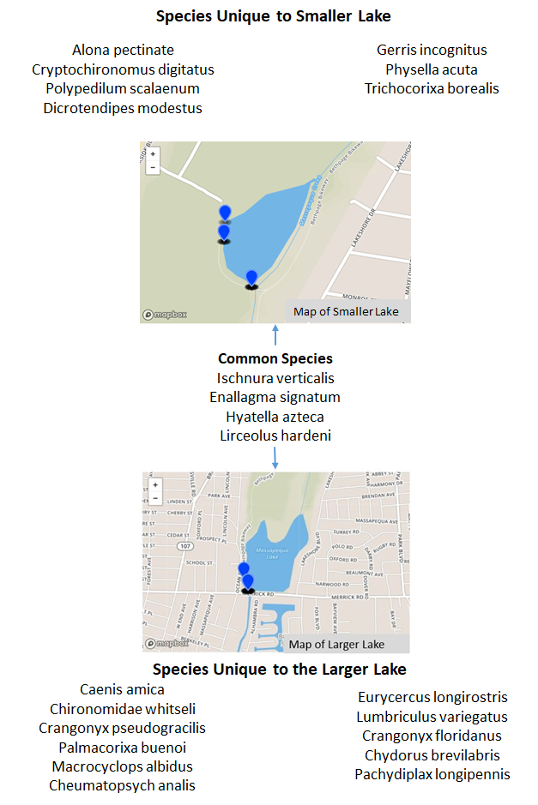
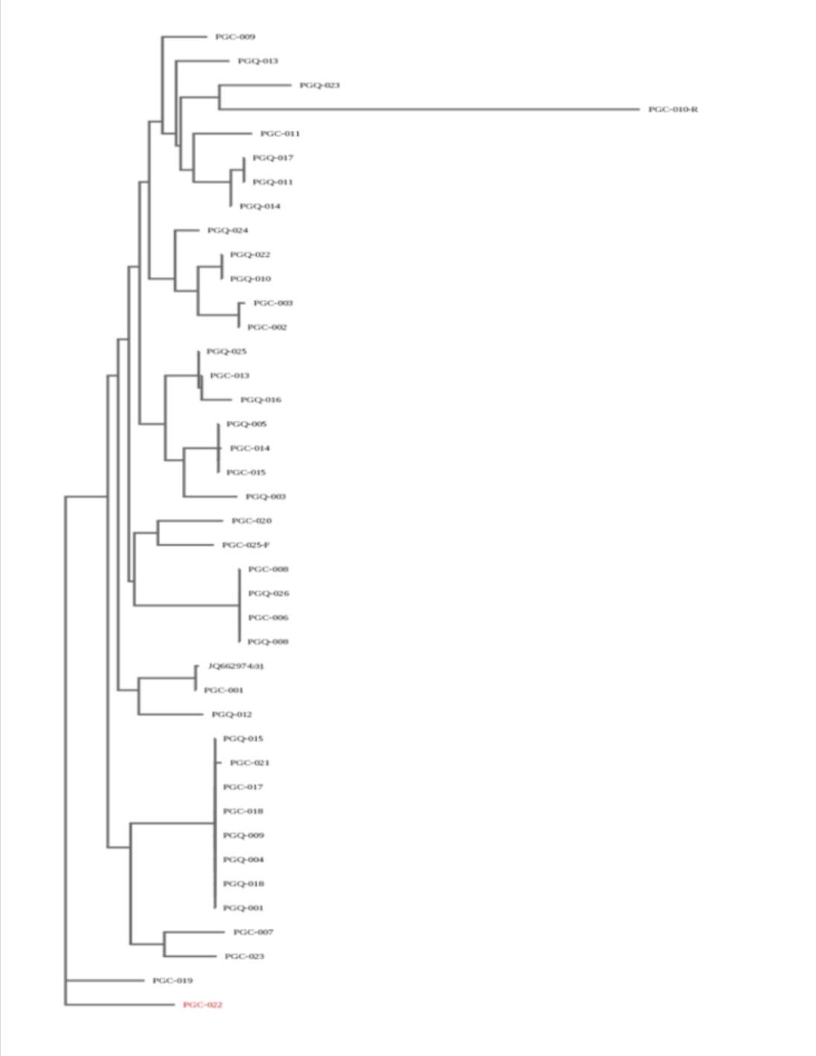
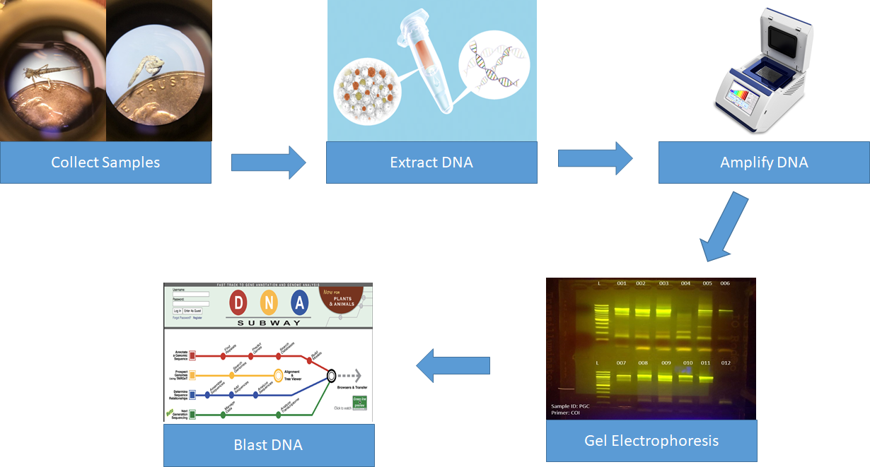
The Effect Mute Swans Have on Biodiversity
Julissa Rivera, Mina Sarmas, Daniella Vetrano, & Megan Zedalis
Mentor: Linda Waldbaum
Plainedge High School
Introduction
The Massapequa Preserve is home to a population of a non-native, invasive, and non-migratory swan species called the mute swans, or Cygnus olor.
Mute swans are highly aggressive and territorial, as they will attack other waterfowl to keep them away from their habitat.They can force out native species and cause a further reduction of biodiversity.
With this project, we intend on determining their effect on the Massapequa Preserve by measuring and characterizing the biodiversity of aquatic invertebrates related to the mute swan population. We predict that our data will show that the mute swans cause a reduction in biodiversity and have a negative effect on their habitat.
Results
We identified 22 species total, with 4 species found in both locations. We found that there were more species that were unique to the larger lake than species unique to the smaller lake. All of the species found are previously known and discovered.
Discussion These results suggests that there is more biodiversity in the area with more swans as it had more species that were unique to this location, refuting our hypothesis. However, the sample size is quite small and may not be an adequate representation to make this claim. The accuracy of our data could have been affected by natural occurrences. For example, the larger size of the lake may allow it to inhabit more species. In addition, species from the smaller lake can move down the connecting streams to the larger lake, but not from the larger lake to the smaller lake.
References Nassau County (n.d.) Peter J. Schmitt Massapequa Preserve. Retrieved from www.nassaucountyny.gov/2905/Peter-J-Schmitt-Massapequa-Preserve The Cornell Lab of Ornithology. (n.d.) Mute Swan. Retrieved from www.allaboutbirds.org/guide/Mute_Swan/lifehistory#at_food Maryland Department of Natural Resources. (2003). Mute Swans in Maryland: A Statewide Management Plan. Retrieved from dnr.maryland.gov/wildlife/Documents/MuteSwan_StatewideMgtPlan.pdf New York Department of Environmental Conservation. (2008) Mute Swan Surveys. Retrieved from www.dec.ny.gov/animals/47734.html New York Department of Environmental Conservation. (2013) Status and Ecology of Mute Swans in New York State. Retrieved from www.dec.ny.gov/docs/wildlife_pdf/muteswanreport.pdf National Science Teachers Association. (n.d.) Collecting Aquatic Invertebrates Retrieved from ei.cornell.edu/teacher/pdf/WD/WD_p78-84.pdf
Acknowledgements
BLI Team 1045
Adam Ayroso, Liam Byrne, Michael Stabile, & Nicholas Stabile
a.
Map of lake with fewer swans
Map of lake with more swans
Fig A: Maps of locations where we collected with species found at each location
Fig. B: Phylogenetic Tree of samples
Fig. C: Method used to process DNA

