Slide 1
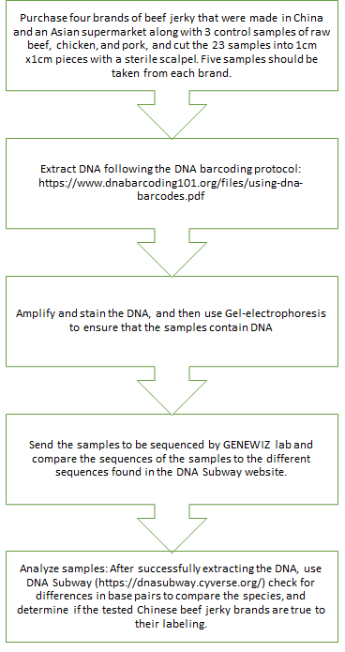
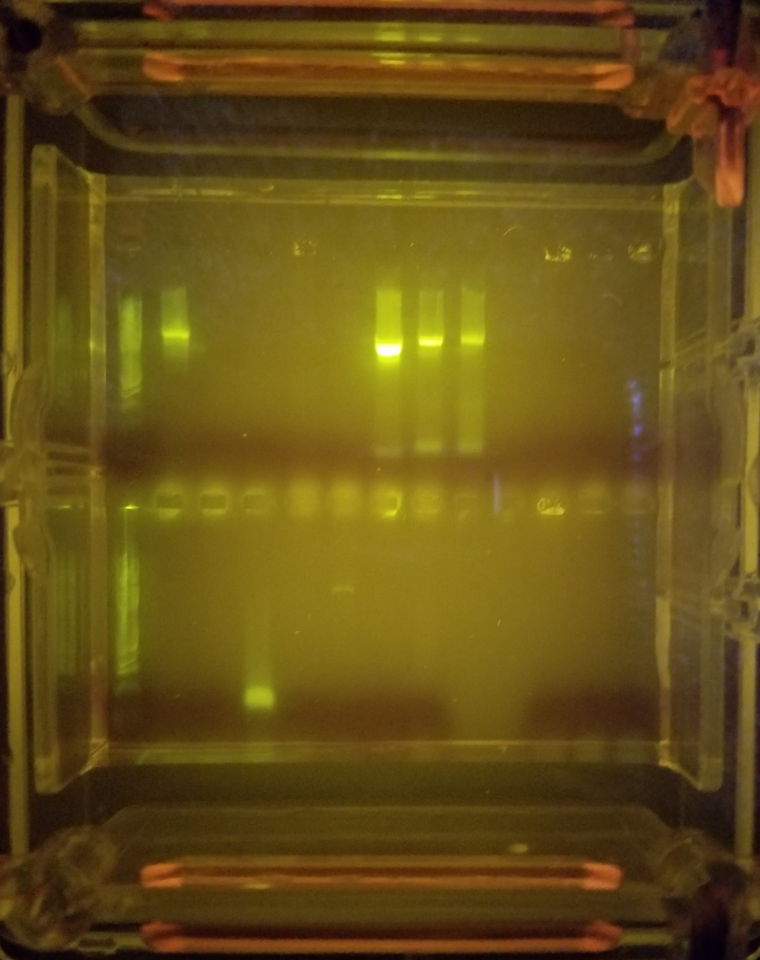
Is Beef Jerky Really Beef?
Funded by the
Thompson Family Foundation
Brittany Huang and April Wu
The Carl Sagan Research Program, Forest Hills High School
Abstract
China has begun to tightly regulate its food production after many reports of food scandals. To target the question regarding the authenticity of Chinese beef jerkys, our experiment focuses on the specific question: “Is Chinese beef jerky really beef?”. It was predicted that the beef jerky may contain other organisms. 20 beef jerky samples, along with 3 control samples consisting of pork, chicken, and beef, were tested through the process of DNA extraction, PCR and gel electrophoresis. The PCR product was sent to GENEWIZ lab to be sequenced. The sequence was blasted on DNA Subway to be compared to known organism sequences to determine if the sample sequences matched Beef. Through DNA Subway, we were able to determine that the beef jerkys were indeed beef (Bos Taurus). The 4 PCR samples that were able to be sequenced, when compared on DNA Subway, were determined to be most closely related to beef (Bos Taurus).The hypothesis that the beef jerkys were not beef was rejected.
Introduction
China has made many headlines due to their popular and serious food scandals in the recent years.
In 2008, twenty-six tons of baby milk powder were contaminated by melamine, causing 300,000 babies to fall ill and 6 babies dead.
Then in 2015, smugglers were caught for transporting forty year-old meat into China: the meat would be transported from Hong Kong to Vietnam and sold in major food markets to local consumers.
In LeShan, China, a man discovered that the pork he had purchased from a local market was glowing bright blue, which was later discovered to be caused by a bacterial contamination (phosphorescent bacteria).
Early in 2017, investigators had reported that there were approximately 50 small factories creating fake branded condiments, ranging from sauces to various spices. These fake products were made from dirty tap water and industrial salt, both dangerous to human health, and were placed into old empty containers, repackaged, and then sold to the people through supermarkets and convenience stores.
These scandals are raising awareness about where and what these consumers should buy and avoid. These counterfeits have affected hundreds of thousands of people each year, and scandals such as the ones in the past decade have shown that China must start implementing stricter food inspections, preventing its people from experiencing similar problems.
In America, many food products are imported from other countries, China included. There are supermarkets that carry Chinese snacks such as candy, chips, and drinks, and one popular snack is beef jerky. Known for its distinct flavors and texture, beef jerky has become one of the most popular snacks amongst customers. However, the numerous scandals regarding China’s food have caused people to become more hesitant when buying food made from China.
With the idea that the beef jerky will most likely not be 100% beef in mind, we hypothesized that the beef jerky made in China will most likely contain other contaminants and organisms. Therefore, this experiment targets the question “Is Chinese beef jerky purely beef?”
Materials & Methods
Results
After reviewing and analyzing the results from DNA Subway, it is evident that the beef jerky samples involved in the experiment are indeed beef, or Bos taurus. In addition, from DNA Subway it can be seen that the quality of the samples vary. For example, samples such as KTM-001-F, KTM-001-R, KTM-006-F, and KTM-006-R have a consistency of poor quality of each base until the 80th base, from which the quality increases and remains consistent until the genome’s 640th bases. On the other hand, bases KTM-007-F, KTM-007-R, KTM-008-R, and KTM-008-F have shown a longer consistency of higher quality base results, which begin at approximately the 90th base and prolong until approximately the 780-790 bases.
Tables & Figures
Figure 1: This chart shows BLASTN results from DNA Subway, which indicated the most related specie of each sample as well as the number of mismatched bases within each sample’s DNA sequences when compared to the control’s.
Figure 2: This phylogenetic tree shows the proximity of our DNA sequences compared to the DNA of the known organism, Bos Taurus. This chart further portrays the relationship among the beef jerky samples.
Figure 3:
Discussion
The results shown on DNA Subway do not support our hypothesis and proved that the samples are indeed beef, namely Bos taurus. We were able to see this in our data by comparing the number of mismatched bases to the control sample. Despite only having four samples for comparison, all of them had relatively low numbers of mismatched bases. As seen in Figure 1, all the samples had numbers of mismatched bases lower than ten when compared with the DNA of Bos Taurus. This means that the beef jerky samples were highly likely to be beef.
There were flaws we ran into while conducting this experiment which may have affected our results. Initially we were going to test 20 samples of beef jerky: 5 pieces from each brand with 3 additional control groups. However, due to factors such as the gelatine in the samples, 16 of the 20 samples could not be sequenced. A majority of our samples turned into gel, preventing them from being able to be put through the PCR process. This means that not all the brands were tested for containing actual beef. Since samples from the same the same brand of jerky were grouped together (e.g. KTM-001 to KTM-005 would be from one group), only 2 out of the 4 brands were able to be tested. Compared to the initial amount of samples we planned to test, 4 samples is a small amount and may not provide complete and accurate data.
We believe that the results showed that the beef jerkys were tested positive for Bos Taurus because of the Food Safety and Inspection Service (FSIS) Meat Inspection Act. The FSIS regulates and ensures the safety and security of the U.S. meat, poultry, and egg products. In addition, the FSIS conducts daily inspections at slaughter and food processing established, ensuring the safety of meat consumption. Therefore, since there is such strict food regulation on products entering the United States it would be unlikely that a product would be mislabeled as beef.
As for future studies, we hope to build on our project by either reconducting this project with more beef jerky brands. Due to a majority of our samples not working during the PCR process, we would like to retest this project with other brands if provided with the opportunity. By using additional brands, we would hope to have more samples to test and sequence to provide us with more data.
References
Tse, D. L. (2015, June 24). “In China, Stomachs Turn at News of 40-Year-Old Meat Peddled by Traders.” The New York Times. Retrieved from
www.nytimes.com/2015/06/25/world/in-china-stomachs-turn-at-news-of-traders-peddling-40-year-old-meat.html
BBC News. (2010, September 20). “Arrests in China over milk tainted with melamine.” BBC News. Retrieved from http://www.bbc.com/news/world-asia-pacific-11372917
Center for Food Safety and Applied Nutrition. (n.d.). “Consumers- Melamine in Tableware: Questions and Answers.” U.S. Food and Drug Administration. Retrieved from
www.fda.gov/food/resourcesforyou/consumers/ucm199525.htm
Wong, E. (2008, December 24). “Company at Core of China’s Milk Scandal Is Declared Bankrupt.” The New York Times. Retrieved from
www.nytimes.com/2008/12/25/world/asia/25milk.html?rref=collection%2Ftimestopic%2FMelamine&action=click&contentCollection=timestopics®ion=stream&module=stream_unit&version=latest&contentPlacement=29&pgtype=collection
Williams, S. (January 8, 2016). “Fluorescent pork for dinner? Chinese man is shocked to find the meat he bought from a marker GLOWING BLUE in the dark.” Daily Mail. Retrieved from www.dailymail.co.uk/news/peoplesdaily/article-3389996/Chinese-man-shocked-meat-bought-market-GLOWING-blue-dark.html
Wang & Griffiths J. (January 18, 2017). “China’s fake food problem: Soy sauce and spice mixes.” CNN Money. Retrieved from www.money.cnn.com/2017/01/18/news/china-fake-food-seasoning-factories/index.html
Buckley, C. (May 3, 2013). “Rat Meat Sold as Lamb Highlights Fear in China.” The New York Times. Retrieved from www.nytimes.com/2013/05/04/world/asia/rat-meat-sold-as-lamb-in-china-highlights-fear s.html
USDA Food Safety and Inspection Service (February 21, 2014). “Advancing Food Safety Regulations” USDA. Retrieved from https://www.fsis.usda.gov/wps/wcm/connect/fsis-content/fsis-questionable-content/celebrating-100-years-of-fmia/overview/ct_index
Acknowledgements
We would like to acknowledge and thank Forest Hills High School for providing our group with the resources and help we needed throughout this project. In addition, we would also like to thank our teacher, Mrs. Homer, for helping us along the way.
Jerky Sample | Most Related Specie | Number of Mismatched Bases to Control
KTM-001 | Bos Taurus | 8
KTM-006 | Bos Taurus | 3
KTM-007 | Bos Taurus | 7
KTM-008 | Bos Taurus | 9
Control | Bos Taurus | X
Figure 3: This figure shows a portion of the forward and reverse sequences of the tested samples.

