Slide 1
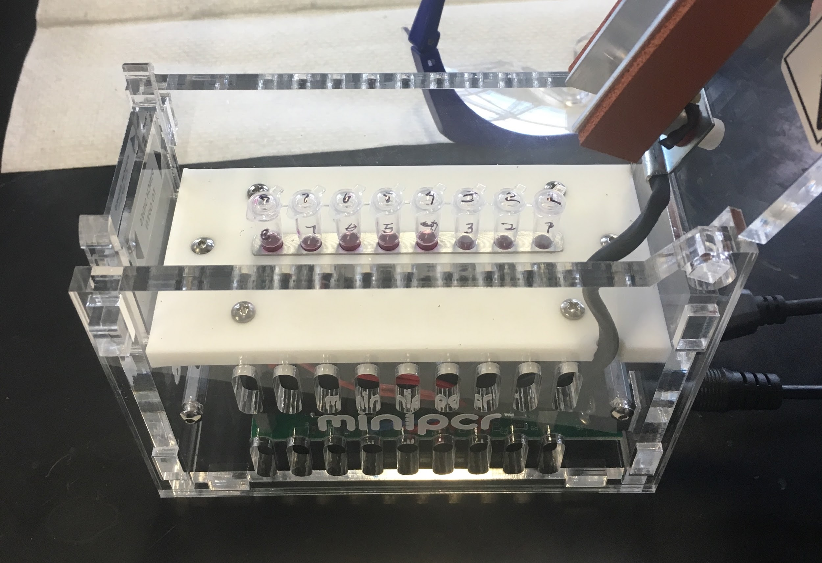
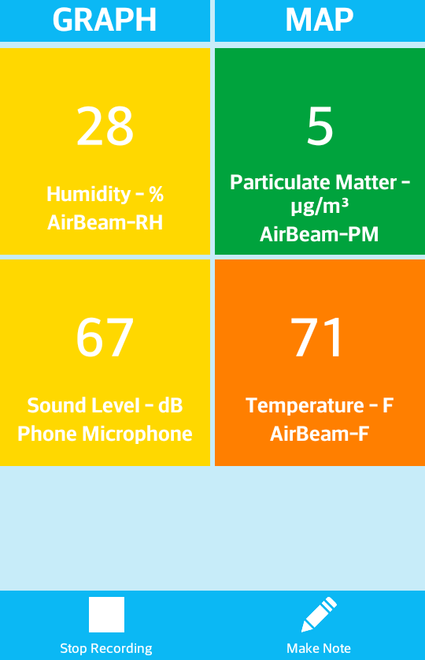
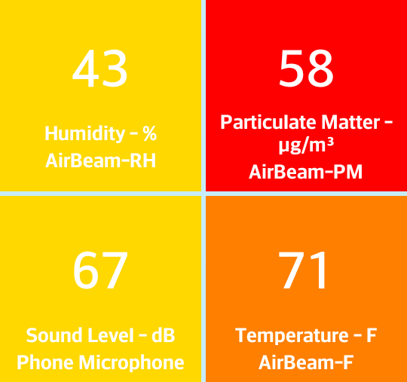
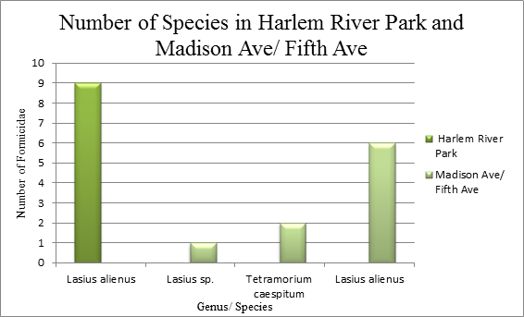
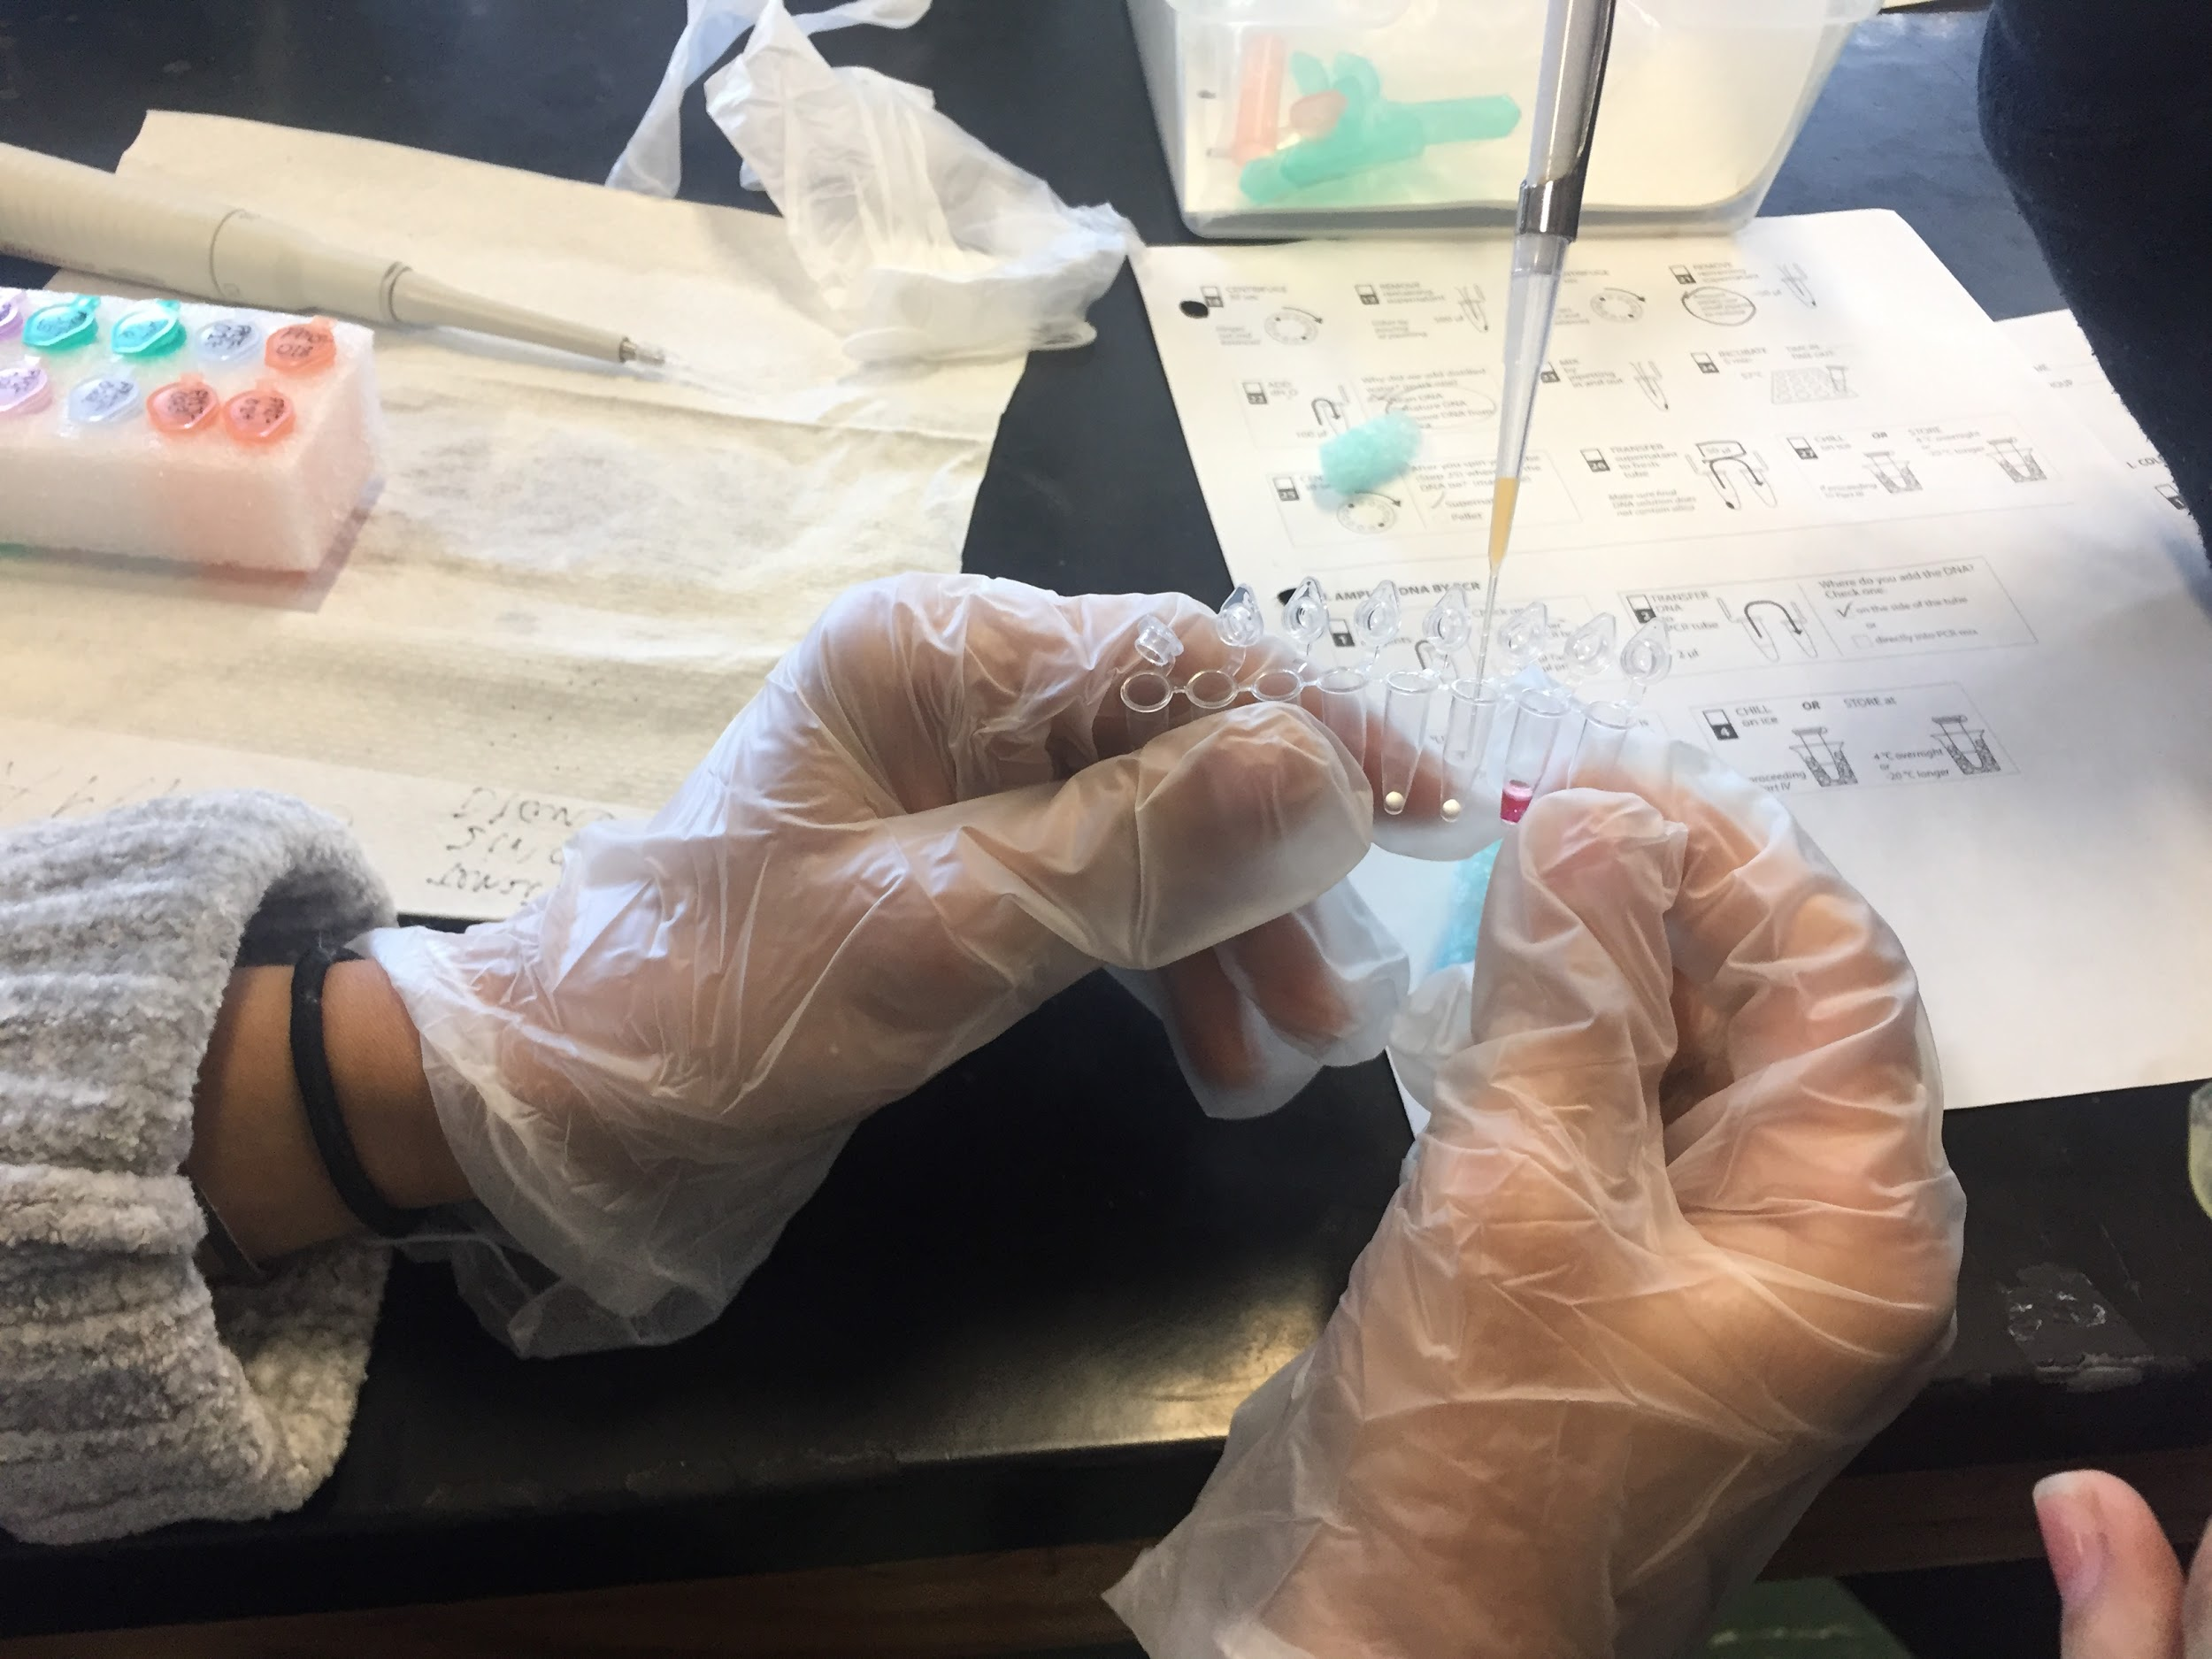
Biodiversity of Ants: DNA Barcode of Formicidae Collected in Two Different Locations Relative to Pollution
Authors: Tenzin Ghongwatsang¹, Diana Flores¹, Zinab Mohamed¹
Mentor: Lisa Homer
Harlem DNA Learning Center¹
Forest Hills High School
Funded by the
Thompson Family Foundation
Abstract
Over the years, studies have depicted an influx of greenhouse gases and other pollutants negatively affecting the biodiversity of Earth’s ecosystems.. The experiment being presented tested how severely pollution affects biodiversity by testing the relationship of Particulate Matter 2.5 (PM2.5) on the biodiversity of ants (formicidae). PM2.5 is a pollutant that has proven to deteriorate its surrounding environment. The experimentation process consisted of retrieving ants from two locations, each differing in amounts of pollution; then extracting DNA and barcoding it to determine the species present. The biodiversity of each location was deduced by analyzing DNA Subway BLAST results to determine the species of ant from each sample. An abundance of species indicates a greater biodiversity. The results have concluded that pollution has a negative correlation with biodiversity; this has been concluded through a conglomeration of past studies, experiments, and previous experimentation. Conclusively, for an ecosystem to thrive and be stable, there has to be biodiversity which was lower in the polluted area. Hypothesis
The hypothesis for the preliminary experiment was the location exposed to a high level of air pollution would have a significantly lower biodiversity of Formicidae (ants) in comparison, to the location with a lower level of air pollution which would have a fairly higher biodiversity of Formicidae.
Introduction
Biodiversity is defined as the existence of a variety of plants and animals in an environment
Particulate matter 2.5 is a pollutant that consists of the solid and liquid particles suspended in the air, many of which have hazardous defects
For our experiment, samples of ants were retrieved from Harlem River Valley Park Park and Madison Ave/ Fifth Ave. Harlem River Valley being an area with a higher concentration of pollution and Madison Ave/ Fifth Ave being an area with lower amounts of pollution.
In both locations, various quadrants were dropped and ants found within the parameters were collected and placed in plastic bags. At both sites, the particle matter was determined using an AirBeam. It was hypothesized that the ants collected in Madison Ave/ Fifth Ave would have a greater biodiversity than the ants collected in Harlem River Valley Park.
This would illustrate pollution’s potential to negatively affect an environment and specifically the biodiversity of an environment.
More species correlates to a better biodiversity and thus a more stable environment
DNA barcoding was utilized to identify the species of the random samples within respective environments
The results were analyzed to compare the differing species in each location and thus denote the environment’s biodiversity
Materials & Methods
Results
The hypothesis was neither supported nor not supported. An error occured during the DNA barcoding process and therefore, it was not possible to conclude our experiment completely.
Despite this, our hypothesis is most likely supported because numerous similar studies have been completed before pertaining to biodiversity and various entities. In particular, a study done involving the biodiversity of ants in two loactions, Forest Park and Central Park.
The hypothesis that the biodiversity would be higher at Forest Park than Central Park was supported by the data that was collected.
From Central Park, 9 ants were collected all of which were Lasius Alienus. On the other hand, in Forest Park 3 different species of ants were collected. There was one ant collected that was of the species Lasius sp. There were 2 ants that were of the species Tetramorium caespitum. The remaining ants collected were 6 ants of the species Lasius alienus.
Discussion
The hypothesis that the biodiversity would be higher in Harlem River Valley Park and lower in Fifth Ave/Madison Ave was neither supported or not supported by our data. From the results, it wasn’t possible to determine that the proximity to pollution could in fact impact the biodiversity of the environment. An error occurred in either the DNA extraction, PCR, or gel electrophoresis process and therefore, it wasn’t possible to draw any conclusions from the data.
Fortunately, similar experiments have been run involving biodiversity and varying entities. The hypothesis was derived from past studies on the effects of various pollutants on biodiversity including the Elsevier’s study on the effects of land-based pollution on reef degradation and coral biodiversity in Indonesia (617-630). Additionally, another related experiment was run before also involving the biodiversity of ants, and it determined that biodiversity is negatively affected by pollution. The experiment compared the biodiversities of two different locations, Central Park and Forest Park, and it concluded that Forest Park had a higher biodiversity. It concluded this because only one species of ants was found in Central Park, but three different species of ants were found in Forest Park.
Since the data of that experiment supported the hypothesis, it is imperative to raise awareness of the negative effects pollution has on the biodiversity of environments.
Lasius alienus was the species found in the highest quantities at both Forest Park and Central Park. The species prefers open spaces which explains why so many were colleced as we the quadrants were dropped on grassy plains. Lasius sp. was another species of ant that we collected, this one at Forest Park. It’s very similar to lasius alienus as it shares the same genus, but it is a different species of ant. Finally, also from Forest Park we collected, 2 ants of the species tetramorium caespitum. The species is native to North Africa, Europe, and Asia, but not to America.
Due to the results from that experiment, it can be concluded that the proximity to pollution and away from pollution does in fact impact the biodiversity of the environment. The experiment can be improvedt in the future, by adding a larger sample size to ensure our results are as accurate.
Selected References
Air Pollution in New York: Real-time Air Quality Index Visual Map (2017). Retrieved from http://aqicn.org/map/usa/newyork/
British Columbia (2016) Threats to Biodiversity. Retrieved from http://www.naturetrust.bc.ca/land-conservation/biodiversity/threats-to-biodiversity/
Soumyajit Dasgupta (2016, July 21) 10 Endangered Ocean Species and Marine Animals. Retrieved from http://www.marineinsight.com/environment/10-endangered-ocean-species-and
Melissa Hogenboom (2014, November 24) New ant discovered already at risk of extinction. Retrieved from http://www.bbc.com/earth/story/20141121-this-new-ant-might-die-out-soo -marine-animals/
Neighborhood Air Quality Fine Particulate Matter (PM2.5). Retrieved from http://a816-dohbesp.nyc.gov/IndicatorPublic/VisualizationData.aspx?id=2023,719b87,91,Summarize
Edward O. Wilson (2016, March 12) The Global Solution to Extinction. Retrieved from http://www.nytimes.com/2016/03/13/opinion/sunday/the-global-solution-to-extinction.ht
Acknowledgements
We would like to thank Urban Barcode for the opportunity to let us participate in their competition and for the equipment they provided us that made this experiment possible. We would also like to thank Mrs. Homer, our biology research teacher, as well as Dyaan Malik.
Visit Harlem River Valley Park and Madison Ave/Fifth Ave and drop quadrants at these locations.
Turn on the AirBeam and connect it to the AirCasting application via Bluetooth.
Once the AirBeam is connected start a session on the AirCasting application.
After AirCasting, calculate the average particulate matter in the general area, end the session and record the results.
Obtain ant samples from the two separate locations by placing a pecan cookie on the grass to attract ants. Collect the samples and place them in a plastic bags.
Freeze the specimens to successfully and humanely terminate them.
Extract DNA from each sample through a multistep process. Begin with extracting the DNA.
Then, amplify the extracted DNA by running the PCR program for invertebrates.
After, conduct gel electrophoresis to separate the macromolecules of the DNA.
Finally, sequence the samples by sending them to Genewiz Lab and then analyze the results on DNA subway.
Figure I: Particulate Matter 2.5 measurements for Central Park
Figure II: Particulate Matter 2.5 measurements for Forest Park
Tables & Figures
Table 1: Biodiversity of Ants in Central Park (High Pollution): March 19, 2017
Genus/Species | Tally | Frequency | Particulate Matter 2.5 (microns)
Lasiis alienus | IIIIIIIII | 9 | 5
Table 2: Biodiversity of Ants in Central Park (Low Pollution): March 19, 2017
Genus/ Species | Tally | Frequency | Particulate Matter 2.5 (microns)
Lasius sp. | I | 1 | 58
Tetramorium caespitum | II | 2 | 58
Lasius alienus | IIIIII | 6 | 58

