Slide 1
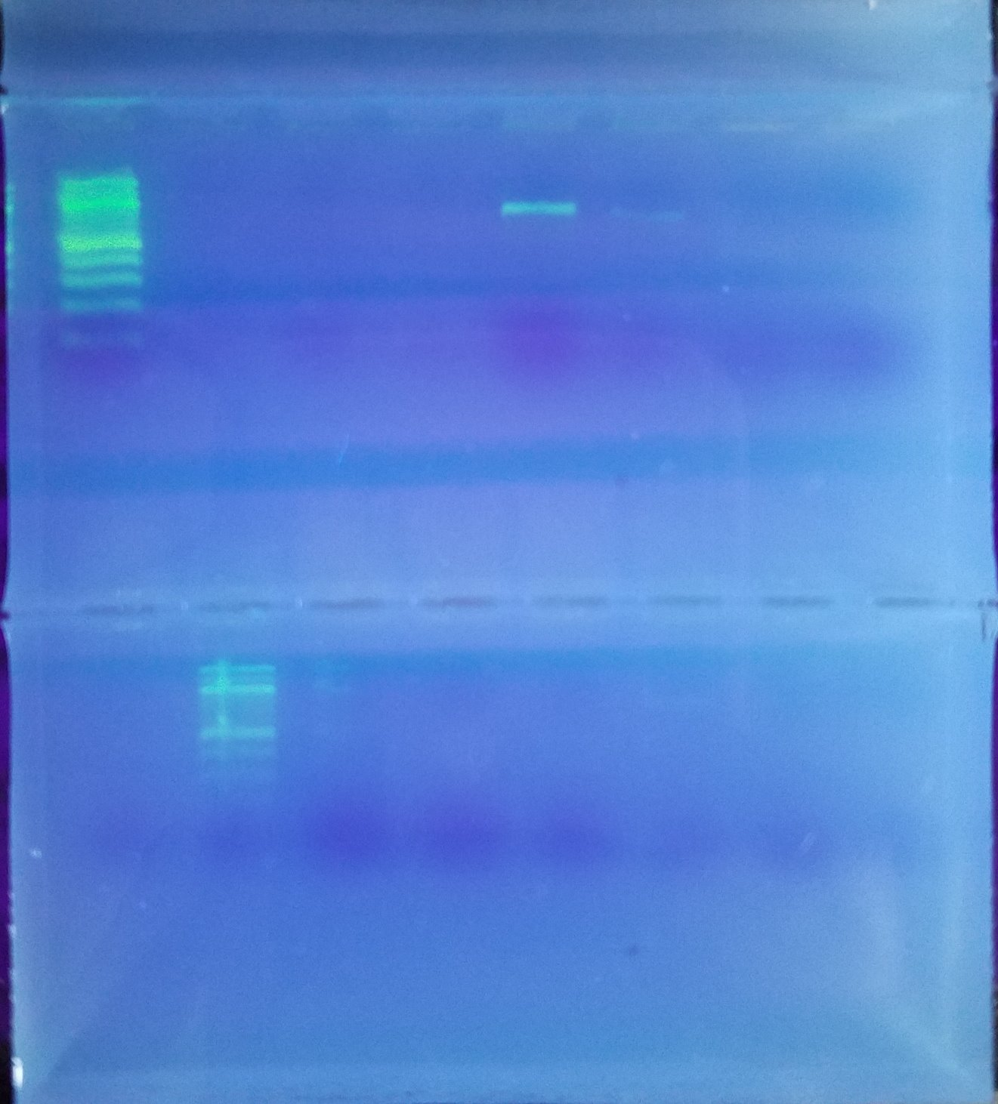
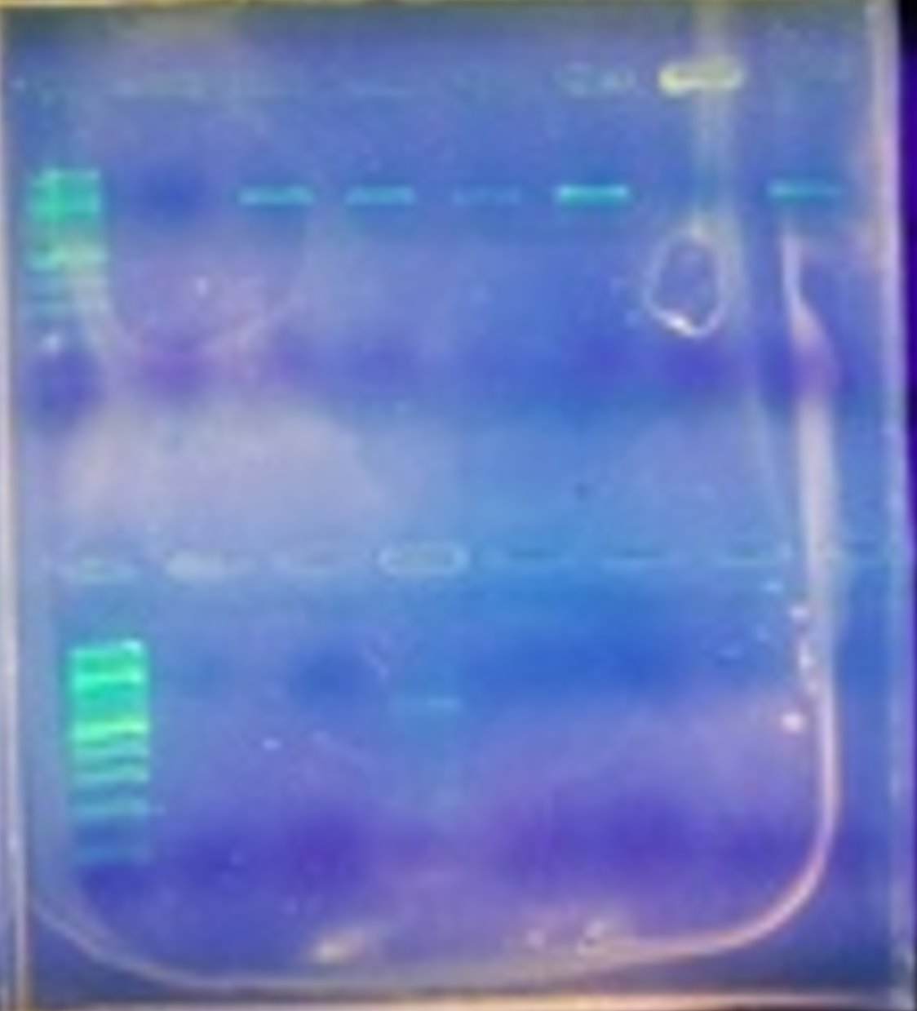
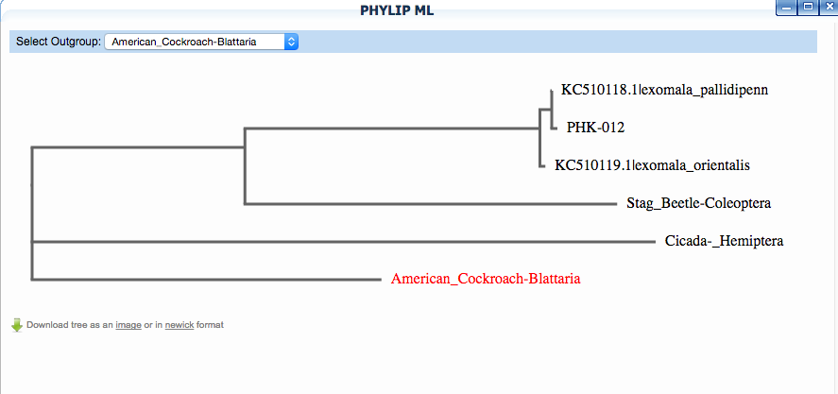
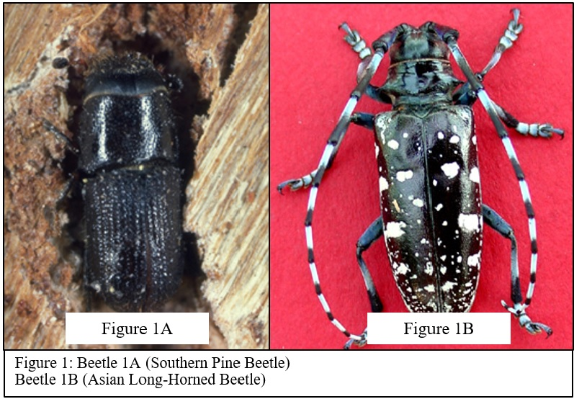
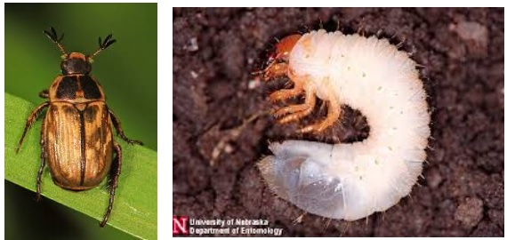
Are Those Beetles Eating Our Trees?
Authors: Ryan McClernon and Santiago Zea
Mentor: Mary Simons
Abstract
There are various species that are introduced to different ecosystems and countries every day. These species can be harmful to ecosystems they don’t belong to. Beetles are not an exception. An example is the Asian Long-horned beetle, which was accidentally introduced to the US in 1996. This specimen caused many environmental problems such as eating different hardwood trees including Birch, Maple, and Ash. The goal of our research is to observe the biodiversity of beetle species in Seaford parks and to identify if there are any invasive beetle species harming the environment of these locations. We hypothesize that there is diversity among beetles on Long Island's parks.
Introduction
Beetles are one of the most diverse invertebrate species in the world by having almost 350,000 different variations. Beetles are not an exception to forced/accidental introduction to a non-native environment. The identification of all the non-native species is key to prevent environmental problems, to determine where those species are originally from and to hypothesize how they ended up in their new, non-native environment. Beetles are easy to identify; however different beetle species can look very similar. DNA barcoding is the most helpful tool to identify all beetle variations present within an ecosystem. Barcoding is a Taxonomic tool used by specialists to easily identify species that may look similar in appearance but are different genetically speaking.
Collecting & Documenting Beetles Materials
Trowel/ Shovel
Sealable plastic bags
Labels
Centrifuge tubes
Microscope
Camera
Beetles
Wet Lab Procedure
Results
Of the 2 samples, PHK-010 and PHK-012 two samples that were submitted for sequencing, only PHK-012 produced a positive result. We concluded that PHK-012 was most likely a member of the Exomala Pallidipennis species, as it was only one mismatch away from the species.
Discussion
We cannot conclusively say that Seaford is home to invasive species, as only one of our 12 samples were sequenced. If given more time and if the weather had been permitting than we may have identified a more biodiverse beetle population and may have identified an invasive species.
References
https://evolution.berkeley.edu/evolibrary/article/side_O_0/beetles_01
https://www.dec.ny.gov/animals/7255.html
http://www.columbia.edu/itc/cerc/danoff-burg/invasion_bio/inv_spp_summ/Anoplophora%20glabripennis.html
https://www.dec.ny.gov/animals/99331.html
https://www.longislandarborists.org/ViewPost.aspx?id=0831a4c7-fffc-4cad-ba53-e883409f6726
Ladder Negative
Control
008 009 010 011
Figure 3A: This is a photo of
The gel containing sample PHK-010
Figure 3B: This is a photo of the gel containing sample PHK-012.
Figure 4: This is a consensus graph showing that the PHK-012 sample is closely related to Exomala Pallidipennis.
Ladder
001 012 003 004 005 006
Figure 2: Photos of Exomala Pallidipennis in its adult and larvae stages
Figure 5: This is a phylogenetic tree showing that the PHK-012 sample is closely related to Exomala Pallidipennis and Exomala Orientalis, both of which are descendants of the very common Coleoptera beetle. We used the American Cockroach as out outgroup, since it has similar phenotypic features to the Beetle, such as an invertebrate and an exoskeleton.
Collection of beetles in 2 different parks.
Isolation and DNA purification
DNA amplification by using COI and Primers
Preparation for Gel Electrophoresis
30 cycles of PCR
Addition of loading dye to DNA samples
Gel Electrophoresis
Loading of samples and running the gel
Successful PCR results were sent for further sequencing

