Slide 1
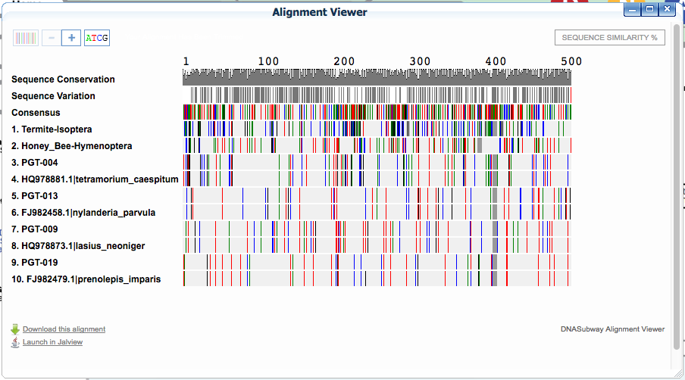
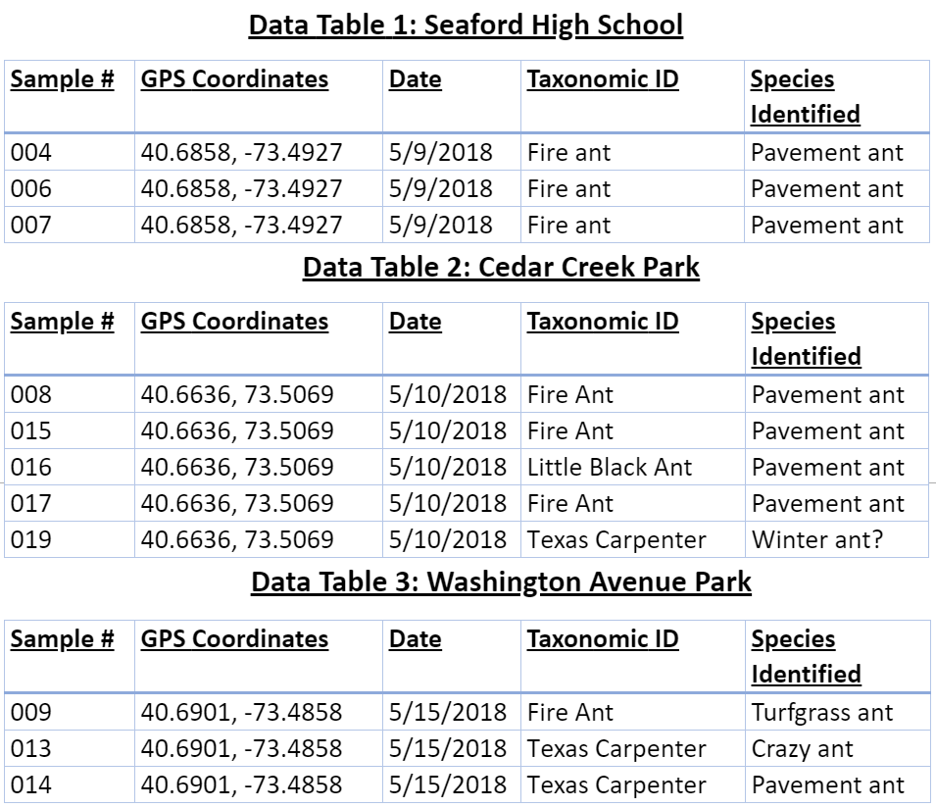
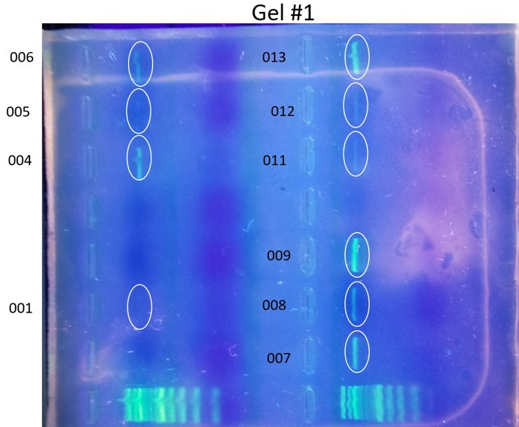
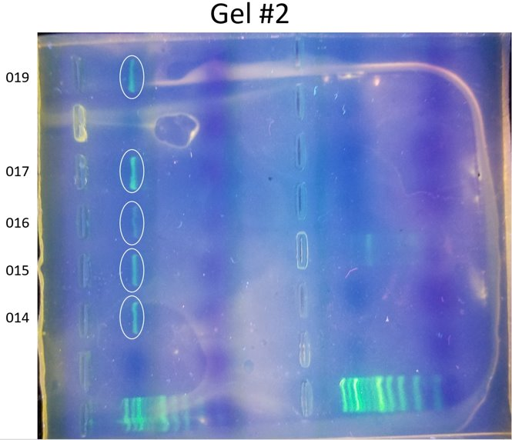
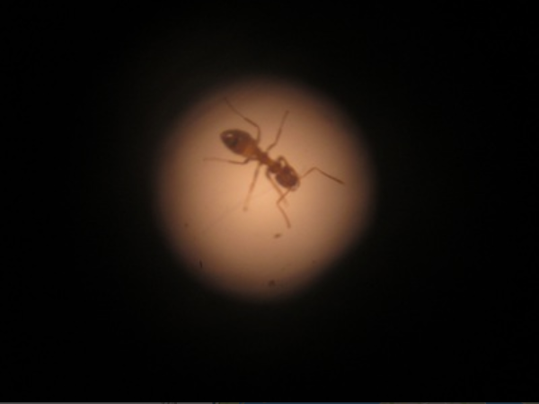
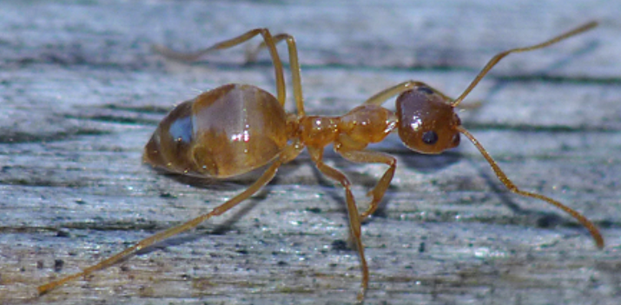
Ants Effect on Soil Composition
Cailin Foster, Julia Martorana
Mary Simons
Seaford High School
Abstract
Ants are found in many common areas inhabited by humans such as parks and fields. These insects can influence the soil that they live in through the compounds they release in feces. We hypothesize that based on the species of ant, the soil containing ant remains would have a different pH than soil not containing ants or ant remains. We intended to determine which species of ants were present in the locations we collected from using the methods of PCR and gel electrophoresis. It is difficult to tell the difference between species which similar traits. We will attempt to identify the species based on their individual characteristics, however sequencing will prove to be more accurate. Then, we planned to use a soil testing kit on the remaining soil to determine the different amounts of compounds and pH of the soil.
Introduction
Ants are present in most places habited by humans, which includes soil in gardens where crops and food are planted. As ant's release feces and other remains in the soil, it can affect its make-up. Following, the new, effected soil can be harmful to the plants that grow in it and the people who eat the products. One source, "Pavement Ants and How to Prevent Them" states that "pavement ants are not known to transmit any diseases to people but will contaminate food and food prep areas while foraging for food."(CITATION) We would like to answer the question of what exactly the soil contains from the ants, so we can determine the effect it has on the foods we eat. If the food is contaminated with certain compounds found in the soil, there can be many health issues spread to humans. Once we collected our ant's, we sequenced their DNA. This step was important for identifying similarities between the ant's, and the number of different species in a given collection site.
Results
Through our results we found a direct relationship between species PGT004, and the Tetramorium caespitum also commonly known as the Pavement Ant where 8 ants were found. Another direct relationship was found between species PGT013, and the Nylanderia Parvula also known as the Crazy Ant. Species PGT009, and the Lasius Neoniger also known as the Turfgrass Ant. We also found that PGT019 was closely related to Prenolepis Imparis known as the Winter Ant, but had a mismatch on one base pair.
Step 1:
Extract & Purify DNA
300ul Lysis Solution
3ul Silica Resin
500ul Wash
100ul dH20
Step 2:
PCR Amplify
PCR Bead
3ul DNA
22ul COI Primer
30 cycles PCR
Step 3:
Gel Electrophoresis
5ul DNA
2ul Sybr Green
Discussion
Based on these results, we can conclude that three out of the four species shown on the graphs can be positively identified. However, specimen PGT019 does not exactly match the species most closely related to it. We think that this may be because of a base mispairing or a possible gene mutation. If not found at another database we may conclude this specimen to be a novel or invasive species.
References
The Good and Bad News About Ants and Plants (https://web.natur.cuni.cz/~herben/pdf/pb05.pd)
(https://animaldiversity.org/accounts/camponotus_pennsylvanicus)
(https://westernpest.com/locations/new-york/ants)
(https://suburbanexterminating.com/pst-identification/profile/pavement-ants)
Acknowledgements
We'd like to thank our mentor Mary Simons, and Seaford High School for supporting and helping us find some conclusive ending to this interesting experiment, and to determine the diversity of our found ant specimen. We would also like to thank Cold Spring Harbor Labs, Brookhaven National Labs and all of the sponsors of the Barcode Long Island program.
(Our commonly found Pavement Ant)
(The Winter Ant possible species for PGT019)

