Slide 1
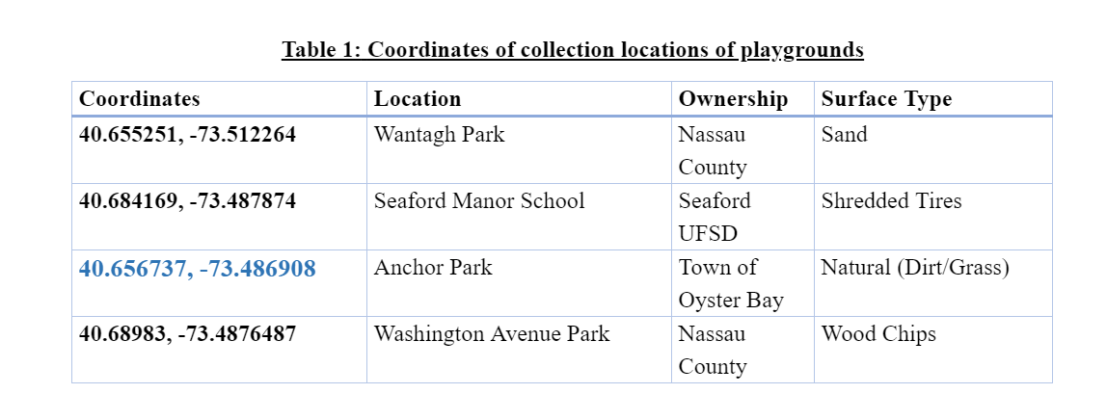
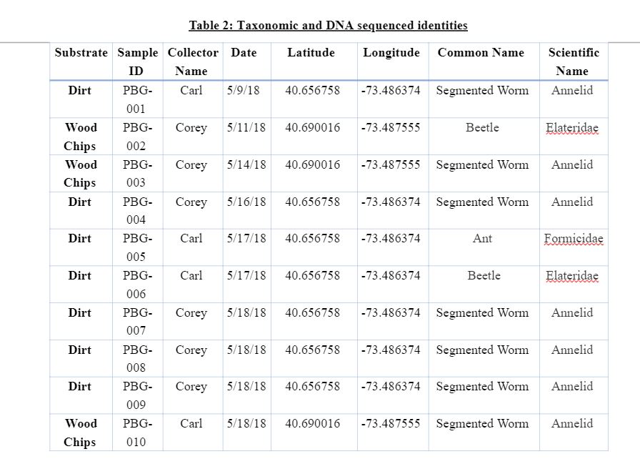
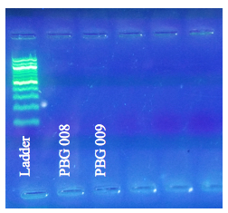
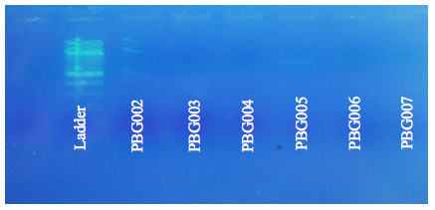
The Various Effects of Playground Substrates on Invertebrates
By Carl Bloom and Corey Marks Mentors: Janine Cupo and Mary Simons
Abstract
There are many different types of substrates that are used in playgrounds as a safe place to fall and not get hurt. In our project we surveyed four different types of playground substrate, which are rubber tires, wood chips, sand, and soil (our control). Our question is which invertebrates will we find and how do they differ from each other. The purpose is to identify the different invertebrates in each substrate material. We identified the invertebrates by first collecting them and taxonomically identifying based on physical characteristics. We then extracting their DNA, amplified a highly conserved gene (COI) and then had them sequenced. We ended up finding 10 organisms in all the substrates, most coming from the soil, and some from the wood chip substrates, most of which were Annelids. (Figure 1). None were from the sand or tires. This meant that the sand and rubber were less likely to have invertebrates in them. However, due to a problem during the purification and amplification of the DNA, we were not able to have any of our samples sequenced.
Results
Throughout this experiment we found ten invertebrates, however from only two of the substrates, the wood chips and soil. Out of the ten we found most of them seemed to be of the same species which looked like a type of Annelid. (Figure 1). Unfortunately, there was a complication with either the PCR of the DNA extraction or when we were loading the DNA into the gel, not allowing us to have any of our samples to be sent out for sequencing.
(Figure 1). This is one of our samples that we collected from the dirt substrate that we taxonomically identified as a segmented worm.
Introduction
The purpose of this study was to identify the different variety of invertebrates found in each of the four substrate materials. We expected to find different species of invertebrates because of the different properties of the substrates. In this experiment we surveyed a variety of substrates, looking for invertebrates (Figure 1). The four substrates that we surveyed were: woodchips, shredded tires, sand, and soil. The rubber tires were composed of the rubber compounds are made up of elastomers, reinforcing fillers, plasticizers and other chemical elements. The wood chips are made from old trees. The soil was used as a control. We predicted there to be few, if any, organisms in the tires. The organisms we expected to find in the sand were pill bugs and sand fleas because these are commonly found in sand₍₂₎ ₍₃₎. In the woodchips, we expected termites because they eat wood. We predicted that the soil would have the largest variety of invertebrates. We compared our findings to what we found naturally occurring at the control playground. The different substrate materials may have an adverse effect on human health as well as the environment. The reason for this is that certain invertebrates can cause a threat to the children on the playground by transmitting diseases when they bite. This can make the shredded rubber tires the best substrate material because if there are few invertebrates in the tires, it could be the safest for children.
(figure 2). This table shows the locations from where we collected our substrates
Discussion
Our findings support out hypothesis and do not support it at the same time. We didn’t find any organisms in the shredded rubber tires, but we also didn’t find any in the sand, in which we were expected to find organisms. For the wood chips we only found the worm like organisms and not any termites. However, we were correct in the natural soil having the highest organisms count out of the four substrates. For further research, we would collect during the summer and not during the spring and winter due to the weather not cooperating with us with the large periods of rain and the ground being frozen. Also, we would further purify our samples to get better results for sequencing because our bands were the correct size just the samples were too dilute to be sequenced.
(Figure 5). This is the other picture with the rest of our samples in the second gel.
(Figure 3). This table shows all of our samples and their taxonomic identities
Methods and Materials
(Figure 4). This is a picture of one of our gels that has the ladder and two of our samples.
Collect samples by placing a 15cm scoop of soil into a labeled zip lock bag
Take Photos and taxonomically identify the organisms found
Store organisms in at -20˚C and prepare them for DNA extraction
Use tweezers to collect invertebrates from substrate.
Extract and purify the DNA
References
1)Janzen, D.H., Hallwachs, W, Burns, J.M., Hajibabaei, M, Bertrand, C, Hebert, P.D.N. (2011 August 16). Reading the Complex Skipper Butterfly Fauna of One Tropical Place. US National Library of Medicine National Institutes of Health. 6(8). Retrieved from https://www.ncbi.nlm.nih.gov/pmc/articles/PMC3156701/
2)Sand Dwellers. Explore Beaches. Retrieved November 15, 2017 from http://explorebeaches.msi.ucsb.edu/sandy-beach-life/sand-dwellers
3)Sand Fleas – What Are They and How Do You Get Rid of Them. Fleabites.net. Retrieved November 15, 2017 from http://www.fleabites.net/sand-fleas-what-are-they-and-how-do-you-get-rid-of-them/
4)Thorne, K. (12 July 2016). Rubber mulch on LI children's playgrounds raising health concerns. ABC7. Retrieved November 8, 2017 from http://abc7ny.com/health/rubber-mulch-on-childrens-playgrounds-raising-health-concerns/1423800/
5)Playing with Danger: Germy Playgrounds. Retrieved November 9, 2017 from http://abcnews.go.com/GMA/OnCall/story?id=3565507&page=1
6)Anatomy of a Tire. (November 8, 2011). Retrieved November 9, 2017 from http://infohouse.p2ric.org/ref/11/10504/html/intro/tire.htm
7)El-Faizy, M. (September 9, 2011). Is This Playground Safe? Many of the Recreation structures in city parks are treated with a potentially dangerous chemical. Daily News. Retrieved from http://infohouse.p2ric.org/ref/11/10504/html/intro/tire.htm
8)Booker, N.M., Fox-Rawlings, S. Children and Athletes at Play on Toxic Turf and Playgrounds Retrieved November 10, 2017 from http://infohouse.p2ric.org/ref/11/10504/html/intro/tire.htm
DNA is sent out to GENWIZ for sequencing
Take photos and upload gels
Perform Gel Electrophoresis
Perform PCR by using the CO1 primer

