Slide 1
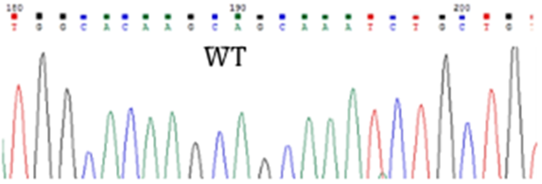
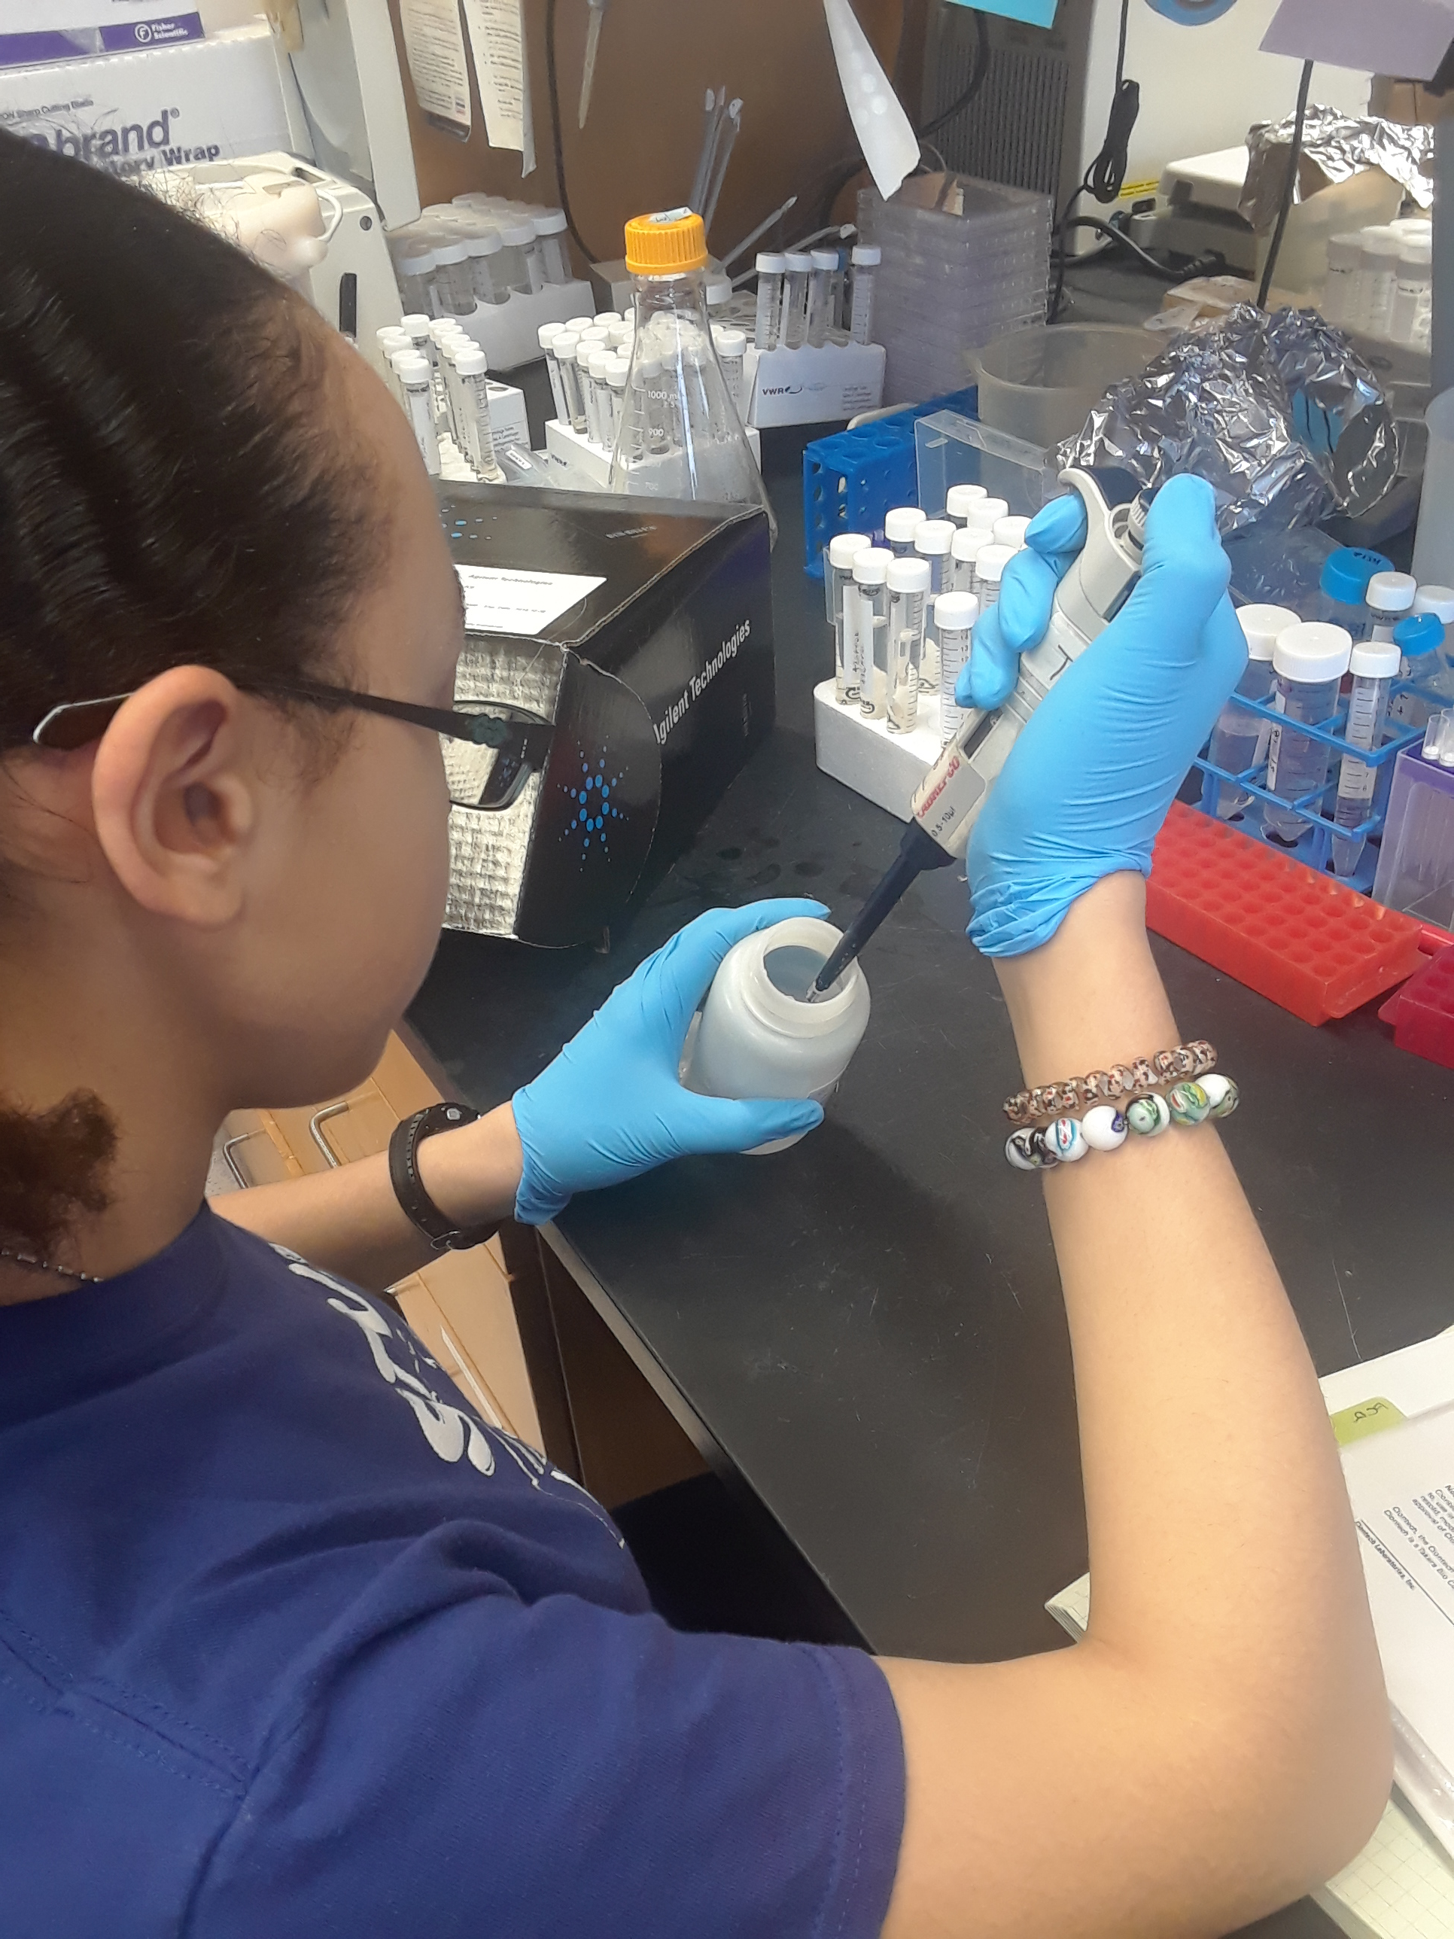
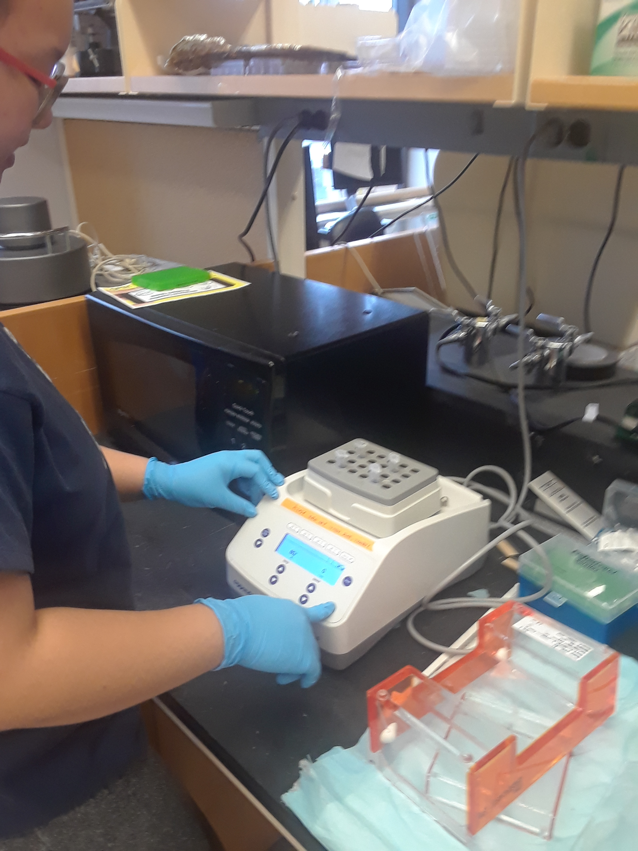
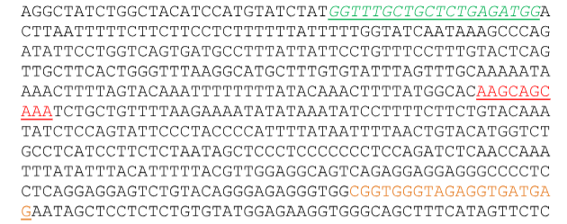
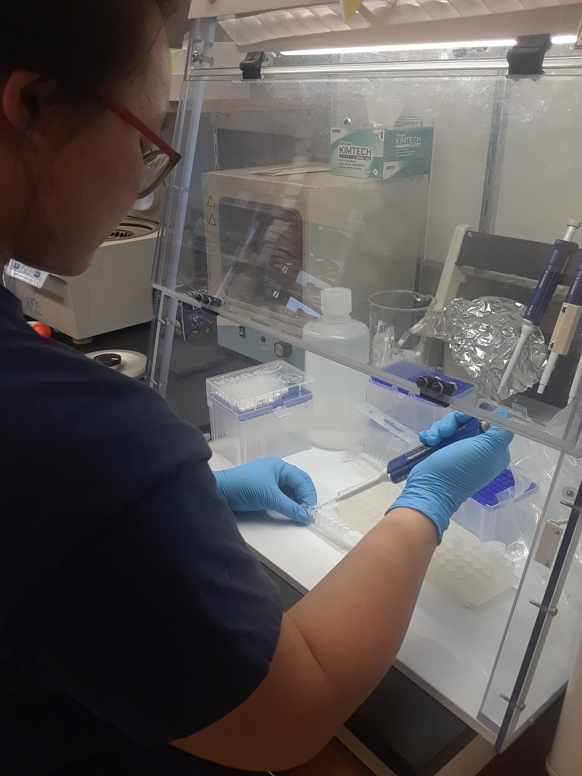
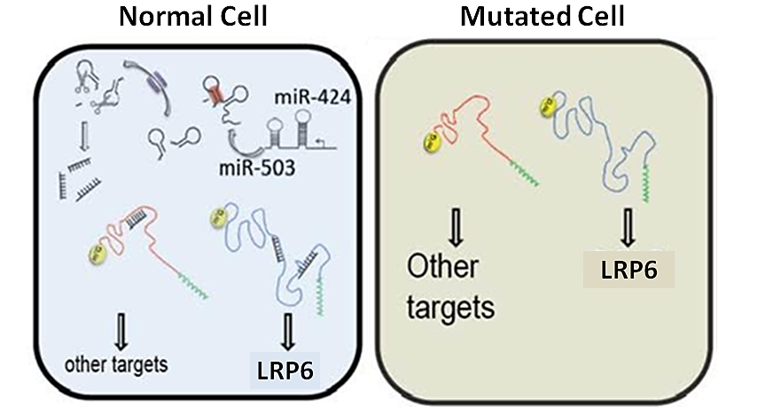
Determining if WNT signaling is deregulated in breast cancers by
altering the interaction between LRP6 and miRNA-424(322)/503
Funded by:
Authors: Lokhay Chan¹, Elizabeth Doss²; Mentors: Dr. Jose Silva³, Tizita Zeleke³
¹ Brooklyn Technical High School, ² Stuyvesant High School , ³ Icahn School of Medicine at Mount Sinai
Abstract
Breast cancer is one of the most common forms of cancer in women of age 40 to 70 years old. There is currently no concrete solution for the disease, like radiation or chemotherapy but numerous organizations have been working at finding ways to cure it. One of the major negative manifestations of the disease is alterations in WNT signaling patterns. WNT signaling pathways are a group of signal transduction pathways that pass information from cell to cell with cell surface receptors. One gene, LRP6, is a key component of WNT signaling as it produces the LRP6 protein. Our lab at Mount Sinai Research Hospital has identified a microRNA, miR-424(322)/503, has shown to be deleted in 20-30% of tested breast cancer cases. This miRNA is responsible for hindering the transcription of LRP6 messenger RNA. The deletion of this miRNA has shown elevated levels of WNT signaling which is positively linked with the development of breast cancer. Our experiment involves the possible mutation of the miR-424(322)/503 binding site in breast cancer cells. We hypothesized that breast cancer cells experience upregulation not only due to the deletion of miRNA, but also a mutation in the binding site of the LRP6 gene. Our project explored this hypothesis by growing and sequencing various breast cancer cells provided by the lab. These cells were cultured and preserved before the DNA extraction occurred. Isolating the DNA then allowed us to perform a PCR of the miRNA-424(322)/503 binding site using custom primers for the LRP6 gene. Purifying and verifying the DNA with an agarose gel, it was then able to be sent to sequence. Upon receiving the results it was deduced that the majority of the samples did not have any gene mutations in the miRNA. One, however, was mutated of the twenty-nine samples, possibly representing a small percentage of breast cancer cases. This information could be expanded at Mount Sinai to explore the presence of similar mutations in primary breast tumors and to functionally interrogate the found mutations.
Introduction
In order to understand the purpose of our experiment, it is important to grasp the concepts of WNT signaling and their implications on human cell functions. WNT signaling regulates various aspects of cell fate determination, cell migration, cell polarity, neural patterning and organogenesis during embryonic development ^{[1]}. For this reason, genes controlling these pathways are considered oncogenes, or cells capable of transforming into tumor cells, because of their heavy role in apoptosis. Low-density lipoprotein receptor-related protein 6, or LRP6, is a protein coded by the LRP6 gene that is a key component of WNT signaling. The LRP6 gene is responsible for coding the protein and achieves this by transcribing RNA and sending them to proteins for translation ^{[2]}. MicroRNA, or miRNA, are non-coding portions of DNA that are usually about 20 nucleotides long. They function in RNA silencing and post-transcriptional regulation of gene expression ^{[3]}. RNA silencing is one of the most important things regulated by microRNA because without an interference, genes would keep producing RNA to be transcribed when there is too much that could end up harming the cell ^{[4]}. It was observed in our lab at Mount Sinai Research Hospital that miRNA deletions were present that affect the LRP6 gene in 20-30% of breast cancer cases ^{[5]}. This is important because the miRNA are not present in the chromosome in order to regulate the transcription of messenger RNA. RNA silencing can not occur, so the LRP6 gene produces increased amounts of mRNA without opposition (see Figure 1). This is extremely dangerous for the cells because it increases the likelihood of developing or intensity of breast cancer ^{[6]}. Based on the findings in the Mount Sinai study, we decided to explore the possibility that upregulation is caused due to a mutation in the miRNA-424(322)/503 binding site in addition to the miRNA deletion.
Materials & Methods
Twenty-nine cell lines were first thawed and cultured in
order to obtain as much DNA as possible. Leaving the cells in
a warm water bath at 37℃ for two minutes, 15 mL conical
centrifuge tubes were prepared and labeled properly. 1 mL
of cells were then transferred into each conical centrifuge
tube with 5 mL of phosphorous-buffer solution (PBS).
Centrifuging for 5 minutes at 1200 rotations per minute
(rpm) caused a pellet of cells to form that could be isolated
from the supernatant with a vacuum. The addition of 10 mL
of medium to the pellet resulted in a mixture of cells which
were transferred from the conical tubes to 10 cm plates (see
Figure 2). We then left these plates in an incubator for a week and viewed the growth of the cells under a microscope.
If they were confluent enough, we proceeded to freeze and preserve them; if they weren’t we changed the medium in the plate and leave them to grow for another week. To freeze he cells, they first needed to be detached from their plates After vacuuming the medium out, the confluent cells twice with 5 mL PBS. Rocking the plates slowly, 2 mL of 0.05% trypsin solution was added to carefully detach the cells from the plate. Additionally, the plate was placed in the incubator and sat for 2 minutes to ensure the cells were all detaching. Then using the 1000 µL pipette, the edges of the plate were scraped and the liquid transferred into a labeled 15 mL conical centrifuge tubes. 5 mL PBS was then added to the empty plate to ensure all cells were picked up and to neutralize the trypsin. Centrifuging for 5 minutes created a pellet that contains the cells so the supernatant was vacuumed out again. The pellet was then suspended in 1 mL PBS and transferred to a labeled Eppendorf tube. The tube spun for 5 minutes at 2.9 x g rpm on the table-top centrifuge. The supernatant was then removed with the vacuum and the tube dropped into a bucket of liquid nitrogen until needed for extraction. We then froze and preserved them for DNA and RNA extraction; if not the medium would be changed and left to culture for another week.
The DNA extraction entailed us to take the cells from the nitrogen and prep them for PCR. Following the steps of an Agilent kit, we first resuspended the cells in 200 µL of PBS to wash it. We spun the tubes for 5
minutes in a 4℃ centrifuge at 3.5 x g. We then made a
Pronase solution using the kit with a ratio of 0.44 µL
pronase per mL of Solution 2 (see Figure 3). Adding 110 µL
at a time, the cells and pronase solution were mixed until
the cloudy gel-like substance turned clear and usable. The
tubes then spun for an hour at 800 rpm and 60°C (see
Figure 4). They were left to chill for 10 minutes on ice,
combined with 40 µL of Solution 3, and left to chill again
for 5 minutes. Spinning them in the 4°C centrifuge for
15 minutes at 2.0 x g then prompted the addition of
RNAse serving to remove the last of the non-DNA
fragments. 2 µL of RNAse was added per mL in each tube.
They were then incubated for 15 minutes at 37°C. Next, double the amount of 100% alcohol was added and the tubes were inverted so that a strand of DNA was visible. It was verified by spinning in the 4°C centrifuge for 10 minutes at 17.0 x g. All the supernatant was carefully dumped out while the DNA remained stuck to the bottom of the tube. 500 µL was added to the DNA to clean it then spun for 2 minutes at 17.0 x g in the 4°C centrifuge. Drying out the DNA and resuspending in 100 µL distilled water gave us our final product of DNA. Concentration was devised and stored by using NanoDrop software in the lab. This process was done with all the cell lines. When all was prepared, we set up the conditions to perform PCR and amplify the DNA (see Figure 5). The PCR was achieved with three steps: activation, denaturation, and final elongation. We set activation for 3 minutes at 95°C. Three steps comprise the next step which include denaturation, annealing, and elongation each of which occurred for 30 seconds. Elongation occurred at 72°C while the former two were tested using 58.6, 60.4, and 61.0°C. It was found that 58.6°C was the ideal temperature where our bands were clear and accurate against a DNA ladder when an agarose gel was prepared.
We prepared this gel by adding 2 g of agarose to 100 mL of Tris-acetate-EDTA (TAE) buffer. It was swirled and microwaved for 2 minutes until it was close to boiling. Wearing EtBr gloves, the beaker was cooled and swirled in cold water until it could be held in our hands. 4.5 µL of ethidium bromide was then added to the solution and placed in a mold with a comb. After all bubbles were shifted, to prevent difficulties in visibility, the gel was left to
cool for 20 minutes. Once solid the gel was placed in the electrophoresis tank, 10 µL test samples were loaded into it along with 2 µL of loading dye in each, a negative control, and two DNA ladders for reference. Here, we were able to see that the conditions were optimal for performing PCR on the rest of the cells.
We proceeded to PCR all of the DNA and repeat the process above: creating a gel or reusing old ones by saving and microwaving them. Our data appeared clear from the visible bands after shining UV light on the gel through Quantity One software (see Figure 6).
The DNA was then sent to be sequenced by Cold Spring Harbor Laboratory and the data received shortly after was analyzed, interpreted, and compared to a wild type sequence.
Results
By sequencing the data we concluded that in the majority of cases, the miRNA-424/503 sequence is not mutated in the LRP6 gene of breast cancer cells. Inputting, trimming, and comparing data on DNA Subway showed us that almost every single one of our test cases were replicas of the wild type data found on GenBank. miRNA-424(322)/503 normally has a sequence of 5'-AAGCAGCAAA (see Figure 7). Twenty-eight of the samples were found to have this exact duplicate between the given primers (see Figure 8).
However, there was one outlier that could encourage further study of the LRP6 gene and our research topic (see Figure 9).
Sample #3 was found to have an undoubtable point. Rather than the aforementioned sequence, it had one of 5'-AAGCAGCAAG. The last adenine base was replaced with a guanine base. Lab conditions prevented differences in the collection of data, so it is unlikely that human error caused this alteration. Thus, it was concluded that the majority of cases showed no change in the sequence while in one there was a mutation that supported our hypothesis. Additional studies will follow up our finding to explore the presence of similar mutations in primary breast tumors and to functionally interrogate the found mutations.
Discussion
Cancer-relevant genes and pathway are mutated through a large variety of mechanism. Here, we demonstrated, for the first time, that the critical control that the tumor suppressor miR-424(322)/503 exerts the WNT-signaling can be disturbed in cancer cells not only by deleting the miR but also by mutating its binding site on the LRP6 gene. Our initial studies have used a large series of breast cancer cell lines as these experimental models fairly recapitulate multiple characteristics of primary human cancers. Additionally, a larger mutation burden is found in these cells that facilitate identification of new alteration. Thus, although our results have found previously unknown alterations in breast cancer cells follow up studies will be necessary to 1) functionally study the identified mutations and 2) investigate the presence of analogous alterations in primary human cancers.
References
[1] Komiya, Y. & Habas, R.. (2008). WNT signal transduction pathways. Organogenesis, 4(2), 68-75. Retrieved from https://www.ncbi.nlm.nih.gov/pmc/articles/PMC2634250/
[2] LRP6 gene - Genetics Home Reference. (2018). U.S. National Library of Medicine. Retrieved from https://ghr.nlm.nih.gov/gene/LRP6
[3] Weiss, C.N. & Ito, K.. (2017). A Macro View of MicroRNAs: The Discovery of MicroRNAs and their role in Hematopoiesis and Hematologic Disease. International Review of Cell and Molecular Biology, 334, 99-175. Retrieved from https://www.sciencedirect.com/topics/neuroscience/microrna
[4] Susi, P.. (2007). RNA silencing as a general defense mechanism against pathogens. Elsevier, 315-325. Retrieved from https://www.sciencedirect.com/topics/neuroscience/rna-silencing
[5] Llobet-Naves, D., Rodrigues-Barrueco, R., Iglesia-Vincente, J., Olivan, M., Castro, V., Saucedo-Cuevas, L., Marshall, N., Putcha, P., Castillo-Martin, M., Bardot, E., Ezhkova, E., Iavarone, A., Cordon-Cardo, C. & Silva, J.M.. (2014). Molecular and Cellular Biology, 34(23): 4216-4231. Retrieved from https://www.ncbi.nlm.nih.gov/pmc/articles/PMC4248740/
[6] Pohl, S., Brook, N., Agostino, M., Arfuso, F., Kumar, A.P. & Dharmarajan, A.. (2017). Wnt signaling in triple-negative breast cancer. Oncogenesis, 6(4). Retrieved from https://www.nature.com/articles/oncsis201714
Acknowledgements
Thank you to Tizita Zeleke and Dr. Silva for teaching, helping, and supporting us. Special thanks to Cold Spring Harbor Laboratory and the Pinkerton Foundation as well as the Urban Barcode Research Program for funding this project.
Figure 2: Preparing plates to grow the cancer cells
Figure 10: This graph shows the exact location where the mutation was found in Sample 3 compared to the wild type. The nucleotides above are different and the graphs show different colored peaks at the locations highlighted by the arrows.
Figure 6: DNA in the agarose gel all are about 500 base pars in length and have decent purity. This shows that the samples are ready to be sent for sequencing.
Figure 3: Using the Agilent DNA kit during extraction
Figure 7: Original, known sequence of DNA where green = forward primer, yellow = reverse primer, and red = desired region that will be observed for mutations
Figure 4:Tubes able to spin for an hour in 60℃ centrifuge
Figure 8: A randomly chosen sequence, Sample 17, shows no sign of mutation
Figure 9: Sample 3 has a mutation at the very end of the highlighted portion
Figure 1: Normal cell with functioning miRNA vs Mutated cell with nothing stopping mRNA transcription.
Figure 5: Preparing tubes for PCR

