Slide 1
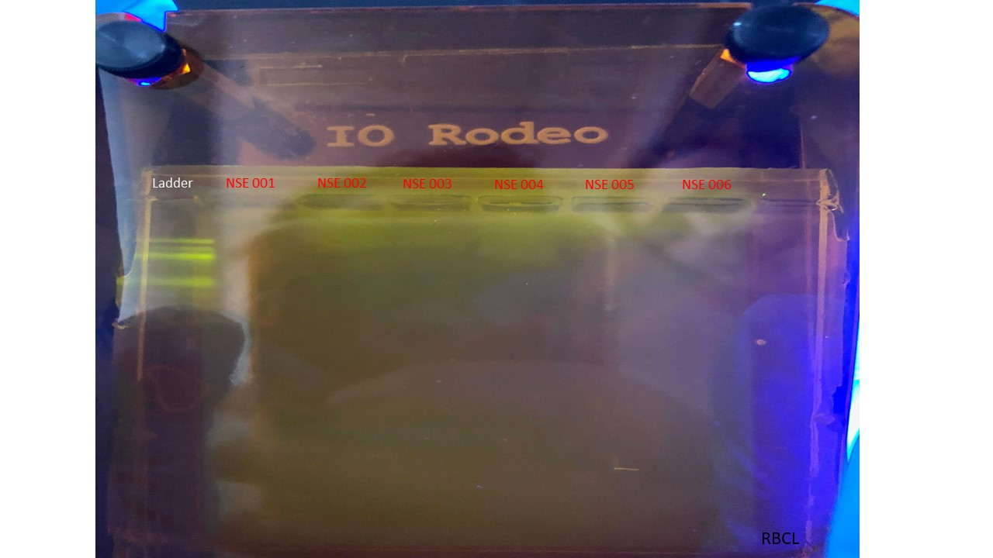
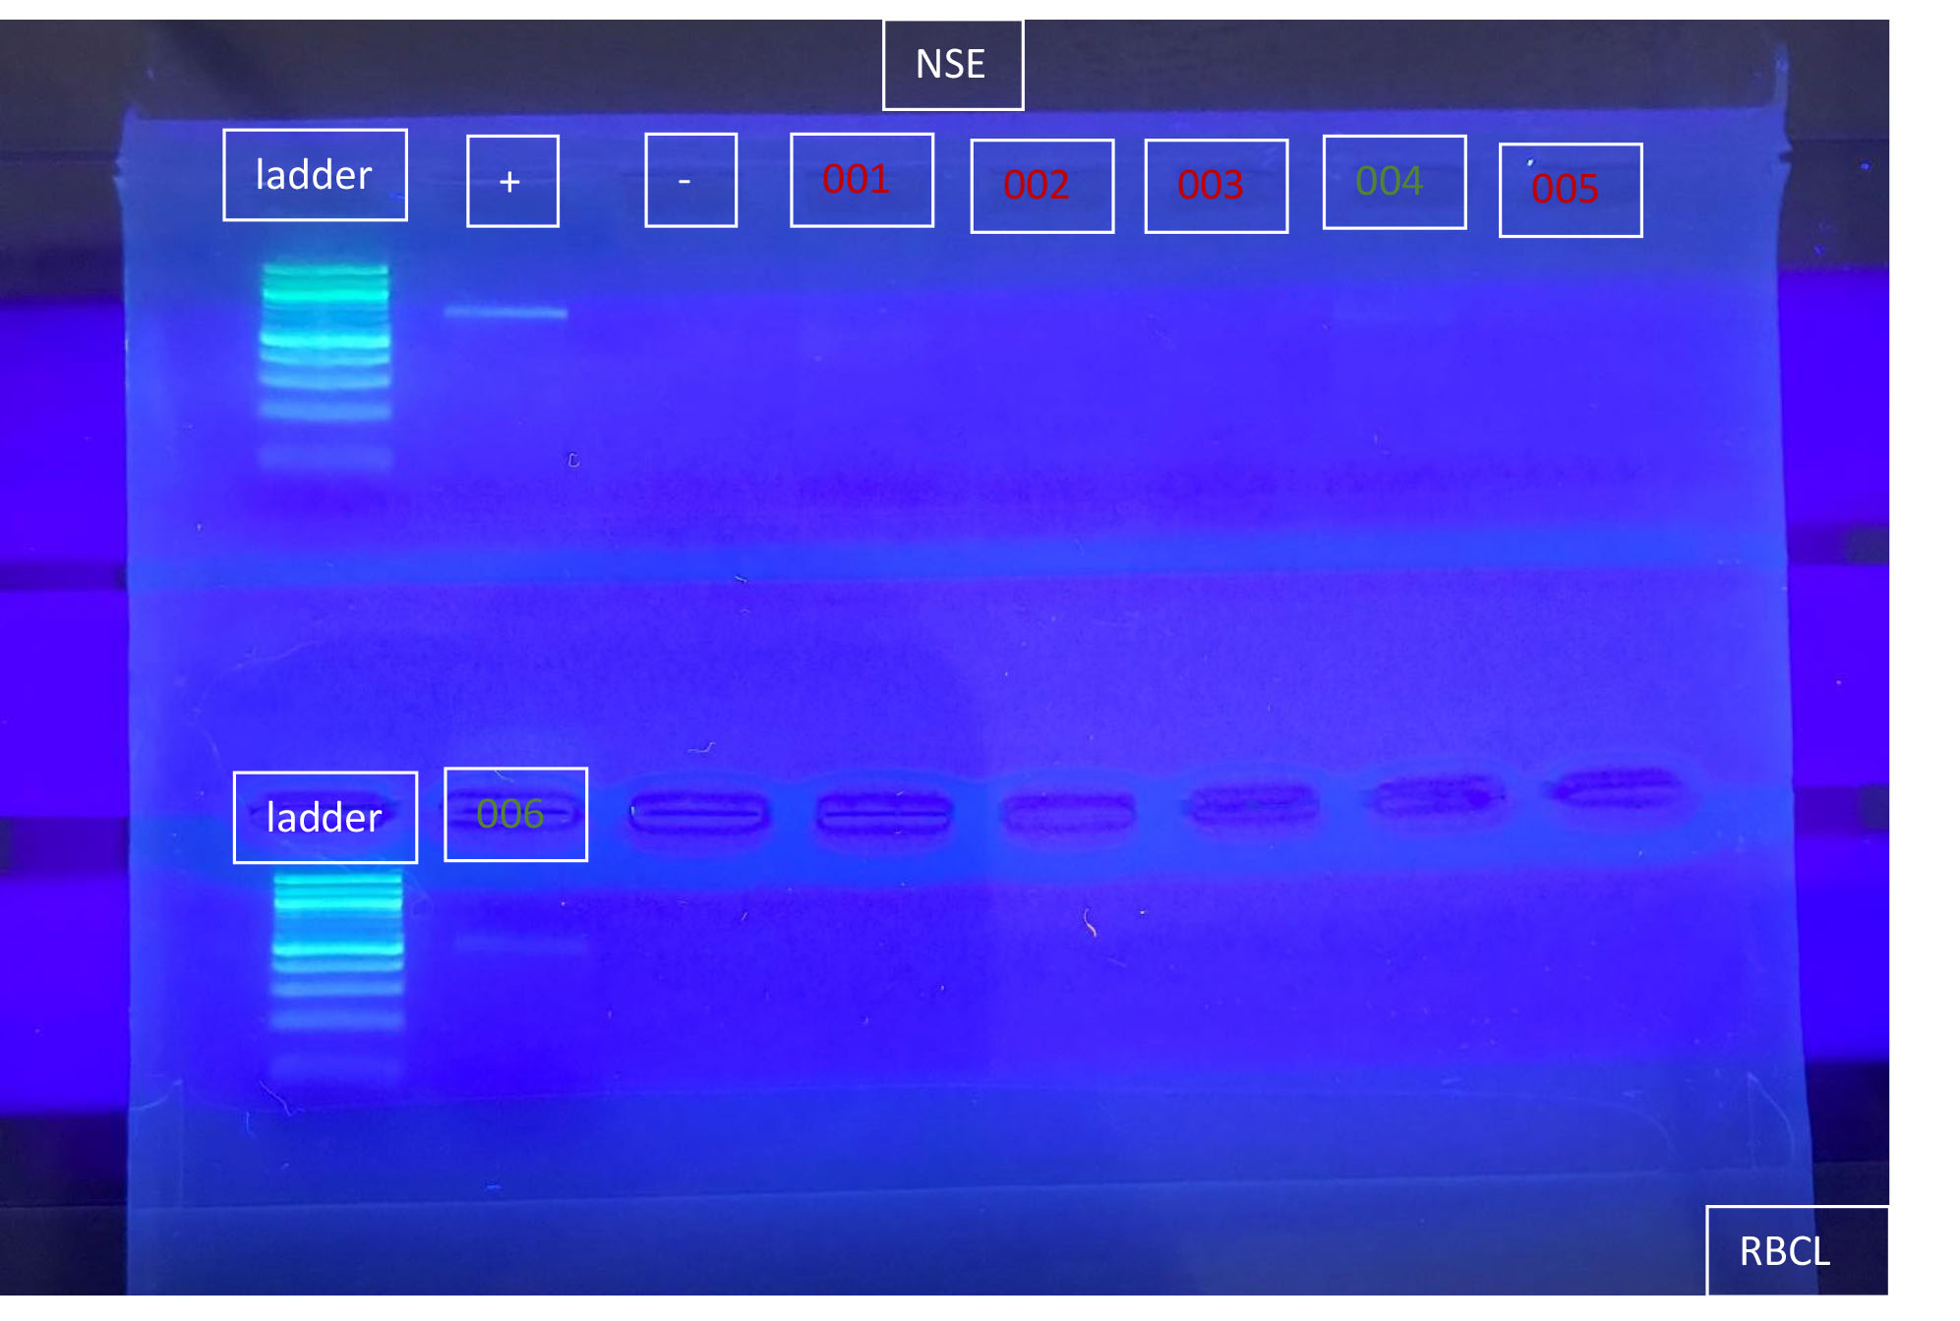
Photosynthetic Marine Growth as Bioindicators for the North and South Shores of Long Island
Abstract
Algae present in the Great South Bay has a negative impact on the ecosystems of the area. Harmful algae blooms cut off the oxygen supply to other organisms. Algae samples were collected from several different boating marinas along the north and south shores of Long Island. DNA was extracted from the samples in a high school setting over the course of 3 days, however PCR was not successful. There was a long amount of time that passed between the first attempt at PCR and the second, which could have caused the DNA to degrade.
Authors: Emily Demieri, Anna Glynn, and Sneha Kumar
Teacher: Mr. Sheltz
Babylon Junior-Senior High School
Results
Results showed that only three out of the eleven samples ended up with DNA sequences. These sequences were NRJ 006, NRJ 008, and NRJ 011 and all of these samples are diverse.
Methods
Algae will be collected from locations on the north and south shore of Long Island. The identification of the algae collected will later be conducted in order to determine the different types of algae found across Long Island.
Samples will be placed in separate, labeled centrifugation tubes. Precautions will also be taken to avoid cross-contamination by cleaning materials with alcohol between samples. Lysis solution will be added to each sample. The tubes will be heated at 65 degrees Celsius, followed by adding RNase to each. The tubes will then be placed in water at 37 degrees Celsius for fifteen minutes. The samples will be cooled before adding protein precipitation to each tube, which will then be stored on ice for five minutes.
Each tube will then be placed in a centrifuge for four minutes. The pellet at the bottom of each tube will be transferred into new tubes. Isopropanol will be added to each, along with supernatant. Each sample will again be centrifuged. After pouring out the supernatant, ethanol will be added to each tube to wash the pellets, and then each will be centrifuged for another minute. Any remaining ethanol will be pipetted out of the tubes. Each tube will then be incubated at 65 degrees Celsius.
The samples will then be put into the PCR tubes. After PCR is completed, loading dye will be added to the samples. The samples will then undergo gel electrophoresis. When sequenced, the algae's genetic sequences will be compared to each other.
Introduction
Algae are organisms that can be commonly found in canals and on docks across Long Island. They have many habitats and are able to thrive in freshwater or in saltwater. They can also endure a range of temperatures, oxygen or carbon dioxide concentrations, acidity and turbidity (livescience.com). Algae are chlorophyll-containing organisms that range from microscopic and unicellular to large and multicellular (encyclopediaoflife.org). Marine algae are essential to many ecosystems of marine life. Algae typically live attached to rocks or other hard surfaces in coastal areas. Algae are generally classified into three groups, red algae, green algae, and brown algae. Species can range in size from very small (3-10 microns) to very large (over 200 feet long) (priweb.org). Brown tide blooms have been present in waters on Long Island such as Eastern Moriches Bay, Quantuck Bay, and the Great South Bay (suffolkcountyny.gov). Areas that have high nitrogen levels often have large algae blooms that become harmful to the rest of the ecosystem. Some pollutants that contain nitrogen and phosphorus are household laundry detergents and commercial fertilizers, which are carried in storm water runoff, along with organic pollution from sewage-related sources including leaky septic tanks and livestock waste (walpa.org).
Algae is used in creating fuel. Harvested, algae can be processed into the raw material to make fuel for cars, trucks, trains, and planes (energy.gov). If the algae of an ecosystem is unhealthy or depleted, it can be determined that the ecosystem is most likely polluted. If there is an abundance of algae, it can be determined that there are high nitrogen levels in the area. Algae is also useful in creating biofuels and has antioxidant and antiviral properties that are beneficial to human health.
Figure 1: The pinpoints on this image are used to represent the locations at which the data samples were collected.
Figure 2: This is an image of green algae that was collected as sample number NSE 001, one of seven algal samples collected in Huntington.
Figure 3: This picture shows the second gel attempt, however the samples could not be sequenced, possibly due to human error.
Figure 4: This picture shows the first gel attempt, however the samples could not be sequenced, possibly due to human error.
References
Algae. Encyclopedia of Life (EOL). Retrieved from the World Wide Web on September 19, 2017.
http://eol.org/info/526
Algal Biofuels. U.S. Department of Energy. Retrieved from the World Wide Web on September 29,
2017. https://energy.gov/eere/bioenergy/algal-biofuels
Bruun, Karl. Algae can Function as Indicators of Water Pollution. Washington State Lake
Protection Association. Retrieved from the World Wide Web on September 29, 2017
http://www.walpa.org/waterline/june-2012/algae-can-function-as-indicatorsof- water-pollution/
Harmful Algal Blooms. Suffolk County Government. Retrieved from the World
Wide Web on October 2, 2017. http://www.suffolkcountyny.gov/Departments/HealthServices/EnvironmentalQuality/Ecology/MarineWaterQualityMonitoring/HarmfulAlgalBlooms.aspx
Marine Algae. Paleontological Research Institution. Retrieved from the World
Wide Web on September 24, 2017. https://www.priweb.org/outreach.php
page=Edu_Prog/s_us_home/s_us_species-marine-life-of-the gulfcoast/s_us_sea
plants/s_us_marine-algae
Vidyasagar, Aparna. What are Algae? . Live Science. Retrieved from the World
Wide Web on September 27, 2017. https://www.livescience.com/54979-what-are-algae.html
Discussion
The DNA from the algae samples was not successfully sequenced or amplified. The PCR process was repeated after the first unsuccessful result. However, the second round of PCR was also unsuccessful. There was a long amount of time that passed between the first attempt at PCR and the second, which could have caused the DNA to degrade and not be viable. The fact that the PCR was not successful could also be due to human error in the procedure of extraction and amplification.
Acknowledgements
Emily Demieri, Anna Glynn, and Sneha Kumar would like to thank, Brookhaven National Labs and the Cold Spring Harbor DNA learning center for the opportunity to participate in Barcode Long Island. They would also like to thank Mr. Sheltz and the Babylon research department for their help with the project.

