Slide 1
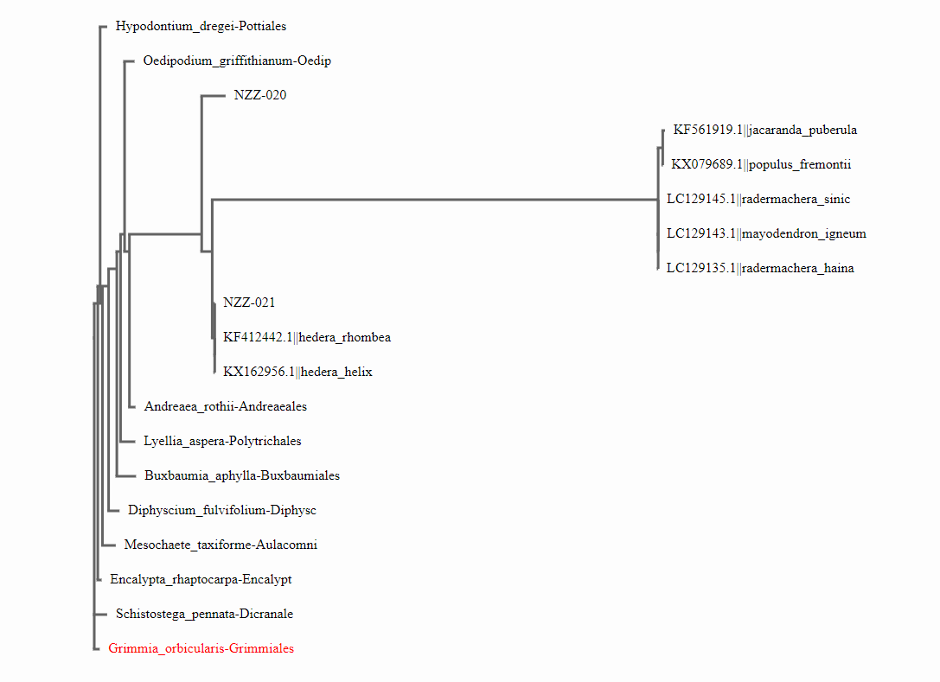
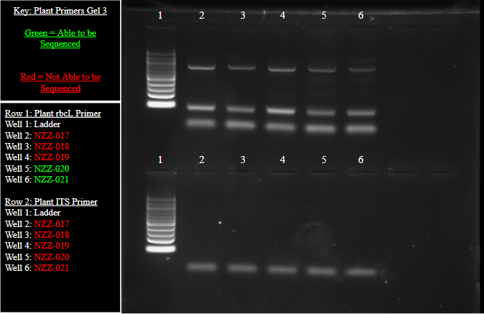
Analyzing the diversity of lichens in Belmont Lake State Park and Sunken Meadow State Park
Authors: Danish Farooq, Gregory Kowalczyk, Michael Steffanetta
Teacher: Andrew Sheltz
Babylon Jr-Sr High School
Abstract
The goal of the project was to identify species of lichen that are difficult to tell apart from other lichen. Lichens are historically difficult to identify with a field guide, unlike other species such as ferns. Lichens are present in various state parks, such as Belmont Lake State Park, and Sunken Meadow State Park. Eight lichen were sampled from each of these parks. Each sample was barcoded, where the rbcL and the IST-1 gene was isolated and then amplified using PCR. After failing to get any sequences, a new 5 samples were collected from Belmont Lake State Park. After undergoing the procedure again, samples NZZ-020 and NZZ-021 were able to be sequenced with the rbcL primer. The sequences were sent to DNA Subway, where they were compared to other species in the database, and the BLAST results were ambiguous since none of them were lichen. The ambiguity was that a species of ivy was barcoded for sample NZZ-021, Hedera helix, yet ivy was nowhere near the sample that was collected. In addition, the phylogenetic tree created showed very minimal relation between the samples alone, thus the genetic diversity of lichen in these two parks can be considered indeterminate.
Introduction
Lichens are a well known yet difficult organism to identify. They are a symbiotic relationship of algae, cyanobacteria, and fungi that play a unique role in the environment. In a field guide, lichens are difficult to decipher from one another because they have similar physical characteristics. There exists 3 distinct growth forms of lichen. One form is crustose; which holds tightly and forms a crust on the surface it grows on. The second growth form is foliose; this growth is attached to the surface by rhizines and it grows off the surface, giving it a leaf like appearance. The third type of growth formation is fruticose; which has a vertical growth pattern with no rhizines and has a bush-like appearance. All of these different forms of lichen have the same factors of cyanobacteria, fungi, and algae that defines them. As for their symbiotic relationship, lichen is a symbiosis between a fungus and a photosynthesizing algae or bacteria. The algae and bacteria provides food through photosynthesis. In return, the fungus provides protective structures, which also gathers moisture, nutrients and provides as an anchor to the environment.
Belmont Lake State Park is an area of about 1.87 square kilometers. The northern portion of the park has Belmont Lake, which is adjacent to the Southern State Parkway. Sunken Meadow State Park has an area of 5.21 square kilometers. Sunken Meadow State Park is adjacent to the Long Island Sound DNA barcoding can be used to see the different lichens species throughout local state parks. The diversity of multiple species of lichen will serve as a way to observe the health of the ecosystem. The survival of multiple species signifies how developed the ecosystem is, lesser species signifies a less developed ecosystem, more species signifies a more developed ecosystem. It will also help determine if there might be a novel sequence in the local area.
Figure 1: The gel with the extracted rbcL gene that underwent gel electrophoresis. The only samples that were able to be sequenced were NZZ-020, NZZ-021.
Figure 2: The ML phylogenetic tree with the sequenced samples, NZZ-020 and NZZ-021 being compared to the BLAST sequences (Hedera helix, Hedera rhombea, Mayodendro igneum, Radermachera sinica, and Populus fremontii) and to other common mosses and fungi. Grimmia orbicularis served as the outgroup because its genetic sequence is so diverse from lichen.
Results
The results of the barcode sequence were ambiguous in nature. For NZZ-020, there were over 10 mismatches between the lichen sequence and the next sequence, which was Mayodendron igneum. For NZZ-021, there were only 2 mismatches between the lichen sequence and the first BLAST sequence, but the BLAST sample was Hedera helix, which is not lichen but rather a species of Japanese ivy. The ML phylogenetic tree indicates a very sparse relationship between the two lichen samples alone, with many branches between the two lichen species.
Discussion
The strenuous barcoding process for lichen is what led to the ambiguity of the ending sequences. Since lichen have plant and fungal components, there were various different primers that could be used to analyze the genetic diversity of the lichen alone. Yet the inherent complexity of the lichen’s genetic makeup and sampling difficulty resulted in poor final sequences. Due to the ambiguity in the amount of mismatches generated by the BLAST sequence, the lichen sequences are either poor in quality, such as NZZ-020 having 10 mismatches as the next closest sequence, or perhaps a novel sequence. Even the MUSCLE program on DNA subway indicated a mere 90% similarity between the two collected samples alone, which is very far off when attempting to analyze what is supposed to be two related organisms. So when assessing the genetic diversity of the collected lichen or identifying the species themselves, both are inconcludable based on the output provided.
Materials & Methods
The first round sampling was conducted in late October on 16 visually different lichens as possible in Belmont Lake State Park and Sunken Meadow State Park, 8 per park. Using forceps, small portions of lichen were plucked off of different surfaces from both Belmont Lake State Park and Sunken Meadow State Park. The main organism was not harmed during collection. Collection locations were geotagged using the Coordinates™ app, giving both the latitude and longitude. In addition, photographs will be taken of each sample. To prevent cross contamination, latex gloves were worn and replaced after collecting each sample, and the forceps were sterilized with an ethanol wipe between each collection. The data table was filled using the surface the lichen were found on, latitude, and longitude. Each initially collected sample was stored in 2 sandwich Ziploc bags - one for each primer - and then preserved a freezer located in Babylon Junior Senior High School. They were logged with a ruler to indicate length and sample number, then uploaded to the Barcode Project Sample Database.
The samples were brought to Brookhaven National Laboratory (BNL) where the samples were prepared for sequencing using the CSHL/BNL standard procedure. For the initial 16 samples, the ITS-1 and the rbcL genes were analyzed (which are both universal genes in the plant and fungi kingdoms). However the initial samples were not able to be sequenced due to poor gene amplification in PCR. In response, a second round of lichens were collected from the areas surrounding Belmont Lake State Park. 5 samples were collected and stored, in preparation for sequencing at Cold Spring Harbor Labs on January 20th 2018. At CSHL, three sets of primers were used: plant rbcL, plant ITS, and fungal ITS. Although no results came from the plant nor the fungal ITS genes, the plant rbcL genes for samples NZZ-020 and NZZ-021 were strong enough to be sent for sequencing.
Resources
“Lichens of New York City” (2015) Retrieved from the World Wide Web on 2 October 2017. http://lichens.nyc/
Brodo, Irwin M. "Lichens of Long Island, New York: Revised Nomenclature” (2004). Retrieved
from the World Wide Web on 2 October 2017. http://www2.huh.harvard.edu/collections/lichens/Long_Island_Update.html
“Types of Lichens” (1997). Retrieved from the World Wide Web on 2 October 2017.
https://staff.concord.org/~btinker/gaiamatters/investigations/lichens/typeslichens.html
United States Department of Agriculture. “Why are lichens important?” (2011). Retrieved from
the World Wide Web on 2 October 2017. https://www.fs.fed.us/wildflowers/beauty/lichens/importance.shtml
Acknowledgements
We would like to thank Mr. Andrew Sheltz for all of his guidance . He has worked at Babylon Junior Senior High School for 7 life changing years. Hi prior knowledge working at at a DOD contracting and his consistent hard work has made us look at scientific research differently. He will be remembered as all of us as we go onto college next year.

