Slide 1
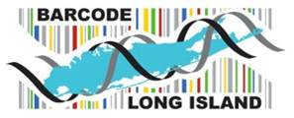
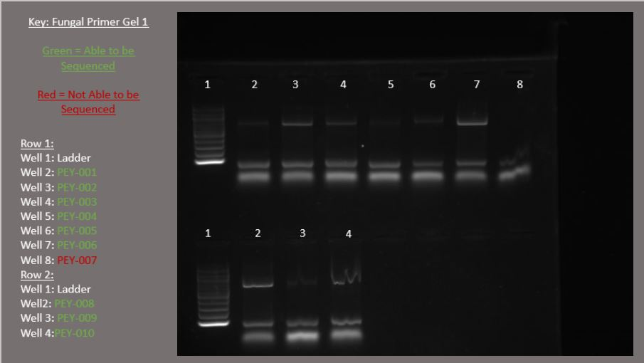
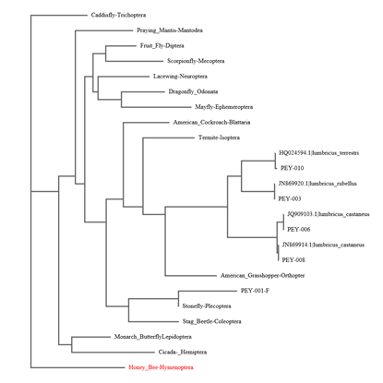
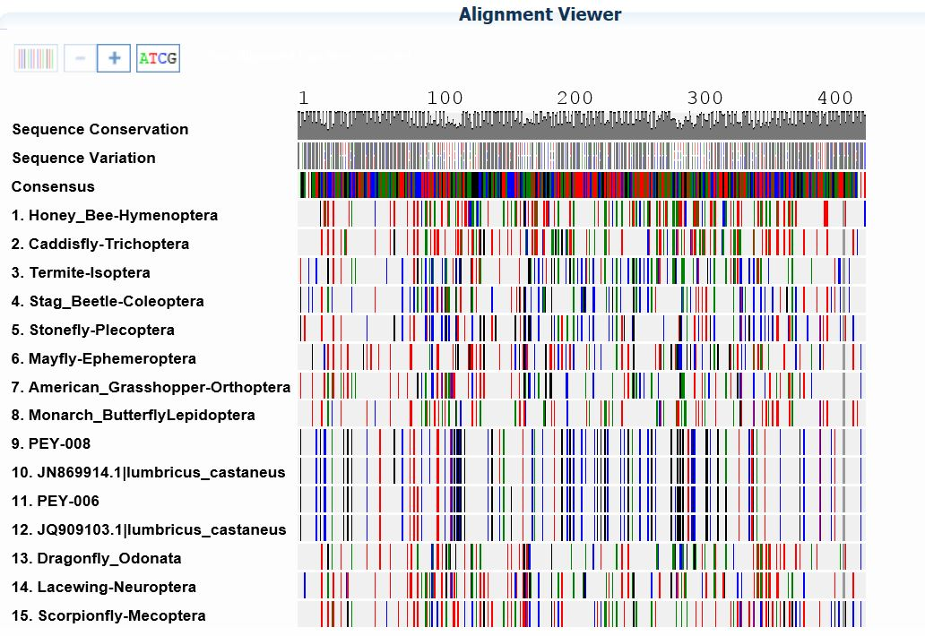
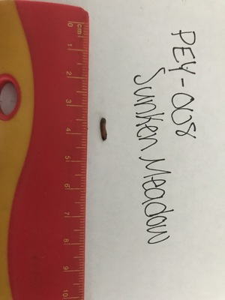
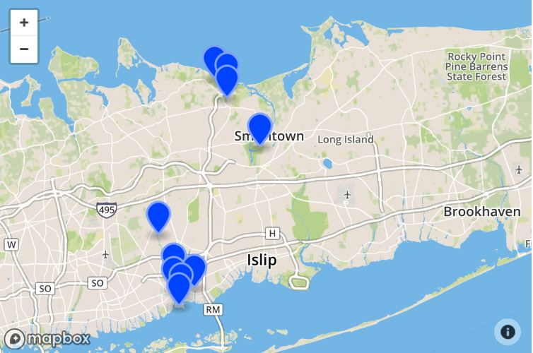
Biodiversity of the Lumbricus terrestris on the North and South Shores of Long Island
Abstract
One of the most important factors in soil quality is the presence of terrestrial worms. Considering the differences in the geographical features of the north and south shores of Long Island, it can be inferred that there are many species impacted by various ecosystems on the island. The point of this experiment was to discover how many species of worms are consistent on both shores, determine the impact diversity of worms has on agriculture, and identify a cause for biodiversity of worms in their habitat. Our team took numerous trips to locations on both shores and recorded the location of the sample and description of the surrounding area. To process the DNA of the worms, standard DNA extraction techniques will be used with the equipment and procedure supplied by Cold Spring Harbor Laboratory. Once the DNA was sequenced, we found the differences between species on the north and south shore.
Madeline Carbone, Valerie Bello, Olivia Berry
Mr. Sheltz
Babylon Jr-Sr High School
Materials and Method
Ten samples of earth worms were collected from the north and south shoes of Long Island by overturning rocks and making shallow holes in the soil, then kept frozen until ready for processing. The samples’ physical appearances, and locations (latitude/longitude) were recorded. In order to obtain the DNA the worms, we used the Barcode Long Island protocols for extraction and amplification of the CO1 gene. We confirmed sample amplification using gel electrophoresis. We then analyzed the sequences using DNA Subway and were able to identify our samples.
Figure 2: Displays the results of the Gel Electrophoresis as well as which samples were able to be sequenced.
Discussion
Four of the original ten samples collected were able to be successfully sequenced and identified as different species of worms. Such as Lumbricus terrestri, Lumbricus rubellus and Lumbricus castaneus. Also, one of our species was discovered to be a possible distinct population of Lumbricus castaneus. Upon further research, our team would look further in to this possible distinct population by trying to determine just how populous this subspecies is. The sample was collected from Sunken Meadow which is where we'd continue with our sample collection.
Introduction
On Long Island, much of the economy is based off of agriculture due to the desirable geographical features the island possesses. The quality of the soil can be attributed to many factors, but one of the most important factors is the presence of terrestrial worms. Since worms feed mainly on plant debris, their digestive system concentrates the organic and mineral constituents in the food they eat, and their casts are richer in available nutrients than the soil around them. This increases the nitrogen content of the soil. As far as the effect on the growth of plants, studies have shown that on average earthworm presence in agroecosystems leads to a 25% increase in crop yield. Although farming is practiced on both the north and south shores of Long Island, there are some geographic differences in the landscape and water features that provides biodiversity. This would also provide various environments for agricultural processes. Since the north and south shores contain different resources as far as plant matter and water sources, it can be inferred that there are many species of worms that thrive given their distinct resources required.
This project will determine how biodiversity of earthworms around Long Island, based on their location on either the north or south shore. There are approximately six species of earthworms on Long Island, stemming from the Lumbricus genus, as shown by a study from Stony Brook University. However, the sites chosen were more scattered, as opposed to our focused areas of the shores, so we may be able to find some additional species in the locations samples are collected from. By barcoding the samples collected, it can be determined whether there are numerous species of earthworms that are not shared by both shores of Long Island, but instead, species that are very specific to an area with required resources.
Figure 3: The phylogenetic tree groups the worm reference data on the left side of the tree, showing that these species are less evolved and older. As the tree moves to the right, the worm samples branch off and become more evolved, more recently. The worms samples’ BLAST matches are indicated on the same branches as our samples.
Figure 4: Shows the sequencing and links the sample localities with their placement in the phylogenic tree
Results
Out of the 10 samples collected we were able to accurately identify...
PAQ-003: Lumbricus terrestri
PAQ-006: Lumbricus rubellus
PAQ-008: Subspecies of Lumbricus castaneus
PAQ-010: Lumbricus castaneus
Figure 5: This shows PEY-008 collected from Sunken Meadow identified as a subspecies of Lumbricus Castaneus
Figure 1: Displays the locations in which the samples were collected
Acknowledgments
We'd like to thank the professionals from CSHL Learning Center, Stony Brook University, Brookhaven National Laboratory, the American Museum of Natural History, the National Institutes of Health SEPA program, Babylon Jr./Sr. High School and of course our advisors Ms. Claire Birone and Mr. Andrew Sheltz for making this project possible.
References
Groenigen, Jan Willem van, et al. “Earthworms Increase Plant Production: a Meta-Analysis.” Nature News, Nature Publishing Group, 15 Sept. 2014, www.nature.com/articles/srep06365.
“How Earthworms Can Help Your Soil.” New South Wales Department of Primary Industries, 1 Jan. 1970, www.dpi.nsw.gov.au/agriculture/soils/biology/earthworms.
“Resources for Educators ».” Moose in Minnesota, nrri.d.umn.edu/worms/educator/activities_observatory.html.
Pomi, Lara. "Earthworms on Long Island." Stony Brook University, February 2005, http://greatlakeswormwatch.org/downloads/publications/Pomi_Report%20Earthworms%20Feb.2005.pdf

