Slide 1
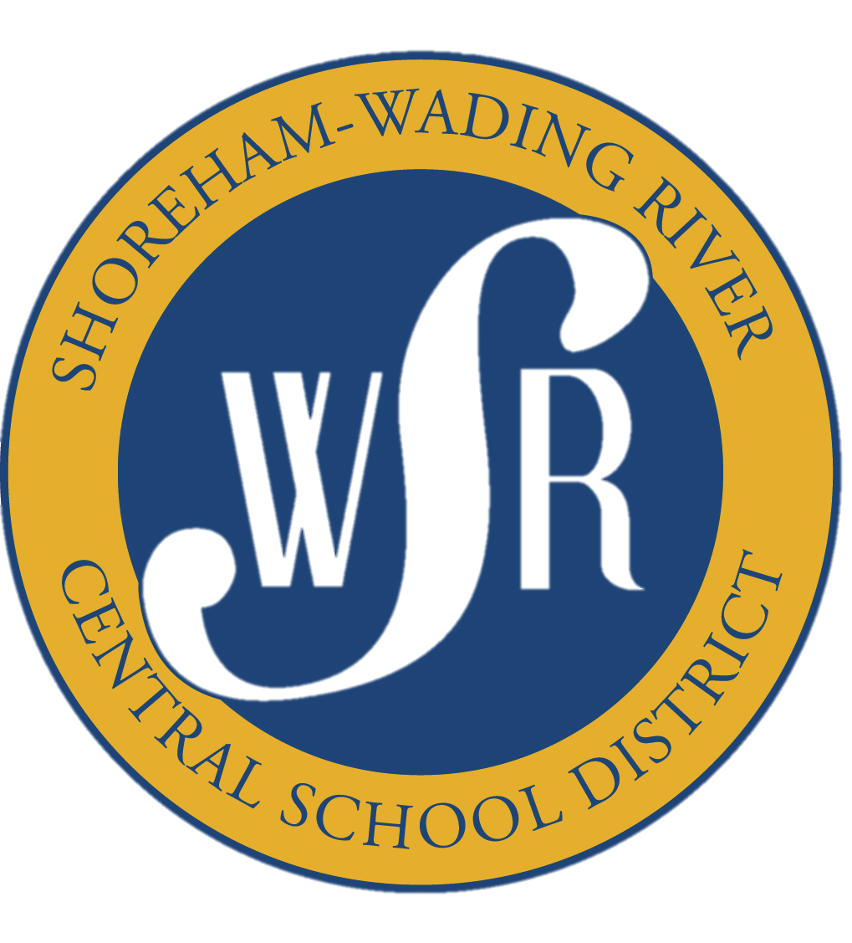
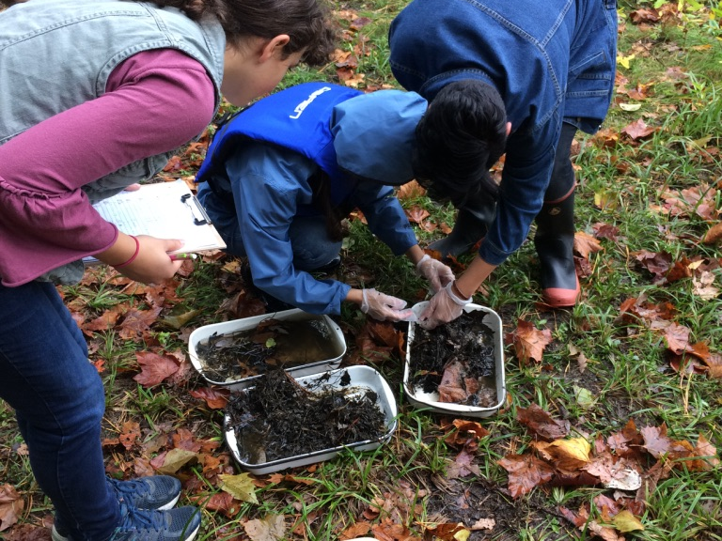
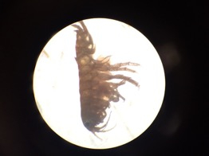
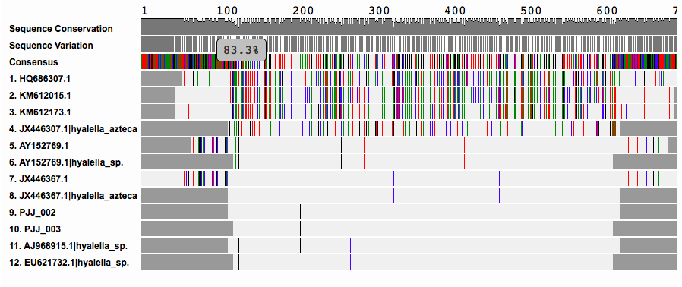
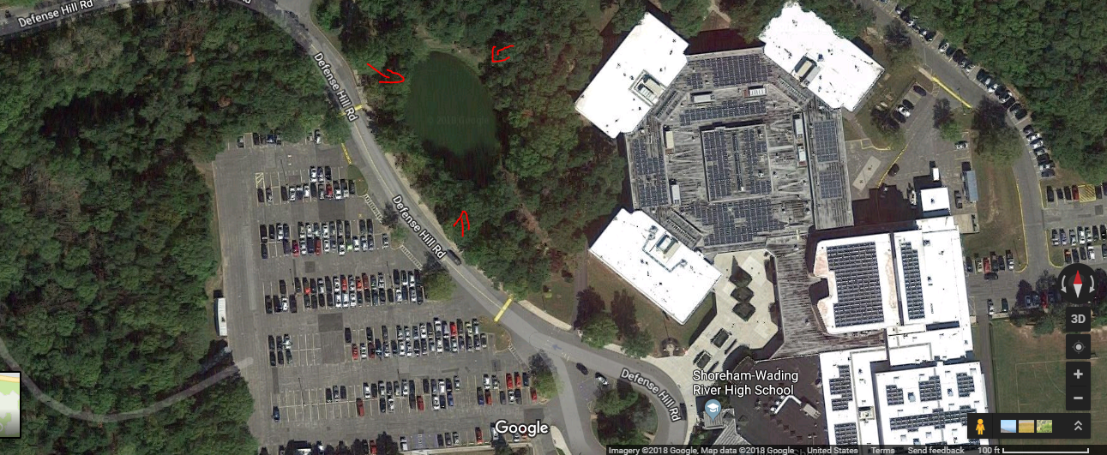
Identification of Aquatic Macroinvertebrates in a
Pond on Long Island
Brianna Donnelly, Natalie Jepson, and Jalal Sawas, Dana Schaefer (teacher)
Shoreham-Wading River High School
Introduction
The SWRHS pond has been a community landmark for several decades, but has fallen into poor health. According to the philosophy of environmental aesthetics, when there is a positive environmental aesthetic in an environment the overall habitat will be healthier and will result in an increase in biodiversity. Macroinvertebrates were collected and DNA was extracted to help evaluate the health of a small freshwater pond located on the campus of Shoreham-Wading River High School. Taxonomic identification was first done by, to be confirmed later by genetic barcoding. Species found and confirmed include the scud Hyalella Azteca and the leech Helobdela stagnalis; both are indicative of a healthy pond ecosystem.
Sample | Common Name | Scientific Name
2 | Scud | Hyalella azteca
3 | Scud | Hyalella azteca
5 | Mayfly | Ephemeroptera
7 | Water Bug | Hemiptera
9 | Water Bug | Hemiptera
13 | Sludge Worm | Tubifex sp.
17 | N/A | Gammoridea sp.
18 | Leech | Helobdella stagnalis
Figure 2: Sifting through leaf litter
Figure 3. Sample 2 Taxonomically identified as a
Scud. Genetically confirmed as Hyalella azteca
Table 1. Species of macroinvertebrate collected at the Shoreham-Wading River High School pond.
Figure 2. Gel electrophoresis displaying successfully amplified PCR fragments from extracted DNA for four samples.
Discussion
We collected multiple Amphipoda sp.(scud) (Fig. 3, Fig 4.), Ephemeroptera (mayfly), Hemiptera (water bug), Tubifex sp., Gammoridea sp., and Hirudinea sp. (leeches) (Table 1). In this collection, we found that all of the macroinvertebrates collected are indigenous and not invasive. All of the macroinvertebrates have the purpose of feeding off of algae, pond sludge, bacteria, organic material, and other substances in order to keep the pond clean. Further, these macroinvertebrates are prey for the larger predators such as fish and frogs, therefore it is implied that there are larger predators, such as fish and frogs, to carry on energy throughout the organisms. We will use this information to design small areas of native plants around our pond, in order to re-establish a healthy, natural ecosystem.
References
Covich AP, Palmer MA, and Crowl TA. 1999 Feb. The Role of Benthic Invertebrate Species in Freshwater Ecosystems. BioScience. 49 (2): 119-127.
Nelms BM, Fechter-Leggett E, Carroll BD, Macedo P, Kluh S, Reisen WK. 2013 March. Experimental and Natural Vertical Transmission of West Nile Virus by California Culex (Diptera: Culicidae) Mosquitoes. Journal of Medical Entomology. 50 (2): 371-378.
Gill, K. Identification Guide to Freshwater Macroinvertebrates. Stroud Water Research Center: 2018. Available from: https://stroudcenter.org/macros/key/
Robinson, M. 2004. The Massachusetts Pond and Lake Guide. Massachussetts Department of Conservation and Recreation Lakes and Ponds Program; 55 p.
Figure 4. Alignment showing similarity between Sample 2 (consensus sequence) and the Hyalella sp.
Figure 1. Location of Shoreham Wading River High School’s freshwater pond, in relation to the high school building and parking lot.
Procedure
First we collected samples of macroinvertebrates from the Shoreham Wading River high school pond (Fig. 2).
Next we identified these “bugs” using dichotomous keys and taxonomic field guides.
Lastly using Barcode Long Islands protocol we extracted their DNA and amplified by Polymerase chain reaction and used Gel Electrophoresis to make sure we had DNA then we sent our DNA to Barcode Long Island for sequencing

