Slide 1
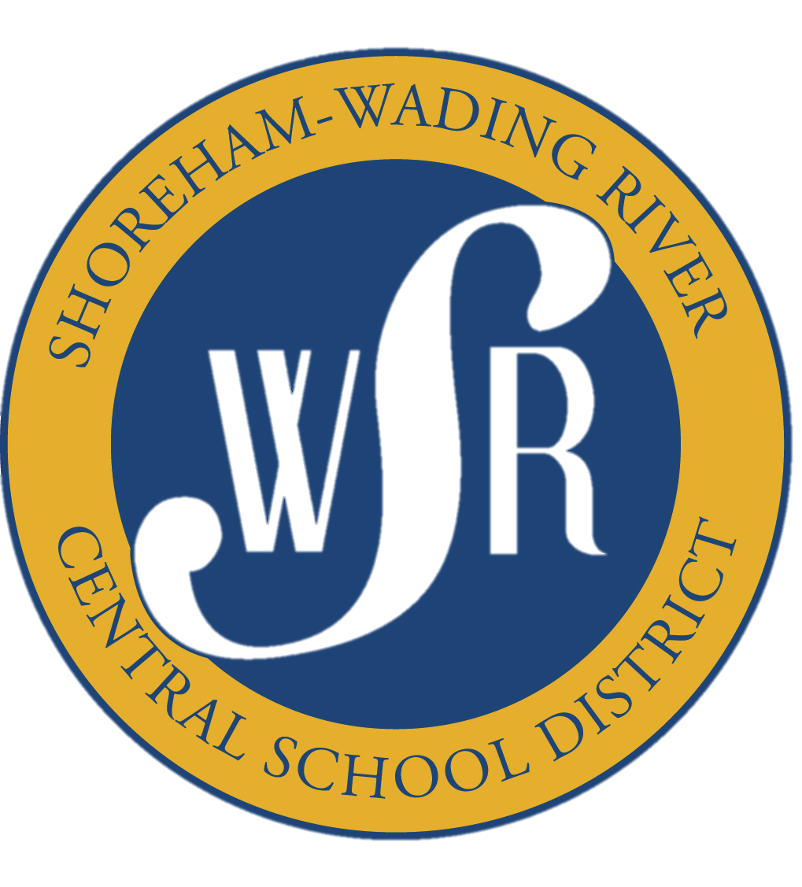
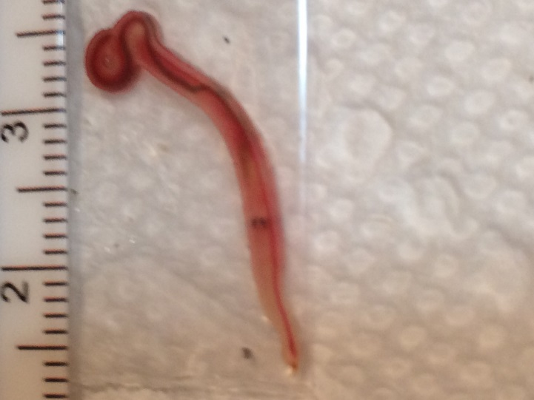
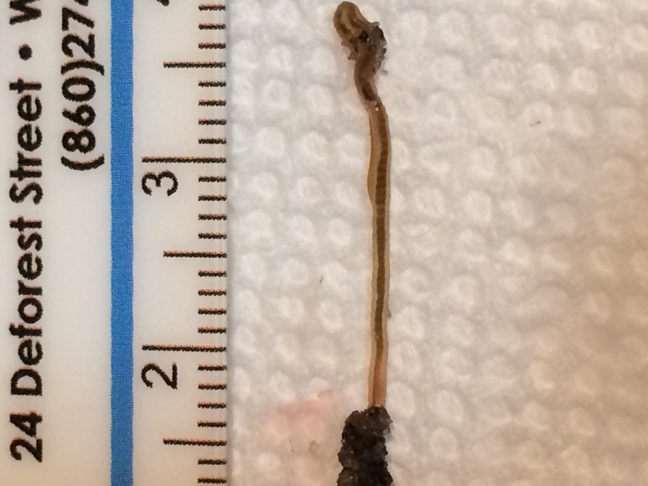
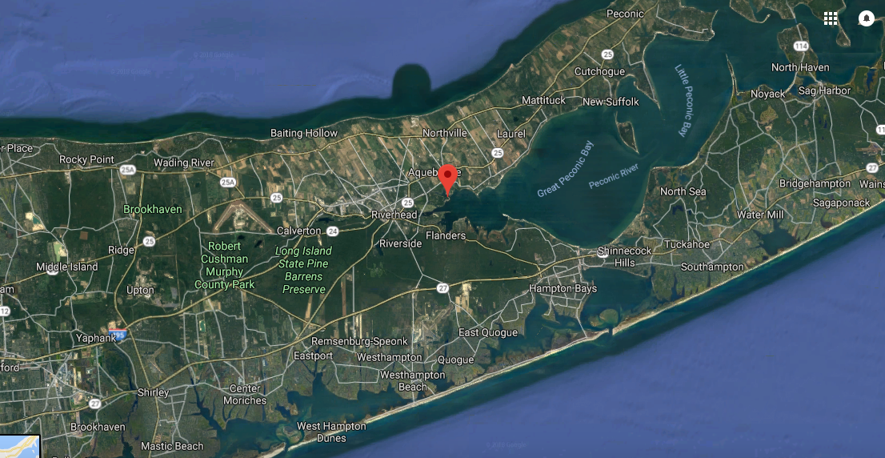
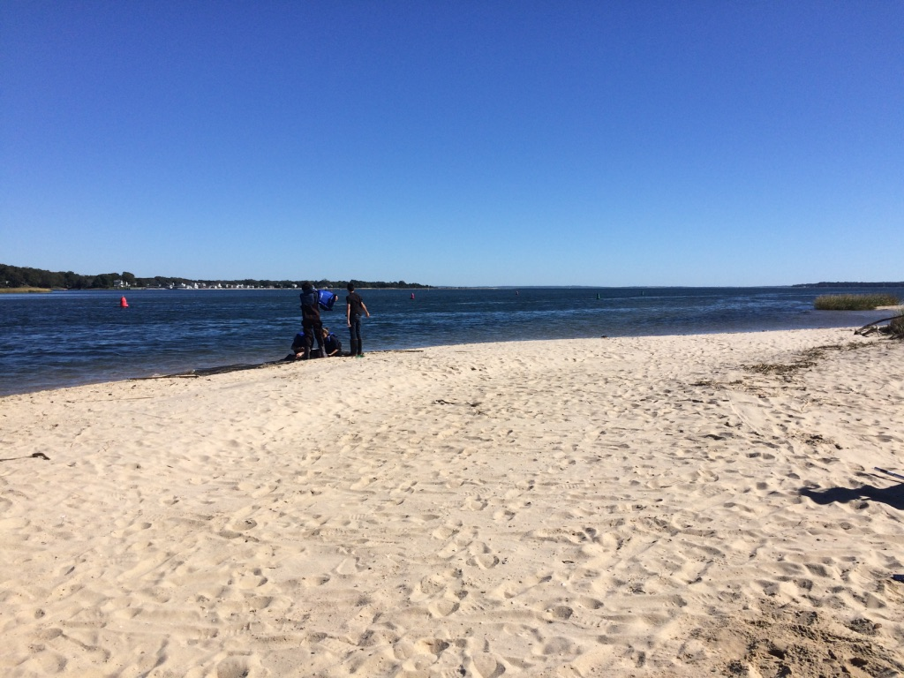
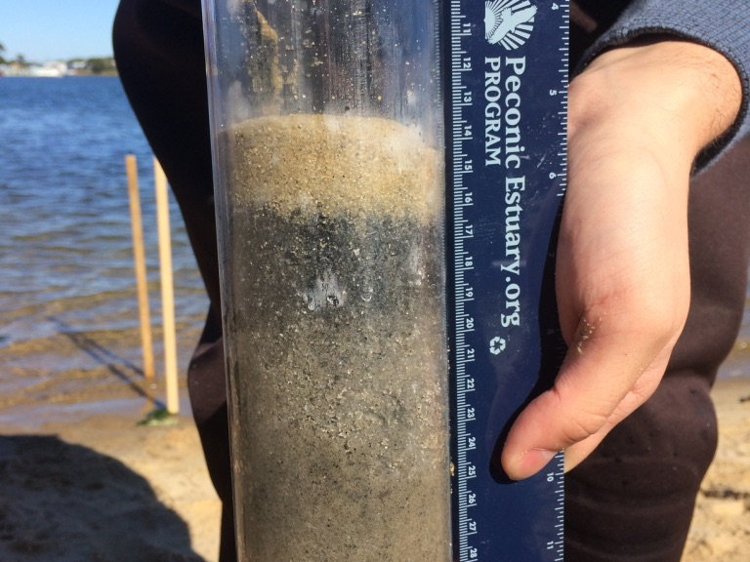
Identification of Marine Worm Species in the Peconic Estuary
Torre Ann Parrinello, Taylor Peperno, Zacharias Raptis, and Dana Schaefer (teacher)
Shoreham-Wading River High School
Introduction
Marine worms are a vital indicator species, living their entire lives in the sediment, exposed to all chemical additives within the water. Their biological functions provide important ecosystem services within their environment. As an extension of the Day in the Life of the Peconic Estuary program,
a citizen science project that evaluates the health at a particular site on the Peconic Estuary, marine worms were collected and identified, to assess the overall health of the Indian Island site on the Peconic Estuary (Fig. 1, 2). While not genetically confirmed, species found include several species of Glycera, Orbina, and Capitella, all of which can be found in a healthy estuary ecosystem.
Sample# | Common name | Scientific name
1 |  | Glycera sp.
5 | Clam worm | Nereis sp.
6 | American Bloodworm | Glycera americana
7 | Capitellid thread worm | Capitella
8 | Bloodworm | Glycera dibranchiate
10 |  | Orbina sertulata
11 | Red mud worm | Notomastus tenius
12 |  | Orbina ornata
14 | Mudworm | Spiondae
15 | Threadworm | Capitella sp.
Figure 4. Sample 8: Glycera dibranchiata
Procedure
Our samples were collected at the Peconic Estuary, within Indian Island County Park. We removed sediment with a small shovel in the intertidal zone, sifted to look for marine worms and placed them in collection bags.We then followed the Barcode protocol for DNA extraction, PCR and gel electrophoresis.
Table 1. Species of marine worm collected at Indian Island County Park.
Figure 5: Sample 14: Spiondae sp.
Discussion
The worm species found in the Peconic Estuary have been identified using a field guide (Gosner and Peterson 1978). Some of the species found were several species of Glycera, which are bloodworms, Capitella, threadworms, Orbinia and several other species. Of the species we identified bloodworms are an indicator of good breakdown of organic matter (nmfs.noaa.gov) and sandworms speeds up the decaying of organic materials and its burrowing has been found to spread nutrients among its surroundings (Christian et al 2010).
Upon completion of running our gel electrophoresis we failed to visualize any PCR products. Due to these unsuccessful results during our DNA extraction process we were unable to genetically sequence and confirm our species identification. Possible explanations for these inconclusive results are the repeating thawing and freezing of our specimens, which possibly caused freezer burn that could have broken down the DNA in our worms because of the water content. Another possible explanation of this is the sediment our marine worms were found in contained microorganisms that broke down DNA of the worms prior to extraction.
References
Christian JR, Grant CGJ, Meade JD and Noble LD. Habitat Requirements and Life History Characteristics of Selected Marine Invertebrate Species Occurring in the Newfoundland and Labrador Region. Canadian Manuscript Report of Fish and Aquatics. Fisheries and Oceans Canada: 2010.
Dean HK. 2008 Dec. The Use of polychaetes (Annelida) as indicator species of marine pollution: a review. Int. J. Trop. Biol. 56 (Suppl 4): 11-38.
Groffman PM and Bohlen PJ. 1999 Feb 1. Soil and Sediment Biodiversity: Cross-system comparisons and large scale effects. BioScience. 49 (2): 139-148.
Nelms BM, Fechter-Leggett E, Carroll BD, Macedo P, Kluh S, Reisen WK. 2013 March. Experimental and Natural Vertical Transmission of West Nile Virus by California Culex (Diptera: Culicidae) Mosquitoes. Journal of Medical Entomology. 50 (2): 371-378.
Figure 1: Map of our site location at Indian Island Park in Riverhead. Map: Google
Figure 2: Our site location at Indian Island Park, Riverhead,
Figure 3: Example of our sediment core taken

