Slide 1
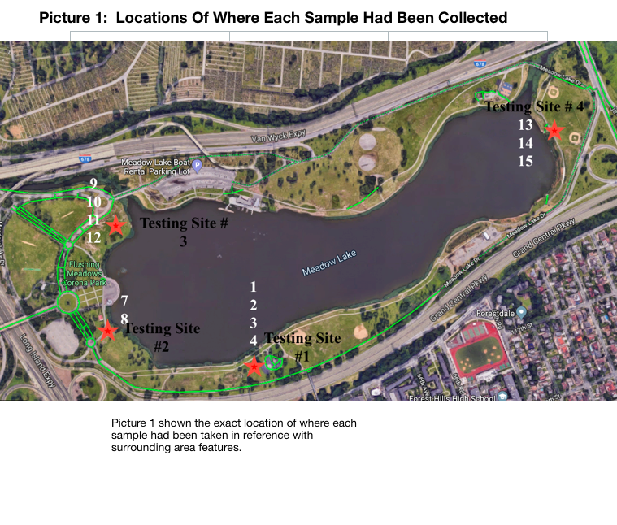
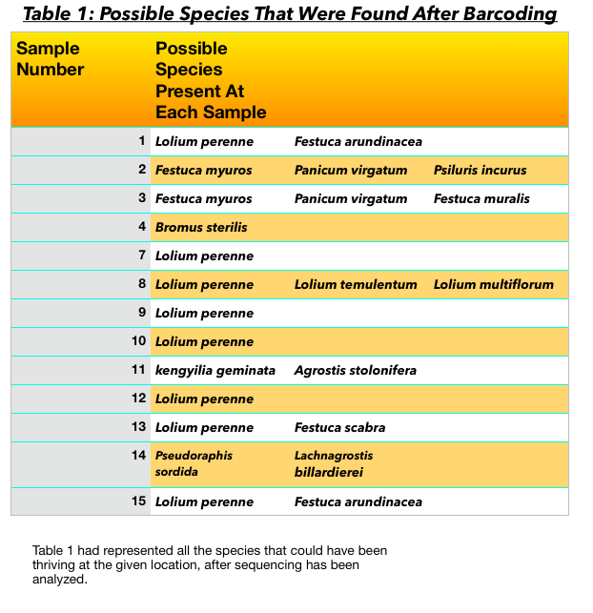
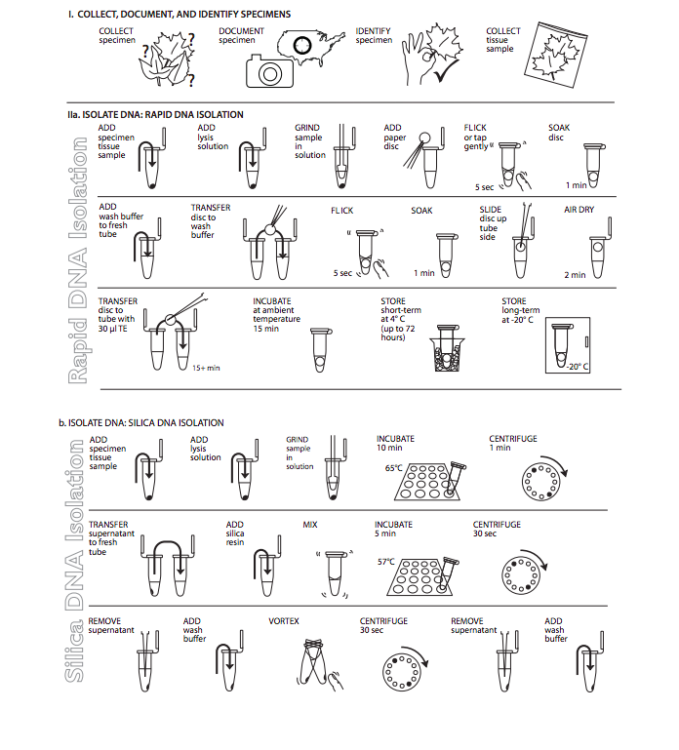
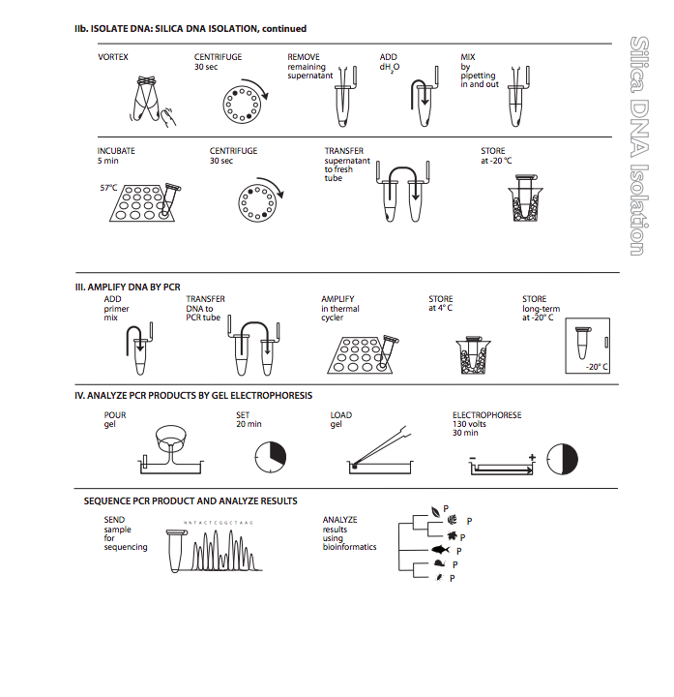
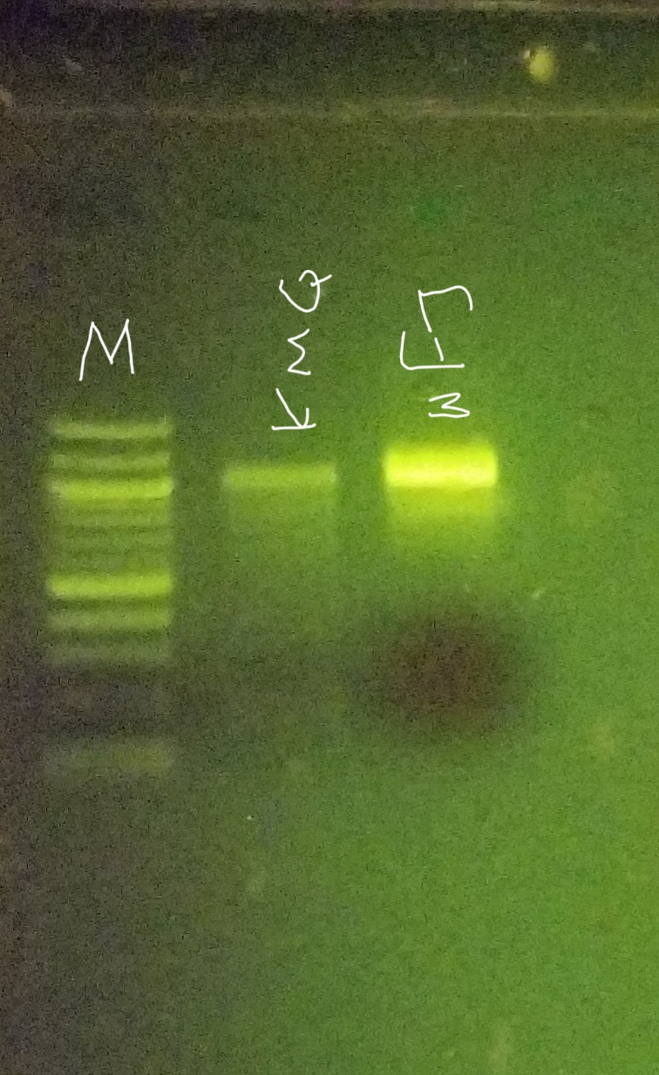
Thriving Grass Species Near the Shores of Meadow Lake
Funded by the
Thompson Family Foundation
Lenard Grayver, Jorden Tethong, Grant Zebi Mentor: Lauren Scanlon
Forest Hills High School
Abstract
Invasive species of any kingdom are harmful to any foreign ecosystem when they take over space meant for other organisms and cause competition over nutrition. In this scenario, the change in population happens to be with invasive plant species in Meadow Lake at Flushing Meadows-Corona Park, New York City. Any invasive species are usually known to be troublesome towards an ecosystem, it is crucial to understand exactly how these species affect the equilibrium of the local environment. Under the Urban Barcoding Projects’ assistance, this experiment examined exactly what grass species are thriving in four designated data collection areas scattered around the shores of the lake, where samples were collected using a 25” x 25” square thrown randomly at each location. The results of the DNA analysis revealed moderate biodiversity of grass species in Meadow Lake with some species being recorded multiple times including Lolium perenne, and the genus Festuca.
Introduction
Invasive species are any type of species which negatively modifies the ecosystems it settles in. It has been researched with evidence that, non-native plants have no significance towards supporting productivity in a local ecosystem (D.T, 2009). Invasive species cause an imbalance in the biodiversity and the food chain of the local ecosystem.
Phragmites australis, one such invasive species, belongs to the Poaceae or grass family and has been introduced in north america in the late 18th century. Phragmites causes habitats to turn in monocultures, single crops that are cultivated in a given area), without the necessary diversity needed to support a thriving ecosystem. This creates a large threat to wildlife that depend on the lake area for survival (D.T, 2009). The research goal will be investigating which grass species will be thriving in Meadow Lake. Since our data collection took place during the winter / colder season, it is possible that there can be seasonal grass species that grow (Hansen, J. 2016).
Materials & Methods
The samples were collected at Flushing Meadow Lake by randomly tossing a quadrant and collecting two grass blades from each location which were preserved in a freezer.
Silica DNA isolation was used to extract DNA. The samples were repeatedly placed into a water bath and centrifuge to prepare them for PCR.
The primers used with the samples were matK primers and underwent 41 cycles in the thermal cycler.
When analyzing the PCR products gel electrophoresis was used by extracting the products and depositing them in the gel with SYBR Green DNA Stain with a pBR322/BstNI marker to show where the product is in the gel.
The samples were then sent to GENEWIZ for sequencing where they were paired, sequenced and then trimmed on DNA Subway. Using BLASTN possible matches were found based on their base pairs and mismatches.
Discussion
Results obtained from DNA Subway had revealed little diversity present at Meadow Lake, with Lolium perenne being a dominant plant species throughout the PCR sequences done on all samples, as seen in Table 1. In fact, Lolium perenne had been found in all locations tested around the shores of the lake. Which had been hypothesized earlier, and thus hadn’t been a surprise for it to be so common. No other specific species were found in all four testing sites, but rather the genus names appeared often. Festuca had appeared in location numbers 1, 3, and 4, as shown in Picture 1, and had been the second most common genus found after sequencing. Lolium perenne is known to be very tolerant of constant grazing and other damage, due to its ability to rapidly to regrow (Emorsgate Seeds,2019). It needed a good supply of the nutrients available in the soil, and it could be concluded that Lolium perenne is in fact an invasive species itself, otherwise it would not have occurred in all four testing locations. This grass had been reported to germinate at temperature intervals of 5⁄15–30⁄35℃ (Shen, 2008) The genus, Festuca, was researched to have also tolerated winter as well as droughts and wet soils. It is known to grow in habitats with perennial bunchgrass, which Lolium perenne does as well(Forage Identification: Tall fescue,2019). Since Lolium perenne and the genus Festuca grew with very similar needs, it had become obvious as to why these two species had been so dominant.
References
DNA Learning Center Barcoding 101. (n.d.). Retrieved October 19, 2018, from
https://www.dnabarcoding101.org/programs/ubrp/
(D. T.,2009). A Call For Backyard Biodiversity. Retrieved October 19, 2018, from
https://www.americanforests.org/magazine/article/backyard-biodiversity/
Forage Identification: Tall fescue. (n.d.). Retrieved from
http://www.uwyo.edu/plantsciences/uwplant/forages/grasses/tall-fescue.html
(Hansen, J., November 22, 2016). Recommended Grasses for Regional Climates. Retrieved
October 19, 2018, from
https://www.pennington.com/all-products/grass-seed/resources/recommended-grasses-for -regional-climates/
New York Invasive Species Information. (n.d.). Retrieved October 19, 2018, from
http://nyis.info/invasive_species/common-reed/
Emorsgate Seeds (n.d.). Lolium perenne – Perennial Ryegrass. Retrieved from
https://wildseed.co.uk/species/view/200
Shen, J. B., Xu, L. Y., Jin, X. Q., Chen, J. H., & Lu, H. F. (2008). Effect of temperature
regime on germination of seed of perennial ryegrass (Lolium perenne). Grass and
Forage Science, 63(2), 249-256. Retrieved from
https://www.researchgate.net/publication/230404164_Effect_of_temperature_regime_on_germination_of_seed_of_perennial_ryegrass_Lolium_perenne/citation/download
Acknowledgements
We would like to thank the Cold Spring Harbor Lab for providing necessary materials along with Forest Hills High School for providing space and other equipment and out mentor Ms. Scanlon for guiding us through the procedure.
Picture 3: Procedure In Simpler Terms
Picture 2: Gel Electrophoresis
DNA Gel Electrophoresis results (middle section only)

