Slide 1
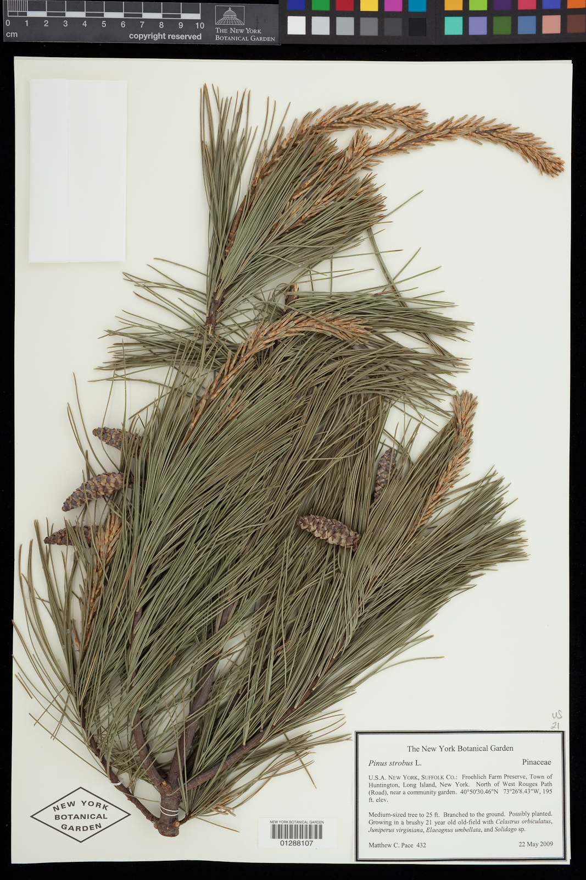
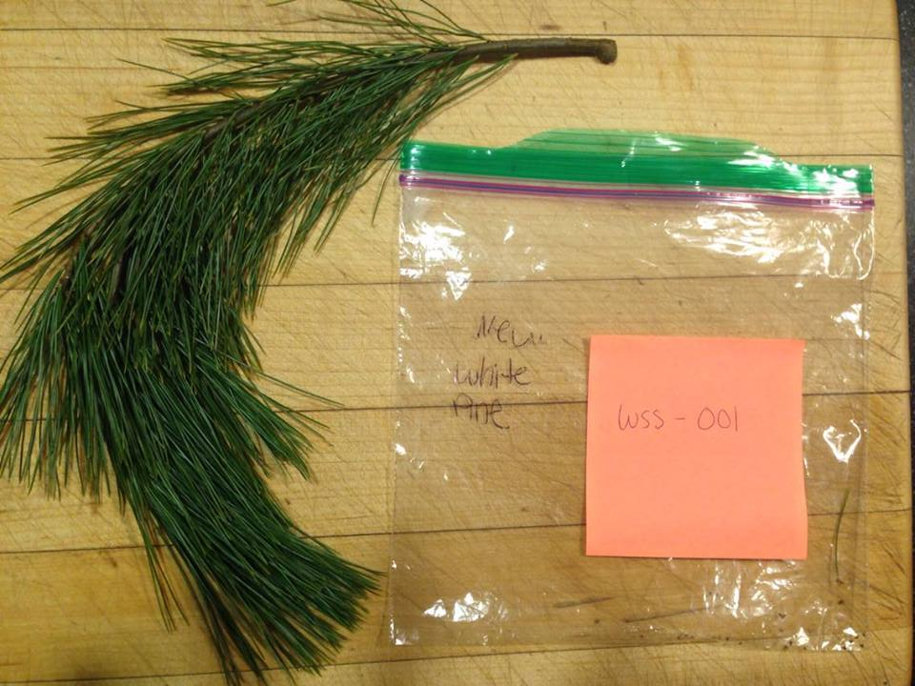
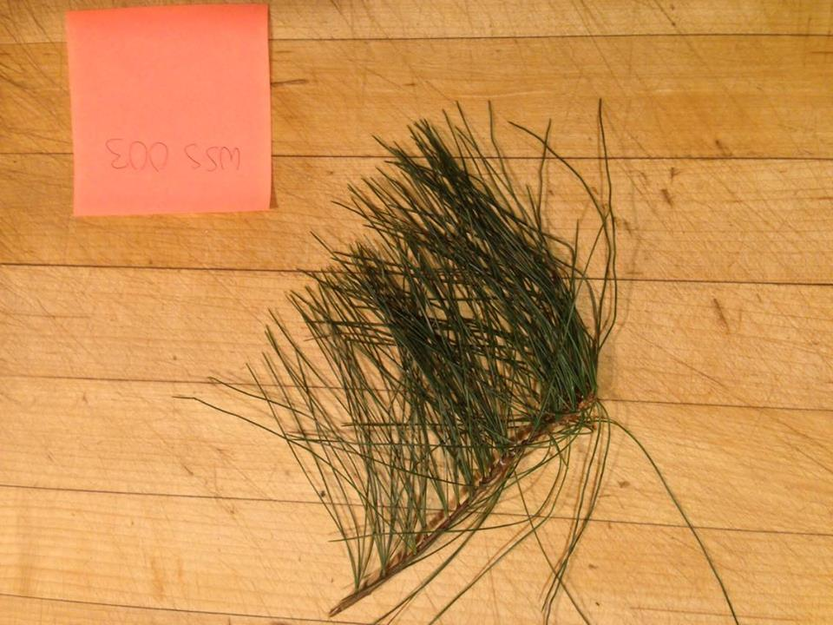
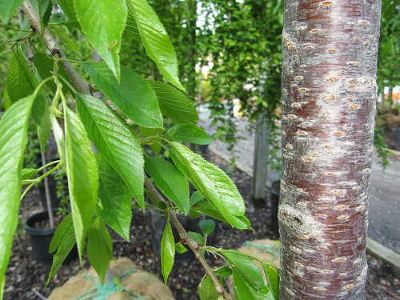
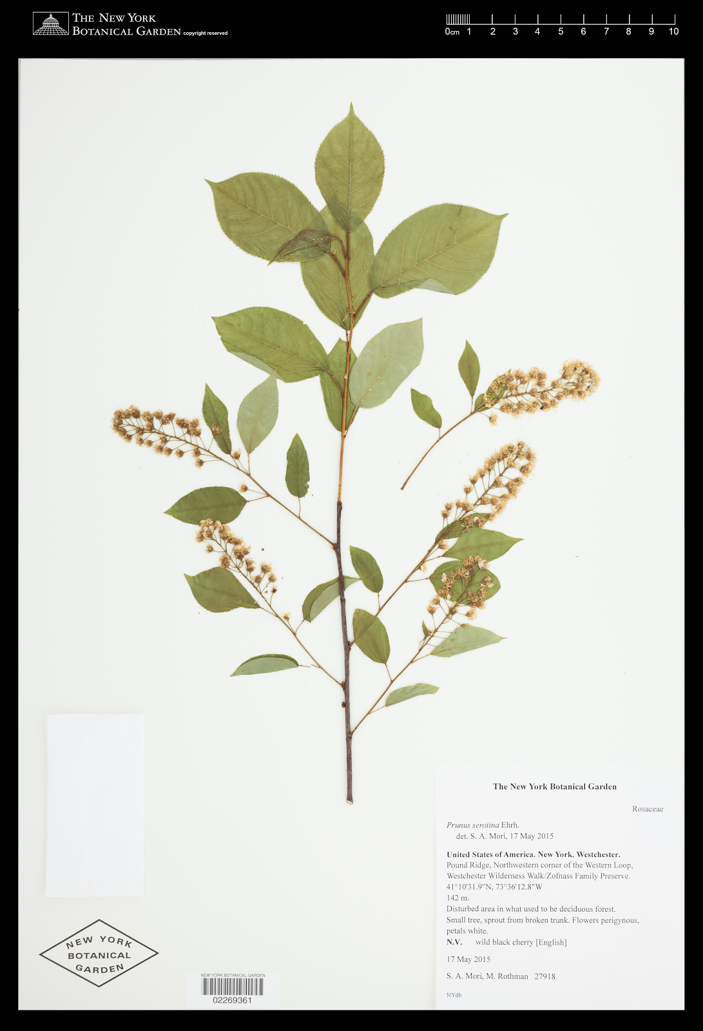
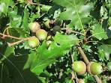
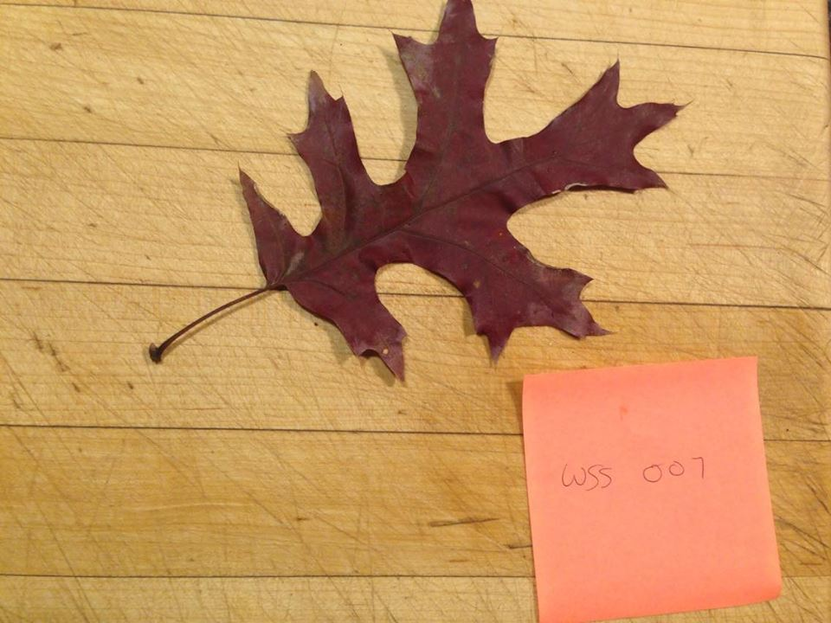
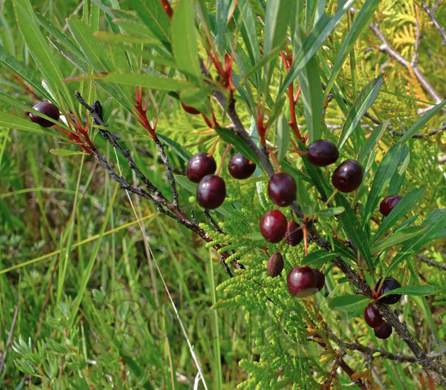
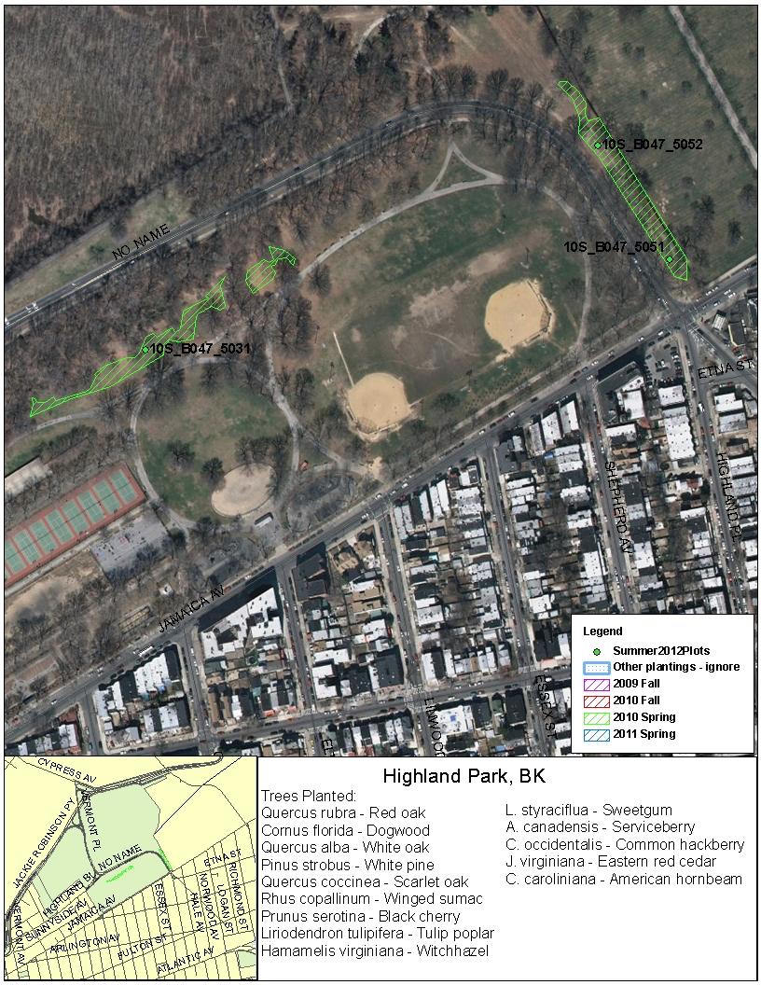
Effectiveness of the Highland Park Tree Restoration
Authors: Hayley Fier, Eirene Fithian, Annie Rozenblyum
Mentor: Shubha Sarode
Leon M. Goldstein High School for the Sciences
Funded by the
Thompson Family Foundation
Abstract
Materials and Methods
Results/Data
Discussion
Million Trees NYC, a program that set out to increase the city’s urban forest, conducted a tree restoration in Highland Park in Brooklyn. The restoration sought to replant red oak, dogwood, white oak, white pine, scarlet oak, winged sumac, black cherry, tulip poplar, witch hazel, sweet gum, serviceberry, common hackberry, eastern red cedar, and American hornbeam in the restoration site. Leaves were collected from restored and unrestored areas of Highland park and their genotypes were compared to test if the species were the same. This was meant to ensure that foreign species were not planted in the park, potentially leading to competition with “old” plants in the unrestored area. Only what was originally thought to be scarlet oak, white pine, and common hackberry samples were collected along with samples of unknown species in the area due to the presence of those leaves. After many complications during the researching process and contamination of some samples, only five of the original 38 leaves that were collected were sequenced properly. Of those five, four of them matched with species that the park claimed to have planted. The other leaf was sequenced as a different type of cherry tree than what was supposed to be in the park. Due to the contamination of samples, however, there was not enough evidence to make a definitive conclusion regarding the effectiveness of the restoration. The sequencing process did however show that one leaf could be sequenced as many different species indicating that DNA sequencing should be backed up by other data as well to make a conclusion.
All samples used for this project were collected on December 2, 2016. The samples for this project were chosen based on a list of species that were native to Highland Park and later part of the restoration process. The “old” samples were collected from areas of the park that had not undergone the restoration process, but the “new” samples were collected from the restored areas denoted by the bright green lines on the map in Figure 1. Due to a later start date than originally intended, the samples that were supposed to be collected (the scarlet oak, American hornbeam, and white pine) were not all available. The American hornbeam, along with many other trees, was not found in the area, so the common hackberry was used instead.
A total of 38 samples were collected. Although there were more samples than originally intended, they were necessary because some were from an unknown species, but had a match (an “old” and a “new” of the unknown species were found). Of the samples collected, it was hypothesized that three were old common hackberry, six were new common hackberry, seven were old scarlet oak, six were new scarlet oak, four were new white pine, and several were unknown (both old and new). The samples were collected by assessing a tree’s status as either old or new by looking at how tall it appeared in relation to the others. Then, leaves were plucked off of the branches and a picture was taken of the relative location in which it was found. As a precautionary measure, a small section of white pine branches were collected to ensure that if an individual needle were not preserved, there would be more material to work with.
After collection, 10-20 milligram sections of leaf tissue were carefully cut from the samples. Then, the sample was placed in a clean 1.5-milliliter tube and labeled with a number and our group code (to differentiate with the other group that was also working that afternoon). Then, the extracting chemicals were mixed with the samples to remove the DNA from the leaf tissues. Other chemicals were then added to prepare the DNA for PCR. Once the preparations were finished, the thermal cycling was started. The thermal cycler was programmed to the plant settings in which the initial step heated the DNA to 94 degrees Celsius. Then, the DNA went through 35 cycles of the following profile which consisted of a denaturing step, an annealing step, and then an extending step. Lastly, the sample was cooled to 4 degrees Celsius for preservation. After the PCR products were made, a gel electrophoresis was run to ensure that the PCR worked. Once the gel ran for about 30 minutes, a photograph of the gel was taken and analysis began, first with the samples being sent to the lab for sequencing.
DNA subway was used as our bioinformatics tool because it organized our data and simplified the process of editing the data and using BLAST. The DNA was analyzed by comparing the sequences obtained from our samples to known genetic sequences of the same species. As shown in figure 2, the genotype of the supposed phenotype versus the genotype of the actual phenotype were compared in terms of the number of mismatches between the known and obtained DNA sequences. Figure 3 is a Prunus given by DNA subway that is also useful for comparing our varied samples.
Figure 2: Leaf Data Table*
A few problems led to inconclusive results of this research. First, since the leaves were collected in the beginning of December, many of them were already dry. There was also some contamination which was possibly caused by mixing with another group’s project that involved the use of parsley and was executed on the same day as our project. We took special precautions so that we worked at different tables, with different supplies, and stored our work in different locations. However, at some point there was a mix-up and a few of our group’s samples were contaminated. This showed us how sensitive the PCR is to what DNA it amplifies and that even though we took precaution, more was needed. Of the 38 samples that were collected from each restored tree and each “old” tree, 20 of them represented a wide range of the different trees without the duplicates that were represented in the number 38. These 20 leaves were the ones whose DNA was isolated. Two of the tubes were contaminated during that process due to an error in removing the tip of the micropipette while transferring solutions. The remaining 18 samples were then put in the PCR machine and run on gel. Of those, 14 showed movement on the gel and were sent in for sequencing. Of those 14, only 5 were not contaminated by parsley DNA. This greatly limited the ability to make a conclusion about the project. However, the results of the sequencing of the samples that were not contaminated are as follows.
Sample WSS-001 yielded a poor sequencing result because dry leaves resulted in a poor quality of DNA. However, when sequenced with BLAST there was still a result that showed the sample to be white pine. This sample was taken from a newly restored tree. With white pine being one of the trees that was meant to be restored, this could show that the restoration project planted the correct species of tree. Strangely, there were only two white pine trees that we could locate in the area, both of them being new trees. We collected samples of them (WSS-001 and WSS-003). The DNA sequencing also matches up with the phenotype of the leaf shown in Figure 2 which has 5 slender needles per fascicle. If this observation is accurate, then it would not matter if the newly restored tree is indeed white pine because if there is not a matching “old” then there could still be threats of incompatibility with other species. To come to this conclusion however would require further observational and perhaps DNA sequencing analysis of the site, testing for “old” white pines.
The results of WSS-039 were surprising because the leaf was thought to be from the common hackberry, however, it was also found to be black cherry (Prunus serotina) leaf. There were many leaves that looked similar to this one, perhaps with slight variations. Some of these samples were lost to contamination so it is not certain if those perhaps were also cherry or were common hackberry as was hypothesized based on the phenotype of the leaf as shown in Figure 2. After a closer look though, it was evident that the phenotype of this plant did indeed match up to that of a black cherry; it had two big glands at the base of the leaf, and the back of the leaf has orange fuzzy hair along the main vein which are unmistakable characteristics of Prunus serotina. This leaf was an “old” leaf collected behind the restoration site. The sequencing matches up with the proposed restoration of the species. There were also “new” versions of this leaf that were found in the restoration sight, but the samples were contaminated. Judging just on phenotype, though, it can be concluded that the restoration was successful for this species.
When it was first collected, the species of WSS-032 was unknown. It was an “old” tree that was collected behind the restored area of the park, where the “old” versions of the trees were to be located. The sample was found to be a cherry oak. The sample had a 99% match with several species of the same genus. This is illustrated also by the close alignment with another species with the genus Prunus shown in Figure 3. What was peculiar was that the closest DNA match to the plant was Prunus pumila (Shown in figure 5) with only 6 mismatches. However Prunus pumila is a bush and this plant was a tall tree so therefore it could not be the same plant. Therefore DNA sequence of this plant did not help to identify it. It did however lead us in the right direction. The blast sequence showed that Prunus spinosa only had 7 mismatches and the phenotypes were the most similar (based on results from the Starr Virtual Herbarium). If this plant is indeed Prunus sp as the phenotype comparison indicated then this tree perhaps was left out of the restoration, as it was not mentioned as a part of the restoration goal in Figure 1, either on purpose or by accident on part by the Million Trees Project Another option could be perhaps that the genotype does not follow as closely to the phenotype as previously thought. The biggest conclusion that can be made from the sequencing of this plant is that it can show that even with a 99% match, it is not certain that a leaf or other DNA that is being sequenced is definitely what it was sequenced as because there may be other matches as well. This could be an issue for example when DNA sequencing is used in court cases to convict people of crimes because it shows the uncertainty of DNA sequencing. This is not only the case for this particular sample but also with the contamination issue because it shows just how easy it is for samples to get contaminated, even with using caution, and that DNA sequencing may not always be a definitive answer to identify DNA.
This is even more evident in sample WSS-045 where there were 0 mismatches with many different leaves. The leaf was sequenced to be Quercus rubra also with many other oak species. That is because all of these oaks have an identical sequence for rbcL, so you cannot identify this tree based on rbcL sequence data alone. However, it was concluded that the leaf was from a Quercus rubra plant because of a phenotype comparison with the Virtual Herbarium and matching the restoration’s goal of which species to plant (figure 1). In terms of the restoration, sample WSS-45 was an “old” plant. Similar to the situation with sample WSS-039, there was a “new” version of the plant discovered in the restoration site whose DNA was contaminated. An image of the “new” plant is shown in Figure 4. If the assumption is correct that this is the same plant as WSS-045 then the restoration of this tree would be considered successful.
To add on to this study, an observational analysis could be done on the park to collect data about the quantity of different types of species. This would answer some of the questions that we had about whether or not there was a “new” version of an “old” tree that we found and vice versa. A more broad collection of leaves would also be more useful to coming to a definitive conclusion regarding the success of the restoration because, again, it would be able to show the link between “new” and “old” species more accurately. Had the results shown that the restoration program was successful, it is possible that the park could have been influenced to maybe try another restoration program. It is also possible that this experiment could be carried out in other parks with different species to see the effect of conservation programs on local wildlife.
Although no conclusion about the restoration was made, the ability to work on this project had a major effect on all of our group members. The group learned about the limitations of DNA barcoding as well as the difficulties and obstacles that are often faced in the research process. We learned that research can be very tedious in the sense that an extensive amount of information and preparation must be collected before the research begins and that no matter how careful you can be, there is always a chance for contamination. The most important thing that we learned though was that even if things do go wrong in the research project, that shows that there is room for improvement and learning from mistakes, but also the importance of taking whatever information you can out of the limited data that you collect.
Sample Number | Sample Species | New or Old Tree | Phenotype (supposed) | Phenotype (actual collected) | # mismatch with database
WSS-001 | Pinus strobus | New |  |  | 21
WSS-003 | Pinus strobus | New |  |  | 0
WSS-032 | Prunus sp (cherry Oak) | Old |  |  | 8
WSS-039 | Prunus serotina (Black cherry) | Old |  |  | 0
WSS-045 | Quercus rubra | Old |  |  | 0
Introduction
Million Trees NYC is trying to increase New York City’s urban forest in order to add nature to the city and also to try to compensate for some of the carbon emissions that the city produces. In 2010 the program conducted a restoration in Highland Park by planting “new” trees in areas close to the “old” trees. If these trees are not the same species, this could be a threat to the old species.
“The introduction of new genetic material in an area can damage local populations of native species”-National Parks Service
It is difficult to identify invasive species prior to its damaging effects. An important aspect of identifying tree species is to look at the entire tree: the leaves, possibly the acorns, the bark, the height, the leaf distribution, etc. However, it becomes difficult to decipher which leaves belong to which species and if two different leaves belong to the same species solely based on their phenotype. One way to truly test if the leaves are the same species is to do a DNA analysis to find the genotype, the genetic constitution of an organism, in order to find out if the two leaves are related, regardless of how different or similar they may look.
Upon examination of the site at Highland Park, it looked as though the new trees that were planted were not the same species as the pre existing trees. We want to test if those were indeed the same species even though they did not appear to be. The phenotype may differ even though they have the same genotype. By testing if the leaves of new and old trees have the same genotype even though they have different phenotypes, we can find one of two things: either the leaves with different phenotypes have different genotypes, indicating that new species were introduced and could become invasive, or the leaves with different phenotypes have the same genotypes thus showing that the genotype cannot be assumed from the phenotype alone.
*Supposed images from Starr Virtual Herbarium
Figure 3: Muscle Alignment*
*Compared with DNA Subway’s given prunus to compare for Samples WSS-032 and WSS-039
Figure 4: image of leaf whose DNA sequencing got contaminated
Figure 5: Prunus Pumila
Figure 1: Map of Highland Park Indicating Location of Restoration
Acknowledgements
We would like to thank the Urban Barcoding Project for supplying us with the necessary tools to complete our DNA analysis. We will like to specially recognize Christine Marizzi and Melissa Lee for helping us throughout the whole research process. We could not have completed this project without them. In addition, we will like to thank our mentor, Ms. Shubha Sarode, for staying late after school with us to complete our research and for guiding us into the proper direction with our proposals and reports.
References
"MillionTrees NYC - About MTNYC - NYC's Urban Forest." MillionTrees NYC - About MTNYC - NYC's Urban Forest. N.p., n.d. Web. 15 Nov. 2016.
United States. National Park Service. "An Introduction to Using Native Plants in Restoration Projects: Planning a Native Plant Project." National Parks Service. U.S. Department of the Interior, Web. 19 Dec. 2016.
“C. V. Starr Virtual Herbarium." The C.V. Starr Virtual Herbarium. NYBG, 2004. Web. 21 May 2017.

