Slide 1
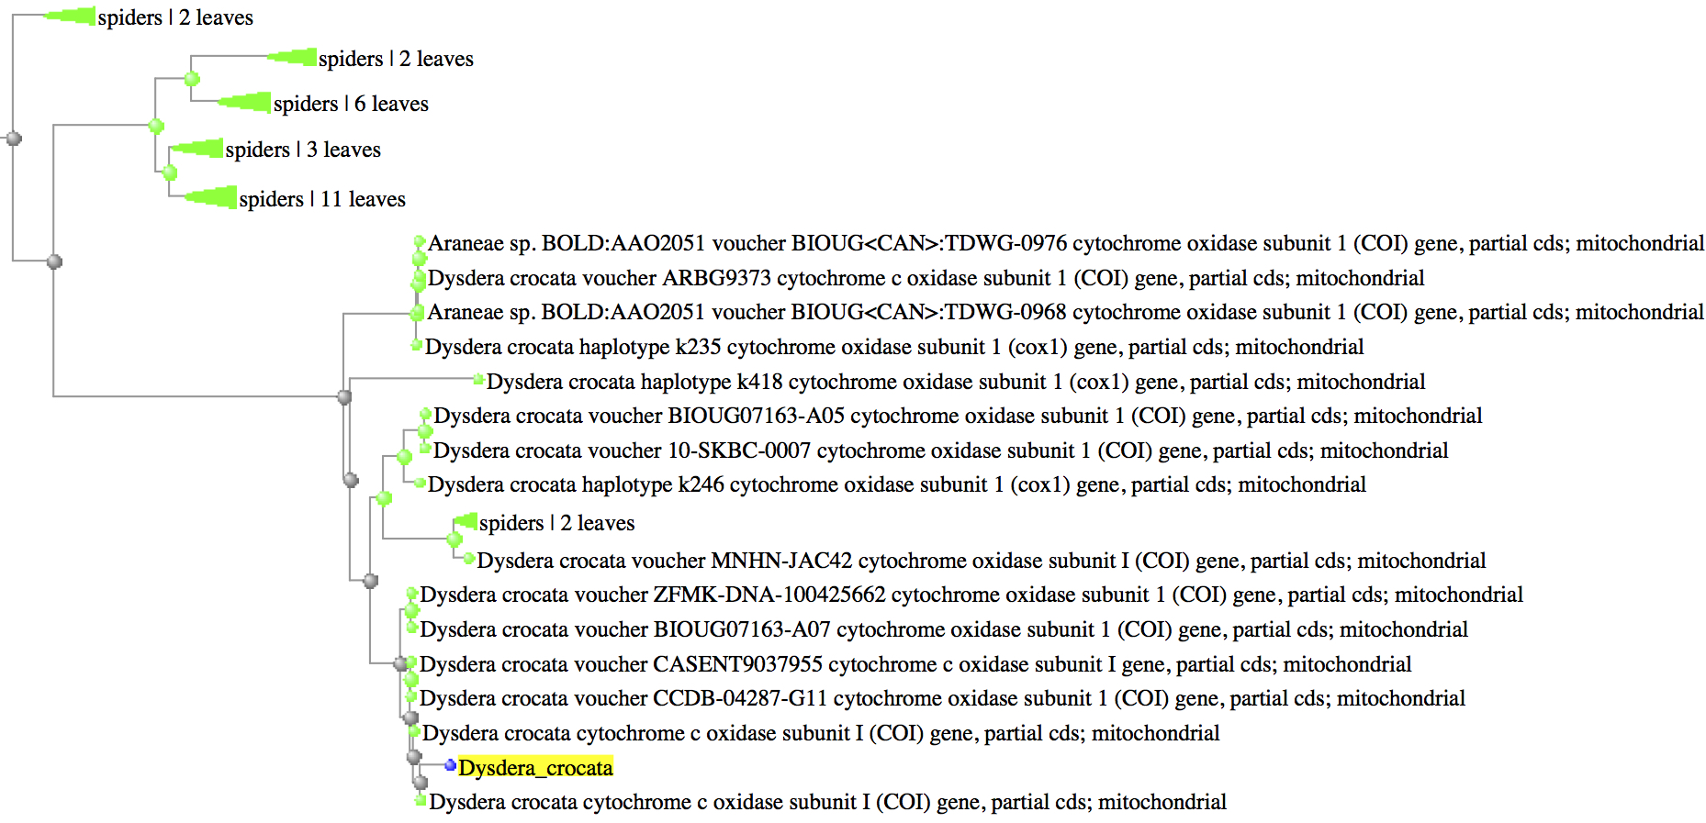
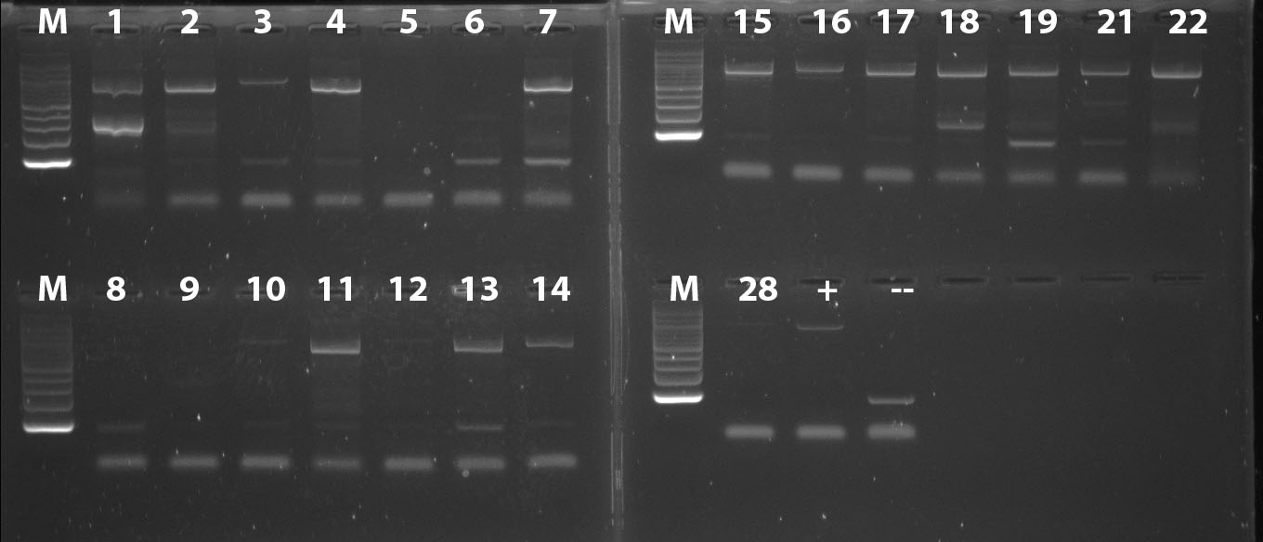
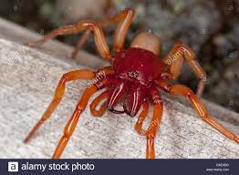
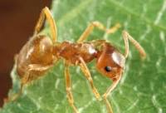
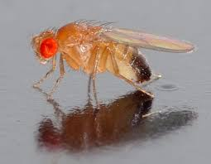
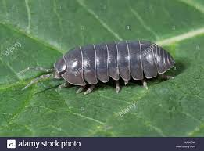
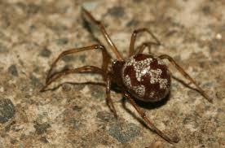
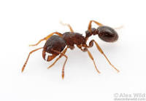
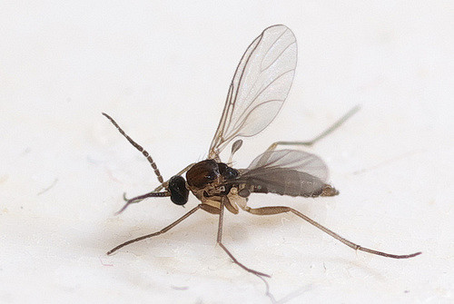
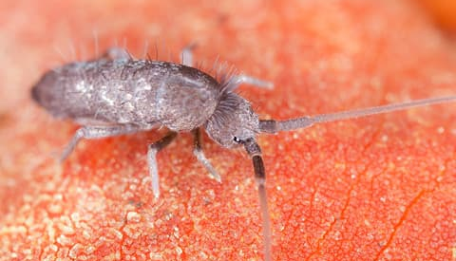
An Assessment of Biodiversity in NYC Apartments
Funded by:
Anna Mikadze & Kyra Singh
American Museum of Natural History
Abstract
Our research aimed to take the first step in the identification of species diversity in NYC apartments. We utilized DNA sequencing (barcodes) to perform specimen identifications in a household in Queens. We detected seven species through DNA sequences: two spiders, Dysdera crocata and Steatoda triangulosa (Arachnidae); two ants, Lasius neoniger and Tetramorium caespitum (Hymenoptera: Formicidae); two flies, Drosophila melanogaster and Sciaridae sp. (Diptera). We also detected springtails (Colembola) but primers did not work and species could not be identified.
Introduction
Extensive research hasn’t been conducted to characterize the diversity and indoor distribution patterns of arthropods and other taxa in human homes (1), not considering those of well-known pest species such as cockroaches and silverfish. Because of this, we are far from understanding which species co-exist with us in our homes, for what reason, and their effect on human health (2). To get a better understanding of biodiversity in urban homes in New York we performed DNA barcoding analysis of arthropods sampled from our homes.
Materials & Methods
In the month of May 2018, we collected a total of 22 samples: 5 spiders, 4 ants, 6 flies, 6 springtails, and one isopod at a house in Queens. These specimens were labelled, and preserved in 96% ethanol. DNA was extracted through the use of Qiagen kits at the Division of Invertebrate Zoology of the American Museum and DNA was amplified at the Harlem DNA Lab using DNA polymerase chain reaction (PCR) using the Folmer Fragment primers for COI. Sequences were edited using Geneious software, version 11.0.3. Preliminary identifications were performed using DNA subway, and the phylogenetic position was evaluated in GenBank through distance methods (Fast Minimum Evolution).
Results
15 out of 22 samples produced bands in the DNA gel, of which eleven produced quality sequences usable for specimen identification (Fig. 1-3). It is important to note that primers did not work for the springtails. All our samples of springtails (six) did not amplify (Fig. 1). Three spiders and two ants produced bad sequences. Successful sequences identify 7 different species of arthropods (Fig. 2–3).
Figure 2. DNA gel bands indicating DNA extraction success and failure
Figure 2. One of the multiple phylogenetic trees inferred to identify sampled sequenced showing the phylogenetic position (BLAST, Fast Minimum Evolution) of a sequence of Dysdera crocata collected in Queeens.
Discussion
Our 22 samples reveal the existence of organisms from different taxa, such as Hymenoptera, Arachnidae, Isopoda, and Diptera. Species diversity was expected to be much higher but weather conditions during the winter were not optimal which hindered sample collection. For example, we missed species such as cockroaches, dust mites, common flies, bees, wasps and beetles that are known to occur in urban settings. In addition, some samples did not amplify or produced problematic sequences (6 springtails, three spiders, two ants). In the case of springtails, it seems that the primers we used didn’t work for this taxon.
There is more diversity of arthropods than we expect living in NYC apartments, as evidenced by the few studies available so far (3–5). Our project has also shown that there are more species in our homes that are waiting to be discovered and researched, which could improve improve human health through increasing our understanding of our ecological relationships to other organisms.
References
Leong, M. et al. 2017. The Habitats Humans Provide: Factors affecting the diversity and composition of arthropods in houses. Scientific Reports, 7: 15347.
Wirtz, R.A. 1984. Allergic and Toxic Reactions to Non-Stinging Arthropods. Annual Review of Entomology 29: 47-69.
Matteson, K.C. et al. 2008. Bee Richness and Abundance in New York City Urban Gardens. Annals of the Entomological Society of America 101:140-150.
Pećarević M. et al. 2010. Biodiversity on Broadway - Enigmatic Diversity of the Societies of Ants (Formicidae) on the Streets of New York City. PLoS ONE 5(10): e13222.
Ramirez, K.S. 2014. Biogeographic patterns in below-ground diversity in New York City's Central Park are similar to those observed globally Proc. R. Soc. B, 281: 20141988.
Acknowledgements
We’d like to thank our mentor, Dr. Jose Manuel Padial, for so graciously guiding us through this research project and dedicating his time to working with us. We’d like to thank Dr. Christine Marizzi and the Cold Spring Harbor Laboratory for taking the initiative to educate students like us through the Urban Barcode Project (URBP) and allowing us to gain research experience in bioinformatics and genetics. We’d also like to thank the Pinkerton Foundation for funding the UBRP and the American Museum of Natural History for offering us working space and resources.
Dysdera crocata
Lasius neoniger
Drosophila melanogaster
Armadillidium vulgare
Steatoda triangulosa
Tetramorium caespitum
Sciaridae sp.
Colembola sp.
Figure 1. Taxa found in an Apartment in Queens (NYC), and identified through DNA barcoding (Colembola sp. was identified by eye)

