Slide 1
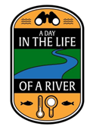
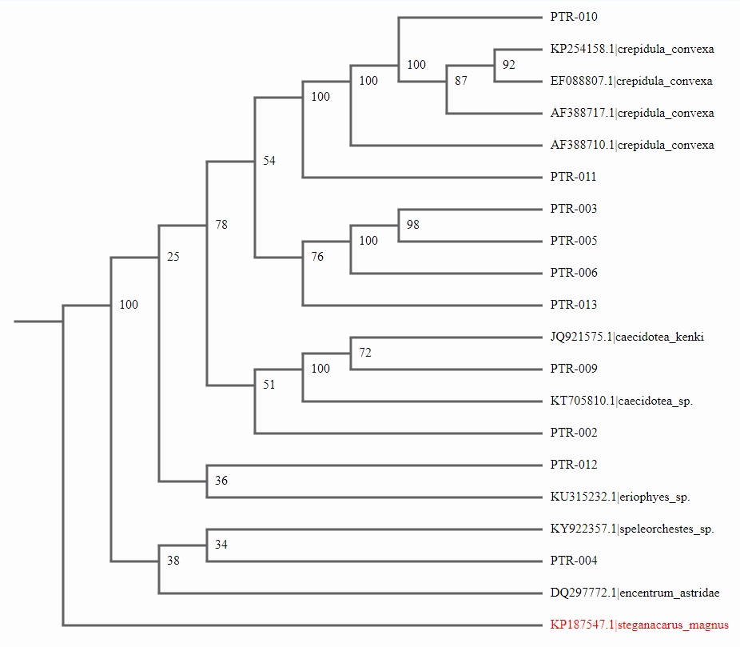
Identifying Threats to Human Well Being Through the Process of DNA Barcoding
Alexi Flores, Olivia Reid, Ethan Young, Adriana Zarcone
Teacher: James Ostensen
Eastport South Manor Jr./Sr. High School
Abstract
The main goal is to identify any possible threats that the Forge River ecosystem may pose to human well being. This will be determined by using DNA barcoding to confirm if the organisms found are possible vectors of disease. These organisms include four sand fleas (small invertebrates that live in clumps of aquatic plants), two earwicks, one Asian Shore Crab, two unidentified invertebrates, two snails, one muscle, and one barnacle. DNA barcoding is commonly used for species identification and is used to determine the species of organisms found among the Forge River. The gene CO1, which is an effective 648 base-pair gene region that can be used in the identification of animals, will be used to determine if these threats are present, because all of the organisms are animals.
Results
The species that we focused on showed little variation. These species have been found to benefit the aquatic ecosystem, not harm it. For example, the Geukensia demissa, ribbed mussel, was a key species that we focused on. It has been found to be a filter feeder, so it benefits the ecosystem by removing unwanted bacteria and algae from the water.
Discussion
Our question has been answered and has proven that in the Forge River, the organisms have a lessened impact on the decrease in water quality. In fact, some organisms are helping improve the water quality, such as the Geukensia demissa, ribbed mussel, which is a filter feeder. These findings show that the decrease in water quality is solely caused by human activity if there is not another reason why it keeps decreasing, which there could be. This change may be an effect of changing climate conditions. Also, it could also be the result of a undetermined plant species, since we only used DNA barcoding to determine animal species and the animal species that we found did not have a large diversity among each other. On the other hand, a mistake could have been made during the process of DNA barcoding, causing the results to be altered. In the future, research should focus on other factors that may have caused poor water quality in the Forge River, besides the organisms it contains.
Figure 1: Phylogenetic tree shows similarities among different organisms (2).
Introduction
Biodiversity is an important part of every ecosystem. Our project focuses on a variety of specimen samples collected from Osprey Park, on the mouth of the Forge River in Mastic Beach, New York, October 13, 2017. We hope to identify the species that the samples belong to, as this information is key to determining any biological threats to biodiversity. The Forge River has suffered from low oxygen levels, high nitrogen levels, and high phosphate levels, causing its water quality to steadily decrease. This has been partly caused by the history of duck farming around the Forge River, as well as a large amount of summer residents nearby that produce large amounts of waste that runoff into the river. This has posed the question: Has the water quality of the Forge River been affected by other factors, besides humans, such as diseases or bacteria carried by the organisms living there? After using DNA barcoding to find information about organisms found in the Forge River, we can answer this question.
Figure 2: Determines similarities and differences among the collected organisms after the process of DNA barcoding (2).
Materials & Methods
During our project, we followed the Cold Spring Harbor Lab Barcode Long Island Protocol(1). This required DNA extraction, PCR amplification, and Gel Electrophoresis processes. During the process of DNA extraction, the DNA is extracted from the specimens and purified. The processed materiel or tissue is then extracted from the DNA fragments. The process of PCR (Polymerase Chain Reaction) amplification targets a specific gene region and copies the DNA segment. The PCR products are then analyzed by Gel Electrophoresis. The products are placed into the electrophoresis chambers in the agarose gel and are viewed using UV transillumination (4). When analyzing, bands are found in some samples. This means that there is similarity between the DNA in the samples.
Acknowledgements
We would like to thank Cold Spring Harbor, Stony Brook University, our teacher, Mr. Ostensen and our school, Eastport South Manor. Also, Day in the Life Program, Melissa Parrott with the Central Pine Barrens Joint Planning and Policy Commission, and Dr. Mel Morris at BNL.
References
DNA Learning Center Barcoding 101. (n.d.). Retrieved October 25, 2017, from http://www.dnabarcoding101.org/
Fast Track to Gene Annotation and Genome Analysis - DNA Subway. (n.d.). Retrieved May 8, 2018, from https://dnasubway.cyverse.org/
Science Daily. (n.d.). Retrieved November 14, 2017, from https://www.sciencedaily.com/releases/2007/09/070914120856.htm
Hartman, J. (n.d.). PEC (PCR Enhancer Cocktails). Retrieved November 09, 2017, from https://www.klentaq.com/pec_pcr_enhancer_cocktails

