Slide 1
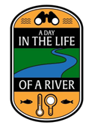
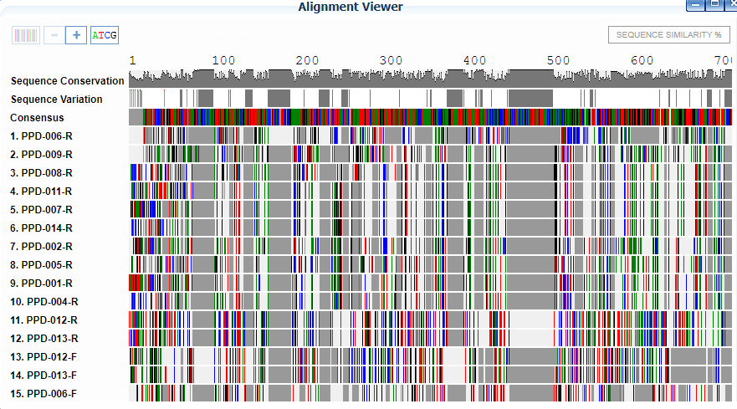
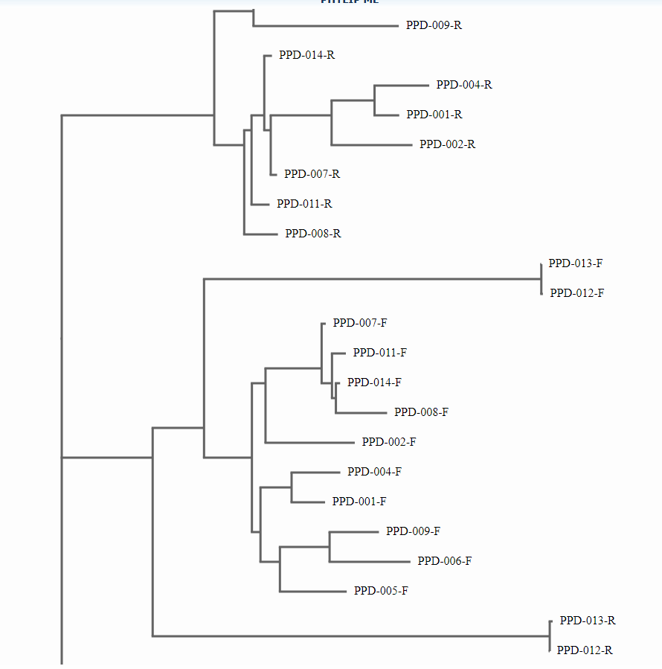
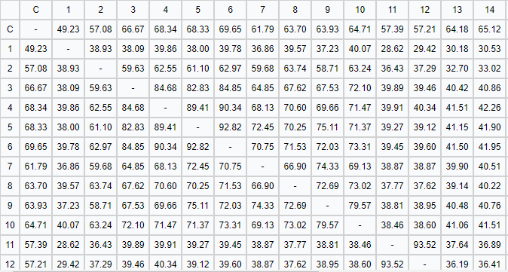
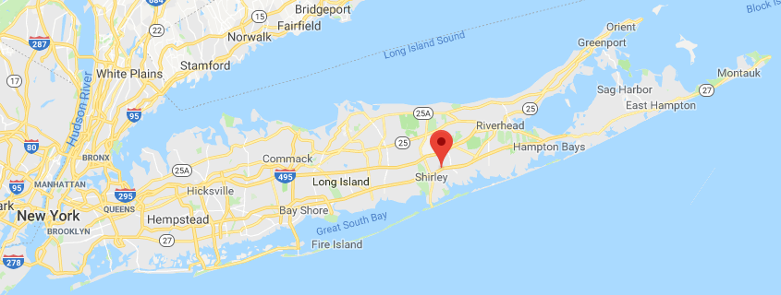
DNA barcoding can help us discover new species we didn’t even know we had. DNA barcoding was first recognized in 2003, when Paul Herbert’s research group in the University of Guelph proposed a new identification process to identify species(2). Here at Eastport South Manor Jr-Sr High School, we collected specimens from the Forge River and now we are trying to see if we will discover new species using the DNA barcoding process. How can we try to help the Forge River specimens with DNA barcoding? Also by collecting specimens from the Forge River we might be able to help clean the river. DNA Barcoding is and will be very helpful to us.
Abstract:
DNA Barcoding is a process in which the 648 base-pair region in the mitochondrial cytochrome c oxidase 1 gene is used to identify animals(CO1) and RBcL and TUFa for plants(4). Scientists once
were only able to identify species using only their senses. Now we have DNA barcoding which helps us a lot. We propose to use this process to identify collected species(1), share our data and make suggestions on how to restore the Forge River to its natural, healthy state. If some species are harmful to human well being then DNA barcoding may help identify them. DNA barcoding can significantly aid us in the discovery of new species and better help us understand the environment around us.
DNA Barcoding
Ava Gansrow, Brielle Ohlsen, Laura Schillizzi, Emily Wynne
Mentor: James Ostensen
Eastport South Manor Junior-Senior High School
Materials & Methods:
First collect you're specimen, then take a piece of sample tissue using tweezers.
Put the tissue sample into a little tube and add 300 ul of lysis solution and grind the sample. Incubate for 10 minutes at 65C. After centrifuge 1 min.
Transfer 150ul of supernatant to a new tube, add 3ul of silica resin ny using a pipette. Mix then incubate for 10 mins at 57C and centrifuge for 30 seconds.
Remove supernatant by using a pipette, add 500ul of wash buffer mix and centrifuge (when using the centrifuge make sure the tubes are set up to be balanced ex. 3 on one side 3 on the other), remove 500ul of the supernatant. Add 500ul of wash buffer into another tube and mix.
Centrifuge 30 seconds, remove 500 ul of the remaining supernatant and centrifuge for 8 seconds. Remove 50ul or remaining supernatant into a new tube. Add 100ul of dH2O, mix by pipetting in and out. Incubate for 5 minutes at 57C.
Centrifuge for 30 seconds transfer 50 ul of supernatant to a fresh tube. Chill on ice or store overnight 4C or -20C for a longer time period.
To amplify DNA by PCR, add PCR reagents to a new tube. Transfer 2ul of DNA to a PCR tube. Amplify in thermal cycles and chill on ice or store overnight 4C or -20C for a longer time period.
To make PCR products for gel electrophoresis, melt agarose at 30 second intervals, cool for 5 minutes, pour gel and set for 20 minutes. Add 2ul of SYBR green to fresh tube. Transfer 5 ul of DNA from PCR tube to SYBR green tube. Load gel, 5ul for sample. Store PCR tube with remaining 20 ul sample chill on ice or store overnight 4C or -20C for a longer time period. Electrophoresis 130 volts 400mA for 30 minutes, photograph and upload the image.
Send sample for sequencing and then analyze results using bioinformatics.
References~ DNA Barcoding packet
Introduction:
Figure 1: Gel electrophoresis 1(3)
Figure 2: Gel electrophoresis 2(3)
.
Figure 3: Shows us the differences in our samples
Figure 5: Phylogenetic Tree of Species
Discussion:
During our research, we discovered a lot harmful things
that can affect our environment. We didn't find a lot of diversity between our two known species of crab and snail. However they were able to provide us a lot of information about our environment. Both species are invasive and possibly carry disease. The crab has been known to eat it's own species (which does not help them and decreases their population) are found in Asia. The snail eats bass and trout eggs, helping to decrease their species population. They are very invasive also and that doesnt help the species living around them. The species around them aren't getting all the aspects they need to survive which is messing up the food chain(3). Out of all the species we could have found in Forge River we managed to pick up more than one of these species, showing that these species are pretty common in the Forge River, which is not a good sign for the ecosystem.
References:
1. DNA Barcoding 101. (n.d.). Retrieved November 14, 2017,from https://www.dnalc.org/websites/dnabarcoding101.html 2. DNA Learning Center Barcoding 101. (n.d.). Retrieved October 31, 2017, from http://www.dnabarcoding101.org/ 3. Fast Track to Gene Annotation and Genome Analysis - DNA Subway. (n.d.). Retrieved May 9, 2018, from https://dnasubway.cyverse.org/
4. What Is DNA Barcoding? (n.d.). Retrieved November 08, 2017, from http://www.barcodeoflife.org/content/about/what-dna-barcoding
Figure 4: Sequence Similarities
Figure 6: The Forge River location
Results:
In our results, we didn't find a diversity of species. We found mostly Vivipaurus Georgiansus(snail) and Hemigrapsus Penicillatus(crab)(3). The snails cause problems and carry illnesses. The snails eat bass and trout eggs, and both species are invasive. The crab has been found to eat its own species. These species are both commonly found in the Forge River which is a bad sign for its ecosystem because invasive species reduce biodiversity.
Acknowledgements:
We would like to thank Cold Spring Harbors, National Institute of Health, Stony Brook University, The Day in the Life Program, Melissa Parrott with the Central Pine Barrens Joint Planning and Policy Commission, Dr. Mel Morris at BNL and Eastport South Manor Junior Senior High School for providing us with information about DNA Barcoding.

Slide 2
During our research, we found many harmful things that can affect our environment. The crabs and snails aren't helpful to our environment. The snails are harmful to our environment. They are very invasive and that doesnt help the species living around them. The species around them aren't getting all the things they need to survive which is messing up the food chain. The snails allos eat bass trout eggs which decrease their population which is negative to the environment. The crabs are cannibals which doesn't increase there population. Also they are very invasive; they first originated in asia and now they are destroying environments in North America.

Slide 3
What everybody is completing
Emily- materials and methods
Brielle- Introduction
Laura- references, acknowledgement, results
Ava- figures(picture and writing next to it)
This is due tuesday

Slide 4
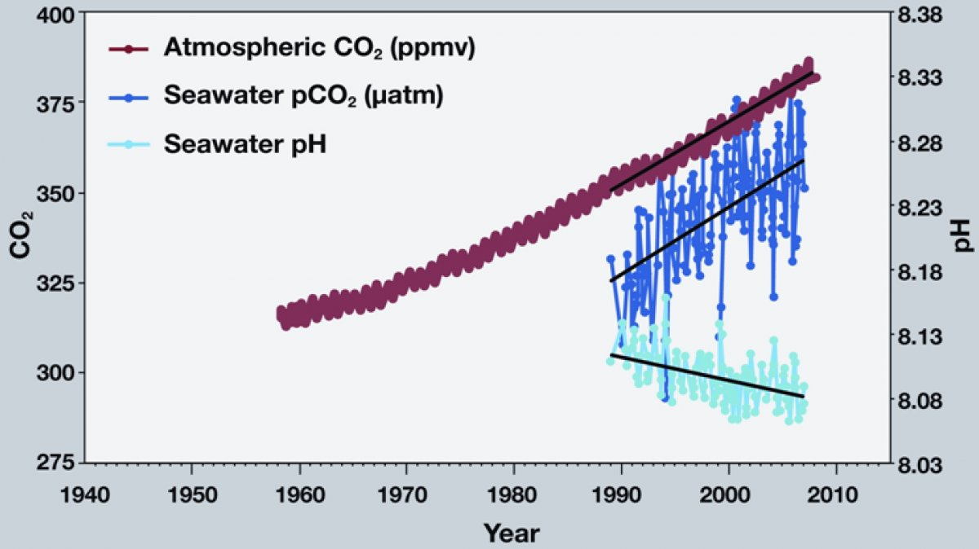
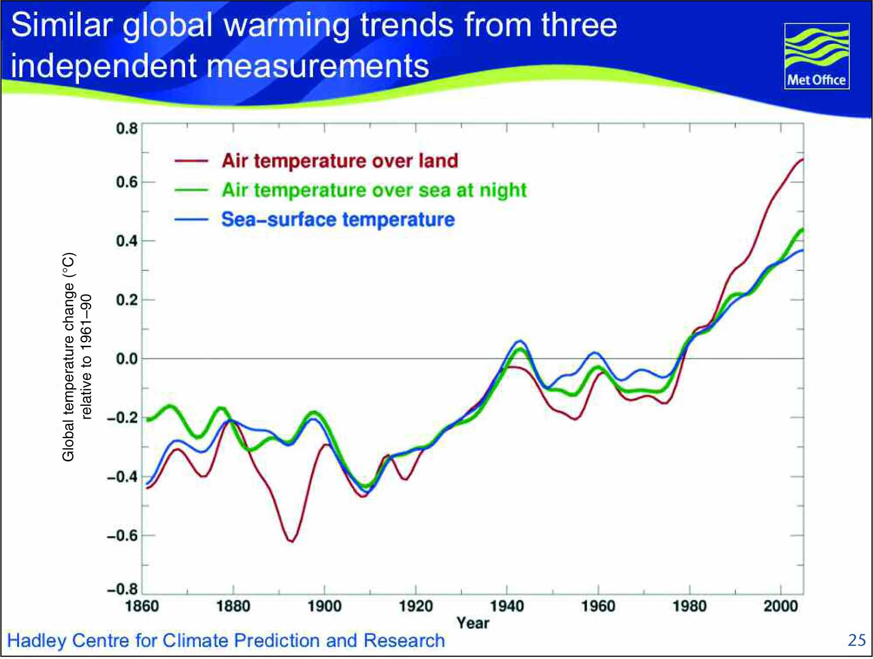
Depasquale, E., Baumann, H., & Gobler, C. (2015). Vulnerability of early life stage Northwest Atlantic forage fish to ocean acidification and low oxygen. Marine Ecology Progress Series, 523, 145-156. doi:10.3354/meps11142
Effects of Climate Change
Authors: Ava Gansrow, Brielle Ohlsen, Laura Schillizzi, Emily Wynne
Teacher: James Ostensen
Eastport South Manor Junior-Senior High School
Abstract
As anthropogenic Carbon Dioxide increases, so does dissolved Carbon Dioxide levels in bodies of water. This results in the lowering of PH, raising acidity. Scientists wonder what effects this will have on marine ecosystems and organisms in time to follow. This is crucial to determine to see what steps can be taken to, if there’s negative consequences, bring PH levels back to equilibrium. To determine the effects, tests will be conducted on two species of macroalgae- Ulva and Gracilaria.
Statement of Purpose
In “Ocean Acidification Accelerates the Growth of Two Bloom-Forming Macroalgae”, by Craig S. Young and Christopher J. Gobler, the main purpose of the article was to test how elevated levels of Carbon Dioxide(which causes climate change)would impact the growth rates of the two species of macroalgae being tested, Ulva and Gracilaria.
In “Climate Change Impacts on Marine Ecosystems”, the purpose of this article was to inform on how greenhouse gases are causing Climate Change. . It also talks about how Climate Change is making a huge impact on marine species.
In “Vulnerability of early life stage Northwest Atlantic forage fish to ocean acidification and low oxygen”, by Elizabeth Depasquale, Hannes Baumann, and Christopher J. Gobler, the main purpose was to see how to help the early life stage Northwest Atlantic forage fish because they are being harmed by acidification and low oxygen.
In “Hypoxia and Acidification Have Additive and Synergestic Negative Effects on the Growth, Survival, and Metamorphosis of Early Stage Bivalve” by Christopher J. Gobler it talks about low oxygen zones in coastal and open ocean ecosystems have expanded in recent decades, a trend that will accelerate with climatic warming.
Materials & Methods
Earth's temperature, amount of precipitation, sea level, solar activity, air pollutants, and water pollution are all indicators of climate change.
To measure the earth's temperature they use satellites, ships and buoys
To keep track of precipitation scientists use anemometers, rain gauges, Thermometers, barometers, and weather satellites.
To keep track of earth's sea level by using tidal gauges, floats, microwave radar water level sensors, and satellites.
To keep track of solar activity scientists monitor satellite footage, and use x-ray data and UV data
To keep track of chemicals and pollutants in the air scientist use air diversion models which have data that puts together topographic, emissions and meteorological data which informs us of pollutants
To keep track of chemicals in our water we use gill-netting fishing, remote sensing and PH testing.
Discussion
There were no mWaters, H. (2017, December 27). Ocean Acidification. Retrieved January 25, 2018, from http://ocean.si.edu/ocean-acidificationain differences in results other than each of the articles focused on a main topic for example the article “Climate change Impacts on Marine Ecosystems” focused on greenhouse gases and how they affect marine organisms meanwhile the article “Ocean Acidification Accelerates the growth of Two Blooming-Forming Macroalgae” focused on the change in ph levels due to the increase in carbon dioxide. Other than this we found commonalities for instance all of these things will continue to marine species negatively. As climate change continues to increase more and more organisms will continue to die.
References
1) Doney, S. C., Ruckelshaus, M., Duffy, J. E., Barry, J. P., Chan, F., English, C. A., . . . Talley, L. D. (2012). Climate Change Impacts on Marine Ecosystems. Annual Review of Marine Science,4(1), 11-37. doi:10.1146/annurev-marine-041911-111611
2)Depasquale, E., Baumann, H., & Gobler, C. (2015). Vulnerability of early life stage Northwest Atlantic forage fish to ocean acidification and low oxygen. Marine Ecology Progress Series,523, 145-156. doi:10.3354/meps11142
3)Gobler, C. J., Depasquale, E. L., Griffith, A. W., & Baumann, H. (2014). Hypoxia and Acidification Have Additive and Synergistic Negative Effects on the Growth, Survival, and Metamorphosis of Early Life Stage Bivalves. PLoS ONE,9(1). doi:10.1371/journal.pone.0083648
4) Waters, H. (2017, December 27). Ocean Acidification. Retrieved January 25, 2018, from http://ocean.si.edu/ocean-acidification
5)Young CS, Gobler CJ (2016) Ocean Acidification Accelerates the Growth of Two
Bloom-Forming Macroalgae. PLoS ONE 11(5): e0155152. Doi:
10.1371/journal.pone.0155152.
Young CS, Gobler CJ (2016) Ocean Acidification Accelerates the Growth of Two
Bloom-Forming Macroalgae. PLoS ONE 11(5): e0155152. Doi:
10.1371/journal.pone.0155152.
6) http://www.crawfordenterprise.com/Climate/Charts/ClimateRelatedCharts.html
Figure 1: As atmosphere and seawater Co2 increase as the seawater Ph decreases.(4)
Suggestions for Future Research
There are some unanswered questions still remaining about climate change like how long will it take to fix climate Change? Or what will happen in the near future if climate change continues? Or if the marine species are being harmed what about land animals?
.
Figure 2: Air temperature and sea surface temperature have greatly increased over the years due to climate change. (6)
Acknowledgements
We would like to thank Dr. Christopher Gobler, Scott C.Doney, Mary Ruckelshaus, J. Emmett Duffy, James P. Barry, Francis Chan, Chad A. English, Anne B. Hollowed, Nancy Knowlton, Jeffrey Polovina, Nancy N. Rabalais, William J. Sydeman, and Lynne D. Talley for providing us with information about climate change
Results - Throughout this experience we found that the main causes of climate change are because of humans. The gases we put from factories and
other things have negatively affecting the environment. Pollutants such as carbon dioxide and greenhouse gases have been causing fish populations to decrease. We also found throughout our reearch we may be able to help get our earth back to its natural state. Scientists will continue to research climate change, and other things that may correlate to it.

Slide 5
Effects of Climate Change on Marine Ecosystems
Authors: Ava Gansrow, Brielle Ohlsen, Laura Schillizzi, Emily Wynne
Teacher: James Ostensen
Eastport South Manor Junior-Senior High School

Slide 6
Abstract
As anthropogenic Carbon Dioxide increases, so does dissolved Carbon Dioxide levels in bodies of water. This results in the lowering of PH, raising acidity. Scientists wonder what effects this will have on marine ecosystems and organisms in time to follow. This is crucial to determine to see what steps can be taken to, if there’s negative consequences, bring PH levels back to equilibrium. To determine the effects, tests will be conducted on two species of macroalgae- Ulva and Gracilaria.

Slide 7
Purpose
In “Ocean Acidification Accelerates the Growth of Two Bloom-Forming Macroalgae” by Craig S. Young and Christopher J. Gobler, the main purpose of the article was to test how elevated levels of Carbon Dioxide would impact the growth rates of the two species of macroalgae being tested, Ulva and Gracilaria.

Slide 8
Methods and Materials
Earth's temperature, amount of precipitation, sea level, solar activity, air pollutants, and water pollutants all can be possible indicators of climate change. In order to keep track of climate change, we must keep track of all these factors by using specific tools and methods.
In order to for scientist to measure the earth's temperature they use satellites, ships and buoys
To keep track of precipitation scientists use anemometers, rain gauges, Thermometers, barometers, and weather satellites.
They keep track of earth's sea level by using tidal gauges, floats, microwave radar water level sensors, and satellites.
To keep track of solar activity scientists monitor satellite footage, and use x-ray data and UV data
they keep track of chemicals and pollutants in the air scientist use air diversion models which have data that puts together topographic, emissions and meteorological data which informs us of pollutants
To keep track of chemicals in our water we use gill-netting fishing, remote sensing and PH testing.
To test the effects of how elavated Carbon Dioxide levels(which is caused by climate change and human activity) on the growth rates of the two species of macroalgae that were being tested, Ulva and Gracilaria, several procedures had to be put in place and many tools were needed.

