Slide 1
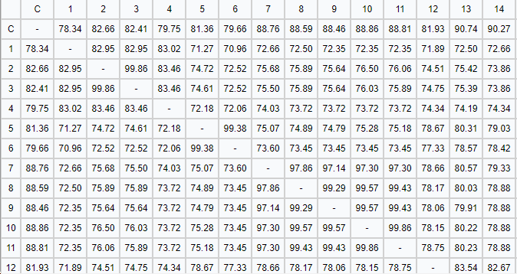
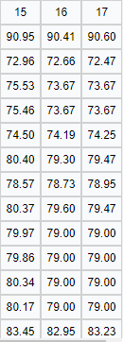
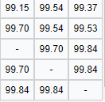
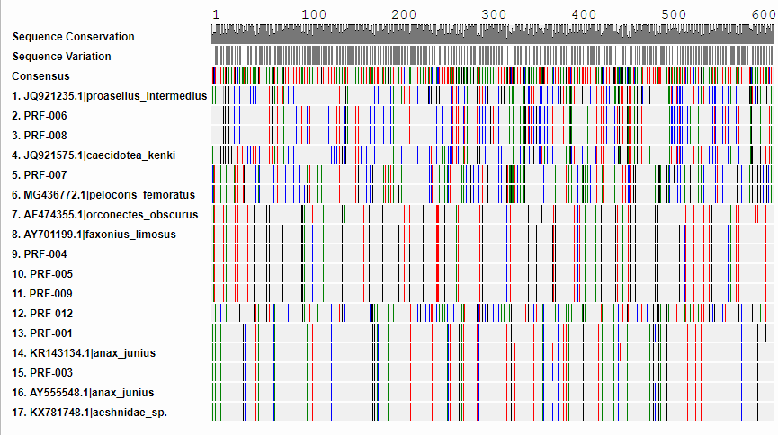
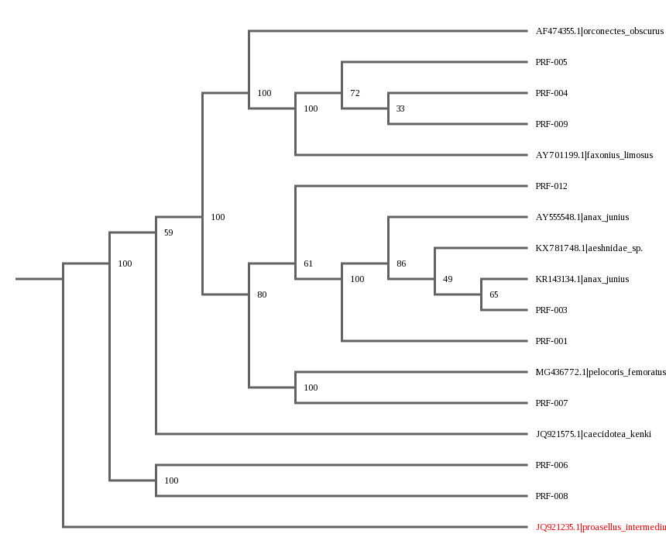
Identification of New Invasive Species in the Peconic River
By: Alec Arvidsson, Peter Geehreng, Matthew Halber, Dylan Kluepfel
Eastport South Manor Jr. Sr. High School
Abstract
Invasive species are one main cause for the poor conditions in the Peconic river. Using DNA Barcoding we can identify new species that may/may not be invasive. Through the process of PCR (polymerase chain reaction) we can extract, amplify, and compare the DNA (from the CO1 genome) of our insect and crustacean species. Using these processes we can identify species and determine if they are known, a novel species, or a invasive species. Using this information we can target these invasive species and eliminate them before they cause more harm.
Introduction
One of DNA barcoding’s primary job in this situation is to identify invasive species, such as in the Peconic (2). Being able to identify an invasive species is crucial to the sustainability of an ecosystem. An invasive species has no predators. Therefore, it can multiply rapidly and have a tremendous population size. This population will then steal food from other animals causing them to die. In the Peconic the Asian Shore Crab is one invasive species that causes ecosystem unsustainability. It’s actions may also be related to the mass Bunker fish kill and the overall poor conditions of the river. This decreases in species because of starvation will reduce the biodiversity of the river making it less resistant and resilient. Not only will it harm the species in the river, it will affect us. A decrease in species won’t allow for food to be collected by humans and polluted river water may contaminate our drinking water. However, can DNA barcoding help us completely get rid of the poor conditions within the Peconic River that has gone unfixed for many years, or have we waited too long to identify to get rid of other invasive species that are affecting the river?
Materials & Methods
Our specimens were found at Osprey Park, on the Forge River. The date of collection of the specimens was Friday, 10/13/17. The species were collected by catching them with nets and by hand. Some of the equipment needed to obtain the samples we’re nets to catch the species, tall rubber boots so you can go far into the water, scraping tools to help dig under the surface to help find some of the species, and jars to keep the species in because they could try to escape. Specimens are then stored by freezing them to keep them preserved.
From our specimens, we will collect a tissue sample from the muscle which is then going to be examined; this tissue sample will be a quarter of an inch in diameter (7). Then, using the tissue sample, we will go through multiple steps to separate the DNA from the tissue. Some steps included, incubation, the addition of solutions (silica resin, wash buffer, primer mix, dH2O, and mineral oil) to separate the DNA from the tissue, and the use of a centrifuge which will then completely separate the DNA from the muscle tissue (7). Once the DNA is thoroughly isolated, we will amplify and store the DNA until we are ready to use it. Finally, after adding and letting the gel set for twenty minutes, we can add our DNA. On either side of the gel, there is a negative side (where the DNA was inserted) and a positive side (the opposite side). The DNA from our sample, which is negatively charged, will be attracted to the positive charge and move toward the other side. The larger molecules will travel slowly, while the smaller molecules will travel faster. This speed at which the molecules move will cause the DNA to be separated by size. We can then compare the banding (separation of DNA by size) to other samples to determine the exact identity of our specimen.
For our animal species we have to extract a specific gene region. For animals, we would use CO1, and to target these particular genes, we will use different types of primers. A primer is a short nucleic acid sequence that allows for DNA synthesis. A primer, for our purposes, helps to distinguish and take out specific gene sequences related to what is needed to identify a species (enzymatic DNA synthesis); this is what's known as DNA amplification. This process is required to test only specific gene sequences within different species. If we didn’t use DNA amplification, we wouldn’t be able to test these particular gene sequences which may lead to misleading results. From our results, we can distinguish different species of animals based on their DNA sequences.
Discussion
Results from the PCR process indicate a novel or invasive species. As stated, PRF- 006 and PRF- 008 both resulted in similar DNA sequences that contained a very low bit score of 600, showing little similarity to any known species. However, these species are most likely novel, rather than invasive species. Our samples show species evenness within the Peconic River, because of this, PRF-006 and PRF-008 are most likely not invasive species because they seem as abundant as other species in the river (and invasive species would have a greater population than other species because they outcompete others). From other findings, most samples collected showed no potential threat to humans. Showing that most of the species collected carried no diseases and were not invasive.
However, these species can not easily be determined. Mistakes during the handling process or PCR process may have resulted in misleading results. Handling of these species by a specific person may have contaminated the DNA extracted, resulting in some DNA from that specified member in the sample. Another constraction to our results is the fact that the percent similarity of these samples to the rest is slightly over 70%, indicating some similarity between samples. .
From this, it can be determined that (from at least our samples) no new invasive species are present in the Peconic River, other than the already known, Asian Shore Crab. This means that there is a chance for the bettering of the Peconic River, and the removal of invasive species.
References
1. Priority Issues in the Peconic Estuary. (n.d.). Retrieved November 08, 2017, from https://www.peconicestuary.org/protect-the-peconic/priority-issues-in-the-peconic-estuary/
2. Armstrong, K., & Ball, S. (2005, October 29). DNA barcodes for biosecurity: invasive species identification. Retrieved November 08, 2017, from https://www.ncbi.nlm.nih.gov/pmc/articles/PMC1609225/
3. What Is DNA Barcoding? (n.d.). Retrieved November 08, 2017, from http://www.barcodeoflife.org/content/about/what-dna-barcoding
4. Huberty, E. (2017, March 06). What Do Millions Of Dead Fish Mean For Our Planet? Retrieved November 08, 2017, from https://www.huffingtonpost.com/entry/what-do-millions-of-dead-fish-mean-for-our-planet_us_58bd5ff8e4b02eac8876d0f6
5. Squire, P. (2016, September 03). In Peconic Estuary, rising temperatures appear responsible for several issues. Retrieved November 08, 2017, from http://suffolktimes.timesreview.com/2016/09/70224/in-peconic-estuary-rising-temperatures-appear-responsible-for-several-issues/
6. The Peconic Estuary Story. (n.d.). Retrieved November 08, 2017, from https://www.peconicestuary.org/discover-the-peconic/the-peconic-estuary-story/
7. Using DNA Barcodes to Identify and Classify Living Things. (2014). Retrieved October 30, 2017, from http://www.dnabarcoding101.org/files/using-dna-barcodes.pdf
Percent Similarity Chart- refer to below image for corresponding species names
Results
Most of our species turned out to be normal specimens found in the Peconic River. Two specimens (PRF- 006 and PRF- 008), however, had very low bit scores (600) and had little similarity to any known species. This indicates a possibility for a potentially new invasive species. Additionally, no other species indicated potentially threats to human health and none were considered invasive.
Dna Sequences of Species (trimmed to show only similar sequence strands)
Acknowledgements
Thank you to Cold Spring Harbor, Stony Brook University, and Eastport South Manor Jr. Sr. High School for helping with the Barcoding Process
Phylogenetic Tree of Species (numbers indicate percent similarity)

