Slide 1
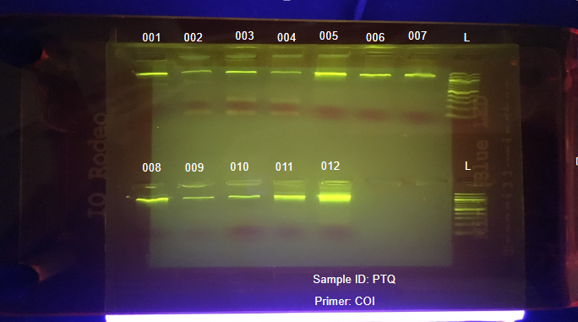
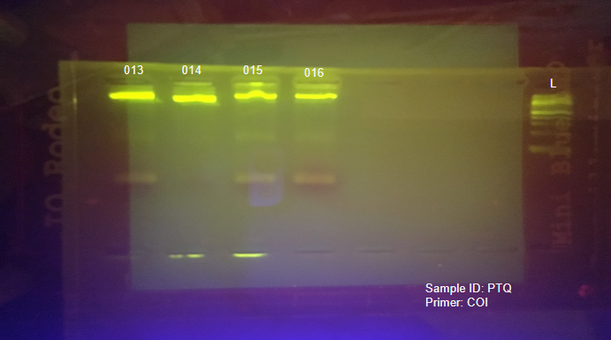
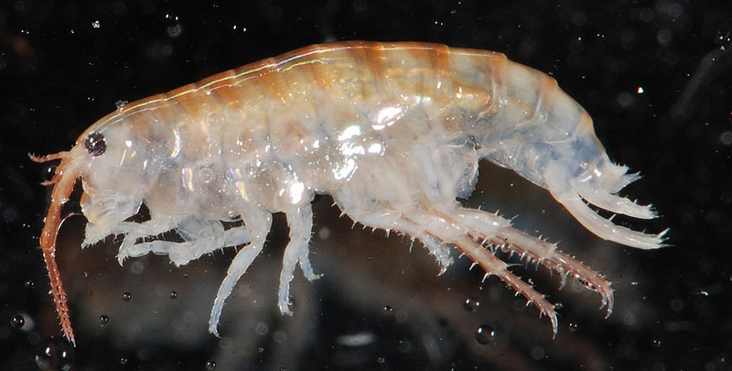
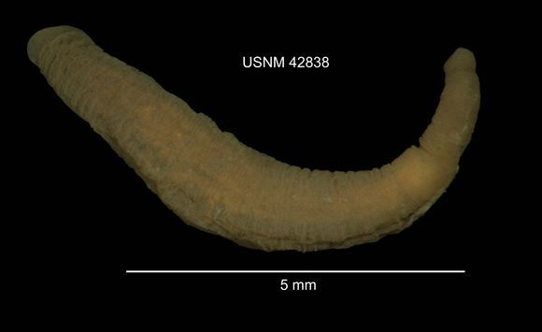
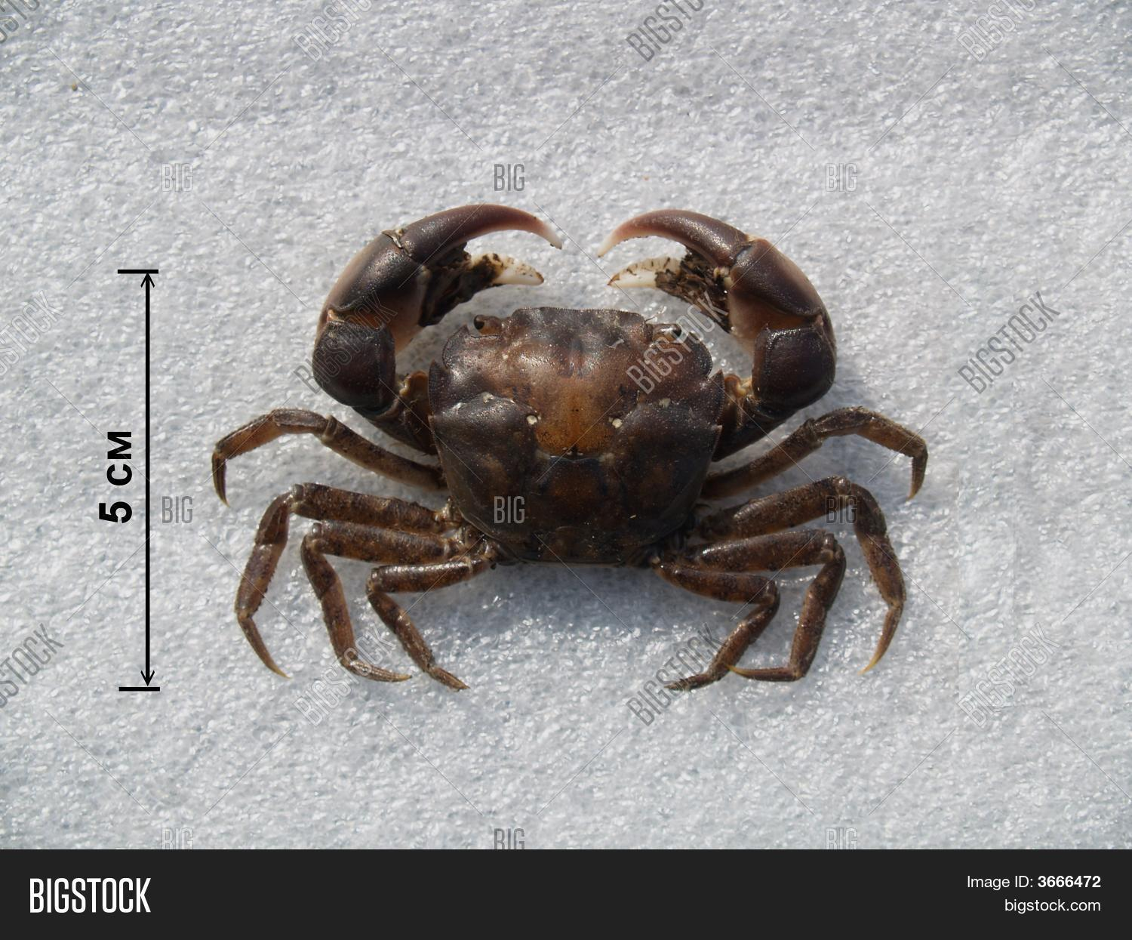
Effect of Forge River Organisms on the Health of Humans and Biodiversity
Gabrielle Freund, Olivia Lindquist, Thomas Michel, Anatolii Vakaryuk Teacher: James Ostensen School: Eastport South Manor Jr/Sr high school
Tables, Photos & Figures
[10 points]
For example: Map of GPS coordinates where samples were collected
Pie charts to showing types/numbers of samples analyzed
Table of BLAST search results
Phylogenetic trees (using different methods)
Table showing sequence similarities among/within species or populations
Figure linking the sample localities with their placement in the phylogenetic tree
Abstract
There is a variety of organisms living in the Forge River. Some are from Asia and Europe that could potentially carry harmful diseases. In an effort to assess biodiversity and water quality, species were collected using nets, water quality testing kits were used on the site of collection, and DNA sequencing materials used for barcoding. The samples that were barcoded came back to be all types of different animals. Some were invasive like the asian shore crab, some were native and some could transmit disease like the sand flea.
Introduction
The Forge River is a 4 mile long river on the south shore of Long Island. It has had negative impacts on its surrounding community due to its pollution. Samples of 16 invertebrates from the river have been collected and have had DNA barcoding performed on them to see if any of these organisms could be contributing to the negative impact on the health of humans and biodiversity in the river. This research will provide identification of collected organisms.
Materials & Methods
Materials:
DNA Footlocker Kit
Invertebrate samples
Forge River
Methods:
First, the samples were collected from the Forge River.
Then, smaller samples were collected from the original samples.
The steps provided by the DNA barcoding protocol were used to barcode the samples. (1)
After that, gel electrophoresis was performed to identify which samples contained DNA.
Samples with DNA were sent off to be barcoded.
Samples were BLASTED to find species. (2)
Discussion
The results show that most of the barcoded samples are invasive, which presents a threat to the current ecosystem of the Forge River. Samples 7, 10 and 11 were found to be invasive species as well as samples 14-16; coming from as far as the shores of east Asia and Europe and are omnivorous. The results were important because it was found where the species were originally from and if they were invasive or not. It was also found how they eat and how they affect human health. For example, transmission of diseases. One of the species found to affect human health was the sand flea, which bites humans and leaves itchy, red marks. Sand fleas can also carry tropical diseases transmitted through their bites. Although the disease is uncommon in the United States, it is not unheard of. Some suggestions for future research would be to further test the diseases found in invasive organisms and see if they can survive the different climates and habitats. The study may not have worked as as originally hypothesized because the organisms tested were different to find information on. In conclusion, the results are important to finding out a lot about a new/different species and if they are dangerous to humans.
References
Using DNA barcodes to identify and classify living things. (2014). Retrieved December 2, 2017, from https://www.dnabarcoding101.org/files/using-dna-barcodes.pdf
Fast Track to Gene Annotation and Genome Analysis - DNA Subway. (n.d.). Retrieved from https://dnasubway.cyverse.org/
Acknowledgements
Big thanks go out to the barcoding team at Stony Brook University for their assistance with our lab work and specifically Dr. Moloney, Mr. Bolen and Mr. Ostensen for their help throughout this entire project. More thanks go out to our school, the Day in the Life Program, Melissa Parrott with the Central Pine Barrens Joint Planning and Policy Commission, and Dr. Mel Morris at BNL.
.
Gel Electrophoresis of samples
1-12 numbered respectively
2) Gel Electrophoresis of samples
13-16 numbered respectively
3) Alignment viewer form DNA Subway samples 1-4 showing similarity and
non-simililarity
Results
Sample 1: Viviparus georgianus
Sample 2: Viviparus georgianus
Sample 3: Hemigrapsus penicillatus
Sample 4: Platorchestia platensis
Sample 5: Myzobdella lugubris
Sample 6: Platorchestia platensis
Sample 7: Hemigrapsus penicillatus
Sample 8: Erythemis simplicicollis
Sample 9: Leptuca panacea
Sample 10:Hemigrapsus penicillatus
Sample 11:Myzobdella lugubris
Sample 12: Platorchestia platensis
Sample 13: Ilyanassa obsoleta
Sample 14: Platorchestia platensis
Sample 15: Hemigrapsus penicillatus
Sample 16: Hemigrapsus penicillatus
(Platorchestia Platensis Sand Flea)
Samples 14,12 and 4
Myzobdella Lugubris Leech)
Samples 5 and 11
(Hemigrapsus Penicillus Crab)
Samples 16,15,10,7 and 3
Notes:
, m.kjbb bnnnnnnmnm /lnkj- ljh blh blh bjhh

Slide 10
Your BLI Summary Report Title [5 points] Abstract [10 points] A succinct summary of your project. The abstract from your summary report can also be used as the abstract for your poster. Introduction [10 points] What question was asked? This section provides background for the reader so that they can understand the precise question you are asking, and why your study is of scientific interest. Use your summary report's Introduction to develop the Introduction on your poster. On your poster you can add more details and better justify your research question. Materials & Methods [10 points] How was the question answered? Use your summary report's Materials and Methods to develop this section and provide details of any modifications to the original protocol. Tables, Photos & Figures [10 points] For example: Map of GPS coordinates where samples were collected Pie charts to showing types/numbers of samples analyzed Table of BLAST search results Phylogenetic trees (using different methods) Table showing sequence similarities among/within species or populations Figure linking the sample localities with their placement in the phylogenetic tree Discussion [15 points] How does this answer your question? What do these findings mean? Be objective in the interpretation of your results. Avoid making judgments. Remember, openly discussing unexpected results, difficulties, or mistakes is central to the scientific process. References [10 points] Document and credit all the sources of information you used for your project at the bottom of your poster. Whenever you state a fact that is based on the results of someone else’s research, you must cite their work in the proper format. Acknowledgements [5 points] Thank people/organizations that assisted them in doing the research. These can include collaborators, funders and reviewers. Results [10 points] What did you find? Show results for each one of the different experimental groups you mentioned in the Materials and Methods section. Mechanics and Logistics [10 points] Document spell checked, punctuation and grammar are correct. Grade contingent on work being completed on time. DUE DATES: DRAFT POSTER DUE FRIDAY MAY 7 FINAL POSTER DUE FRIDAY MAY 18

