Slide 1
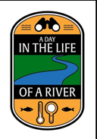
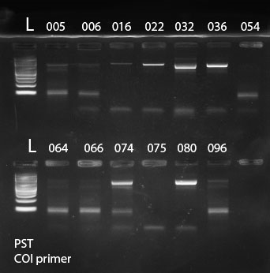
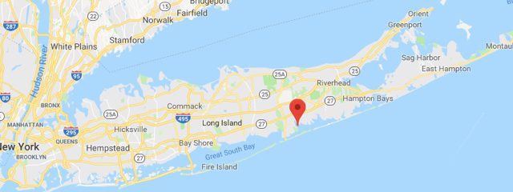
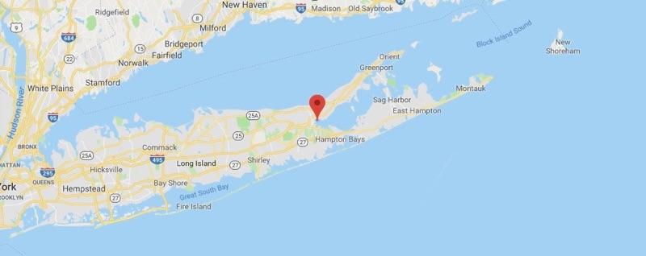
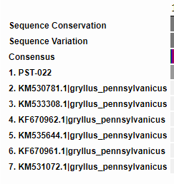
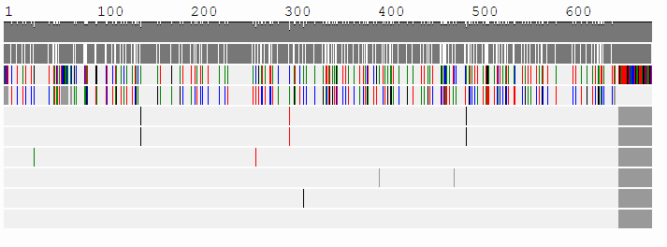
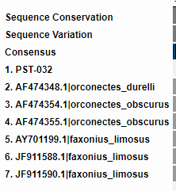
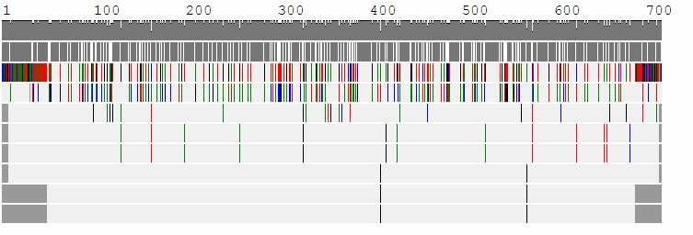
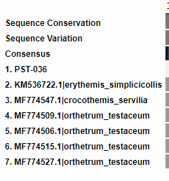
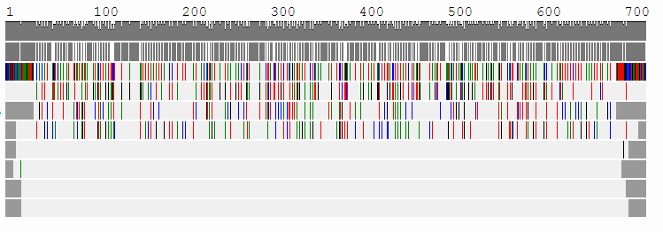
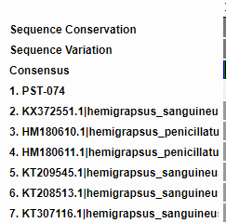
Biodiversity in the Peconic and Forge River
Authors: Sarah Dunn. Savannah Haushalter, and John Sepe
Mentor: Mr. Ostensen
Eastport South Manor Jr. Sr. High School
Figure 2: The Forge River. Latitude and Longitude of where some of the samples were collected
Figure 1: The results of gel
electrophoresis on PST
samples
Figure 3: The Peconic River: Latitude and longitude of where
some samples were collected
Materials and Methods
Thirteen unknown various aquatic and terrestrial organisms were collected on the Forge and Peconic rivers along different locations. They were collected using hands and nets.
The collected samples were then placed in plastic bags of ethanol and stored in a freezer after having their pictures taken and being labeled/identified.
Using the tweezers and our hands, we attempted to take pieces of muscle tissue from the organisms mainly from the limbs (2)
The microtubes were then taken to have the DNA extracted and make copies of the CO1 gene using PCR (5), which used the materials: Microtubes, micropipette, incubator, centrifuge, agarose, vortex, and an ice bath. (1)
The photographs were uploaded, and approved samples were sequenced using BLAST and the results were analyzed using bioinformatics. (1)
Abstract
The purpose of this research project is to assess biodiversity and the impacts of the species found in the aquatic habitats on human health. In this project we also hope to identify a novel species. One of the main goals was to identify disease causing organisms that could pose a threat to human health, such as unknown transmitters of disease. By doing this we could prevent the spread of disease in the future. The research question that our group poses is; Do any of our collected specimen have a harmful impact on human health?
Introduction
Many rivers and estuaries have an expansive amount of biodiversity. In this research project, we have collected organisms from the Peconic and Forge rivers to analyze the differences and similarities in DNA across all collected species. We are able to see if the biodiversity is exclusive to each area individually, or if there are similarities in specie types in both bodies of water. Through DNA barcoding and gel electrophoresis, we were able to compare species. These processes were able to give us information to determine whether or not a novel species was collected.
We gathered these specimens to analyze their original origin to help us understand more about the species, whether or not a species is invasive or harmful to its surrounding environment. When barcoding the collected specimens, we are able to reveal any diseases that can harm human health, along with any damages the species can cause to its environment. Once we are able to identify any environmental issues with the species, we will know how to act upon any underlying issues.
Figure 4: DNA Barcode sequence alignment for selected species
Results
In this research project, we collected a total of twelve samples from the Forge and Peconic rivers which were then barcoded. Four samples were barcoded successfully with high alignment lengths, which included: PST-022, PST-032, PST-036, PST-074, and PST-080. Samples PST-022, PST-032, and PST-036 were closely identified with little to no mismatches. PST-074 had a variable amount of mismatches, and PST-080 had a consistent amount of high mismatches, with the closest match being Mooredbella Melanostoma with 61 mismatches. Hemigrapsus Penicillatus, an invasive crab species was closely identified, as well as Anopheles Rangeli, a mosquito responsible for the spread of viruses and has been linked to spreading an agent that can cause brain tumors. Unfortunately, because of some confusion during the barcoding process sample PST-080 was lost and further research can not be done on it.
Discussion
While barcoding the selected specimens, we were able to tell through linked websites which specie causes harm to human health. While barcoding PST-022, the closest related species carried no disease, therefore not impacting human health.
When species numbered PST-032 was barcoded, we found that Gryllus Pennsylvanicus carries the O’nyong’nyong virus and Malaria, which is a fetal parasite. Barcoding PST-032 showed us that there is a possibility that this specimen too could carry harmful diseases.
While barcoding specimen PST-036, no major disease carrying organism showed as a result for the specific specimen, therefore indicating that PST-036 probably doesn’t carry diseases.
When species numbered PST-074 was barcoded, both the Erythemis Simplicicollis and one Orthetrum Testaceum species was found to carry diseases which impacts human health. A different Orthetrum Testaceum does not have enough data and studies on the species so whether or not it carries diseases is inconclusive.
This findings answer our question since we were able to prove that some closely related species carry diseases, impacting human health.
While barcoding each selected specimen, we found that a few had a lot of mismatches and some had very little. When we further researched the specimen with high mismatches we saw that no other researched/studied specimen looked quite like ours.
References
DNA Learning Center Barcoding 101. (n.d.). Retrieved from https://www.dnabarcoding101.org/
MT-CO1 gene - Genetics Home Reference. (n.d.). Retrieved from https://ghr.nlm.nih.gov/gene/MT-CO1
Peconic Estuary Program. (n.d.). Retrieved from https://www.dec.ny.gov/lands/31842.html
(n.d.). Retrieved from https://www.nature.com/scitable/definition/gel-electrophoresis-286
What is PCR (polymerase chain reaction)? (2016, January 25). Retrieved from https://www.yourgenome.org/facts/what-is-pcr-polymerase-chain-reaction
Acknowledgements
On behalf of this group, we’d like to thank our mentors, Mr. Robert Bolen and Mr. James Ostensen for guiding us through this project. We’d also like to acknowledge the Stony Brook University professors for allowing us to use there time to prepare specimen samples. The Cold Spring Harbor Institute and the Day in the Life Program played a major role in this project and we’d like to thank them for this opportunity.

