Slide 1
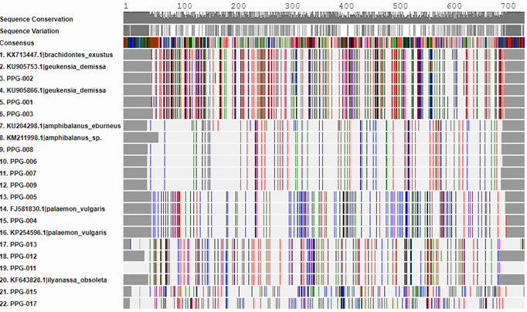
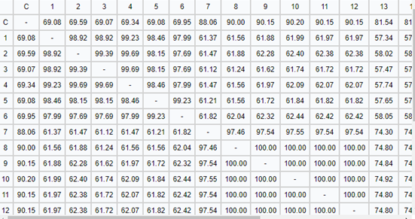
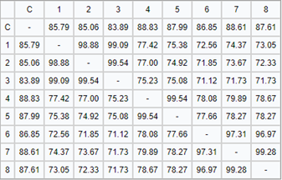
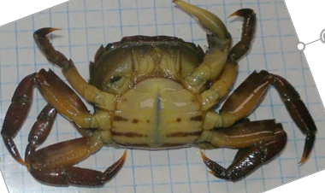
Biodiversity in the Forge River
Anna Suske, James Simon, Marcella Ortolan, Michael Hasapidis
Mentor: James Ostensen
Eastport South Manor Junior-Senior High School
Abstract
The focus of this project was to compile information from previous studies on the biodiversity in the Forge river. We conducted this project to compare our results to previous years in order to see how the changing environment affects the biodiversity.
Introduction
The primary goal of this experiment is to collect specimen from the Forge River, a declared impaired body of water, set a baseline for biodiversity, and determine the potential impact on human health.
By allowing other schools and future generations to look at the results, it will be possible for them to see how the ecosystem has changed in terms of species living in the Forge River. We can help future generations tell if our efforts to improve water quality has been working. This is also a sign of increased biodiversity. If there is more biodiversity that means that there will be a more stable environment. A second goal is to identify indicator species. These organisms are called indicator species and when they are present they can indicate that the conditions that are required for the survival of many different species that are present as well. These indicator species can also reveal the overall health of the river which can impact humans
Materials & Methods
A fifty foot seine net was used to collect organisms then sort the organisms by hand. A seining net is a net with one pole on each end, with floats on the top and weights on the bottom.
Next the specimen were collected and identified, brought them into the school, took pictures, immersed each in anhydrous ethanol to preserve DNA and kill bacteria to thereby prevent decomposition.
Next the specimen were froze to further preserve them.
Experts from Stony Brook lab helped identify the species.
Then DNA was extracted from the samples.
The PCR lab was then performed .
And lastly the gel electrophoresis was performed to analyze the PCR results.
Discussion
The goal of this project was to help set a baseline of biodiversity in the Forge River. In this project, we barcoded different specimen that were collected from Osprey Park. The results we had were very good sequences which had an average of 0 mismatches therefore telling us the species the organism is. Our results suggests that there is not a lot of biodiversity in the Forge River which most likely the cause of the poor river quality. Our results also determined that there are invasive species in the river. One example of those species is the Hemigrapsus penicillatus, also known as an Asian Shore crab. It is classified as an invasive species because it is indigenous to the western Pacific Ocean from Russia, along the Korean and Chinese coasts. The Asian shore crab also has no natural predators in this area because it is invasive. There is a possibility of the biodiversity increasing in the forge river. In order for this to happen, we need to continue with the shellfish restoration to improve the water quality. We can also introduce predators to the invasive species living in the Forge River. The improved water quality and an increased biodiversity could be determined by future barcode projects from the Forge River.
References
1) What is DNA Barcoding? (n.d.). Retrieved September 12, 2017, from http://www.ibol.org/phase1/about-us/what-is-dna-barcoding/
2)Forge River (New York). (2017, September 25). Retrieved October 01, 2017, from
https://en.wikipedia.org/wiki/Forge_River_(New_York)
3)“DNA Learning Center Barcoding 101.” DNA Learning Center Barcoding 101,www.dnabarcoding101.org/.
Acknowledgements
Thank you Stony Brook University for allowing us to use your facilities. Thank you Cold Spring Harbor for providing us with support, materials and facilitating the barcode project. Thank you ESM your support.Thank you to Day in the Life Program, Melissa Parrott with the Central Pine Barrens Joint Planning and Policy Commission, Dr. Mel Morris at BNL,
Results
The sequence quality is very good, shown by the high bit score.
The average mismatch is 0 therefore there is no novel species.
The species we found include snails, crabs, shrimp and barnacles.
An invasive species was found. The invasive species found was the Asian shore crab also known as Hemigrapsus penicillatus
Chart 1: Chart shows the genetic similarities between the collected organisms and the known organisms that prove the species are related. This chart includes the collected specimen 1-9 and 12.
Chart 2: Chart shows the genetic similarities between the collected organisms and the known organisms that prove the species are related. The collected specimen are 11,13,17 and 15.
Figure 3: Specimen 017. Asian crab, Crangon Septemspinosa.
Figure 4:
Map of Osprey Park where the specimen were coollected.
Table 1: Goes with chart 1 and shows shows similarities among the different species
Table 2: Goes with chart 2 and shows the percentages that they are a certain species.

