Slide 1
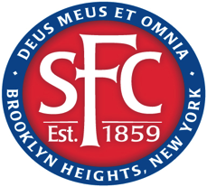
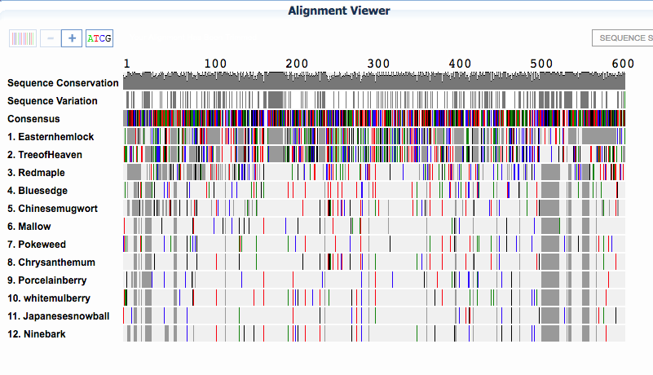
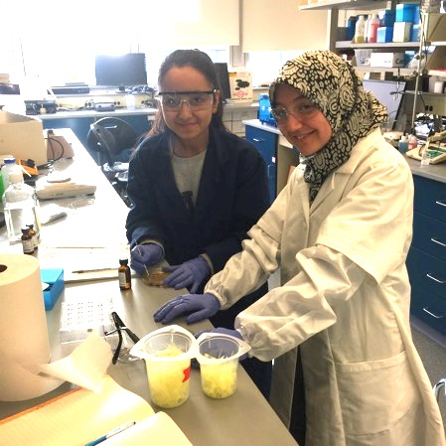
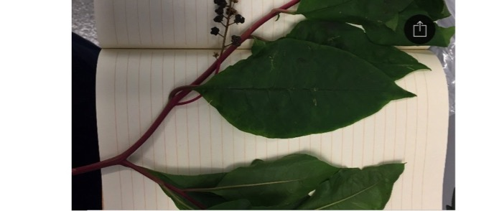
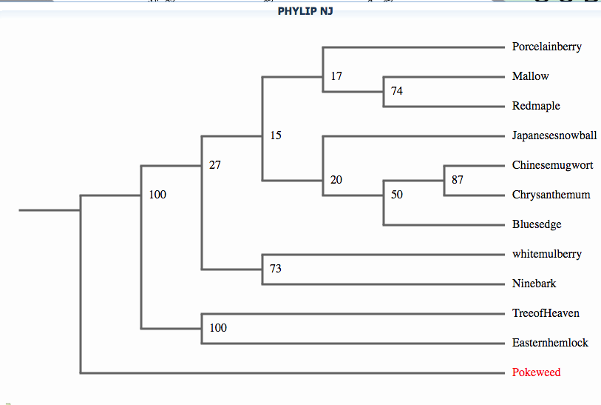
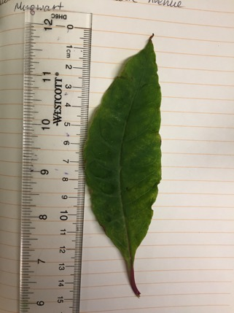
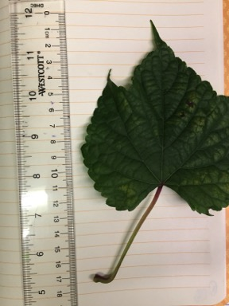
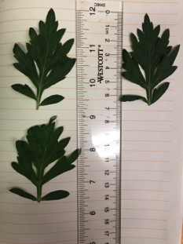
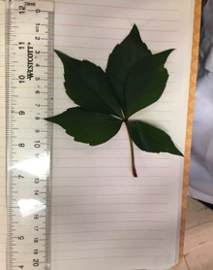
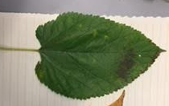
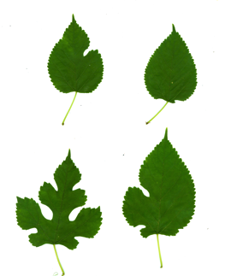
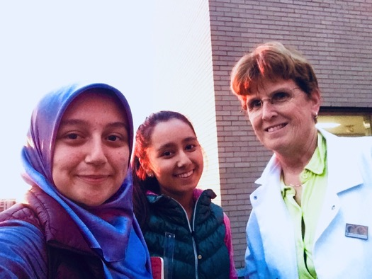
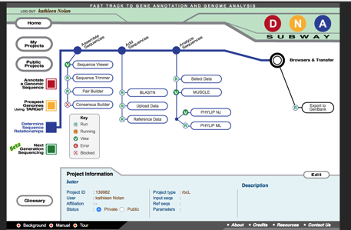
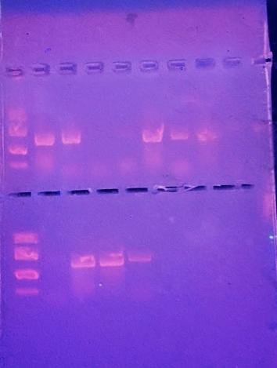
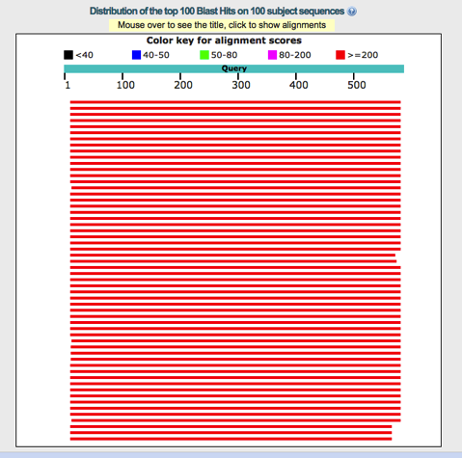
J
Should we save native species at the expense of invasive species?
A Comparative Study of Native and Invasive Plants in NYC Using DNA Barcoding
Authors: Muminakhon Nazarzoda,¹ Diyora Samadova ¹
Mentor: Kathleen Nolan ²
¹ James Madison High School; ²St. Francis College
Abstract
Native species are plants, animals, or other organisms that have historically occurred and evolved in a specific region. Invasive species have been brought accidentally or intentionally into a place by humans or their activities. How do natives and invasives impact one another and should one be removed to save another? In this research, we identified seven non-native and four native plant species in different parts of Bronx and Brooklyn parks and studied their relationship with the environment and surroundings. To reach this goal, we extracted DNA from specimens from various locations, ran PCR to amplify the DNA, performed gel electrophoresis to make sure DNA was extracted, and finally we sent the DNA to the facility to be sequenced. Using BLASTn and the DNA sequence we determined plants’ identities. We also attempted to observe their evolutionary relationships. This work was a first step for us in learning about native versus non-native species and their relationships to each other.
Results
In our first trial, only 3 samples’ DNA showed in the gel. DNA amplification was ran again in a little different way after which we acquired better results. Out of 22 specimen, the DNA of 14 plants could be seen in the gel. Despite this, all of the samples were sent to the facility, and 17 of them could be primed. Only 12 out of these 17 gave us accurate information about plants. Results that showed “no priming” or imprecise results were mainly from dry leaves. 7 out of 12 were found to be invasive, while the other 5 are native to North America.
Discussion
The majority of the plants we identified were non-native species. Lindemann-Matthies (2016) noted that there was a negative correlation in positive feelings for ornamental plants (invasives) and their ability to identify these plants. Moreover, they were unwilling to remove these plants, partially because they were so familiar to them and they did not see them as being “invasive”. One of our roles as students and educators would be to teach the public about some of the damage that invasives can do. It is generally projected that there will be an increase in hurricanes and storms because of climate change. Bhattarai and Cronin (2014) found an increase in cover of Phragmites spp. (a marsh grass) after Hurricane Katrina, and predict that it will become increasingly difficult to manage “invasions” such as this. Holcombe et al. (2010) have devised predictions of species diversity based on climate change projections. DNA barcoding can enhance detection of species, especially invasives, and mitigation could perhaps be effected before the invasive populations become too large. However, Bosci et al. 2016 predict that native plants have a much wider climate tolerance than originally thought. Even though this is probably true for invasives as well, it gives hope to those who would like to “restore” habitat to include more native species, especially in light of climate change. Information from our study also might help set the stage for future park restorations such as has been attempted in Prospect Park in Brooklyn (DiCicco, 2014).
Introduction
Biodiversity is the variety of life in the world or in a particular habitat or ecosystem. Biodiversity is highly dependent not only on native, but also on invasive species.. Native species are plants, animals, or other organisms that have historically occurred and evolved in a specific region. Invasive species have been brought accidentally or intentionally into a place by humans or their activities. Sometimes invasive species conquer native species, adapt to their environment and take away their nutrition. Slowly invasive species spread all over that particular region and displace native species. An example personally noted is a vine that might cover a tree.
Invasive plants pose much controversy in the scientific community. Do we remove them or let them stay? For example, removal of Japanese knotweed along the Bronx River was only successful temporarily (Haight 2017). A hallmark of invasive species is that they grow quickly over disturbed areas. In other words, cutting them down can actually increase their re-growth. It is not clear-cut as to whether or not invasive species are “bad” for the environment. Puth and Burns (2009) attempted to study species richness in NYC, and noted that, while there are several declines, there are also increases in species richness due to exotic or invasive species. A specific study that attempted to restore native plants to the area around Corona Lake in Queens showed that, without management, many of the invasive plants will return (Galbraith-Kent and Handel, 2007).
This research was conducted to get an overview of New York City’s biodiversity, collect data that might be used in future for comparison or further studies, and study the evolutionary relationships of certain species. Some questions that were answered in our study are: How and why are DNA sequences applied? Can DNA be extracted from dry plants? How is biodiversity is affected by invasive species? What can we do to maintain biodiversity?
Common name | Latin name | Date and Location | Native or Invasive? | Notes
mulberry | Morus alba | Bronx-Spuyten Duyvil | Invasive Asia | Toothed leaf---plastic shape
Japanese snowball | Vibernum plicatum | Bronx-Spuyten Duyvil | Invasive Asia | Toothed oval leaf
Tree of Heaven | Ailanthus altissima | Bronx-Spuyten Duyvil | Invasive- Asia and Australia | Pinnately compound leaf—looks tropical
Ninebark | Physocarpus opulifolius | Brooklyn-Seth Low Park | Native to N. America, Asia | Dark purple tri-lobed Pointy leaves
Pokeweed | Phytolacca americana | Bronx-Spuyten Duyvil | Native to N. America | Oval leaves--Purple berries in fall
Mallow | Malva neglecta | Brooklyn-Seth Low Park | Invasive Asia | Small, roundish leaf
Mugwort | Artemisia argyi | Brooklyn-Marine Park | Invasive Asia | Deeply lobed and pointy leaves
Porcelain berry | Ampelopsis glandulosa | Bronx-Spuyten Duyvil | Invasive Asia | Leaves triangular--Beautiful purple and turquoise berrieis in fall
Blue sedge | Carex pallescens | Bronx-Spuyten Duyvil | Native to N. America | Green blade with yellow edges
Eastern hemlock | Tsuga canadensis | Bronx-Spuyten Duyvil | Native to N. America | Evergreen-small, flat needles
Chrysanthemum | Chrysanthemum borale | Brooklyn-Seth Low Park | Invasive Asia | Climbing vine—oval or triangular leaves
Red maple | Acer rubrum | Brooklyn-Marine Park | Native | Three-lobed, pointy leaves
DNA Subway flowchart which shows how DNA sequences are entered into the program, which then makes alignment of sequences and phylogentic trees (both neighbor joining and maximum likelihood).
Acknoledgements
JMHS: Mr. Herbs S., Mr. William Dumont
UBRP team: Dr. Alison Cucco, Dr. Christine Marizzi, Dr. Kathleen A. Nolan (mentor)
The Pinkerton Foundation, Science Sandbox and Cold Spring Harbor Laboratory
Materials and Methods
Plant specimen, permanent marker, pipette and pipette tips, lysis solution [6 M Guanidine Hydrochloride], incubator, centrifuging machine, tubes, silica, wash buffer, distilled water, DNA polymerase, taq polymerase (12.5μl) & rbcl primer mix (10μl) or 23μl primer mix to PCR beads, ice, thermocycler, agarose gel (agarose powder, 1x TAE buffer, dye), marker-PBR 322, gel electrophoresis.
All of the samples were collected randomly from different parts of New York City, mainly from parks. We had total of 22 samples from which 11 were collected from Riverdale, Bronx on 28 December 2017; 4 from Bensonhurst Parks, Brooklyn (dates vary); 4 from Marine Park, Brooklyn on 29 October 2017; and 4 from Brooklyn Heights on 10 October 2017. We did have some dry leaves, but some of those that are from Bensonhurst were collected a year ago. Fresh leaves were our control group, and dry leaves were our experimental group. We performed DNA extraction, amplification, and gel electrophoresis. Extracted DNA were sent to the sequencing facility.
When the DNA sequences were mailed back to us, they were copied and pasted into a box on the NCBI webiste and run through a Basic Alignment Sequence Tool (BLASTn) program. This tool compares our sequences to those in Gene Bank, and then displays the top 100 closest matches to our sequence(s). If we knew the species, it made it easier to identify, because there are similarities among the species. If we did not know the sequence, we picked the top sequence. Most were between 99-100% similar. Once we knew the species names within reason, we renamed the sequence with the common name of the plant. Then these sequences were added in the proper forward in the program DNA subway. We were able to pictorially show alignements of the 12 seqeunces (one was a repeat) and generate phylogenetic trees. The closer the branches were to each other, the more closely related were the species.
References
Bhattarai G, Cronin J. 2014. Hurricane Activity and the Large-Scale Pattern of Spread of an Invasive Plant Species, Plos ONE [serial online], 9(5):1-7.
Bocsi, T., Allen, J.M., Bellemare, J., Kartesz, J., Nishino, M., Bradley, B.A. 2016.
Plants’ native distributions do not reflect climatic tolerance, Diversity and Distributions, 22, 615–624.
DiCicco J. 2014. Long-Term Urban Park Ecological Restoration: A Case Study of Prospect Park, Brooklyn, New York, Ecological Restoration [serial online], 32(3):314-326.
Galbraith-Kent, S.L., Handel, S. N. 2007. Lessons from an urban lakeshore restoration project in New York City, Ecological Restoration 25(2):123-128.
Haight C, V S. 2017. Japanese Knotweed Management in the Riparian Zone of the Bronx River, Ecological Restoration [serial online], 35(4):298-302.
Holcombe T, Stohlgren T, Jarnevich C. 2010. From Points to Forecasts: Predicting Invasive Species Habitat Suitability in the Near Term, Diversity (14242818) [serial online], 2(5):738-767.
Lindemann-Matthies P. 2016. Beasts or beauties? Laypersons' perception of invasive alien plant species in Switzerland and attitudes towards their management, Neobiota [serial online], 29:15-33.
Puth L, Burns C. 2008. New York's nature: a review of the status and trends in species richness across the metropolitan region. Diversity & Distributions [serial online],15(1):12-21.
This is a sample sequence obtained from a forward universal primer that revealed Carex pallescens.
This table shows matches to Carex pallescens as well as other Carex species.

