Slide 1
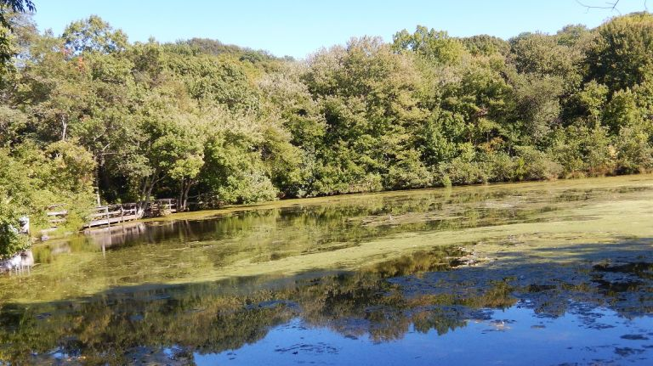
The Biodiversity of Algae on Long Island
Authors: Coraima Flores, Stella Mancini
Mentor: Ms. Nellins
Saint Dominic High School
Discussions:
Since we did not amplify any algae, our conclusions cannot answer the question we asked. What we can conclude though is that plant DNA may have broken down and contaminated the algae, or we could have incorrectly identified the algae and collected plants instead. Our studies did not work with what we had originally hypothesized because we did not obtain the expected results or results pertaining to our project at all. Algae is difficult to isolate and the results that we acquired were not algae but instead plants. Some mistakes that we had made during our experiment was that we did not put our samples in ethanol so the DNA could have been lost. Another mistake could have been that we collected plants not algae. For future investigations, we should collect algae from an isolated area and preserve the samples in ethanol and not water.
Abstract:
Algae can be found in various habitats due to its toleration for most conditions. It relies on sunlight for photosynthesis and often blankets over water. In this investigation, we studied possible differences in algae from a natural pond compared to a plastic-lined artificial pond. We sought to collect ten samples from each location, which we would then examine to evaluate the similarities and differentiations between algae from either area. In addition to the twenty algae samples and twenty test tubes to hold them, this study required two primers--rbcL and tufA--which are effective on the DNA of algae. We did not get any algae results but instead plant results. From both locations, we obtained many different types of plants including plants like oak and duckweed. Our results mean we could not properly answer our question. This indicates the decomposition of neighboring plants in the same water as the algae.
Results:
Not all of our samples amplified completely, but most of them had one readable sequence of either forward or reverse strand. In fact, when we had analyzed the samples following gel electrophoresis we found that most of the DNA had moved very little, indicating either large amounts of base pairs or some other obstacle that prevented travel towards the positively-charged side of the gel. We BLASTed those samples and in doing so found that none of them were identified as algae, but rather as very different plant species.
References:
Gobler, Christopher J., et al. "Characterization, dynamics, and ecological impacts of harmful Cochlodinium polykrikoides blooms on eastern Long Island, NY, USA." Harmful Algae 7.3 (2008): 293-307
Graham, Linda E. “Algae - Botany 330.” Preservation of Algal Samples, 26 Sept. 2014, courses.botany.wisc.edu/botany_330/preservation.html.
Holz, Joe, et al. “Benefits and Problems with Pond Algae.” Kasco Marine, Kasco, 10 Feb. 2016, kascomarine.com/understanding-the-benefits-and-problems-with-pond-algae/.
Jagielski, Tomasz, et al. “High Quality DNA Extraction from Microalga.” Plant Methods, BioMed Central, 3 Oct. 2017, www.ncbi.nlm.nih.gov/pmc/articles/PMC5627410/.
Leibold, Mathew A. "Biodiversity and nutrient enrichment in pond plankton communities." Evolutionary Ecology Research1.1 (1999): 73-95.
Management, SOLitude Lake. “Pond Algae In The Winter!?” SOLitude Lake Management: Full-Service Lake And Pond Management, 18 Feb. 2013,
www.solitudelakemanagement.com/solitude-lake-management-blog/bid/292839/Pond-Al gae-In-The-Winter.
Ryther, John H. “THE ECOLOGY OF PHYTOPLANKTON BLOOMS IN MORICHES BAY AND GREAT SOUTH BAY, LONG ISLAND, NEW YORK.” The Biological Bulletin, Apr. 1954, www.journals.uchicago.edu/doi/abs/10.2307/1538713.
“Sampling Tips.” Manaaki Whenua - Landcare Research, .www.landcareresearch.co.nz/resources/identification/algae/identification-guide/find-collect/ng-tips.
“Using DNA Barcodes to Identify and Classify Living Things.” DNA Barcoding 101, 2018.
“What Causes Algae in Lakes and Ponds? | AEC Lakes.” Lake and Pond Management Services | Aquatic Environment Consultants, 2017, aeclakes.com/resources/causes-of-algae-in-lakes-and-ponds/.
Intro:
Algae is an extremely diverse category of eukaryotic organisms that are responsible for synthesizing a massive amount of the world’s oxygen supply. It comes often as a byproduct of pollution. Algae functions both as a major oxygen source, but also consumes massive amounts of oxygen, which over time can kill off or limit other species in a habitat. More recently, algal blooms have been occurring in beaches all around the United States, allowing scientists to conduct more studies on how they impact environments and how their functions differ from each other. These micro- and macroscopic organisms behave in a way very similar to that of plants, but have a different cellular structure. Being that “algae” is not a very specific organization of eukaryotes, not all members of this group are very closely related, and thus there is a great amount of diversity between different species of algae. This experiment in DNA sequences seeks to find differentiations between several algae samples collected from a manmade pond and a natural pond in Suffolk County, Long Island. We hypothesize that if we collect samples of algae from two different ponds on Long Island, then we will find genetic differences between the specimens because their habitats are not the same and neither are their environmental functions. We ask the question: Does plastic affect the algae or will both the algae from the natural pond and the manmade, plastic pond be the same?
Sample Number | Closest Species Identified With
1, 9, 11, 17, 20 | --- (no results)
18 | --- (indistinguishable due to too many different possibilities)
2, 3, 4, 5, 6, 7, 10 | Quercus rosacea
8 | Solanum rostratum (Buffalo bur) With a 26 base-pair difference
12 | Fouquieria splendens (Ocotillo) With a 60 base-pair difference
13, 14 | Landoltia punctata (duckweed)
15 | Quercus vaseyana
16, 19 | Wolffia brasiliensis (Brazilian watermeal)
Methods and Materials:
To collect our samples, we followed a certain criteria to help us choose our algae. We were looking for algae that was green, in the water, and what appeared to be an abundance of algae. We collected our algae on April 6, 2019 during the day, so we could visibly see the algae. We collected the algae after winter because winter slows the growth of algae (Management, 2013). We obtained our samples at the Stella Mancini’s house and at the Twin Ponds in Centerport. We did not need permission to collect algae from these locations because they fall under the category of DEC, which says our experiment is educational. We collected 20 samples-- 10 from Stella’s house and 10 from the Twin Ponds. To collect the samples of algae, we had a pair of tweezers to collect a small amount of algae for DNA amplification from each pond. At the natural pond we should collect from the streambed, which will be full of algae if the water is nutrient-rich (Whenua). Water that is rich in nutrients often yields sheathed or gelatinous algae, which will be much easier to identify (Leibold, 1999). The same goes for the manmade pond. We put the algae in 1.5mL tubes and we wore latex gloves to protect our skin. We plan to store it so we needed to transfer 96% ethanol for storage because freezing the sample in water can lead to the loss of DNA. (DNALC, 2018). We used the DNA Learning Center’s Silica method to isolate and extract DNA from our samples (DNALC, 2018). IT was difficult to get isolation of the algae, so we had to use different primers to try to get the isolation. We used tufA and rbcL, which was the primer that had successful amplification. Once we collected and isolated the DNA, we started the PCR process to amplify the DNA. First, the DNA was isolated and cleaned to separate it from any other microscopic samples and cellular debris that could also be present in the water. Next we amplified the rbcL ribosomal DNA--found in certain bacteria and archaea--in our algae samples using the polymerase chain reaction process. Once our samples have undergone the amplification process, we prepared them for gel electrophoresi. After both of these have been prepared, we inserted the DNA samples into the wells, along with a ladder that allowed us compare them to the primer. We will use the internet and taxonomy books to help us identify our species.
Acknowledgements:
We would like to thank St. Dominic High School, especially our teacher Ms. Nellins. We also want to thank DNA Learning Center for teaching us the resources that we used for this project.

