Slide 1
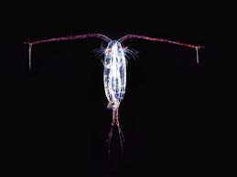
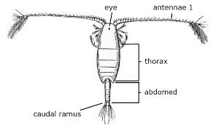
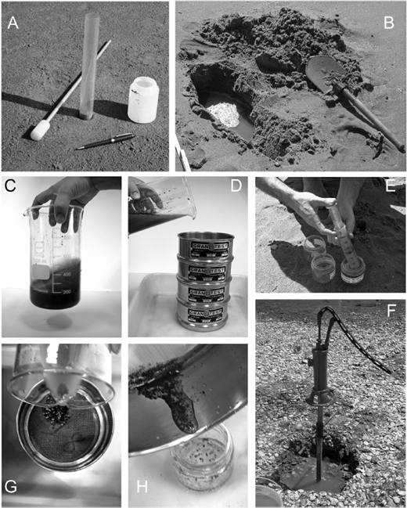
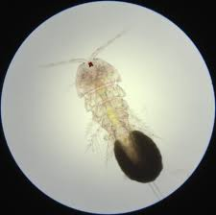
Introduction
Our project aimed to identify the numerous copepod species inhabiting the Long Island Sound. The Long Island Sound is an estuary, a combination of fresh and saltwater. It is located between the southern shore of Connecticut and the north shore of Long Island (SoundWaters). Pathogens and nutrient pollution feed algal growth in the water. When the algae dies, dissolved oxygen for copepods is limited. This limitation is caused by algae blocking sunlight, therefore photosynthesis of the aquatic plants is reduced, causing a lack of oxygen to be produced. As a result, the copepod populations will decline in growth and decrease in population size. The availability of dissolved oxygen can be predicted by water clarity. The clarity is better in the eastern area of the sound and is worse in the western area. Previously, seagrasses and salt marshes were abundant and widespread in the vast waters of the Sound. Now, they are predominantly inhabited in the eastern sound, as well as other areas, due to water clarity, as well as development, fishing pressure, and climate change (Long Island Sound Report Card). Due to the limited oxygen, the copepod biodiversity has been greatly diminished.
The Sound is an important resource in Long Island’s economy. It is a major support system to many fisheries, including oysters, scallops, and lobsters. By reducing pollution in the air and water, we reduce the risk of pathogenic disaster and nutrient pollution. The value of the Long Island Sound can be increased relatively by reducing pollution, increasing protection and restoration efforts for coastal habitats, and increasing our resilience to climate change by protecting our coastal lands. With better knowledge of the effect of pollution on copepods in the sound, we can help increase biodiversity and help organisms by reducing pollution and contamination (Long Island Sound Report Card).
The objective of this project is to explore the biodiversity of copepods and further examine their contributions to the ecosystem. The goal is to successfully collect many copepods from the Long Island Sound, all of different species, and analyze the differences in their DNA. Then, we want to see how these different species play various roles in the environment and study how they are similar and different from each other. The hypothesis is that because there are at least two different species of copepods in the Long Island Sound, at two different locations, they play a abundant, vital role in maintaining the stability of the aquatic ecosystem in which they thrive. Without copepods and diversity among them, due to modern day limiting factors, such as pollution, aquatic environments may decline and the balance and overall health in the ecosystem will be decreased significantly.
By determining the effect of pollution on species diversity, specifically in copepods, we hope to increase conservation efforts for the species in this area. As a result, there will be more reliable species available and increased health and growth among other populations. We also hope to provide information that can be used to establish habitat restoration efforts to help protect endangered or vulnerable species. We also hope to learn more about how to increase the population and health of the copepods (Researchgate). Based off knowledge of contaminants and prior published research journals, we also hope to find a way to avoid contamination of the sound and its organisms.
Biodiversity in Aquatic Ecosystems
Makaela Flanagan and Juliana Colica
Discussion
This lack of data does not answer our question as to whether there are various types of copepods in the Sound or not or if they have a significant impact on their ecosystem. These results mean that human error may have come into play causing unsuccessful collection. After three different methods were attempted, we found that an alternate collection method using soil probes to collect sand and water below sea level to collect copepods may have been more successful. Another result found from our lack of data is that the weather conditions were not optimal for copepod collection. Due to such low temperatures of the water, it is very likely that there may have been no copepods at the time. Another possibility is that many copepods may not have been present due to their mating and growth patterns, both of which do not align with our time of collection. This is important because it proves the importance of climate change and temperature conditions on organisms and maintaining the ecosystem, as without copepods, the balance and biodiversity of the ecosystem is thrown off. It also reveals the effect that human error has on research, as it can potentially lead to recurring failure and or false results. Mistakes leading to this lack of data may have been poor collection methods, as well as collecting samples from the wrong locations on the beaches. We suggest that future scientists collect samples in warmer weather when copepods are in great abundance, use more precise collection tools, ensuring copepods can be collected and separated, and possibly more accurate microscopes that better the chances of viewing the naked-to-human-eye copepods.
Materials and Methods
For this experiment, our approach consisted of a water sample from two specific areas of the Long Island Sound. Four samples were taken in each location of the Long Island Sound and were kept in refrigerators. We investigated each sample under a microscope and researched to analyze the different copepods in each of the samples. After, the copepods in each sample were removed and their DNA was isolated using the silica procedure and rapid amplification methods. Once the CO1 gene had been amplified successfully we used an electrophoresis gel and scanned/ photographed the bands. Finally, we looked for trends, similarities, and differences among the samples once they’re barcoded. Unfortunately, our results were inconclusive, as we did not have any amplified DNA after three attempts.
Abstract
There is a great abundance of species biodiversity in aquatic ecosystems on Long Island, many of which people lack knowledge on. These organisms play vital roles in maintaining the environment and species relationships. Copepods are small, but vital, organisms in aquatic ecosystems that may be present in multiple species. The purpose of this research is to better our knowledge on the diversity in copepods present in the Long Island Sound, specifically copepods like Acartia hudsonica Pinhey, and to determine the overall health of the ecosystem. With this information, achieved by collecting copepods, amplifying their DNA, and comparing the differences among them, we hope to identify different copepod species and research their different impacts on the environment. After attempting to complete the procedure multiple times, we failed to collect copepods, and therefore turned to previously published research to gain information on copepod diversity.
Results
There were no results obtained from the procedure. This is mainly due to no copepods being successfully collected multiple times, and therefore no DNA being isolated or amplified. This was proven when the gels were ran and no DNA bands were present at all.

