Slide 1
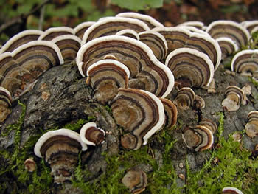
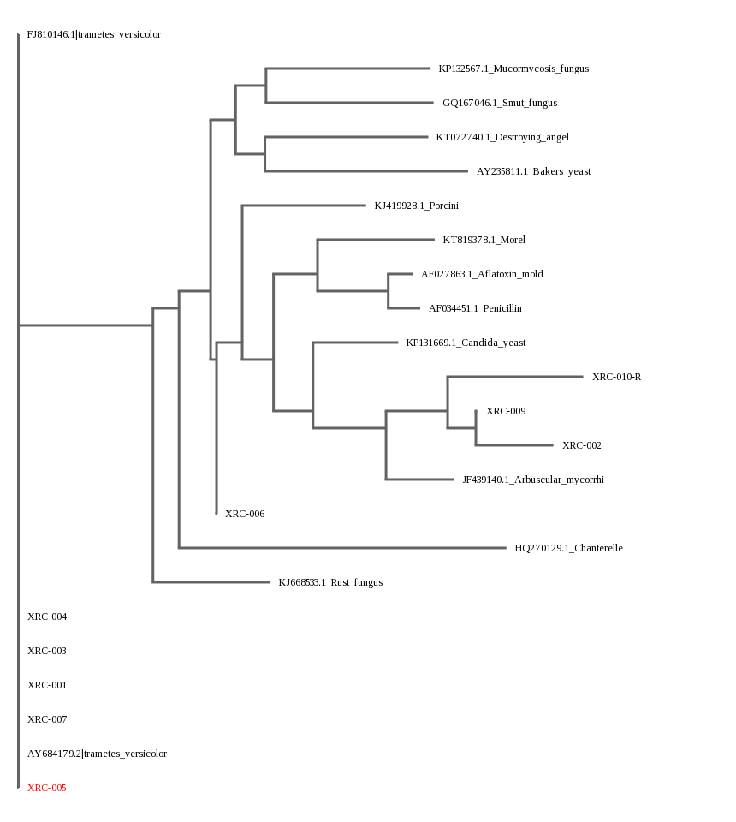
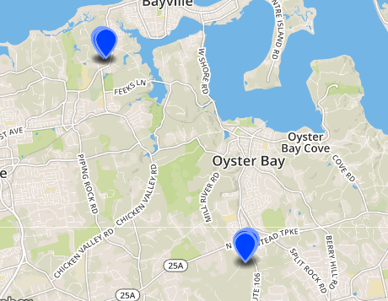
Abstract
The Impact of Human Interaction on the Biodiversity of Fungal Life on Long Island
Materials and Methods
The most conclusive areas to be studied for fungal biodiversity include residential lots and an undisturbed natural preserve (Moore et al. 2018). A backyard was the most suitable location for these sample to be collected for the developed portion. The location that was used for the undisturbed area was the Muttontown Preserve, which is the most easily accessible place to collect samples from somewhere that has not been disturbed by human interaction, and certainly has not had any development on it. This large forest area was provide the best example of an area in Long Island unaffected by human contact, as larger forests are less likely to have experienced human contact and “provide a diversity of habitat for fungal communities,” (Tongass National Forest Monitoring and Evaluation Report, 2014). All authorization from the Muttontown Preserve was obtained from the authority of the county of Nassau, and necessary and proper safety precautions were taken in collecting the samples. Each of these samples were collected near the roots of trees. It was expected that we obtain multiple samples in our collection, and so we collected ten samples to be used. The importance of finding an area that has not gone through ecological succession in the past, at least due to mankind, was fundamental in ensuring the accuracy of our results. The organisms were collected with the use of gloves to ensure sanitary conditions for the mushrooms. A sample of mushrooms will be collected in a pot, and steamed with deionized water (Gochenaur, 1984). The mushrooms were observed under a specimen microscope before undergoing taxidermic identification. The ITS primer, specific to most types of fungi, was able to identify its constituents, the mushrooms that we will have collected, and amplify their genetic material using “taq” polymerase chain reaction. Using a thermocycler, the temperature of these increased to above 90° celsius each cycle (DNA Barcoding 101, 2018). Doing this broke the hydrogen bonds, allowing the specified ITS primers to anneal to its complementary base pairs. As the temperature begins to again rise, the protein, taq polymerase, created new strands identical to those already separated. This was done over 30 cycles to create upwards of one billion segments (Science Learning Hub). The genomic information of the fungi was used at length to barcode those species, furthering the biodiversity knowledge of the island.
In studying the factors surrounding biodiversity, the organism of fungi is important to analyze. Mushrooms, a specific type of fungi, can be greatly affected by the environment in which it functions. In our project, we will explore the effects of the specific environmental spectrums of Long Island. In the dichotomy created between fungi growing in residential areas and in forest areas, we will find how human contact impairs the abilities of mushrooms to grow. Thus, many species of fungi have, and will continue to be, lost with the growing population and residential development in Long Island. The forests, however, will continue to have a flourishing fungal population with many different forms of mushrooms. In studying the varying biodiversity of residential and forest areas of Long Island, we can conclude on the effects that human interaction negatively impacts the biodiversity of mushrooms.
Intro
In the deciduous inclines of Long Island, life is being disturbed by developments of mankind which forces it to retreat. Human development disturbs the interaction of fungus
with other organisms in ecosystems across Long Island, which can have deeper implications on biodiversity across New York. The kingdom of fungi includes a large range of species, such as mushrooms (Moore et al. 2018). These organisms, in having to grow in areas of water and soil, have been affected by the expansion of residential communities. With roads paved and forests cleared, fungi on Long Island is scant with loss of water and nutrients necessary for proliferation. Nevertheless, fungi can still be found in residential communities where nutrients can be found in order to sustain life. In backyards, gardens, or even growing on the sides of houses, fungi is able to persevere around Long Island. In fact, the few preservations left on Long Island incorporate the aspects necessary for fungal life. Forests, marshes and other forms of wet areas with sufficient water pose as additional places where fungi can be found (Moore et al. 2018). Residential communities, where nutrients for success of fungal communities of organisms lack, and forests or preserved areas with prevalent fungal life include different species in the kingdom of fungi. Residential areas cannot sustain large communities of fungal development similar to forests, and so the fungal life found in both areas has drastic differences. The two different areas also provide evidence that fungal life will execute certain processes and incorporate distinct methods of sustaining life when in a different environment (Adams et al. 2013). The development of fungi in forests or preserves greatly differs when compared to areas of human activity in residential communities, and presents that species of fungi are changing due to human activity, and could pose future problems resulting from the loss of biodiversity. By taking samples from near the roots of the plants, we will better be able to study the symbiotic fungal life that finds its home near those roots. Biodiversity hotspots could be preserved, as using mushroom fungal life could be used to better control the populations of trees within forests, with microorganisms controlling these plants’ populaces.
Results
All of our samples except for one came back with very little sequencing. The one mushroom which seemed to have a very strong sequence was XRC-005. The closest match to this was Trametes versicolor. Samples XRC-001 through XRC-004 and XRC-006 through XRC-009 did not provide strong sequencing, and for that none of them had an excess of six base pairs, the longest of which being XRC-002 which was comprised of exactly six thymines. XRC-010 only had the reverse strand, and for some unseen reason, the forward strand did not have any good sequencing.
Discussion
We were very surprised when the sequence trimmer for our first sequence (XRC-001) left us with one (1) single base pair. We did not get a lot of quality sequences back, so this may be due to an issue in replication. We believe that the main reason for this is an issue in crushing the mushrooms, as they were very difficult to crush. Another reason may have been improper storage of the mushroom samples, as our use of empty tubes and placement of them in a freezer could have been problematic. We could have used ethanol in the tubes to properly store DNA between wait time during separate steps of the PCR process. The results told that DNA must be extracted and stored properly for DNA preservation in testing. The biodiversity of fungi is a complex topic, and the process of extracting DNA to barcode the species must be followed in strict detail. We could use what we learned in this experiment to re-do this experiment, and try eliminating factors which caused us to receive these results.
Acknowledgment
CSH Lab
Ms. Tracy Nellins
Muttontown Preserve for Allowing our Collection of Samples
References
Ms. Tracy Nellins; Muttontown Preserve; Dr. Sharon Peppenella; Mr. Jeffrey Petraka
By Michael McGowan and Michael Kammerer

