Slide 1
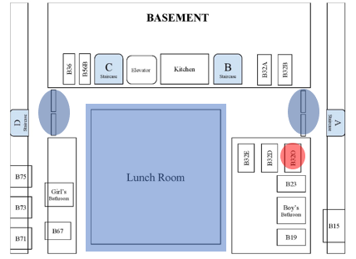
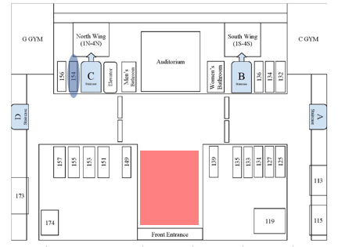
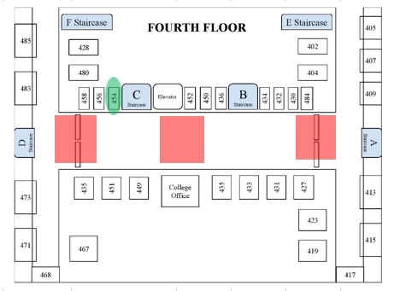
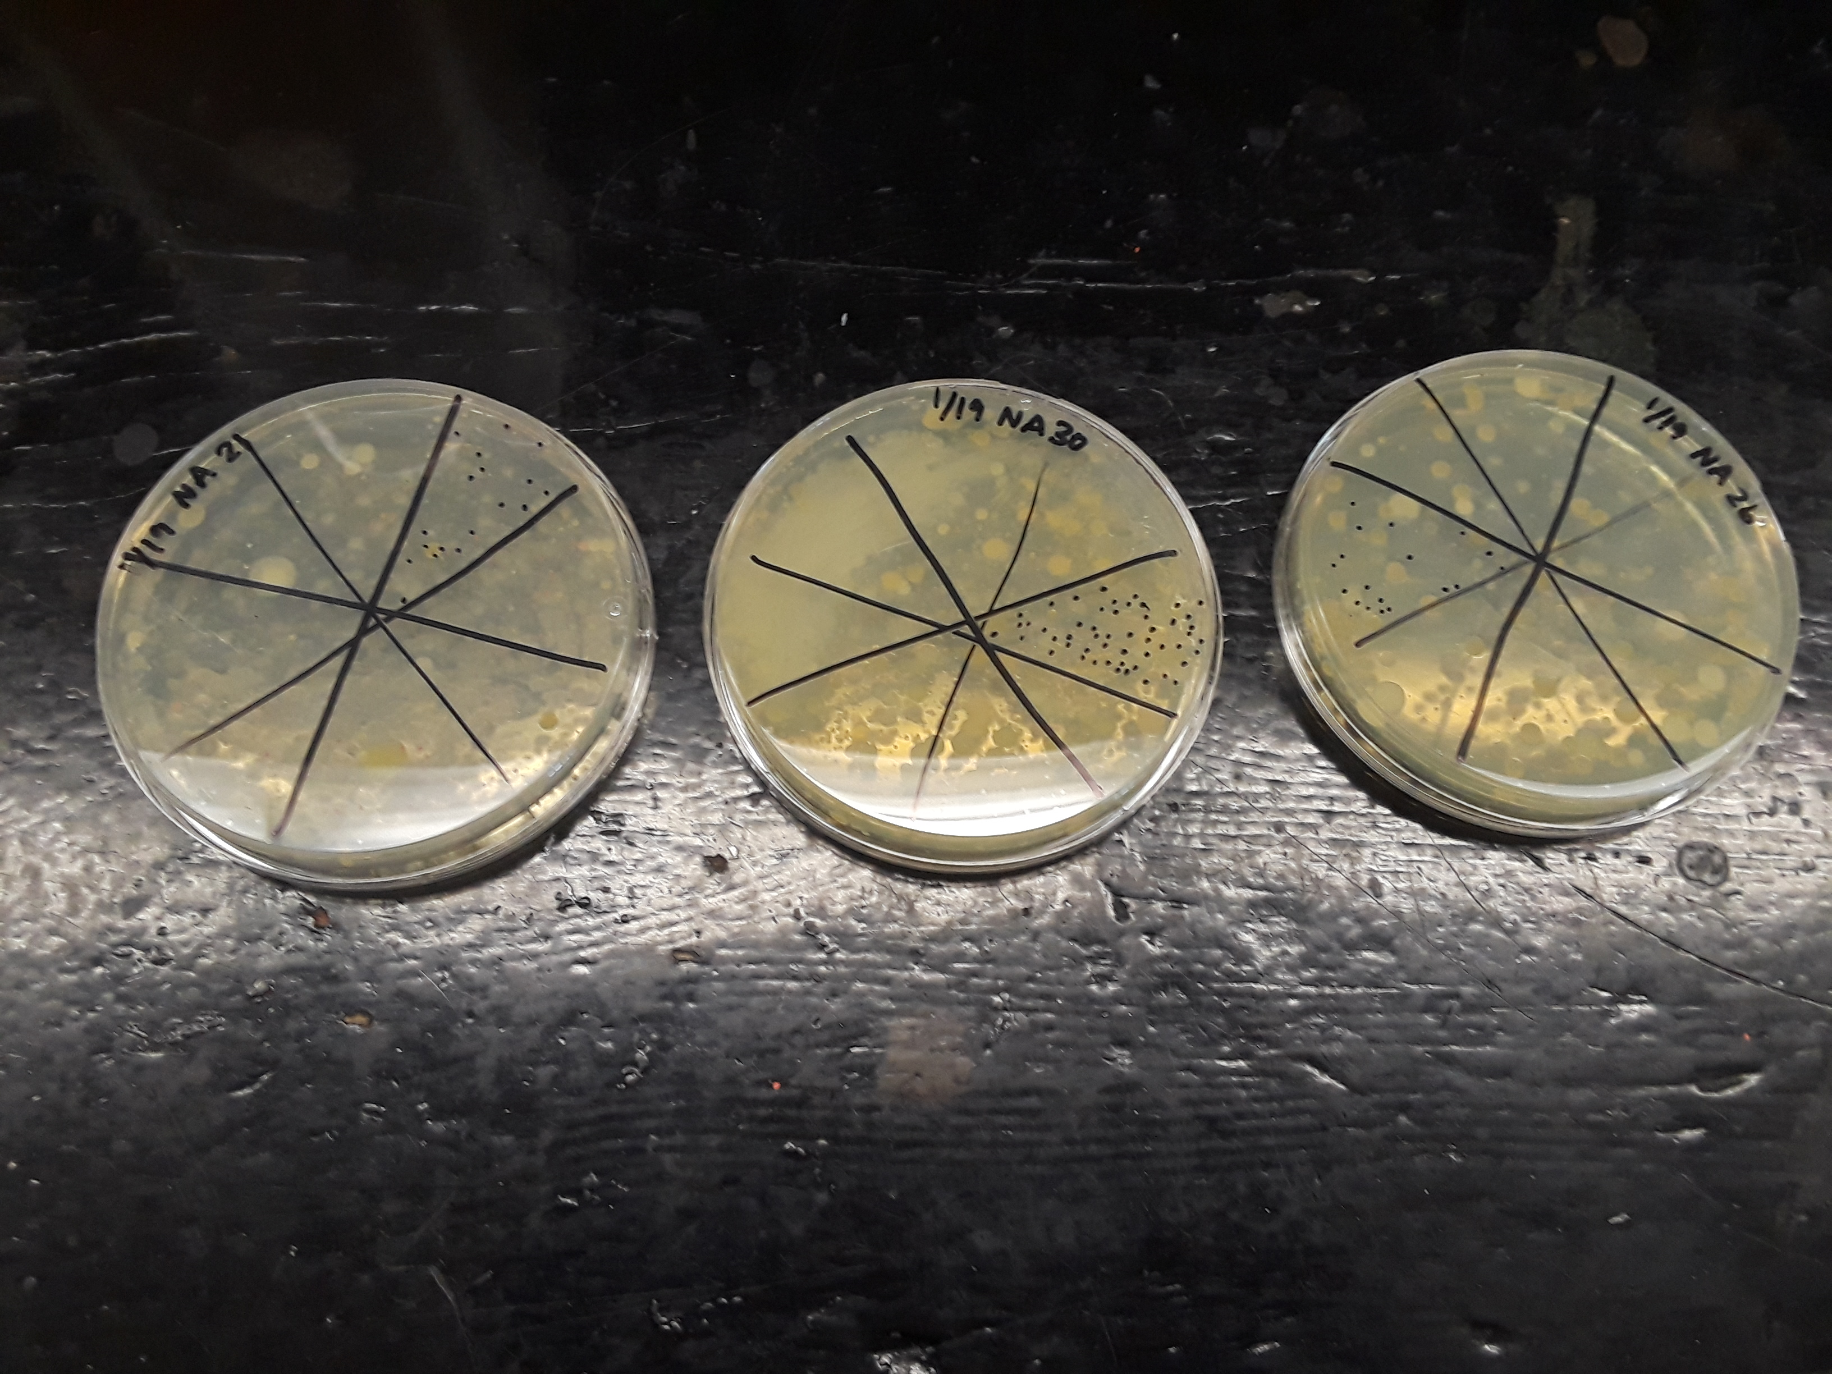
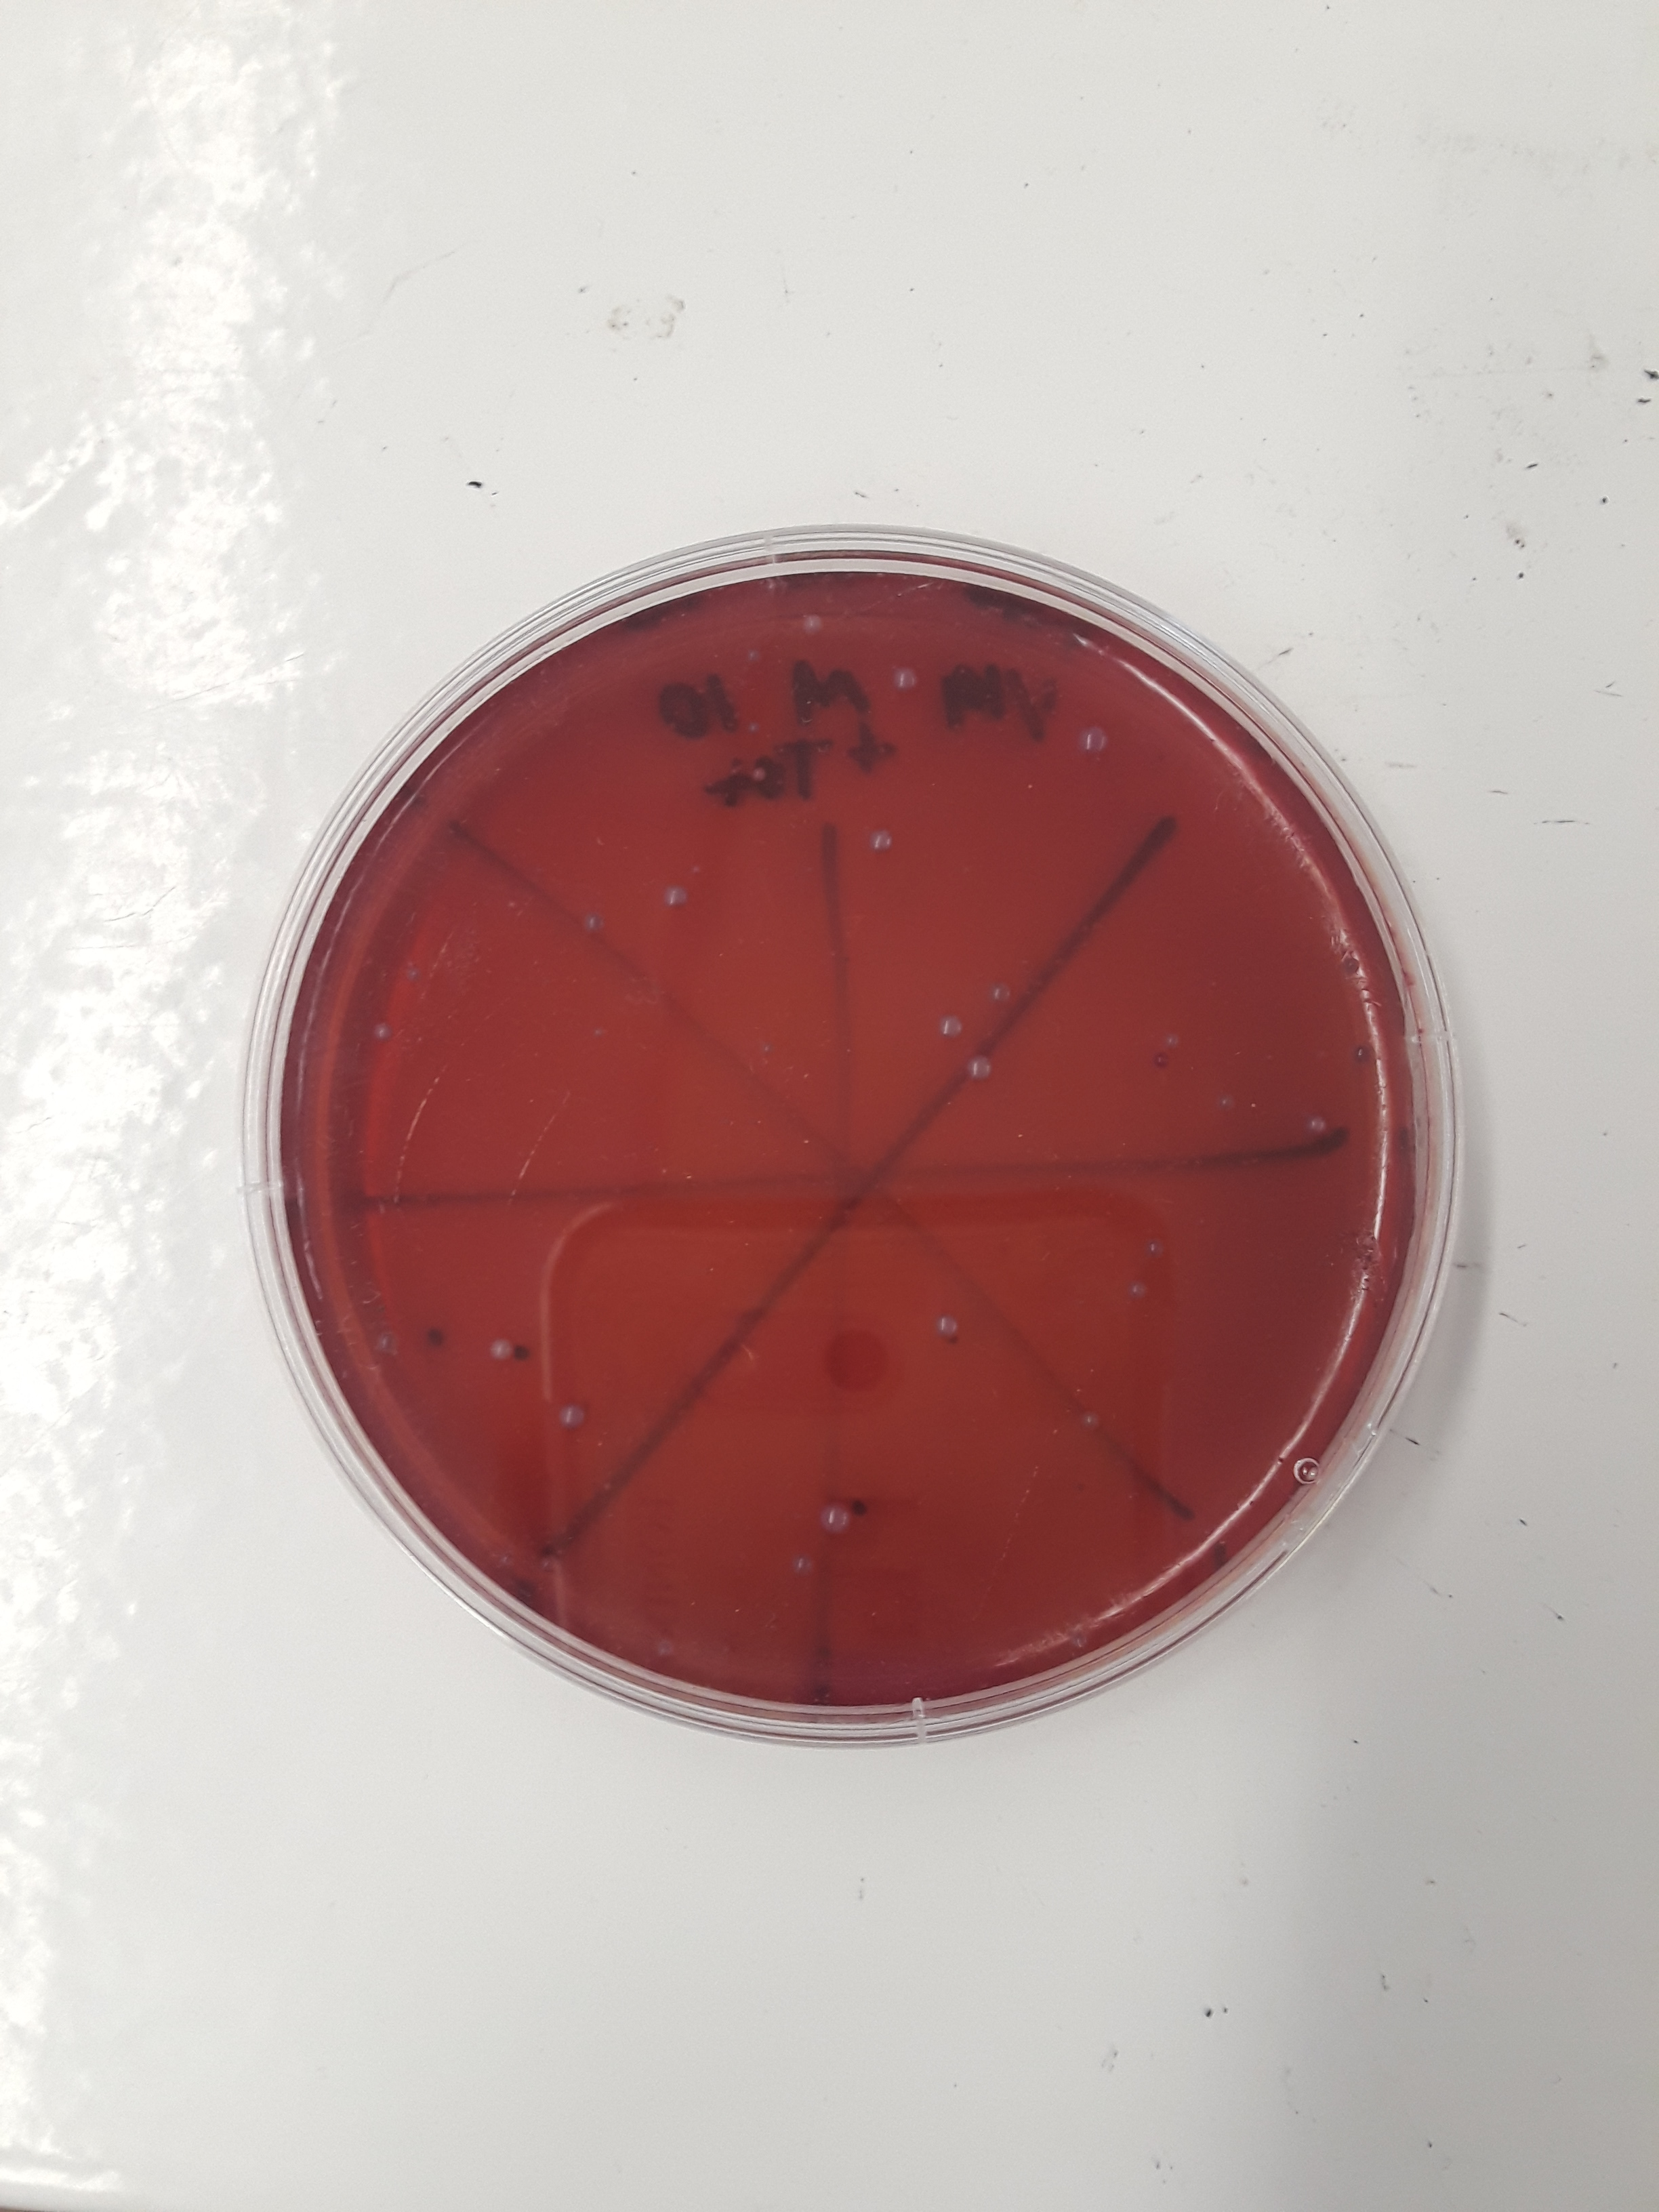
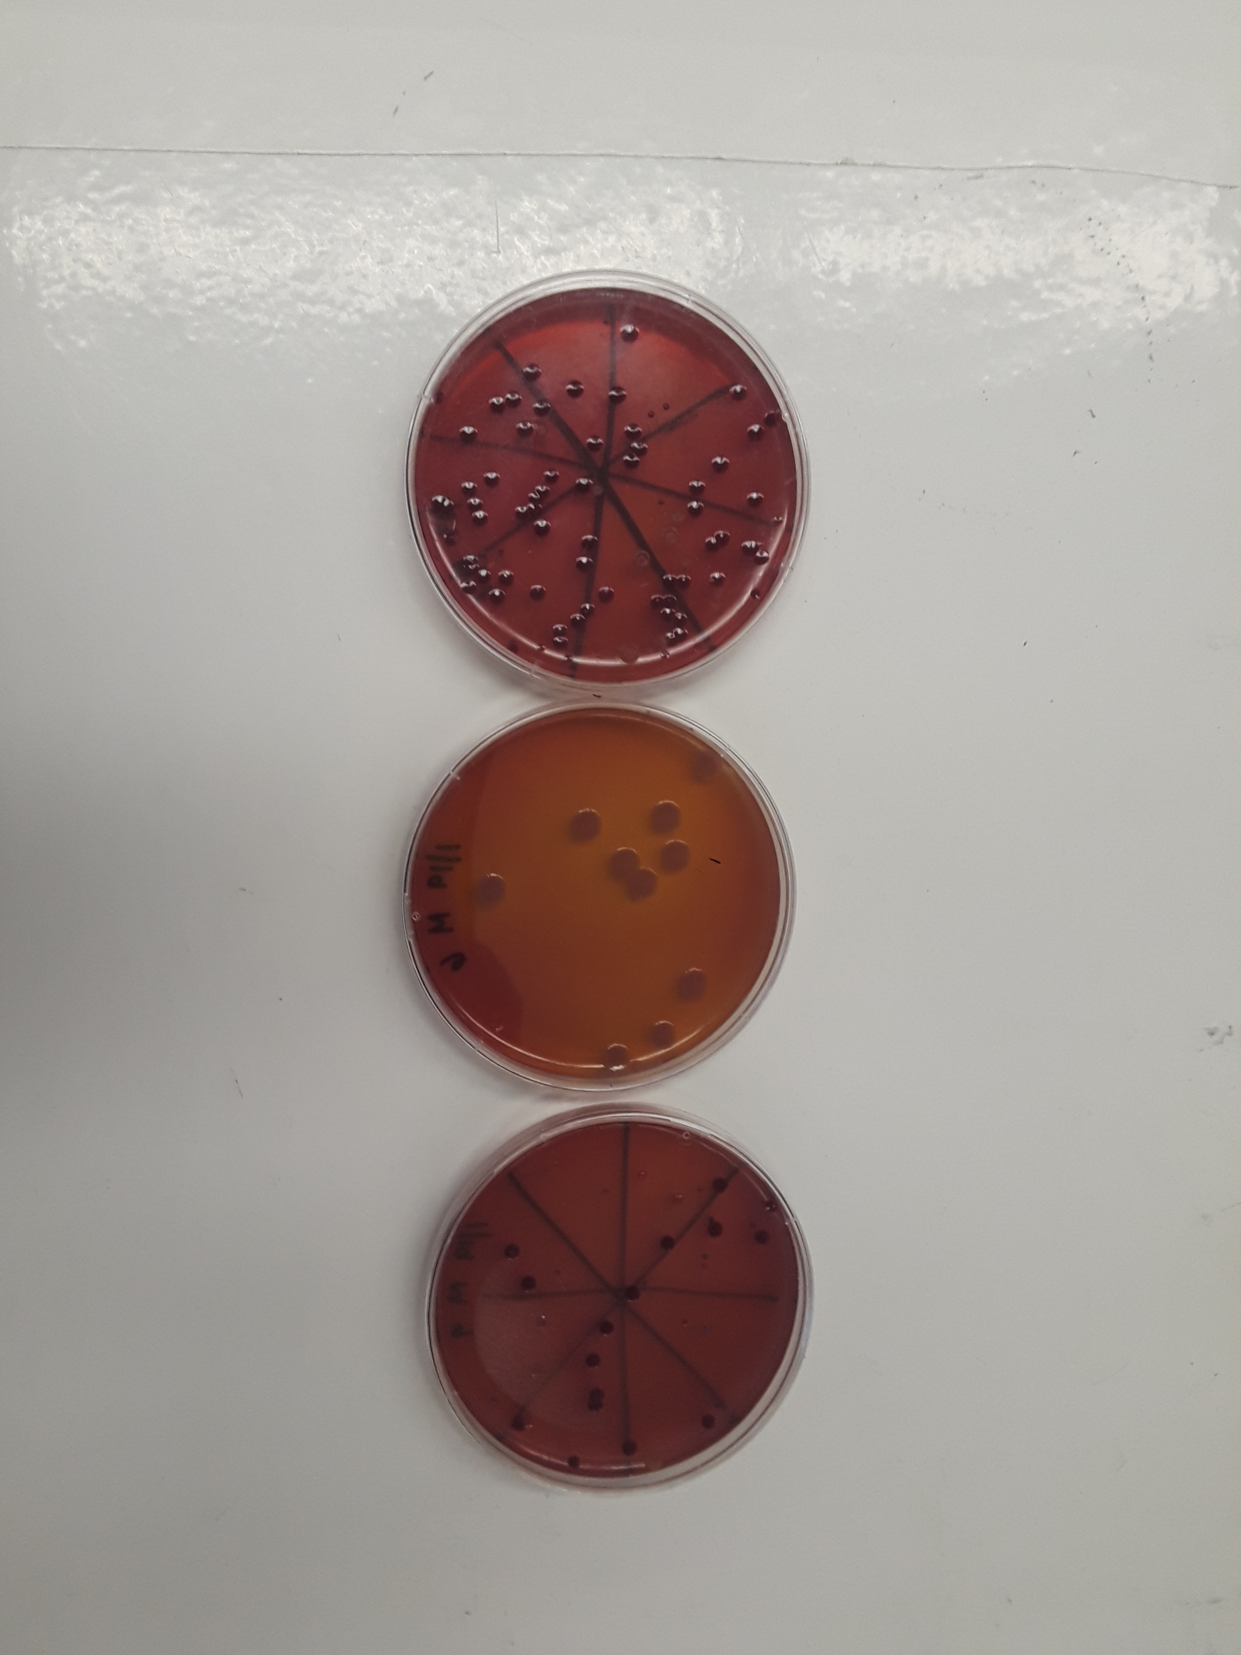
Hot Zone: Bacterial Content of Two NYC Public High Schools
Authors: Nasreen Duqmaq ¹, Sevara Mallaboeva ² Mentor: Dr. Theodore Muth ³
¹ Scholars’ Academy 320 Beach 104th St, Rockaway Park, NY 11694; ² Midwood High School 2839 Bedford Ave, Brooklyn, NY 11210; ³ Brooklyn College 2900 Bedford Ave Brooklyn, NY 11210
Abstract
Despite having a thicker peptidoglycan layer than gram-negative bacteria, gram-positive bacteria are more receptive to antibiotics since they lack an outer membrane; the cell membrane of gram-negative bacteria is thin, but difficult to penetrate especially in conjunction with their outer membrane, making them resistant to antibiotics and other antibacterial interventions. Considering the prevalence of bacteria and NYC high school students’ lack of knowledge regarding how such microorganisms can impact their health, public high schools in NYC were surveyed to discern the types of bacterial communities that are present. Samples were collected from the lunchroom and hallways in High School A and High School B. It was hypothesized that there will be a large quantity of colonies for nutrient agar plates, a moderate amount of colonies for MacConkey agar, and barely any (at most 10) colonies for the tetracycline agar. In addition, it was assumed that the bacteria possibly found from the sequencing will be bacteria found on human skin, streptococcus, and soil bacteria. A Qiagen PowerSoil kit was used to extract DNA from the samples so that it could be sequenced. The bacteria was also grown in a culture dependent environment in petri dishes with different conditions including: nutrient agar, gram negative, and tetracycline. The bacteria populations at both schools were largely diverse; according to the Alpha Diversity graph, all six samples have relatively the same sample diversity with the exception of sample 1. The Beta diversity graph showed that the samples from high school 1 clustered, while the samples from high school 2 clustered. Proteobacteria consisted of the greatest percentage of population except for sample 5 where proteobacteria made up 24% while the “other” category outnumbered it with 36%. The 95% confidence interval for both the MacConkey and Tetracycline agars had outliers that suggested that there are possible hotspots around school, although further investigation would have to be conducted to confirm. The data suggests that while the bacterial communities at High School A and High School B are distinct, they still share some key similarities. The investigation aims to increase awareness of health literacy and sanitation in public high schools in NYC.
Introduction
Previous research has investigated the connection between human skin, classroom objects, and bacteria, there are no studies that compare the bacterial content of two high schools (Meadow, 2014).
An experiment was setup to compare the bacterial communities on the floors of a high school where students predominantly use public transportation versus a school where there is minimal use of public transportation by students. The question centering the research is “How does the bacterial content of the floors of commuter vs. non-commuter high schools compare to one another?” If the floor of two high schools (commuter vs. non-commuter) are swabbed, then there will be potential similarities, but distinct differences between the bacteria communities, since public transportation is densely populated with potentially harmful bacteria. It’s hypothesized that there will be a large quantity of colonies for nutrient agar plates, a moderate amount of colonies for MacConkey agar, and barely any (at most 10) colonies for the tetracycline agar. In addition, it’s assumed that the microorganisms possibly found from the sequencing will be bacteria found on human skin, streptococcus, and soil bacteria.
Our purpose was to gain a more in depth knowledge of the sanitary conditions within public high school environments, while also making high school students more cognizant of the bacteria they encounter on a daily basis. Bacteria is a congenital aspect of our environment, thus analyzing the relatedness of bacterial communities in certain locations can illustrate to what degree, if any, people are the vectors of transport for bacteria (Hays, 2015), thus the research can potentially improve the health literacy of students and increase the sterility within NYC high schools.
Results
Based on the Alpha diversity graph, it can be seen that the bacteria population in all three sites are largely diverse. All six samples have relatively the same sample diversity with the exception of sample 1 (hallways from School B); it’s slightly less diverse than the rest of the samples. Although the samples may be all may contain approximately equal diversity, there are still differences in the types of species found at each site. The Beta diversity graph displays a cluster of the samples from high school A and a cluster of the samples from high school B. However, samples 2, 4, and 6 were relatively close to each other, despite the clusters. Sample 2 is from the classrooms of School B, sample 4 is from the lunchroom of School A, and sample 6 is from the hallways of school A. There seems to be a big similarity between the species found in these three locations. Further investigation must be done to understand why.
The 100% segmented bar graph illustrates a common abundant bacteria found in almost all the samples under the phylum level. Proteobacteria made up the greatest percentage of population except for sample 5 where proteobacteria made up 24% while the “other” outnumbered it with 36%. Two samples had proteobacteria as more than half of the proportion; sample 1 had 84% while sample 3 had 72%. The other three samples had relatively similar percentages of the phylum, below 50%. The other portion of the type of bacteria found was the second greatest amount of percentage that made up the graphs, with the exception of sample 5. In four samples (sample 2, 4, 5, 6), firmicutes was a third largest proportion of bacteria. Another largely found phylum was actinobacteria in samples 2, 5, and 6. Although the samples don’t have very similar percentages of bacteria, they all have a comparable trend of abundant bacteria.
The 95% confidence interval for both the MacConkey and Tetracycline agars have similar data centering one particular range of numbers of colonies. In both graphs, there are at least two outliers. MacConkey agar ranged from 0 - 400 colonies while containing four outliers: 624, 800, 1000, and 1100. Tetracycline agar ranged from 0 - 32 colonies with outliers at 48, 70, and 104. The nutrient agar bar graph illustrates that there is diverse population of bacteria in all the swabbed sites. However, there were some locations where there was a very low concentration of colonies compared to the rest of the samples; samples 2, 6, 12, 20, 22, 24, 25, and 28. This suggests that these locations are more sanitary than the rest of the school (comparing the samples with the two high schools).
Figure 1: Heat map of School B
Key: green - low percentage of bacteria, blue - some percentage of bacteria, yellow - moderate percentage of bacteria, red - high percentage of bacteria
Figure 2: Colony count derived from the nutrient agar plates.
Figure 3: 95% confidence interval for the colony count from the MacConkey agar plates.
Figure 4: 95% confidence interval for the colony count from the Tetracycline agar plates.
Materials & Procedure
First, a floor plan of the two high schools were made. Then the plates were prepared using standard Nutrient agar, MacConkey agar, and Tetracycline agar plate procedures for a total of ninety plates, or thirty plates for each type of agar. They were left for a day to solidify. During that twenty-four hour period, the samples were collected from the two locations, using the floor plans as a guide. An area as large as a palm of a hand was swabbed; the swab was then placed in a fifteen ml Falcon tube. Eighteen samples from the commuter high school and twelve from the non-commuter high school were taken. In order to plate the samples, a nutrient agar plate was obtained. The bottom of the plate was labeled with the appropriate identifying information. One hundred microliters of the bacterial DNA sample was pipetted and placed in the center of the plate. The bacteria was gently spread all over the plate with a plastic utility. After usage, the utility was dipped in ethanol and placed over the Bunsen burner; this procedure was done to ensure sterility. This was repeated for Mac + Tet plate and MacConkey plate using the same sample. These procedures were repeated for all the samples. The lids were closed, they were stacked, and placed at room temperature for 2 days (Nutrient agar and MacConkey), or 3-4 days (Tetracycline). The number of colonies in each plate was counted, taking note of the differing conditions. The DNA extraction was done next using the instructions of Qiagen PowerSoil kit. The amplification and the sequencing steps were done in the sequencing facility.
Key for Nutrient agar bar graph and 95% CI graphs:
2nd Floor - Hallway
2nd Floor - Library
2nd Floor - Hallway
3rd Floor - Hallway
3rd Floor - Room 302
3rd Floor - Hallway
1st Floor - Side Entrance (exit 9)
1st Floor - Gym
1st Floor - Main Entrance (exit 1)
1st Floor - Cafeteria (outside kitchen)
1st Floor - Cafeteria (entrance)
Auditorium - (entrance + aisles)
Lunch room 1
Lunchroom 2
Basement classroom: rm B32C
16. Basement hallway 17. Front entrance 18. 1 classroom: rm 154 19. 2 hallway 20. 2 classroom: rm 245 21. 3 hallway 22. 3 classroom: rm 332 23. 4 hallway
24. 4 classroom: rm 454 25. A1 classroom: rm A115 26. A1 hallway 27. A2 hallway 28. A2 classroom: rm A216 29. A3 classroom: rm A319 30. A3 hallway
*”A” represents Annex building of school B
** Numbers in the front represent the floor number
Discussion
Based on the results, it can be concluded that the bacterial content between the two high schools are very distinct but there are possible similarities which supports the hypothesis previously made. The beta diversity graphs provides evidence that the species found in the two high schools are very different. However, both high schools are equally diverse, according to the alpha diversity graph. There are both tetracycline resistant and gram negative bacteria found in both schools. A high number of colonies were found in the MacConkey agar. Moreover, the tetracycline agar, on average, contained few colonies with the exception of few large proportion of colonies. The outliers found in the bar graph and the 95% CI graphs indicate that there are possible hotspots around school, but this could also be due to sources of error (incorrect swabbing technique and underrepresentation of the school). Further research must be done to analyze these high quantity colonies in these sites.
The sequences illustrate that there is a high quantity of pathogenic bacteria because proteobacteria contains a numerous amount of pathogens, such as Escherichia, Salmonella, Vibrio, and many others. Firmicutes are second most abundant bacteria found among the samples. Such bacteria are able to survive extreme conditions and they include some pathogens; in addition they play a role in the spoilage of beer, wine, and cider. A third most abundant bacteria is actinobacteria. Actinobacteria are found in soil; they play an important role in decomposition and humus formation. These bacteria show that the two high schools are contaminated with pathogenic bacteria that could potentially harm the students which leads to the purpose that it’s important to understand the contamination and sanitation of New York City public high schools.
Figure 5: Alpha diversity graph describes the level of diversity between the samples.
Acknowledgements
We thank our mentor Dr. Theodore Muth for teaching us about the various microbiological procedures used throughout this project and guiding us through this fascinating investigation. We also would like to give acknowledgement to Harlem DNA Lab and Cold Spring Harbor Laboratory for allowing students like us to participate in the UBRP. In addition, we thank Pinkerton Foundation and Simons Foundation for their support for the UBRP.
References
Hannigan, G. D., & Grice, E. A. (2018). Microbial Ecology of the Skin in the Era of Metagenomics and Molecular Microbiology. Cold Spring Harb Perspect Med. 3:a015362. doi: 10.1101/cshperspect.a015362
Hays, B. (2015, Feb. 6). High school scientists find drug-resistant bacteria in NYC subway. UPI. Retrieved from https://www.upi.com/Science_News/2015/02/06/High-school-scientists-find-drug-resistant-bacteria-in-NYC-subway/5381423231403/
Irimia, R.E., & Gottschling, M. (2016). Taxonomic revision of Rochefortia Sw. (Ehretiaceae, Boraginales). Biodiversity Data Journal. 4: e7720. doi:10.3897/BDJ.4.e7720
Meadow, J. F. et al. (2014). Microbiome. 2:7. https://doi.org/10.1186/2049-2618-2-7
Rogers, K., & Kadner, R. J. (2018, Feb. 22) . Bacteria. Encyclopedia Britannica. Retrieved from https://www.britannica.com/science/bacteria
Figure 6: Beta diversity graph illustrates the diversity among the species found in the all six samples.
Figure 7: 100% segmented bar graph displays the percentage of the top seven bacteria found within the samples as well as the “other” bacteria.

