Slide 1
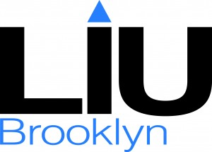
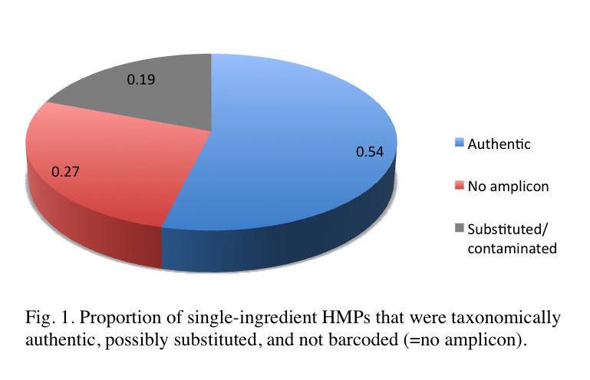
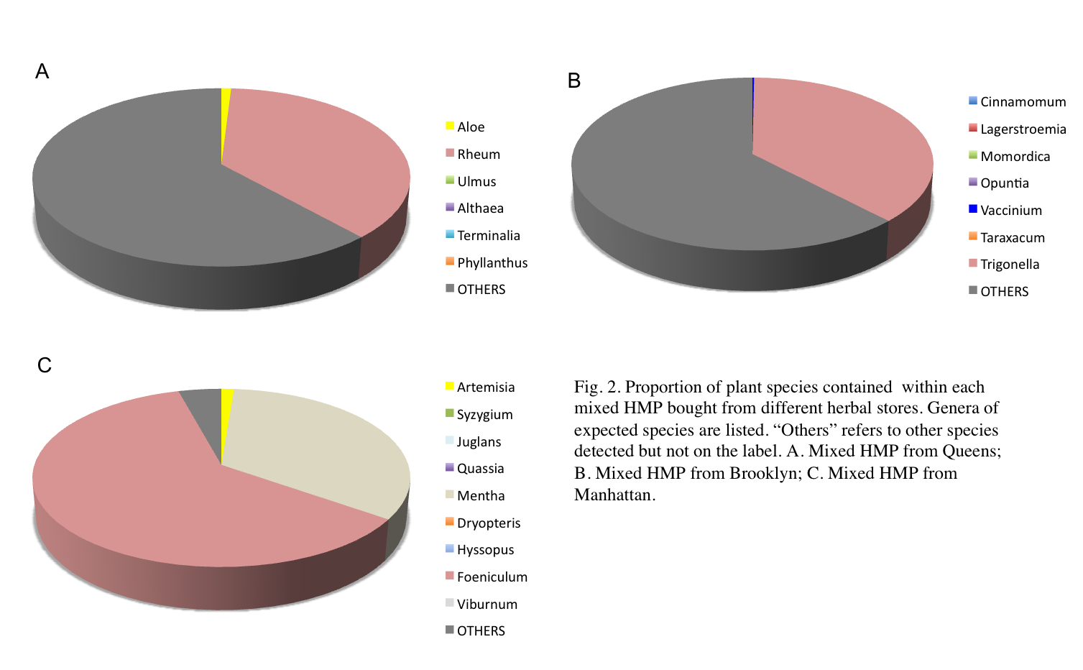
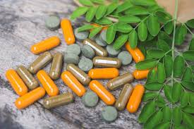
DNA barcoding of herbal supplements sold in New York City promotes pharmacovigilance among high school students
Yandel Morel¹, Ena Smith², Jeanmaire Molina (mentor)³
¹Long Island City High School, ²Progress High School, ³Long Island University-Brooklyn
ABSTRACT
The herbal medicine industry is a multibillion-dollar industry in the US alone. However, the US Food and Drug Administration (FDA) does not strictly regulate herbal supplements, which has resulted in fraudulent products that do not contain the declared species. The lack of FDA oversight in herbal products presents the opportunity to crowd-source DNA barcoding as a form of pharmacovigilance among American consumers, including high school students participating in the Urban Barcode Research Program (UBRP). As part of UBRP, an initiative to engage students in scientific research, we validated the taxonomic identity of the plant species contained in herbal medicinal products (HMPs) sold in New York City using DNA barcoding. Sanger sequencing was used for barcodes obtained from single-species HMPs, while next-generation sequencing using the Ion Torrent platform was used to sequence barcodes obtained from multi-species HMPs. Five of 26 (19%) single-ingredient HMPs did not match the declared species on the label. All three multi-species HMPs also contained a great proportion of undeclared species including traces of poisonous plants. These results motivate us to be more pharmacovigilant and more careful of the HMPs we consume.
Fig. 1. Proportion of single ingredient HMPs that were taxonomically authentic, possibly substituted, and not barcoded (=no amplicon)
Figure 2. Proportion of plant species contained within each mixed HMP bought from different herbal stores. Genera of expected species are listed. “Others” refers to other species detected but not on the label. A. Mixed HMP from Queens; B. Mixed HMP from Brooklyn; C. Mixed HMP from Manhattan.
INTRODUCTION
As of 2008, approximately 20% of the American population have been using herbal supplements (Bent, 2008). The amount of revenue generated by this industry in the United States has been estimated to be $6 billion in 2013. The US Food & Drug Administration (FDA) does not confirm the accuracy of product labels, so the establishment of an herbal supplement’s quality and safety is at the responsibility of the manufacturer, which may result in herbal supplements with poor quality (Sarma, 2016).
In fact, several studies have shown that adulterations and substitutions have been common in herbal medicinal products (HMPs) sold in the US, as revealed by the technology of DNA barcoding (Newmaster et al., 2013; NY City Press Office, 2015). In New York City, out of 38 herbal products barcoded from 8 herbal stores, 4 did not match the expected species (10.5% were fraudulent, Michel et al. 2016).
The lack of FDA oversight in herbal products presents the opportunity to crowd-source DNA barcoding as a form of pharmacovigilance among American consumers with former students of the Urban Barcode Research Program (UBRP) reporting that 4 out of 20 online herbal products sampled did not contain the declared species (Molina et al. 2018).
In this study, again as part of UBRP, we used ITS2 DNA barcoding to confirm the taxonomic identity of single-ingredient herbal products sold in New York City. We also used the next-generation sequencer, Ion Torrent Personal Genome Machine (PGM), housed in the Biology Department of Long Island University-Brooklyn (LIU) to sequence 3 multispecies herbal products.
RESULTS & DISCUSSION
Out of 26 single-ingredient HMPs, 19 were successfully barcoded for ITS2 (73%). Seven could not be barcoded (no amplicon) in spite of multiple amplification attempts. Fourteen contained the expected species (54%), while 5 did not match the expected species on the label (19%; see Table 1 and Fig. 1). This can be detrimental to the health of unsuspecting consumers due to potential allergic reactions and/or interactions with other medications they are taking, not to mention, lack of therapeutic effect since a different plant was used.
Most of the time species results from DNA Subway matched Genbank BLAST results except for 2 species. For example, the expected species of Jamaican dogwood, Piscidia piscipula (Fabaceae) showed up as a top hit in web BLAST, but in DNA Subway, other species of Fabaceae were top hits. Phylogenetic analysis was necessary to confirm that the herb was Piscidia piscipula. Thus, it is advisable to compare DNA Subway results to web BLAST and/or conduct phylogenetic analysis especially when the expected species does not appear among the BLAST results in DNA Subway.
ITS2 Sanger-based DNA barcoding worked well for single-ingredient herbs, but it is limiting because it cannot be used for mixed-species herbal products (Ivanova et al. 2016). Thus, we also barcoded mixed-species HMPs using next-generation sequencing (NGS) on the Ion Torrent platform. Many species on the product labels were not detected in the NGS results (Fig. 2). This may be due to two reasons: 1) the expected species were not actually included in the HMP; or 2) the primers used were unable to amplify ITS2 in the expected species, though they may be present in the HMP. Regardless, it is disconcerting that a great proportion of undeclared species were found in the mixed HMPs. Even more concerning was that there were traces of poisonous plants including poinsettia and milkweed!
HMPs in the American market, due to the lack of stringent government regulation, do not always contain the declared species on the labels. This project motivated us to be more pharmacovigilant, and be more careful of HMPs we consume. UBRP gave us the opportunity to crowdsource DNA barcoding and promote pharmacovigilance in high school labs (Molina et al. 2018), so that we can inform our families and friends before they pick out an herbal supplement from the health foods aisle.
MATERIALS & METHODS
Twenty-nine HMPs were purchased throughout New York City (12 from Manhattan, 11 from Brooklyn, 6 from Queens), with 26 containing a single plant ingredient and 3 being multispecies HMPs. DNA extraction was conducted using the Qiagen DNeasy Plant Mini Kit or Phire Plant Direct PCR kit. Extracted DNA was PCR-amplified using ITS2 primers (see Molina et al. 2018). Potentially adulterated HMPs were extracted, amplified and sequenced twice for ITS2 to confirm the result.
PCR amplicons were visualized using gel electrophoresis. PCR amplicons obtained from single-species herbal products were submitted to Genewiz Inc. (South Plainfield, NJ) for Sanger sequencing, whereas PCR amplicons obtained from multispecies herbal products were sequenced on the Ion PGM at LIU following manufacturer’s protocols for amplicon sequencing.
Raw sequence chromatograms obtained from single-species herbal products were assembled, edited, and compared (BLAST) against a local nucleotide database using DNA Subway (blue line, https://dnasubway.cyverse.org). BLAST results from DNA Subway were compared with web BLAST results from the Genbank nucleotide database, with top hits recorded as the taxonomic identity of the herb in the product. When there were multiple top hits, including the expected species, phylogenetic analysis was performed as in Molina et al. (2018).
Sequence reads obtained from the ION PGM for multispecies HMPs were analyzed following Geneious’ (v. 7.1.9, Biomatters Ltd.) metagenomics analysis tutorial available online https://www.geneious.com/tutorials/metagenomic-analysis/ . Resulting contigs were then individually blasted against the Genbank nucleotide database and the top species hits were compiled for each contig.
REFERENCES
Bent S. 2008. Herbal medicine in the United States: review of efficacy, safety, and regulation: grand rounds at University of California, San Francisco Medical Center. Int. J. Gen. Med. 23: 854–859.
Ivanova, N. V., Kuzmina, M. L., Braukmann, T. W. A., Borisenko, A. V. & Zakharov, E. V. 2016. Authentication of herbal supplements using next-generation sequencing. Plos One.
Michel C.I., Meyer R.S., Taveras Y., Molina J. 2016. The nuclear internal transcribed spacer (ITS2) as a practical plant DNA barcode for herbal medicines. J. Appl. Res. Med. Aromat. Plants 3: 94–100.
Molina J., Sherpa C., Ng J., Sonam T., Stuhr N. 2018. DNA barcoding of online herbal supplements: crowd-sourcing pharmacovigilance in high school. Open Life Sciences 13:48-55.
Newmaster S., Grguric M., Shanmughanandhan D., Ramalingam S., Ragupathy S. 2013. DNA barcoding detects contamination and substitution in North American herbal products. BMC Med. 11, 222.
NY City Press Office. 3 Feb 2015. A.G. Schneiderman asks major retailers to halt sales of certain herbal supplements as DNA tests fail to detect plant materials listed on majority of products tested. https://ag.ny.gov/press-release/ag-schneiderman-asks-major-retailers-halt-sales-certain-herbal-supplements-dna-tests [accessed Nov. 16, 2017]
Sarma N., Giancaspro G., Venema J. 2016. Dietary supplements quality analysis tools from the United States Pharmacopeia. Drug Test Anal. 8: 418-423.
Expected Species (scientific name) | Common name | Botanical Family | Taxonomic ID based on web BLAST and/or phylogenetic analysis (P) | Taxonomic ID based on DNA Subway
Astragalus propinquus | astragalus | Fabaceae | Astragalus propinquus | Astragalus propinquus
Azadirachta indica | neem | Meliaceae | Moringa oleifera!!! | Moringa oleifera!!!
Dioscorea villosa | wild yam | Dioscoreaceae | Astragalus propinquus!!! | Astragalus propinquus!!!
Morinda citrifolia | noni | Rubiaceae | Plantago ovata!!! | Plantago ovata!!!
Piper methysticum | kava | Piperaceae | Tribulus terrestris!!! | Tribulus terrestris!!!
Piscidia piscipula | Jamaican dogwood | Fabaceae | Piscidia piscipula (P) | Millettia spp. or Lonchocarpus spp.
Polygonatum sp. | Solomon's seal | Asparagaceae | Bixa orellana!!! | Bixa orellana!!!
Table 1. Seven of the 26 single-ingredient HMPs bought from various herbal stores in NYC. The common name, expected scientific names, and botanical family are provided. Taxonomic identifications (ID) of HMPs from web BLAST and/or phylogenetic analysis (indicated with “P”) and from DNA Subway BLAST are indicated for ITS2 DNA barcodes. Scientific names refer to the accepted species names from The Plant List (http://www.theplantlist.org/). “spp.” refers to multiple species within the genus. Potentially contaminated/ substituted HMPs (i.e. HMP not in the same family as expected species) are indicated with !!!
ACKNOWLEDGMENTS
We thank UBRP of CSHL, Christine Marizzi, the Pinkerton Foundation, and the Biology Dept. of LIU Brooklyn for support and sponsorship.

