Slide 1
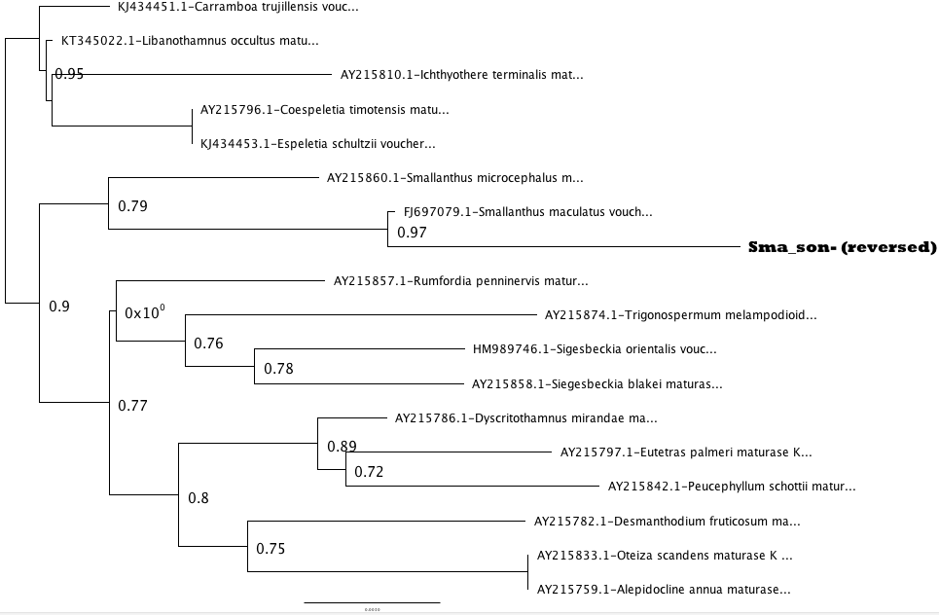
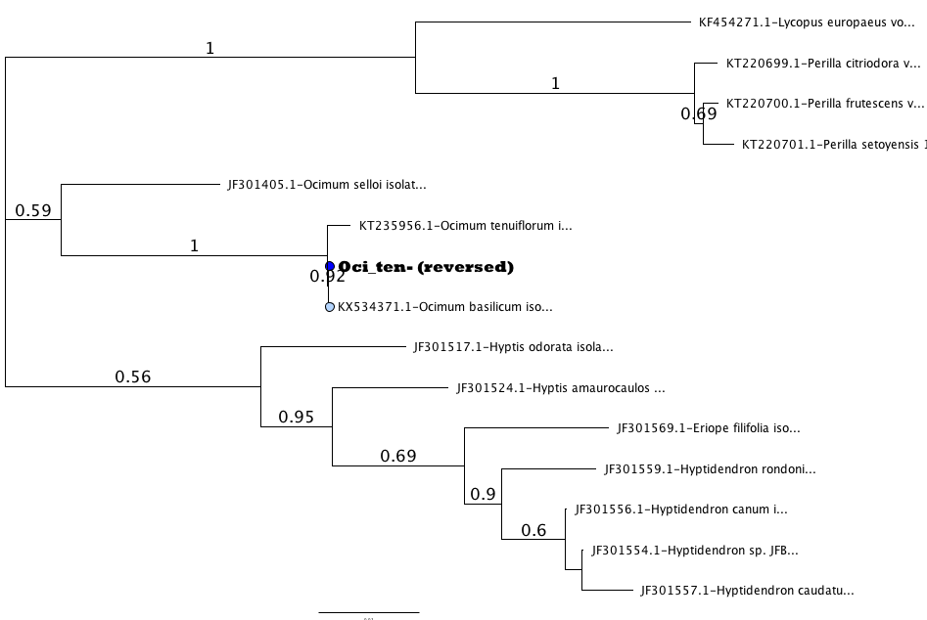
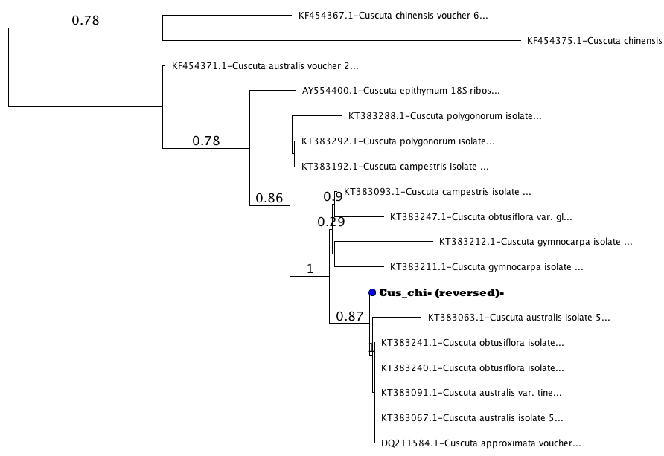
Taxonomic authentication of ethnic herbal products sold by a major online retailer through DNA barcoding of the internal transcribed spacer sequence (ITS2)
Joyee Ng¹, Chhoti Sherpa¹, Tenzin Sonam¹, Nicole Stuhr², Jeanmaire Molina²
¹Brooklyn Technical High School, ²Long Island University-Brooklyn
ABSTRACT
Herbal medicinal products (HMPs) have grown increasingly popular in the United States. Many Americans have the misguided notion that herbal medicines, being natural, are safer alternatives to modern pharmaceuticals. Yet due to the lack of FDA regulation, retailers of the products can substitute or add in other herbs that are not advertised on the label. This may result in ineffective medicines, and/or allergic reactions due to the undeclared plant material. In this study we aimed to identify which ethnically-sourced HMPs sold by a major online retailer are taxonomically accurate through DNA barcoding of the internal transcribed spacer 2 region (ITS2). We were able to barcode 21 HMPs, but four of these did not match the expected species. It was concluded that the four HMPs advertising astragalus, epazote, ginseng, and chanca piedra were either deliberately substituted or accidentally contaminated by the retailers, because their ITS2 DNA sequences did not match the expected species on GenBank, a government database. Our study highlights the importance of consumer awareness when buying herbal medicines in the US, and motivates more crowd-sourced DNA barcoding projects such as what we have done to allow consumers like us, and our families, make informed choices to safeguard our health.
Figure 1. Pie chart showing proportion of taxonomically authentic and contaminated HMPs. Eleven of 32 (13%) samples could not be barcoded in spite of multiple attempts, most of them HMPs from roots or bark..
A
B
C
Figure 2. Phylogenies for some HMPs (in bold) when BLAST results were ambiguous. A. Yacon (Smallanthus sonchifolius) clusters with another Smallanthus sp. because expected species not in Genbank. B. Tulsi (Ocimum tenuiflorum) clusters with O. tenuiflorum and O. basilicum suggesting ITS2 may not have enough variation to differentiate these species. C. Cuscuta HMP, supposedly C. chinensis, appears outside this clade and may be a substitution/contamination, though not considered egregious since they are closely related.
INTRODUCTION
One-third of Americans use herbal supplements to help cure illnesses and diseases (Ehrlich, 2015). However, the US Food and Drug Administration (FDA) does not regulate herbal medicinal products (HMPs) sold in the US (www.fda.gov), and have been found to not contain the herbs advertised (Newmaster et al. 2013; Michel et al. 2016).
Substitutions, contaminations or use of fillers in HMPs can jeopardize the health of consumers because it does not have the therapeutic effect expected and may cause serious allergic reactions or interfere with medications.
Through DNA barcoding, a biotechnological tool that uses short genetic markers to identify an organism (Newmaster et al. 2013), we aimed to identify which HMPs are taxonomically accurate.
The nuclear marker internal transcribed spacer 2 (ITS2), which has been shown to be practical DNA barcode for herbal supplements (Michel et al. 2016), was used on the samples. In cases where ITS2 could not be amplified or resulted in a taxonomic identification different from the expected species, the plastid marker matK was also amplified.
RESULTS & DISCUSSION
Of the 32 herbal medicinal products (HMPs), 21 HMPs were successfully barcoded, with 19 ITS2 barcodes (271-514 bp) and 6 matK (633-875 bp) sequences generated (Table 1). 17 HMPs (17/32, 53%, Fig. 1) were taxonomically accurate (i.e. matched expected species or at least family) based on BLAST results (DNAsubway and web BLAST) or phylogenetic analyses.
4 samples (ginseng, epazote, astragalus, chanca piedra) are possibly contaminated because they did not match their expected species name, and/or family, even after using different barcodes (ITS2, matK), though these sequences for other confamilial species are represented in Genbank and would be expected to come up as the top hits if they had been taxonomically authentic.
The unexpected outcomes could possibly be a deliberate substitution or accidental contamination. In these cases, the consumer would not get the therapeutic effect that he/she paid for, may have an allergic reaction to the undeclared plant, or may be contraindicated with medications.
11 HMPs could not be barcoded in spite of multiple attempts. HMPs prepared from leaves are most easily barcoded in contrast to roots/barks which are rife in secondary metabolites that can inhibit PCR (Michel et al. 2016). Failure to barcode may also be because the primers used were not suited for amplifications of all species.
Some samples had to be phylogenetically analyzed like yacon (Smallanthus sonchifolius), tulsi (Ocimum tenuiflorum), and Cuscuta chinensis (Fig. 2A, B, C respectively) because the BLAST hits were ambiguous (i.e. congeneric species, in addition to the expected species, were top hits). The sequence of the tulsi HMP clustered with other congeneric species including the expected species, which could indicate the ITS2 does not have enough genetic variation to differentiate among these closely-related species. HMP yacon does not have the expected species represented in Genbank but it did cluster with other congeneric species, which suggests it may be taxonomically accurate, at least at the genus level. The HMP dodder is expected to be Cuscuta chinensis but clustered with other Cuscuta spp., and may represent a substitution, but not an egregious one considering the HMP is still Cuscuta, unlike the 4 mentioned above wherein completely unrelated species to the declared species were contained in the HMP.
Our study highlights the importance of consumer awareness when buying herbal medicines in the US, and motivates more crowd-sourced DNA barcoding projects such as what we have done to allow consumers like us, and our families, make informed choices.
MATERIALS & METHODS
32 single-ingredient HMPs were purchased from a major online retailer (Table 1)
We extracted DNA using commercial extraction kits. PCR amplification of the ITS2 and matK barcodes, visualization of PCR products, and purification were performed following steps in Michel et al. (2016) and Pedales et al. (2016. Purified PCR products were submitted for sequencing to Genewiz Inc. (South Plainfield, NJ).
Sequences were assembled, edited, compared to sequences from GenBank’s NCBI using the “blue line” workflow in DNAsubway (Cold Spring Harbor Labs, NY). The same raw sequences (forward, reverse sequences from Genewiz, Inc.) were edited and assembled manually in Geneious 7.1.9 (Biomatters, New Zealand) and were also compared against the GenBank nucleotide database using BLASTn (Altschul et al. 1997)
Species with highest max score/bit score were considered the taxonomic identity of the HMP, unless results were ambiguous (i.e. different species with similarly high pairwise identity to the query). In this case, HMP specific identity was verified by phylogenetic analyses as in Michel et al. (2016) and Pedales et al. (2016).
Botanical family | Expected Species (scientific name) | Medicinal use described on label | Indigenous culture/ native Distribution | Plant part extracted as indicated on label | Taxonomic ID based on web BLAST | Taxonomic ID based on DNAsubway
Amaranthaceae | wormseed/ epazote (Chenopodium ambrosioides) !!! | Expel wormseed or intestinal hookworms. Treats menstruation problems, asthma, and nervous disorders. | Latin American (Central America, South America, Southern Mexico) | unknown | ITS2: Artemisia absinthium; matK: Artemisia absinthium (Asteraceae) | ITS2: Artemisia vulgaris; matk: Athanasia flexuosa (Asteraceae)
Araliaceae | Korean ginseng (Panax ginseng)!!! | As a dietary supplement | East Asia | root | ITS2: Astragalus membranaceus; matK: Astragalus sp. (Fabaceae) | ITS2: Astragalus membranaceus; matK: Mimosa pudica (Fabaceae)
Asteraceae | yacon (Smallanthus sonchifolius*) | support stable blood sugar levels acts as a natural metabolism booster and appetite suppressant (weight loss); increases digestive health | Latin America (northern and central Andes) | root | ITS2: not barcoded; matk (P, Fig 2): Smallanthus sp. | ITS2: not barcoded; matk: Rudbeckia hirta
Convolvulaceae | dodder (Cuscuta chinensis | unknown | Asia (China) | seed | ITS2 (P, Fig 2): Cuscuta spp. | ITS2: Cuscuta australis
Fabaceae | Astragalus (Astragalus propinquus)!!! | dietary supplement | Asia (China) | root | ITS2: Plantago spp.; matk: Plantago ovata (Plantaginaceae) | ITS2: Plantago spp. matK: Plantago patagonica
Fabaceae | Butea superba | aphrodisiac | Asia (Thailand, Vietnam, India) | unknown | not barcoded | not barcoded
Lamiaceae | tulsi powder (Ocimum tenuiflorum) | Promotes clear, comfortable breathing, strengthens immunity, has antibiotic, anti-viral, anti-bacterial properties | Asia (India) | leaf | ITS2 (P, Fig 2): Ocimum basilicum/tenuiflorum | ITS2: Hyptidendron sp.
Phyllanthaceae | chanca piedra (Phyllanthus niruri)!!! | support for urinary system | Asia (India) | leaf | ITS2: Desmodium spp. (Fabaceae); matK: not barcoded | ITS2: Desmodium spp.; matK: not barcoded
REFERENCES
Altschul SF, Madden TL, Schäffer AA, Zhang J, Zhang Z, Miller W, and Lipman DJ (1997). Nucleic Acids Res. 25:3389-3402.
Ehrlich, S.. (2015). Herbal Medicine. University of Maryland Medical Center. http://www.umm.edu/health/medical/altmed/treatment/herbal-medicine
Michel, C.I., Meyer, R.S., Taveras, Y., Molina, J. (2016) J. Appl. Res. Aromat. Med. Plants 3: 94–100.
Newmaster, S., Grguric, M., Shanmughanandhan, D., Ramalingam, S. & Ragupathy, S. (2013). BMC Medicine 11:222
Pedales RD, Damatac, A, Marquez CM, Limbo CA, Navarro AI, Molina J. 2016. J AOAC Int. 99:1-11.
ACKNOWLEDGMENTS
We would like to thank LIU-Brooklyn, the Pinkerton Foundation, Cold Spring Harbor Laboratory for sponsorship.
Table 1. Some of the single-ingredient HMPs in this study. Taxonomic identifications (ID) of HMPs based on BLAST results of ITS2/matK barcodes are indicated. “spp.” refers to multiple species within the genus. “*” refers to an HMP that has no corresponding sequence for the expected species in Genbank, though a closely related species is available. Some HMPs could not be barcoded in spite of multiple attempts. When BLAST results were ambiguous, phylogenetic analysis was performed to confirm taxonomic identity and is indicated with “P”. Potentially contaminated/substituted HMPs are indicated with !!!

