Slide 1
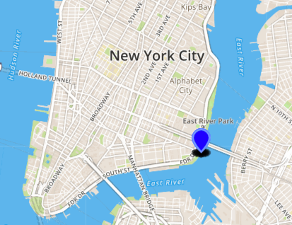
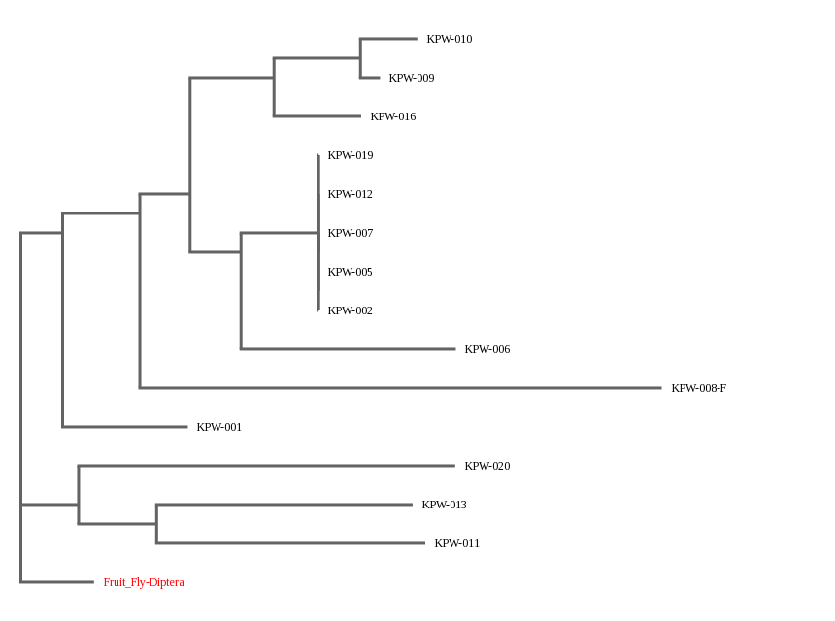
Invertebrate Biodiversity in the East River
Authors: Joshua Acevedo, Harold Miller Mentor: Sabrina Miller
Funded by the
Thompson Family Foundation
Academy for Young Writers
Abstract
Recent conservation movements, such as the Billion Oyster Project have revived New York City waters, and pushes for a healthier marine ecosystem. Our water quality tests suggest that New York City waters needs improvement to amplify marine biodiversity.
Introduction
When Henry Hudson navigated over what would become the New York Harbor in 1609, an estimated two hundred twenty thousand acres of oyster reefs thrived just beneath him. But by 1609, this same harbor was left void of life as raw sewage toxified the waters, exterminating oysters, a keystone species responsible for maintaining water quality.^{[1]} It wasn’t until 1972 that the Clean Water Act was passed^{[2]}, funding the construction of sewage treatment plants and granting the Environmental Protection Agency the authority to implement pollution control programs.^{[3]} Today, the NYC Department of Environmental Protection claims the harbor has been cleaner than ever in the last century,^{[4]} and this improved water quality has paved the way for the Billion Oyster Project, which aims to reintroduced a billion oysters into the harbor. So far, it has reached a quarter of its goal since its foundation in 2010.^{[2]}
But in spite of the moral high ground these conservation projects have, raised problems for NYC residents, very expensive problems. During the sixty six year period of the New York Harbor being dead, the joke of New York City being a “clean harbor” was “a quick way of saying that the water pollution was so severe that it killed any organisms attached to the hulls of ships.”^{[5]} “Suddenly, this pier we've been using for eight years is unsafe, and now we learn it's because of some worm,” said Denise Virga, manager of the local community board. But the culprit, the teredo navalis, isn’t a worm. “It’s the mollusk that swallowed New York,” notes one city engineer.^{[6]}
To combat such mollusk's such as shipworms and the revived hardy boring worm, creative solutions were devised. The construction of a pier south of the Hunts Point peninsula is planned to be built purely out of plastic.^{[10]} “As long as they have wood, they will continue to grow, pointed out Daniel Distel, a research professor at the Marine Science Center at Northeastern University.^{[7]} Battery Park employed divers to pour a “740-foot-long concrete wall under the water… intended to reinforce a timber wall, now under attack by borers.”^{[8]} The recently reopened East River Park had sixty five of its eighty three million dollar budget spent on replacing fourteen thousand rotted timber pilings with concrete supports encased in steel. The same is happening at the Brooklyn Bridge Park, where officials are being forced to spend up to two hundred million dollars to replace twelve thousand wood pilings in danger of being chewed through. “We literally have a clean harbor, but it’s causing incredible devastation to the physical infrastructure of the waterfront, and it’s costly to repair and replace,” said Adrian Benepe, commissioner of the city parks department.^{[9]}
East River Study ^{[11]}
Organisms Surveyed Different Species Found
3500 18
560 8
1480 11
1460 12
6920 13
3500 18
1460 12
6920 13
Materials & Methods
DNA Extraction
Lysing the Cells
Specimen tissue was isolated in a micro tube.
300 μL of lysis buffer was added and the sample was mechanically grounded using pestles.
Sample was heated at 65°C for 10 minutes and centrifuged at 10,000 rpm for 1 minute.
Binding the DNA
150 μL of supernatant was transferred to a new micro tube.
3 μL of silica resin was added.
Sample was heated at 57°C for 5 minutes and centrifuged at 10,000 rpm for 30 seconds.
Removing Cell Debris / Contaminants
The supernatant was removed and 500 μL of wash buffer was added
Pellet was suspended through repeated pipetting.
Sample was centrifuged for 30 seconds.
Repeat steps 3.1. - 3.4. two more times.
Unbinding Silica from DNA
100 μL of dH₂O was added.
Sample was heated at 57°C for 5 minutes and centrifuged at 10,000 rpm for 30 seconds.
50 μL of supernatant was transferred to a new micro tube.
Sample was then stored in ice
Polymerase Chain Reaction
DNA Amplification through PCR
2 μL of the thawed sample was isolated in a micro tube.
23 μL of diverse metazoan invertebrate (DMI) primers and a PCR bead were added.
Sample was placed in a thermal cycler for 4 hours.
Gel Electrophoresis
5 μL of each amplified DNA sample was loaded into a 2% agarose gel with a positive control and DNA ladder.
The gel was electrophoresed 30 minutes at 125 V.
Samples that produced the target bands (~300 bp for DMI primers and ~700 bp for CO1 primers) were sent to Gene Wiz for sequencing in both the forward and reverse directions.
DNA Sequencing and Editing
Sequenced DNA was uploaded to the DNA Subway online database, where they were trimmed, paired, and edited.
Table 1: Species Collected from East River
Discussion
None of the invertebrates caught in our study were borers, shipworms, or gribblers, and they pose no threat to the wooden pilings beneath piers nor the steel hulls of ships, and only one is even a mollusk. This suggests that organizations like the Billion Oyster Project still have their work laid out for them, but also that the damage done to piers isn’t at its worst. Should it, along with similar conservationist movements repopulate the waters with borers and shipworms, then the costly replacement of infrastructure for any wooden structures by the water must be tackled equally as feverous. This is not to say these efforts should be fought against, in fact, they should be encouraged, and what our study found was that we will need to adapt to these issues in the near future.
Since the 2015 study of biodiversity in the East River surveyed thousands of organisms and this 2018 project only managed to collect twenty samples, we wouldn't’t be able to compare estimates for biodiversity from either. The former found less than one specie per hundred surveyed organisms while we found one every other organism. But other teams in our school have also participated in the Urban Barcode Project with whom we could reference and compare results with. They surveyed the Gowanus Canal and the Bronx River, which helped us better picture the state of New York city waterways as a whole.
References
[1] (2009). Aquaculture FAQ - Why are oysters considered a keystone species. Sea Grant Delaware. https://www.deseagrant.org/outreach-extension/aquaculture-faq-why-are-oysters-considered-keystone-species
[2] (2010). Billion Oyster Project.
https://billionoysterproject.org
[3] (2017). History of the Clean Water Act. United States Environmental Protection Agency.
https://www.epa.gov/laws-regulations/history-clean-water-act
[4] (2018). Harbor Water. NYC Environmental Agency
http://www.nyc.gov/html/dep/html/harborwater/index.shtml
[5] Gruson, Lindsey. (1993). In Cleaner Harbor, Creatures Eat the Waterfront. The New York Times.
https://www.nytimes.com/1993/06/27/nyregion/in-cleaner-harbor-creatures-eat-the-waterfront.html
[6] Mathews, Joe. (1997). Hungry 'worm' eats away at Big Apple Epidemic: Worm-like mollusks are devouring the wooden piers of New York City's waterfront. The Baltimore Sun.
http://articles.baltimoresun.com/1997-03-19/news/1997078098_1_pier-mollusks-teredo
[7] Herszenhorn, David. (1999). Pest Is Eating at City’s Edges; A Cleaner Harbor Gives New Life to Marine Borers. The New York Times.
https://www.nytimes.com/1999/07/28/nyregion/pest-is-eating-at-city-s-edges-a-cleaner-harbor-gives-new-life-to-marine-borers.html
[8] Hynes, Tom. (2016). These Tiny Wood-Eating Creature Want To Sink Brooklyn Park. Gothamist.
http://gothamist.com/2016/09/20/brooklyn_bridge_park_borers.php
[9] Foderado, Lisa. (2011). Cleaner Harbor Has a Downside: Pests That Plague Park Construction. The New York Times.
https://www.nytimes.com/2011/08/24/nyregion/cleaner-new-york-harbor-brings-pests-that-plague-park-projects.html
[10] (2015). Habitat Pages. Harbor Estuary.
http://www.harborestuary.org/pdf/HabitatPages/ShorelinesShallows/NYSDEC-BenthicMappingReport-102815.pdf
[11] Monitoring The Quality of Surface Waters. Water Research Center. https://www.water-research.net/index.php/water-treatment/water-monitoring/monitoring-the-quality-of-surfacewaters
Acknowledgements
- Alison Cucco, Harlem DNA Lab
For helping us collect our samples by the East River.
- Nicolle Martinez, Lower East Side Ecology Center
For helping us with water quality testing.
Species Richness 2018 2004
Gowanus Canal - 13 Species 18 Species
Bronx River - 14 Species 9.9 Species
East River - 9 Species 13.1 Species
Table 2: Water Quality of the East River
Water Quality Metric | Values
Nitrates | 2 ppm
Phosphates | 2 ppm
Dissolved Oxygen | 4 ppm
pH | 8
Salinity | 38 ppt
Images of Species Collected
Location of the sample collection from the East River
Dysanopeus sayi
Ectopleura crocea
Botrylloides violaceum
Molgula manhattansis
Palaemon
macrodactylus
Mytilus
trossulus
Haliclona fascigera
Halichondria panicea
A Phylogenetic tree to demonstrate which organisms are closely related.

