Slide 1
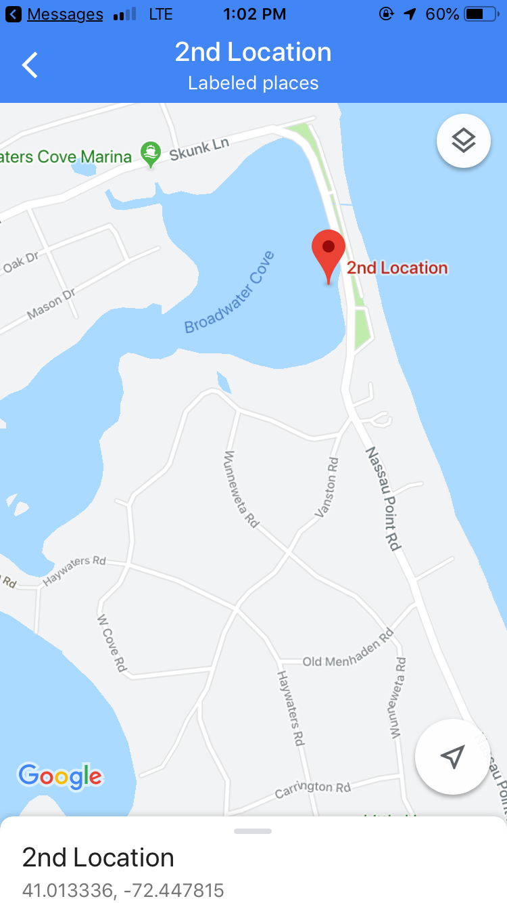
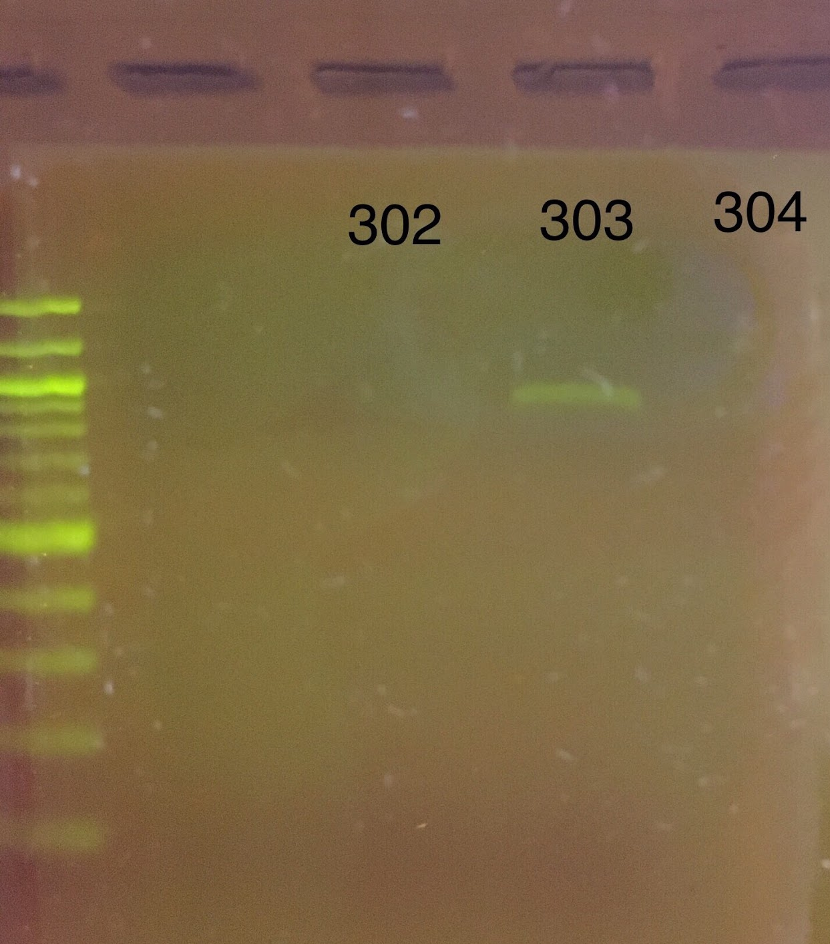
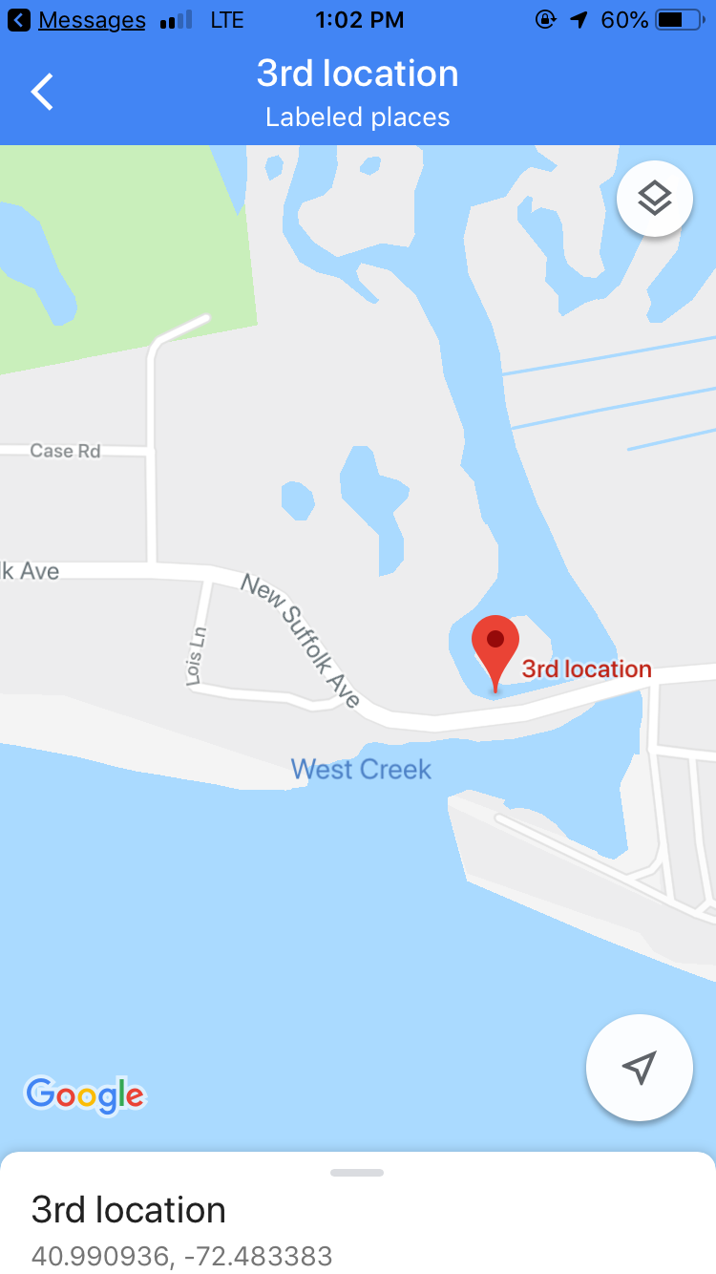
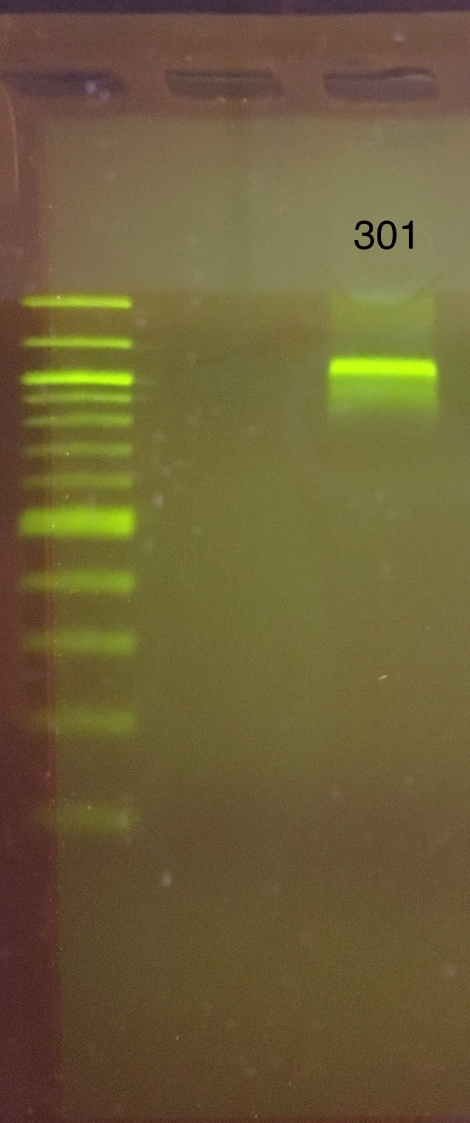
Amphipod Diversity in Two Bay Estuaries in Mattituck:
Farmland vs. Residential
Maxwell Cantelmo,¹ Wylee Sanders,¹ Madison Storm¹
Mentor: Anna McCarroll¹
¹Mattituck High School
Abstract
Our goal was to collect and analyze data from marine amphipods in farmland and residential estuaries, hypothesizing that the use of fertilizer could potentially increase nitrogen levels. Objectively, the team was also looking at the amphipods for indication of the health of the environment. Amphipods were retrieved with plankton nets by wading into shallow waters. After sequencing, however, the only viable samples were deemed to be of poor quality because of poor results on both the forward and reverse sequences. Results reflect what implications the water quality has for human health. The most important finding was mainly the lack of nitrogen present at Location 3.
Introduction
We looked at marine amphipods found in estuaries along the North Fork of LI that feed into the Great Peconic Bay, specifically Wickham Creek which is surrounded by farmland and West Creek off of New Suffolk Avenue which is surrounded by residential properties. In addition, the team evaluated amphipods as an indicator species for the health of the environment. Amphipods collectively include members of the invertebrate order Amphipoda, class Crustacea. Selecting the amphipods from these two different locations allowed us to compare the amphipods based on what pollutants feed into the water. We hypothesized that the estuary nearest to the farmland will have a greatly decreased biodiversity in terms of amphipods than that of the more agriculturally undeveloped waters in West Creek. We speculated that any difference in biodiversity could be caused by fertilizer use, so nitrogen content in the water will be tested. Nitrogen, given high enough concentrations, may pose a threat to the amphipods, or potentially indicate the presence of other chemicals introduced by farming that may pose a threat to animals, and to humans.[1]
To identify the varying classifications of Amphipoda Crustacea, dichotomous keys were used. Certain species have an abundant amount of pleopods and uropods, while others were lacking, Found samples included: Microdeutops gryllotalpa, Meara danae, Paracorphium lucasi, and Westwoodilla tone. [2]
Materials & Methods
On 4/29/19, at 4:20pm, during high tide, it was 56F, and the team went to three separate marine locations in Mattituck-Cutchogue to wade in and collect samples. Samples were taken from the brackish water using a plankton net (a 8”x 20”nylon net with 50ml collecting bottle). At each site, 25 samples were collected and stored in sterile 50ml polypropylene tubes. Samples were examined under a microscope. Amphipods were only found at two locations, Location 0429-02 and 0429-03. Photographs were taken and samples were preserved overnight in 99% ethanol at 37F. Using the Silica Resin DNA Isolation Method, DNA was extracted and amplified with PCR. A sample of each was run on gel electrophoresis to determine if there was enough DNA to sequence. Three of the 10 samples appeared on the gel and were sent to GENWIZ for sequencing.
Results
Table 1. Data taken from Location 2 and 3
Location | Water Temp (F) | Salinity (PPt) | Nitrogen Level (Nitrates PPt) | Amphipods
0429-2 | 52 | 24 | 5 | 8
0429-3 | 49 | 20 | 0 (None detectable) | 2
Discussion
The two locations of the study were chosen because of the different composition of the surrounding land. Location 2 was near more residential property, compared to Location 3 which was surrounded mostly by golf courses and country clubs. The surprising results of this study come from the fact that there was less nitrogen present at Location 3. There are more fertilizer-heavy facilities, such as the golf course, which potentially suggest a higher concentration of nitrogen, however this was not the case. Data regarding the presence of nitrogen in tandem with its effects on amphipod biodiversity could be used in determining health effects on other organisms, or more importantly, people. A high nitrogen content coupled with an extremely low biodiversity would suggest potentially toxic conditions which could be potentially hazardous. The health of bodies of water is a crucial aspect of life on Long Island; water provides food, leisure activities, and an income for countless people. The data did not show much of a difference between the two sites in regards to the diversity of the animals, suggesting that the water near large fertilized areas is not completely unusable. Muddy conditions limited the viable samples. This could potentially be solved in future studies by using a small boat or other watercraft and towing the plankton net a fair distance behind, as to avoid the mud entirely. In regards to the processing of the animals, there was an issue with the grinding of the animals. This could be solved by using a more aggressive grinding technique to extract DNA.
References
Nitrogen and Water; The US Department of the Interior, 2019, www.usgs.gov
AMPHIPODA: GAMMARIDEA, May 2007, P. 535 www.marinespecies.org
Acknowledgements
We would like to thank the BarcodeLI team at Cold Spring Harbor for all of their help with supplies and guidance; Jeff Petracca, lead entomologist at The LI Aquarium for recommendations; Eric Frend and Janine Ruland of the Mattituck HS Science Department for protocol and research help; Mattituck HS Principal Shawn Petretti and MCUFSD Superintendent Jill Gierasch and the MCUFSD BOE for support and encouragement.

