Slide 1
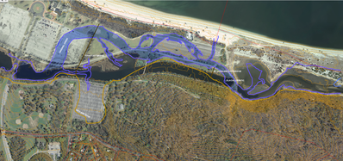
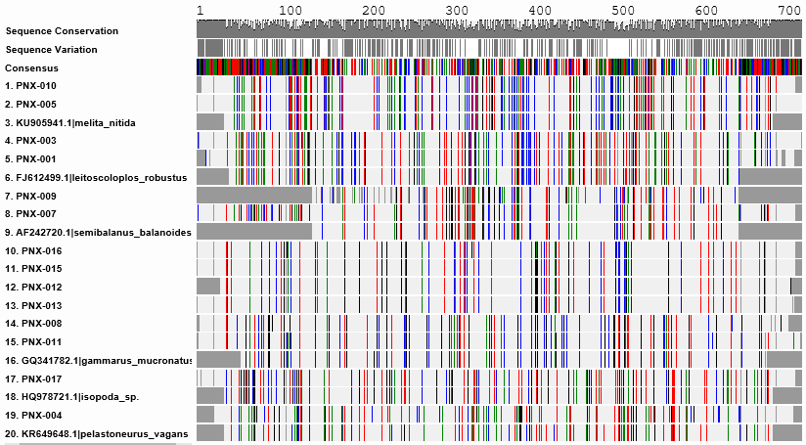
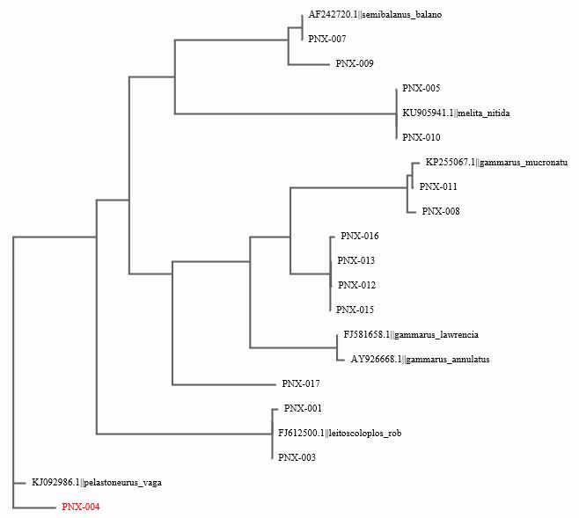
Assessing the Biodiversity of a Restored Estuary
Nistha Boghra, Kelly Chaudhry, and Chelsea Fonseca
Mentor: Monica Marlowe
Sachem High School North
Abstract
We sampled at Sunken Meadow State Park, specifically Sunken Meadow Creek, which is an estuary on the North Shore of Long Island. A dam was removed in 2012 to restore tidal flow to 132 acres of estuary. Our main goal is to sample the biodiversity of benthic invertebrates from Sunken Meadow Creek, both upstream and downstream from the former dam, to compare the biodiversity. We hypothesized that we will find a greater biodiversity of benthic invertebrates below the former dam. This area was never impacted and has always been an estuary system. Above the former dam was previously a freshwater environment and we predicted that there will be less invertebrates colonized in the sediments.
Introduction
Simply defined, an estuary is an area where freshwater meets the sea. In estuaries, salt water is diluted with fresh water and therefore this is a suitable region for a diverse number of organisms. Overall, they provide a great habitat for organisms to live and reproduce in an area that allows safety, habitat and an abundance of food for a huge variety organisms, including fish, mammals, and migratory birds (NOAA 2017).
We aimed to sample the biodiversity of benthic invertebrates at Sunken Meadow Creek, both above and below the former dam, which blocked the estuary from the Long Island Sound. We hypothesize that we will find a greater biodiversity of benthic invertebrates below the former dam. This area was never impacted and has always been an estuary system. If restoration was successful, we should find similar species on either side of the dam. We will sample small benthic invertebrates, including but not limited to worms, larvae, insects, and amphipods.
Materials & Methods
We collected samples from two sites: one site downstream from the former dam in the natural estuary and one site upstream from the dam that is transitioning back to an estuary system (Figure 1).
Materials & Methods
Results
PNX 1-11 were collected downstream from the dam, while PNX 12-17 were collected from upstream the dam. According to the MUSCLE, PNX1 and PNX3 are Leitoscoloplos robustus. PNX5 and PNX10 are Melita Nitida. PNX8 and PNX11 are Gammarus Mucronatus. PNX12, PNX13, PNX15, and PNX16 have almost identical sequences, with over 30 mismatches in DNA from Gammarus Mucronatus. Table 1 displays the results by showing the closest species to each organisms, and how many mismatches it has to that species. Figure 3 is the Alignment Viewer from GenBank, and displays how closely related the organisms are by showing the gene sequence. There were more different species of benthic invertebrates downstream the dam. There are organisms of the same species on either side.
Discussion
PNX4, PNX9 ,PNX12, PNX13, PNX15, and PNX16 have over 30 mismatches in DNA in both GenBank and BOLD, therefore they are novel species. Our data suggests that the estuary restoration is successful because there are organisms of the same species on either side of the dam. However, in the future, we would like to include long term water quality data, specifically salinity, pH, dissolved oxygen, nitrate, and phosphate.
References
“Estuaries.”​Earth Explorer. 1995. ​eLibrary Science. Web. 11 Dec 2017
“Why are estuaries important?” National Oceanic and Atmospheric Administration (NOAA). EcosystemServices.” (NIWA)
“The Value of World's Ecosystem Services and Natural Capital”. 1997. Robert Costanza, Ralph D’Arge, Rudolf de Groot, Stephen Farber, Monica Grasso, Bruce Hannon, Karin Limburg, Shahid Naeem, Jose Pareulo,Ribert G. Raskin, Paul Setton, Marjan van den Belt
“Using Benthic Invertebrates as Bioindicators (RAMP)”
“Controlling Eutrophication.” 2009. Daniel J. Conley, Hans W. Pearl, Robert W. Howarth, Donald F. Boesch, Sybil P. Seitzinger, Carl E. Havens, Christiane Lancelot, Gene E. Likens
National Oceanographic and Atmospheric Administration (NOAA). “What is Eutrophication.”
Acknowledgements
We give great thanks to DNA Learning Center Staff and our mentor, Mrs. Marlowe, for guiding us and for giving her time throughout the whole process.
We would like to acknowledge the Sachem Central School District administration and Cold Spring Harbor Laboratory and Barcoding Long Island for providing us with this amazing opportunity.
We appreciate the help of Dr. Daniel Moloney from Stony Brook University with his help in the gel electrophoresis process.
We designated areas of 1 square meter at two sites upstream and two sites downstream from the dam for sampling. The one square meter plots were created using a meter stick. Using waders and gloves, we looked for organisms in the top 5 cm of the sediment.
For each organism, a photograph was taken immediately and its environment was documented using the provided datasheet. We also recorded location in latitude and longitude, in geographic coordinates and elevation, and exact time of sampling.
We placed the organism in a petri dish, sealed, and labelled with corresponding identification number.
After collecting at least 10 organisms from both above and below the dam, they were photographed and preserved in a freezer.
Organism | Closest Species | Common Name | Number of Mismatches
PNX1 | Leitoscoloplos robustus | Polychaeta Worm | 3
PNX3 | Leitoscoloplos robustus | Polychaeta Worm | 0
PNX4 | Pelastoneurus vagans | Fly Larvae | 37
PNX5 | Melita Nitida | Amphipod | 0
PNX7 | Semibalanus balanoides | Barnacle | 0
PNX8 | Gammarus mucronatus | Amphipod | 7
PNX9 | Semibalanus balanoides | Barnacle | 57
PNX10 | Melita Nitida | Amphipod | 0
PNX11 | Gammarus mucronatus | Amphipod | 4
PNX12 | Gammarus mucronatus | Amphipod | 117
PNX13 | Gammarus mucronatus | Amphipod | 114
PNX15 | Gammarus mucronatus | Amphipod | 114
PNX16 | Gammarus mucronatus | Amphipod | 117
PNX17* | Philoscia muscorum | Woodlouse | 0
A
B
Figure 1: Sunken Meadow Creek
The purple shaded area represents where the estuary historically was. The dam, represented by the line, was removed in 2012.
Table 1: Results
Each sample with the closest match in the Gen Bank and/or BOLD databases.
Figure 3: Alignment Viewer
Each organism is aligned with its closest match using MUSCLE in DNA Subway.
Figure 4: Phylogenic Tree
PNX12, 13, 15, and 16 are novel species in GenBank and BOLD.

