Slide 1
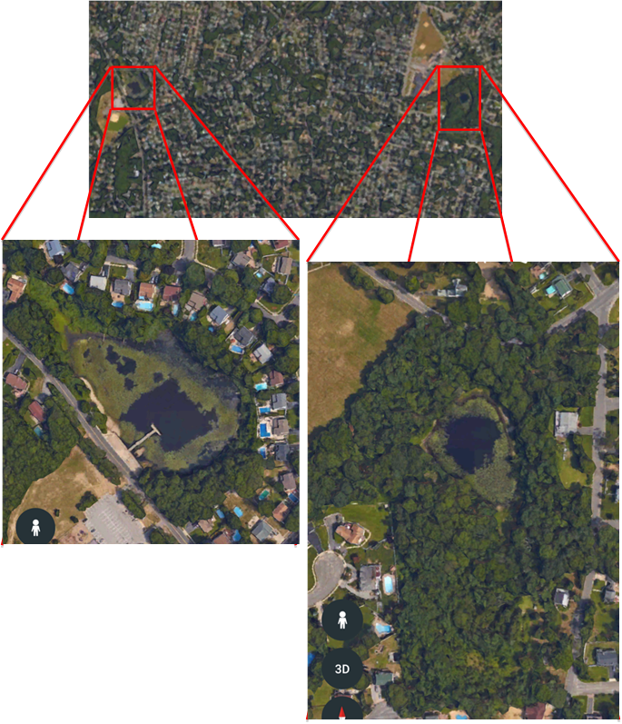
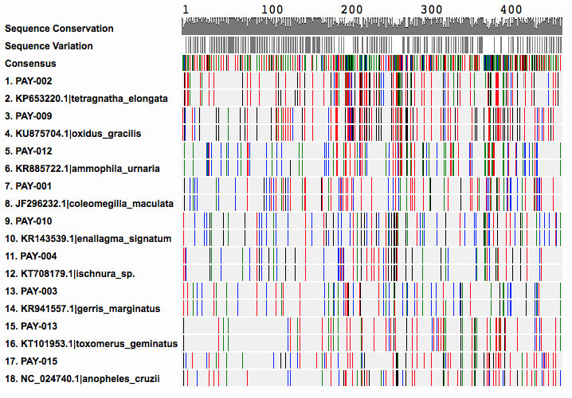
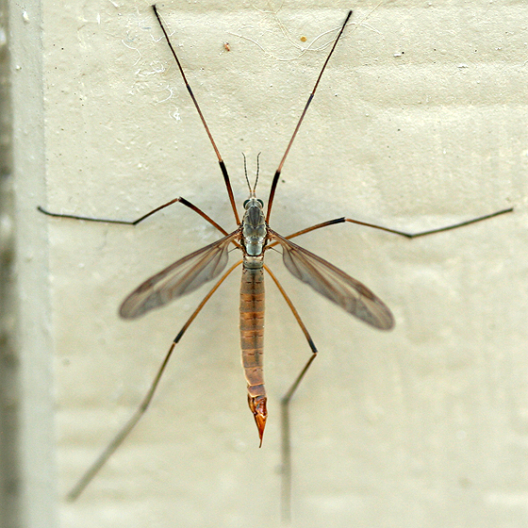
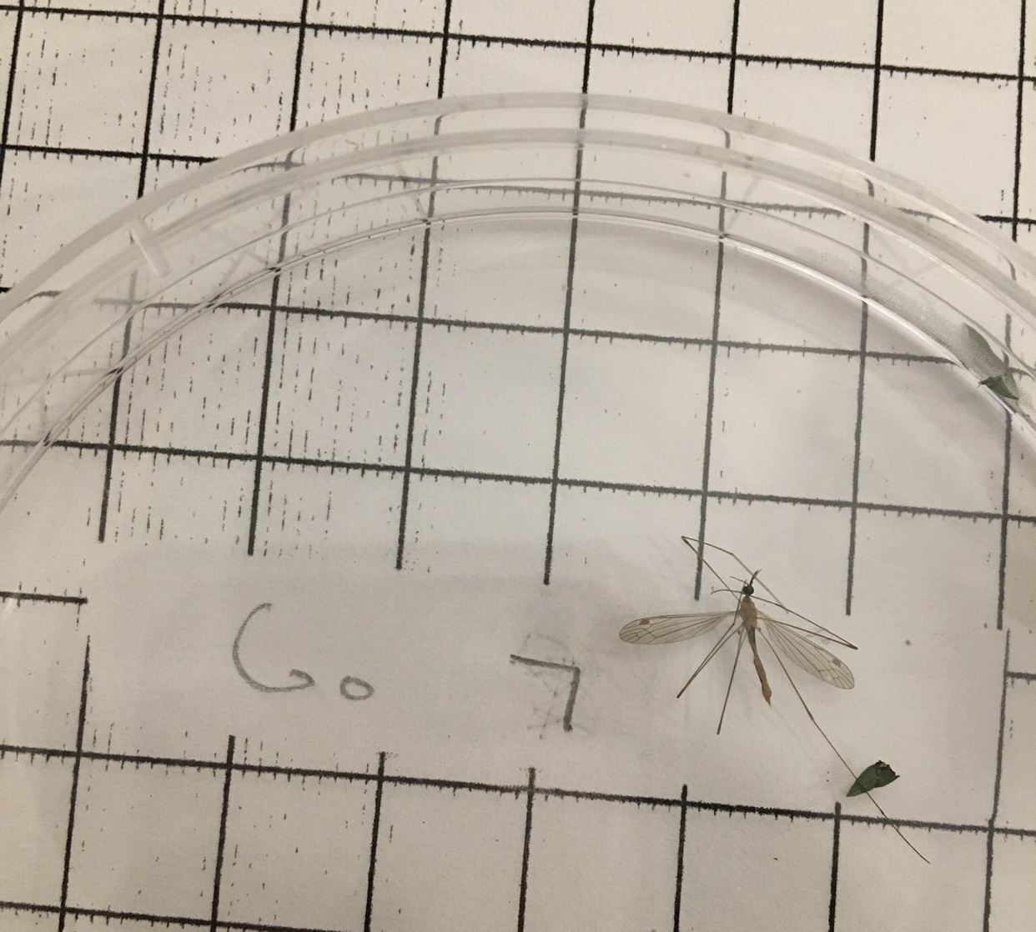
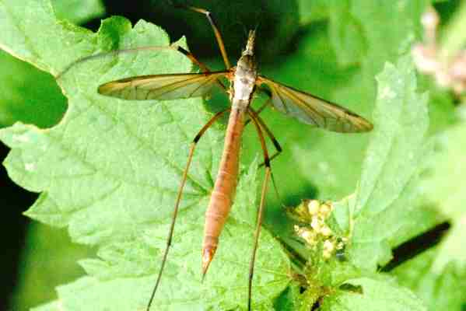
The Effect of Riparian Buffer Zones on Biodiversity in Wetlands
Kaya Manolt, Caitlin Tucker, and Madison Tutone
Mentor: Monica Marlowe ~ Sachem High School North
Abstract
Parameters such as a neutral pH, lower nitrates and phosphates, and increased dissolved oxygen promote biodiversity and attract organisms that are indicators of good water quality. The presence of a vegetated buffer zone can reduce the nitrate and phosphate levels within a wetland. We collected approximately twenty invertebrate specimen from two local ponds. Pond 1 is surrounded by a buffer zone while Pond 2 is not. We found overall a higher level of biodiversity in Pond 1. Also, we found five dragonfly larvae, which are indicators of good water quality, only in Pond 1. Then, we amplified the DNA that we extracted from each specimen and sent it out for sequencing. From there we were able to identify the species that we had seen at the ponds, further confirming the presence of indicator species at Pond 1. Through monthly water quality tests, we discovered that Pond 2 had higher nitrate levels than Pond 1. Using the results from our research we can conclude that buffer zones do positively affect water quality and biodiversity. Our goal was to further exemplify the positive impact buffer zones have on the world’s most valuable ecosystem: wetlands. Hopefully by conducting this experiment we can educate others on the importance of buffer zones. The world is currently going through a water quality crisis, and any education that can be provided to the public on how to improve the ecosystems that we rely on serves as a step towards eventually solving this problem and improving water quality on a global scale.
Introduction
According to to Costanza et al. (1997) wetlands are one of the most valuable ecosystems in the world due to the fact that improve water quality by trapping sediments, filtering out pollutants, and absorbing nutrients that would otherwise result in poor water quality (WSU 2008). They also produce great volumes of food that attract many animal species, therefore can provide habitat for an immense diversity of plants, amphibians, reptiles, mammals, and migrating waterfowl.
Abiotic factors such as pH, nitrates, phosphates, and dissolved oxygen can influence the biodiversity found in wetland areas. Unbalanced levels of any of these parameters will reduce water quality and species richness of a water. Fortunately, riparian buffer zones can serve as a natural protection from these chemical imbalances.
We predicted that nitrate and phosphate levels will be higher and dissolved oxygen and biodiversity will be lower in Pond 2 than Pond 1 due to its lack of a buffer zone.
Materials & Methods
At each pond, we sampled within a one meter square plot. Latitude and longitude were recorded. Each specimen was stored in a petri dish and labeled. Water quality parameters were measured using a LaMotte water quality test kit. Three measurements for each parameter were averaged on each sampling date. Paired T-Tests were performed for each water quality parameter of pH, nitrate, phosphate, and dissolved oxygen.
Open labs were attended at Stony Brook University. At the open labs the protocol given by Cold Spring Harbor DNA Learning Center were followed to extract, isolate, and amplify each organism’s DNA. DNA samples were then sent for sequencing.
Results
Pond 1 showed increased water quality and biodiversity of indicator species compared to Pond 2. For example, at Pond 1 we found multiple dragonfly larvae, which is an indicator of good water quality. Also, we found that in Pond 2 there were increased levels of nitrates. However, both ponds showed presence of nitrates and phosphates, as well as exhibited low dissolved oxygen levels ranging from 3.39 ppm - 3.53 ppm (Table 1).
After we extracted our DNA and put it through the PCR, twelve of our samples could be sent out for sequencing. Two samples, PAY-008 and PAY-016 were not able to be sequenced. We were able to identify nine of our specimens (Table 3). One of the samples, PAY-015’s species was not able to be identified by GenBank (Figure 2). The closest match in the DNA Subway and GenBank databases to PAY-015 was Anopheles Cruzii, a type of mosquito. There were sixty-eight mismatches between the two organisms (Table 3).
Acknowledgements
We would like to thank Cold Spring Harbor Laboratory, Barcode Long Island staff , Stony Brook University, Brookhaven National Laboratory, our parents, Suffolk County Legislator Leslie Kennedy, her Chief of Staff; Ali Nazir, and the Sachem Central School District
Table 3: BLAST results with closest matches using the Cytochrome Oxidase subunit 1 (COI) gene in GenBank
Sample | Closest Species | Aln. Length | Mis-Matches
PAY-001 | Coleomegilla maculata (Spotted Lady Beetle) | 658 | 0
PAY-002 | Tetragnatha elongata (Elongated Stilt Spider) | 658 | 8
PAY-003 | Gerris marginatus (Water Treader) | 698 | 2
PAY-004 | Ischnura verticalis (Eastern Forktail Damselfly) | 658 | 8
PAY-009 | Oxidus gracilis (Greenhouse Millipede) | 622 | 0
PAY-010 | Enallagma signatum (Orange Bluet Damselfly) | 658 | 1
PAY-12 | Ammophila urnaria (Hunting Wasp) | 583 | 1
PAY-13 | Toxomerus geminatus (Flower Fly) | 658 | 0
*PAY-015 | Anopheles cruzii (Mosquito) | 707 | 75
Pond 1
Pond 2
Figure 1: Aerial photographs of Pond 1 and Pond 2. Pond 1 has a forested buffer zone, while Pond 2 does not
Table 1: Average water quality results measured using a LaMotte water quality testing kit
Figure 2: Visual of MUSCLE showing each PGR sample with the closest match according to DNA Subway BLAST
Table 2: Indicator species presence at each pond
 | Pond 1 | Pond 2
Salinity (ppt) | 0 | 0
Temperature (°C) | 12 | 14.19
Turbidity (JTU) | 19.17 | 20.28
pH | 6.93 | 7.10
Nitrate (ppm) | 3.46 | 4.83
Phosphate (ppm) | 1.52 | 0.99
Dissolved Oxygen (ppm) | 3.53 | 3.39
Indicator Species | Pond 1 | Pond 2
Eastern Forktail Damselfy | ✔
Orange Bluet Damselfly | ✔
Darter Dragonfly Larvae | ✔
Figure 3: Official photographs of Tipula paludosa compared to PAY-015
Discussion
Using the information we gathered through DNA barcoding we were able to identify PAY-015, found at Pond 1, as a member of the Tipulidae family, more commonly know as the Crane Fly. Unfortunately, using both GenBank and BOLD Systems, we were not able to identify the species of the specimen. This being said, the presence of crane flies in the far eastern portion of New York State is peculiar due to the fact that they are documented in the very far west regions of the state a majority of the time. This also has some significance regarding the unfortunate introduction of Tipula paludosa and T. oleracea to New York, two invasive species of crane fly discovered by Cornell University experts in 2005 (CC 2005). Although we cannot be sure since we did not get definitive results back from the nucleotide databases, PAY-015 physically resembles the Tipula paludosa. These species are responsible for the destruction of turfgrass, forage grass, seeding nurseries, vegetable crops, and small fruit crops. It’s presence during October when we found the specimen makes sense because they are usually found in late summer to early fall. However, the specimen was unusually small for a Crane Fly so this leads us to believe that it was in a young adult or maturing stage. The insinuates that there may have been a hatching site nearby due to the fact that Crane Flies are generally poor flyers. The most logical explanation for the presence of Crane Flies this far east is the transfer of larvae or egg infested soil from the west to the east, this would provide an easy mode of transportation for these insects. This presence of Crane Fly could serve as an introduction for more, even possibly invasive, species of Crane Fly to migrate towards the eastern portion of New York State.
References
Cold Spring Harbor DNA Learning Center (CSH). 2014. Using DNA Barcodes to Identify and Classify Living Things.
Natural Resources Conservation Service (NRCS). 2001. Riparian Forest Buffer. USDA Wildlife Job Sheet. https:// efotg.sc.egov.usda.gov/references/public/IL/ripairian.pdf
Robert Costanza et al. 1997. The value of the world's ecosystem services and natural capital. Nature. 387. 253 – 260
Washington State Department of Ecology (WSU). 2008. Functions and values of Wetlands: Nature’s sponges, Nurseries,
and Water Filters.
Cornell Chronicle (CC 2005). 2005. Cornell experts find two new species of Crane Fly have invaded New York, threatening lawns, golf courses, and
pastures

