Slide 1
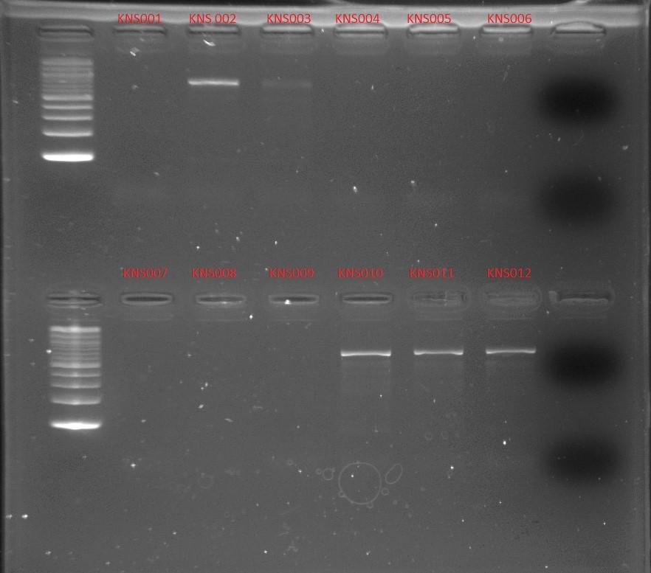
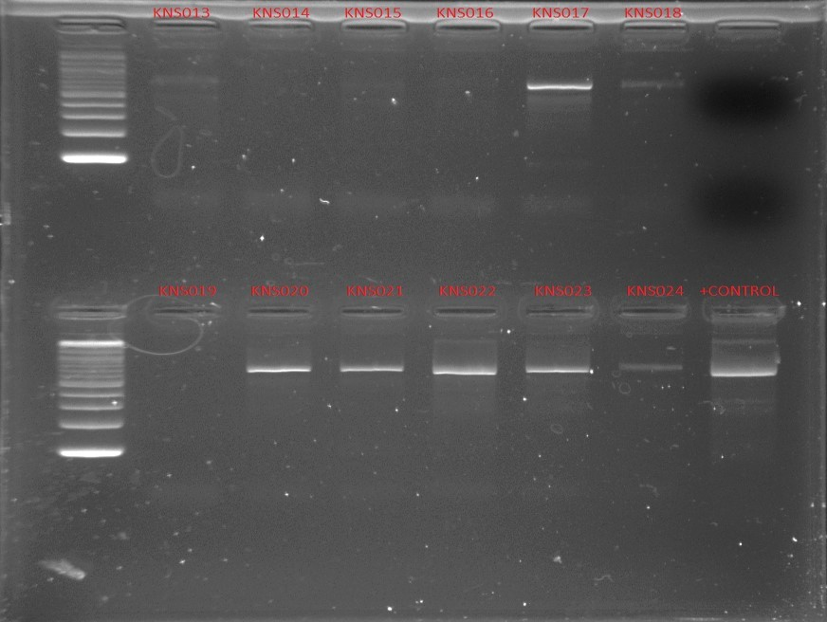
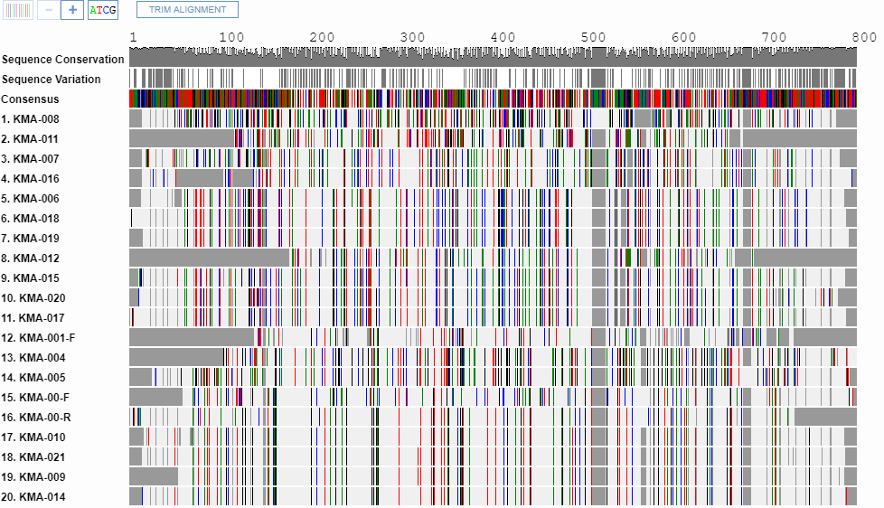
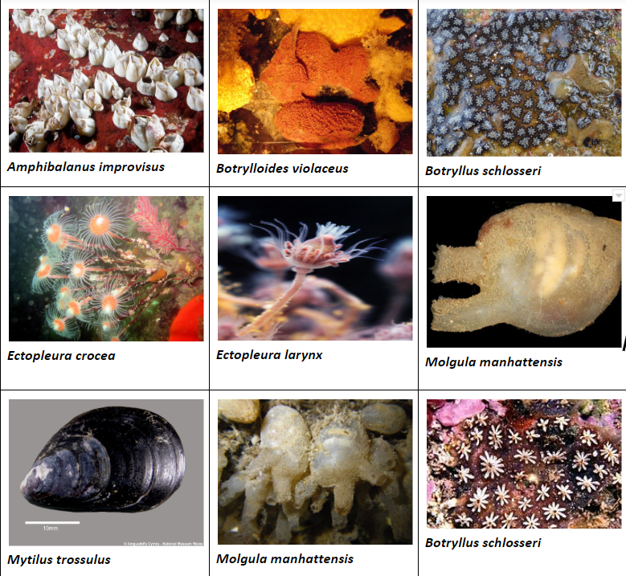
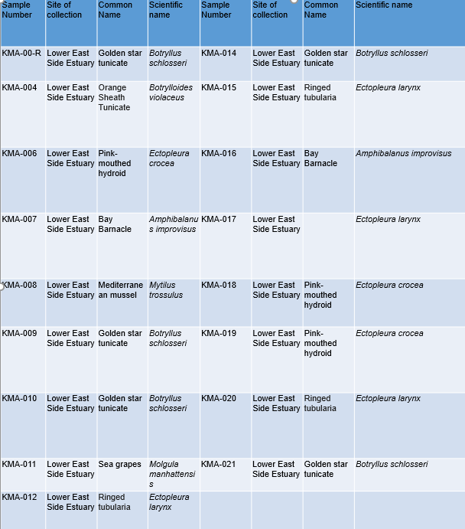
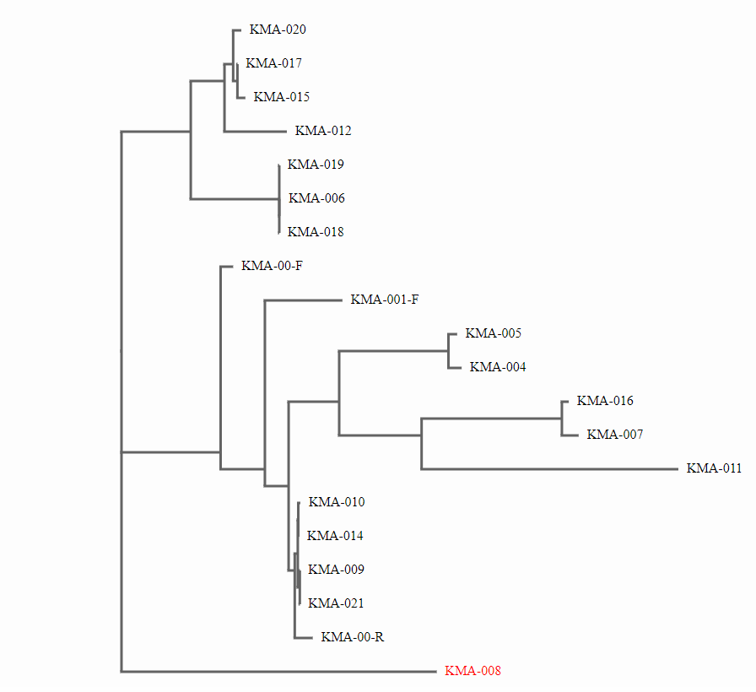
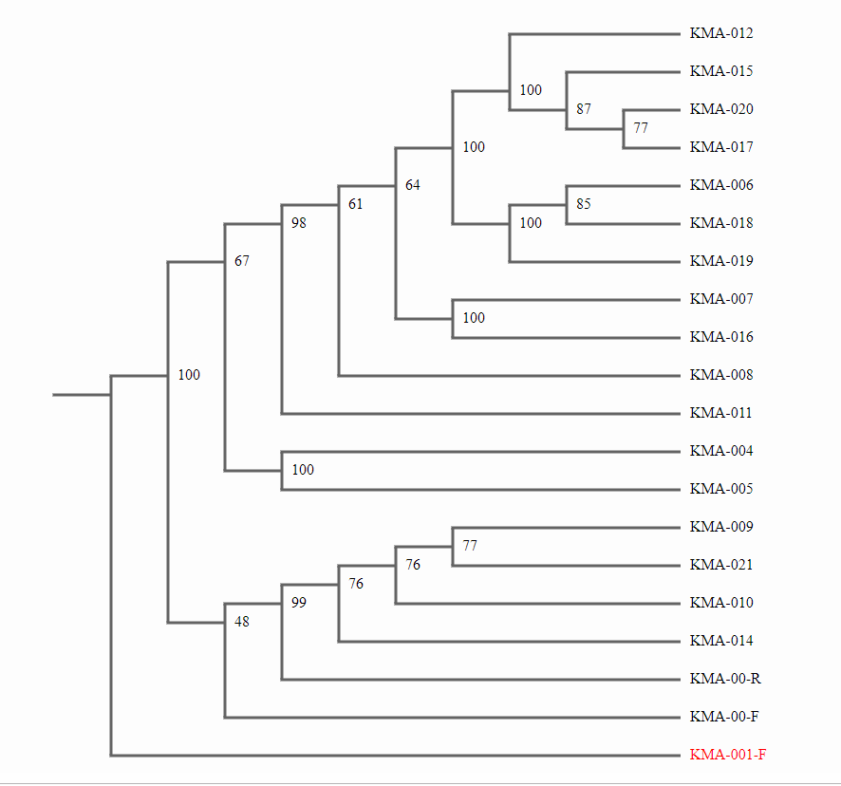
Barcoding Marine Invertebrates found in Lower East River Estuary, NY
Authors: Maik Cen Wu and Mame Diop
Sponsoring Teacher: Alfred Lwin
Manhattan Comprehensive Night and Day High School, New York, NY
Funded by the
Thompson Family Foundation
Abstract
Invertebrates are organisms without backbones. Marine invertebrates belong to many different types of organism that inhabit in oceans. Marine invertebrates have a wide diversity and they come in as small as microscopic size to, as large as several meters. Such marine invertebrates as sponges, cnidarian, marine worms ,lophophorates, mollusks and arthropods and echinoderms and hemichordates are the most commonly found organisms. Marine invertebrates are considered as economically and ecologically important organisms. Estuaries provide habitats for wide varieties of plants and marine animals including invertebrates. Estuary habitats are affected by run-off pollutions shoreline developments by human activities. Research has showed that there is correlation between species richness and pollution in estuary ecosystems. Our research aimed to find out diversity of marine invertebrates in Lower East River Estuary, NY. We collected samples of marine invertebrates from Lower East River estuary and barcoded them. Our DNA barcode result showed that the invertebrate samples belong to Amphibalanus improvisus, Botryllus schlosseri, Botryllus violaceus, Ectopleura crocea, Ectopleura larynx, Molgula manhattensis, Mytilus trossulus.
Introduction
Among all the animals in the world, invertebrates occupy 98 to 99% of all the known species on the planet Earth. 60 % of marine animals are considered marine invertebrates.
So far only 10% of the marine invertebrates in the world have been identified, and the rest of the marine invertebrate species in the world are awaiting to be discovered. Crabs, corals, sea anemones, jellies, sea stars, sea urchins and shrimp are considered most common marine invertebrates which include harmless and colorful, such as Christmas tree worm and coral reef, or deadly , such as blue-ringed octopus and jellies fish. Understanding marine invertebrate distribution can give us information about climate change. Several research studies of marine invertebrate for the past 40 years have contributed to discoveries and production of synthetic drugs and molecular research tools.
Our research focused on identifying marine invertebrates in Lower East River Estuary, NY through DNA barcoding. Most of the marine invertebrates are filter feeders. According to the barcode research “Sampling Sessile Invertebrates found in Oyster Station in Lower East River” by Choedon Pema, Li Yonglong and Lakouetene Elizette, from Manhattan Comprehensive night and Day High School, 8 different species of sessile invertebrates were found in Lower East River Estuary. We hypothesized that Lower East River estuary provides suitable habitats for wide varieties of invertebrates, and that the estuary may harbor more than 8 different species.
Materials and Methods
In November 2018, our team made a trip to Lower East Side Ecology Center, New York, N.Y, for our sample collection. In order to collect marine invertebrate samples, we pulled out oyster restoration stations from east river estuary, specifically, at the waterfront of Lower East River Ecology Center, NY. We collected our samples of marine invertebrates, both motile and sessile, with hands and then we stored them in vials that contained 90% of alcohol. Before storing those samples in the fridge, we took photos and properly labeled them. Later in February, we took the sample to the Harlem DNA Lab for DNA extraction. We followed the Barcoding 101 protocol to isolate mitochondrial DNA, and ran PCR, using invertebrate primer and then ran gel electrophoresis to analyze our PCR products. Although we had collected around hundreds of unknown samples from the location, we were only able to isolate 22 samples due to limited time and resources. Gel analysis showed that we had good DNA sequences to barcode. Later, we requested DNA learning center to have our PCR products sequenced. When we received the results of our sequencing run, we uploaded those sequence results to DNA Subway. Then we used blue line to determine the sequence and blasted them.
Result
Our DNA barcode result showed that our samples belong to 7 different species of marine invertebrates that inhabit in Lower East River Estuary: (Amphibalanus improvisus, Botryllus schlosseri, Botryllus violaceus, Ectopleura crocea, Ectopleura larynx, Molgula manhattensis, Mytilus trossulus.)
Discussion
Among the 22 total samples we collected, 17 of the samples came out with good DNA sequences. Sample No. 1, 9, 10, 14, 21 belongs to Botryllus schlosseri. Sample No.4 belongs to Botryllus violaceus. Sample No. 7 belongs to Amphibalanus improvisus. Sample No. 8 belongs to Mytilus trossulus ( Medeteranean mussel). Sample 11 belongs to Molgula manhattensis. Sample No. 6,18,19 belongs to Ectopleura crocea. Sample No. 15,17,20 belongs to Ectopleura larynx. We found that Botryllus violaceus and Botryllus schlosseri belongs for the same family, Styelidae. Botryllus schlosseri or Golden Star Tunicates are considered as a pests to oyster trays and cause fouling smell to ships. However, scientists use them in experiments of embryology, genetics, and immunology. Amphibalanus improvisus, (common name: Bay barnacle) can cause fouling but they play important role as filter-feeders in estuary ecosystem. The above-named species can be used as bio-indicators to evaluate the estuary environmental conditions. Our DNA barcode research at least sheds lights on the types of marine invertebrate biodiversity in Lower East River Estuary. Because of the limited time and limited resources, we could not use as many samples as we wanted to barcode. However, our research result based on small sample number, can indicate what types of marine invertebrate species are found in Lower East Estuary. Our data of those marine invertebrate samples might be useful for other research on diversity of marine invertebrates. We recommend that more research will be needed with larger sample sizes and more sampling sites. At least we hope that our DNA Barcode research may contribute to NYC Biodiversity Database.
References
Marine invertebrates. n.d. Department of the Environment and Energy. Available from:https://www.environment.gov.au/marine/marine-species/marine-invertebrates, May 16, 2019.
Marine Invertebrates. National Parks Service. [accessed 2019 May 15]. Available from:https://www.nps.gov/caco/learn/nature/marine-invertebrates.htm
Home - PMC - NCBI. National Center for Biotechnology Information. [accessed 2019 May 15]. Available from: https://www.ncbi.nlm.nih.gov/pmc/
The Oceans' Unsung Heroes - Invertebrates. Mission Blue. 2013 Apr 29 [accessed 2019 May 15]. Available from:https://mission-blue.org/2012/08/the-oceans-unsung-heroes-invertebrates/
EPA. 2016 Dec 19 [accessed 2019 May 15]. Available from:https://www.epa.gov/climate-indicators/climate-change-indicators-marine-species-distribution
Figure 2f from: Irimia R, Gottschling M (2016) Taxonomic revision of Roche fortia Sw. (Ehretiaceae, Boraginales). Biodiversity Data Journal 4: e7720. Available from:https://doi.org/10.3897/BDJ.4.e7720. doi:10.3897/bdj.4.e7720.figure2f
Marine Invertebrates. National Parks Service. [accessed 2019 May 15]. Available from:https://www.nps.gov/caco/learn/nature/marine-invertebrates.htm
Figure 2—source data 2. The source data to plot the bar chart in Figure 2F. doi:10.7554/elife.36696.007
© The American Genetic Association 2013. All rights .... n.d. . https://pdfs.semanticscholar.org/fbf4/c5f88cf43785e608034cf7f7564e403fba30.pdf, May 16, 2019.
David.shiffman. david.shiffman. Shark Research Conservation Program SRC University of Miami. 2013 Jun 10 [accessed 2019 May 17]. https://sharkresearch.rsmas.miami.edu/possible-links-between-estuarine-pollution-and-invertebrate-biodiversity/
Climate Change Indicators: Marine Species Distribution. Available from:https://www.epa.gov/climate-indicators/climate-change-indicators-marine-species-distron
Nature News. [accessed 2019 May 17]. https://www.nature.com/scitable/knowledge/library/bioindicators-using-organisms-to-measure-environmental-impacts-16821310
Acknowledgements:
Our Marine Invertebrate DNA Barcode Team would like to express our thanks to
Cold Spring Harbor Laboratory for sponsoring this research project;
Dr. Christine Merizzi, Dr. Aliso Cucco, Dr. Melissa Lee, Dr. Lydia and the rest of the UBP team for their constant advices and supports for our project;
Our principal Michael Toise, Asst. principal (science) Mark Testa and MCNDHS staff for their avid supports;
Ms. Margaret Aylward, and CDI staffs for their constant support, and
Science teacher and mentor Alfred A. Lwin for his relentless support and advice during our DNA Barcode project.

