Slide 1
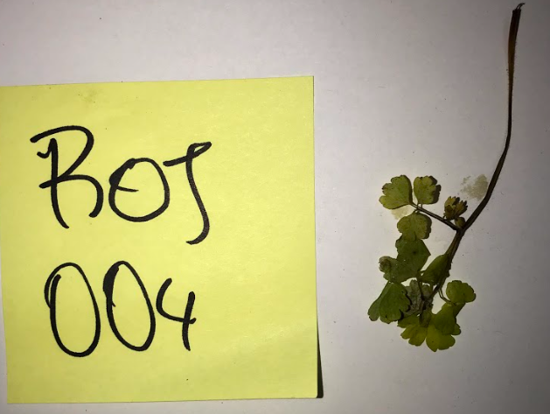
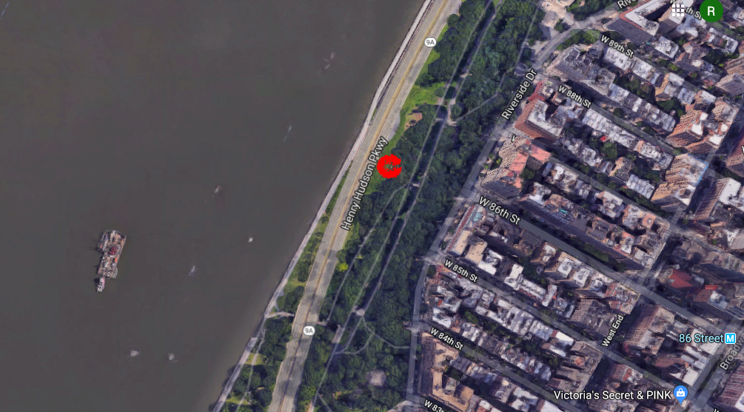
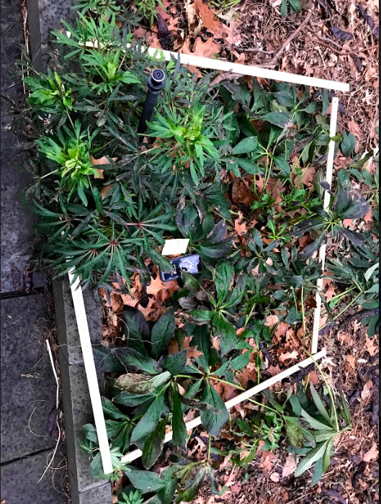
Biodiversity of Plants in Riverside Park
Tseten Lama, Rosalía Minyety, Megan Navarro
Mentor: Vincent Joralemon
Funded by the
Thompson Family Foundation
Frank McCourt High School
Abstract
This research project serves to observe if Riverside park is home to invasive plants depending on the amount of pollution in the surrounding area. It is believed that the samples located in the area nearest to the parkway will be invasive/non-native species and the samples farthest from the parkway will produce samples that are native and will have less non-native species. Additionally, it was hypothesized that the farther the sample area is from the highway, the more biodiversity of plants we would see. This was determined by the amount of biodiversity and the types of plants there were by extracting samples of plants and sequencing their DNA.
Introduction
New York City is one of the most populated metropolis in the world with over 8.6 million people. Due to this fact, there is also a great concentration of pollution the city is impacted by and it has been becoming more polluted over the years, not only affecting people living in the city but also the natural ecosystem that lives in this area. An example of this effect is the growth of invasive species in different places where the non-invasive are able to survive. These invasive species exploit the resources that trees/plants that native species need, which allows the invasive species to thrive and take over the new environment. The percentage drop in this species is due to the fact that it is a non-native species that is invading the ecosystems, which makes them invasive. This project serves to explore how pollution affects the biodiversity patterns in relation to native and non-native species in Riverside Park, located in New York City.
Results
Out of all 27 sequenced samples Hydrangea was the only species that is native to the United States and can be found in parks in New York City, which was one sample collected. The other 26 are part of a non-native species. 3 of the results did not have any sequence and 4 did not appear in the BLAST database.
Tables & Figures
Discussion
In the end, it was found that as the species were farther away from the highway, there was no correlation between the diversity of species and whether or not they were native from the United States. Only one species was found to be native which was Isopyrum Biternatum,.This was surprising because all plants that resulted in a sequence were non-native species. One difficulty that was faced was the lack of plants at the 10-meter-mark. Since there was a stone staircase, this prevented from collecting samples at this location. However, it was then decided to extend the distance to an extra 5 meters, so samples at 15-meters and 20-meters were collected It is planned to do a part 2 for this experiment during Summer 2019 to compare how different seasons affect biodiversity in this same location.
References
Barron, James. “New York City's Population Hits a Record 8.6 Million.” The New York Times, The New York Times, 22 Mar. 2018, www.nytimes.com/2018/03/22/nyregion/new-york-city-population.html.
“Bioindicators: the Natural Indicator of Environmental Pollution.” Taylor & Francis Online, 22 Apr. 2016, www.tandfonline.com/doi/full/10.1080/21553769.2016.1162753.
Cold Springs Harbor DNA Learning Center (2014). Using DNA Barcodes to Identify and Classify Living Things. Retrieved from http://www.dnabarcoding101.org/files/using-dna-barcodes.pdf
“Enemion Biternatum Raf.” United States Department of Agriculture, plants.usda.gov/core/profile?symbol=ENBI.
International Environmental Technology. “What Is Soil Contamination? And Why Does It Happen?” What Are Negative Emissions? Envirotech Online, 26 Nov. 2014, www.envirotech-online.com/news/health-and-safety/10/breaking-news/what-is-soil-contamination-and-why-does-it-happen/32581
“NYC Street Tree Census - 2015 Report.” NYC Street Tree Census - 2015 Report, media.nycgovparks.org/images/web/TreesCount/Index.html
Parks in Bloom. (n.d.). Retrieved from https://www.nycgovparks.org/greening/bloom-guide
Pham, D. (2015, April 14). This Map Lets You Explore NYC's 592,130 Street Trees by Species and Trunk Thickness. Retrieved November 9, 2018, from https://www.6sqft.com/amazing-maps-explore-the-citys-592130-street-trees-by-species/http://media.nycgovparks.org/images/web/TreesCount/Index.html
S. M. (2018, March 23). Lenten Rose, Helleborus ×hybridus. Retrieved from https://wimastergardener.org/article/lenten-rose-helleborus-xhybridus/
Acknowledgements
We want to thank the Harlem DNA Lab for allowing us to use their materials to extract and analyze the DNA from the samples collected. Also, the Cold Spring Harbor Laboratory for creating such amazing opportunities for high school students to experience science in their own schools. We also appreciate Frank McCourt High School and its stuff members for supporting and believing on the completion of this project. A big thanks to Mr. Vincent Joralemon for taking time to guide us during our research project and encouraging us to do and be the best we can. Finally, our teammates because of the hard-work and dedication put into the termination of this project and the responsibility and readiness that helped complete each section of this long-worked research.
Materials & Methods
The samples were taken in a section of Riverside Park, close to the 84th street entrance. They were collected by measuring a one-meter square in a section and taking as many plants as possible. Then each sample would be given a specific code number in order individually identify it (ROJ-000).
After this, they were moved into vial tubes and were later processed with the rbcl isolation Technique in the Harlem DNA Lab. 27 samples were collected in total.
Appeared Species | Times it appears | Meters from highway | Non-native vs native
Aquilegia Vulgaris | 1 | 5 meters | Non-native
Helleborus Croaticus | 1 | 20 meters | Non-native
Helleborus Foetidus | 3 | 20 meters | Non-native
Helleborus orientalis | 4 | 1 meters, 5 meters and 20 meters | Non-native
Helleborus thibetanus | 5 | 5 meters and 15 meters | Non-native
Helleborus viridis | 1 | 20 meters | Non-native
Hydrangea chinensis | 1 | 5 meters | Non-native
Isopyrum Biternatum | 1 | 20 meters | Native
No comparison availability | 2 | 5 meters and 20 meters | Non-native
No info/No Sequence | 5 | 5 meters, 15 meters and 20 meters | Non-native
Skimmia reevesiana | 1 | 15 meters | Non-native
Zanthoxylum avicenna e | 1 | 2 meters | Non-native

