Slide 1
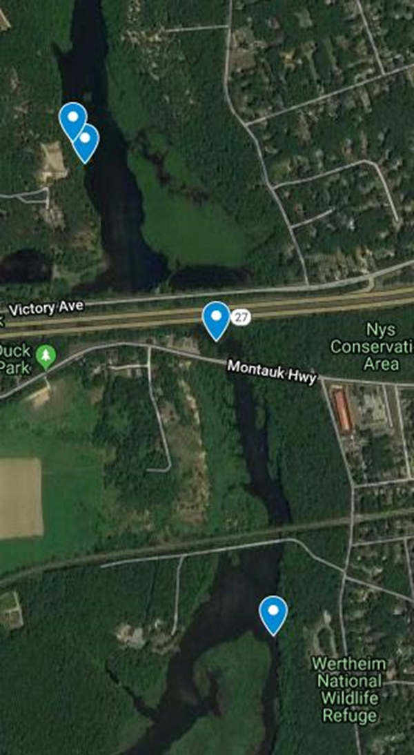
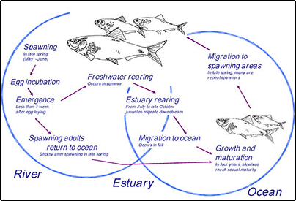
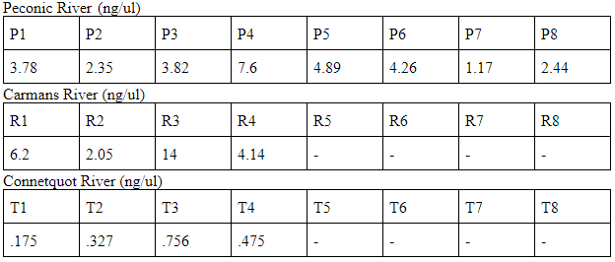
Tracking Fish in Long Island Rivers Using eDNA
Victoria Cipriani¹, Lauren Kennedy¹, Michele Muscolo¹
John Halloran¹
1-Connetquot High School
Abstract
The three rivers we sampled from -- Carmans, Peconic, and Connetquot -- have all had dams installed on certain spots on the river for anthropomorphic or industrial reasons. The Carmans River and the Peconic River have had fish ladders installed by the dams in order to make it easier for the fish to get access to parts of the river above the dam. We have two goals in our experiment; to find a correlation and difference of biodiversity between rivers with and without restoration, and movements of fish within the rivers.
Introduction
A fish ladder allows fish to pass an obstacle on a river, and contains a series of ascending pools reached by swimming against a stream of water (1). Fish leap into the pool and rest before continuing through ladders (1). Studies by J. Jed Brown et.al. show that fish ladders may be causing more than solving problems as fish aren’t effectively making it over the ladder (2). Environmental DNA, eDNA, is DNA left by organisms and found in environmental samples like fresh water. DNA can then be collected from organisms we may not be able to isolate.
Materials & Methods
Water samples were taken above and below each obstruction with a Nalgene bottle facing upstream, with metadata recorded to qualify any possible alterations in the results such as GPS location, time, temperature, etc. In total, we were looking to collect six samples from different locations on the rivers, each sample from above and below the obstruction. We tested three rivers: Peconic River [artificial brook], Carmans River [fish ladder], and the Connetquot River [dam].
Water was filtered within a couple hours of collection. Samples were kept on ice to slow DNA being hydrolyzed. Samples were stored it in a 50mL vial filled with 200 proof molecular grade ethanol for preservation. These were frozen until PCR.
We used the ECO fish primers to amplify each gene, and tag samples, in PCR.
Carmans River with collection spots
Discussion
We ran into many issues while working with this project and have been unable to get a complete set of results. We used a double stranded dye and believe that may have caused some of our issues. The qPCR machine that we used appears to need to be recalibrated. We were able to extract and read DNA from some of the locations, but not all. This is a continuing project as we have not been able to get full results due to the time constraint and the government shut down. Moving forward we may be using more specified primers and working with Cold Spring Harbor for NGS results.
References
US Department of Commerce, and National Oceanic and Atmospheric Administration. “What Is a Fish Ladder?” NOAA's National Ocean Service, 1 June 2013
Government, Suffolk County. “Suffolk Legislature Approves Funds for Carmans River Fish Ladder.” Suffolk County Government - Suffolk Legislature Approves Funds for Carmans River Fish Ladder.
Acknowledgements
We would like to thank John Halloran, our research teacher, for his continued help and support throughout this project. Also, thank you Connetquot State Park for allowing us to collect water samples.

