Slide 1
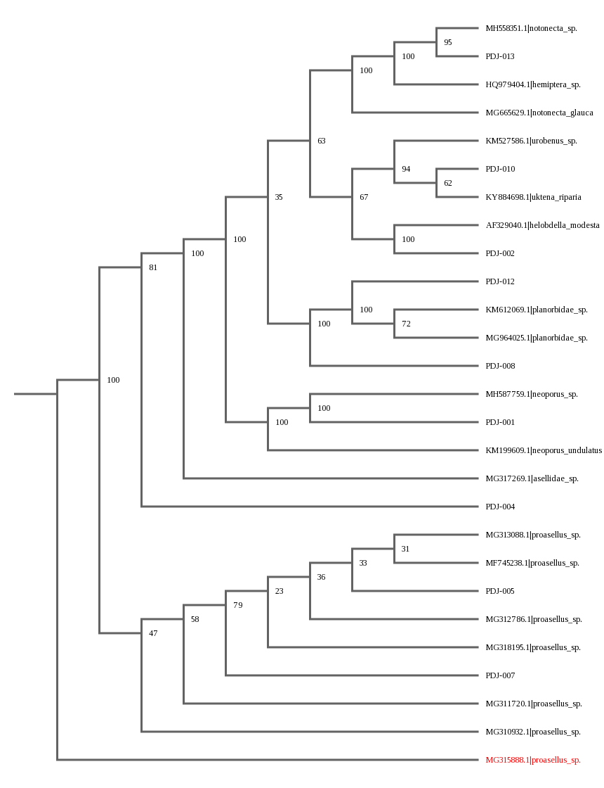
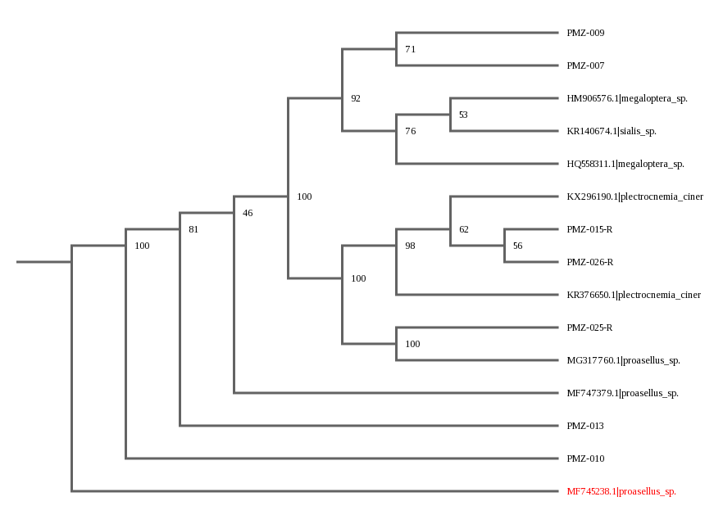
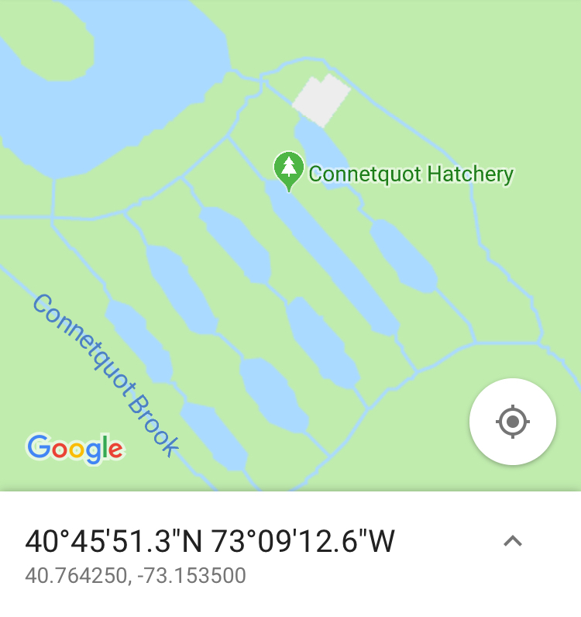
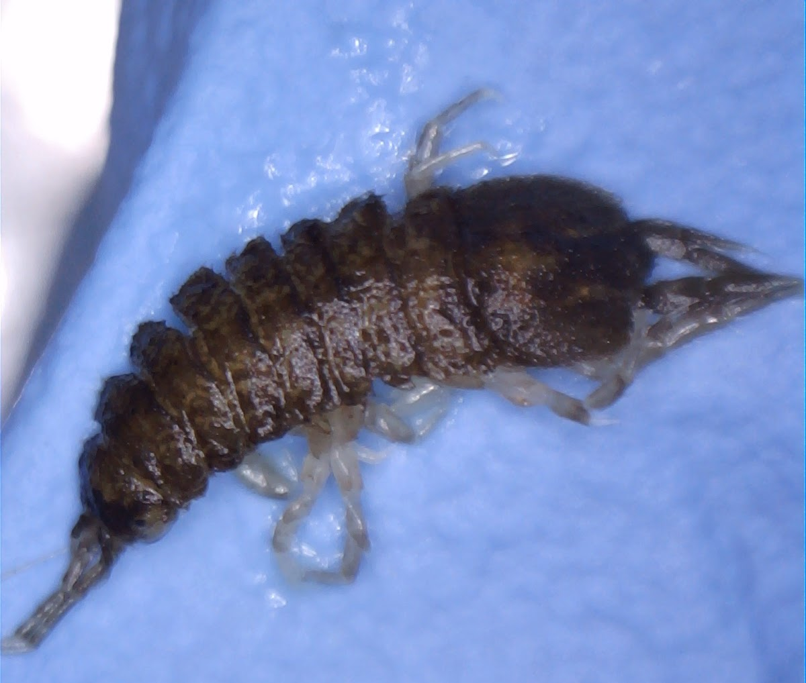
The Use of Macroinvertebrates as Indicators of Water Quality in the Connetquot River
Jenna Marcotte¹, Emily Picchiello¹, John Halloran¹
Connetquot High School¹
Abstract
The purpose of the research conducted was to utilize macroinvertebrates to indicate the water quality of the Connetquot River. It was hypothesized that the types of organisms present would show a decline in the water quality. The results of collection of macroinvertebrates in 2018 included Megaloptera sp., Proasellus sp., and Plectrocnemia cinerea. The numbers of mismatches in sequences to those of the database were very minimal. Between both 2017 and 2018, similar types of organisms were found, and most of the organisms found are known to have moderate to high tolerances to pollution. Taking this data into consideration, the hypothesis was not proven, as there was not great change in the types of organisms found, nor was there great specificity in the types of conditions they require .
Introduction
The types of organisms which live in a certain area can tell a lot about the conditions of the area. Since aquatic macroinvertebrates spend all or most of their life in a body of water, their abundance and quality of life can be a decent indicator of the quality of the water itself (Science Learning Hub 2016). Aquatic macroinvertebrates live in and around the bottoms of lakes, rivers, and streams. Macroinvertebrate communities reside in an aquatic system long enough to reflect the chronic effects of pollutants, and yet short enough to respond to relatively acute changes in water quality (EnviroScience). Shifts in macroinvertebrate communities can identify the impacts of pollution and the effectiveness of pollution control (EnviroScience). Since Connetquot High School students have participated in Barcode LI in previous years, it is possible that this thinking could be applied to determine the changes in the Connetquot River.
Materials & Methods
The pH and temperature of the water were taken using probes and a LabQuest. The Fieldmaster Mighty Grab was then used to collect from the river and the contents were emptied into one of several plastic bins. Another method of collection was a set of nets. Each sample was sifted through with various tools in order to uncover macroinvertebrates and placed into an ice cube tray with water. This entire process was repeated around eleven times, using both the grab dredger and the net. While collecting, several different reference charts and keys were used to infer what type of organism we had collected before placing it into plastic sample containers to ensure collection of unique specimens. Once in their respective containers, specimens were placed in a cooler with ice to be preserved for the duration of collection. Samples were photographed and transferred into containers with 95% ethanol to be preserved until PCR could be carried out. DNA extraction was done according to the Silica protocol and amplified using the COI gene primers. Gel Electrophoresis was done after PCR to ensure it had worked. The Sanger sequencing method was used by Genewiz to obtain sequences.
Results
For the collection done in 2018, , 27 samples were collected. Of those, four pairs of sequences were viable, as well as three reverse sequences. PMZ-007 matched with Megaloptera sp. BOLD:AAH7456, having only 7 mismatches. PMZ-009 matched with both Sialis sp. BIO3 and Megaloptera sp. BOLD:AAH7456, having 9 mismatches to each. PMZ-010 matched with Proasellus sp. 08BBCRU-098, having 0 mismatches. PMZ-013 matched with Proasellus sp. BIOUG08049-D03, having 0 mismatches. PMZ-015-R matched with Plectrocnemia cinerea BIOUG10061-A06, having 4 mismatches.
PMZ-025-R matched with Proasellus sp. BIOUG27704-D12, having 16 mismatches. PMZ-026-R matched with Plectrocnemia cinerea BIOUG10061-A06, having 2 mismatches.
Phylogenetic tree of 2018 Macroinvertebrates
Map of
Collection
Location
Discussion
The types of macroinvertebrates found in the Connetquot River in October of 2018 were Megaloptera sp., Proasellus sp., and Plectrocnemia cinerea. Organisms classified as Megaloptera usually are in relatively clean and well oxygenated water (NYS Department of Environmental Conversation). Their presence may serve as an indicator of good water quality. Plectrocnemia cinerea can also be classified as Megaloptera. Proasellus sp. are a part of the family isopoda which, is relatively tolerant of pollution and can help track water recovering from sewage pollution (Main Department of Environmental Protection). In 2017, some macroinvertebrates found were Coenagrionidae sp. (part of Odonata), Haliplidae sp., and Neoporus undulatus (part of the family dytiscidae), as well as some Proasellus sp. Organisms in Odonata can range from very sensitive to very tolerant of pollution, but more specifically damselflies are moderately tolerant (Main Department of Environmental Protection). Haliplidae require clean and oxygen rich water to survive (Science Direct). Organisms in the family dytiscidae are known to have tolerance of high salinity levels (CSIRO 2004). Among both years, the organisms collected followed a general trend of moderate to high tolerance of pollution. This study might be improved had it occurred over a much longer period of time, as well as if DNA extraction, PCR, and sequencing had worked for more of the samples taken.
References
1. 2016. “Freshwater Macroinvertebrates.” Sci Learn Hub. Available: https://www.sciencelearn.org.nz/resources/1820-freshwater-macroinvertebrates via the INTERNET. Accessed 2019 May 6.
2. Benthic Macroinvertebrates and Biological Monitoring. EnviroScience. [accessed 2019 May 8]. https://www.enviroscienceinc.com/services/aquatic-survey/benthic-macroinvertebrates/
3. “Dobsonflies, Hellgrammites, Fishflies & Alderflies (Megaloptera).” Dept of Env Cons. Available: https://www.dec.ny.gov/animals/87947.html via the INTERNET. Accesed 2019 May 16.
4. Aquatic Sow Bugs (Isopoda). Biomonitoring Macroinvertebrates-Sow Bugs, Monitoring and Assessment, Bureau of Land and Water Quality, Maine Department of Environmental Protection. [accessed 2019 May 17]. https://www.maine.gov/dep/water/monitoring/biomonitoring/sampling/bugs/sowbugs.html
5. “Dragonfly & Damselfly Larvae (Odonata).” Maine Dept of Env Prot. Available: https://www.maine.gov/dep/water/monitoring/biomonitoring/sampling/bugs/dragonsanddamsels.html via the INTERNET. Accessed 2019 May 16.
6. “Haliplidae Aubé, 1836 (Crawling Water Beetles).” Sci Direct. Available: https://www.sciencedirect.com/topics/agricultural-and-biological-sciences/haliplidae via the INTERNET. Accessed 2019 May 16.
7. 2004. “Family Dytiscidae.” Water for a Healthy Country. Available: http://www.cpbr.gov.au/cpbr/WfHC/Dytiscidae/index.html via the INTERNET. Accessed 2019 May 16.
Acknowledgements
We would like to thank our Science Research teacher Mr. John Halloran for giving us the instruction and tools we needed to carry out this experiment. In addition, we would like to thank Barcode LI for approving and allowing the completion of this project by supplying reagents and materials, as well as funding sequencing.
Phylogenetic tree of 2017 Macroinvertebrates
PMZ-007
PMZ-010

