Slide 1
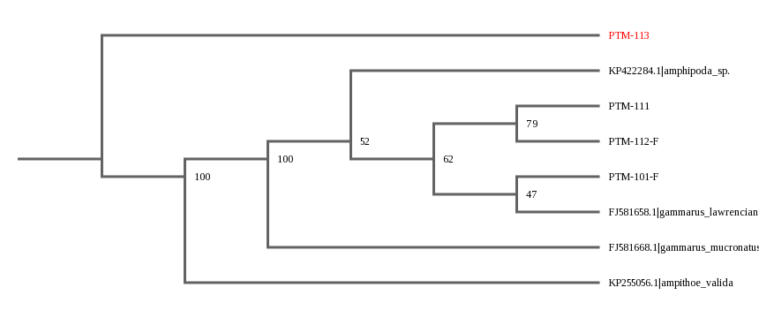
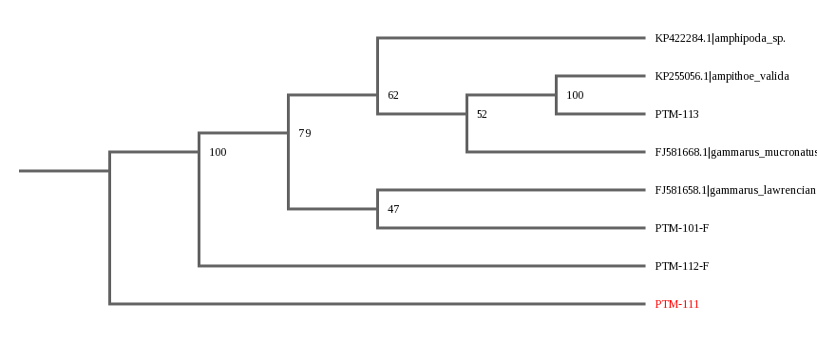
Testing Marine Copepod Diversity Throughout the Connetquot River
Alejna Kolenovic¹, Jenna Drapala¹, John Halloran¹
1 Connetquot High School
Abstract
The depletion of freshwater in aquifers has become an issue. By observing changes to freshwater copepods, this could indicate salt water intrusion of aquifers along the Connetquot River (USGS Water Center, 2015). The question being tested was to determine if the type of copepod differed according to salinity along the river. An objective was to determine the differences between salt and freshwater copepods. Copepods were collected at different salinity points on the river, which determined whether differences amongst the types of copepods were present. Results displayed that few copepods were collected. It was hoped to find copepods such as calanoids, harpacticoida, and cyclopods, which live in both fresh and saltwater environments. One of the copepods collected was a known specimen, and the other copepod is not a known specimen, and may be a novel sequence.
Introduction
From 1850 to 2008, the levels of carbon dioxide have increased 30%, and as of 2008, carbon dioxide levels have risen up to 386 ppm (USGS, 2019). Melting ice caps, due to increase in temperature, has resulted in rising sea levels, and increases the probability of saltwater intrusion (Micscape Magazine, 2012). Saltwater intrusion occurs when the water in the aquifers is used quicker than it can be replenished, so saltwater begins to fill the aquifer, instead of fresh water (USGS, 2015). This salt water intrusion could create problems by affecting people who receive the water for different uses.
Copepods were barcoded, which is s a process of sequencing the DNA of a specimen to determine which species the specimen belongs to. Over time, if copepods in a given area of the Connetquot River or other areas of Long Island were barcoded, and changes in the species were discovered, or if the quantity of freshwater copepods decreased, this could indicate saltwater intrusion (USGS, 2019).
Materials & Methods
The first location of collection was Bunce’s Bridge, a freshwater location. To collect copepods, a plankton net was used on October 26. For the second location at Great River, samples were collected on November 12. The samples collected were preserved by being placed into ethanol tubes and frozen until needed for extraction.
In order to identify the type of copepod, an identification guide (Micscape Magazine, 2012) was used, and in order to compare the copepods, the pictures taken of them prior to DNA extraction were used.
DNA extraction was performed according to the Silica protocol provided by CSHL, and amplified by PCR using the primers of LCOI 490 for the forward strand of DNA, and HCO2198 for the reverse strand of DNA. Confirmation was done by gel electrophoresis and positive results were sent to Genewiz for Sanger Sequencing.
Results
Out of 36 copepods collected, 24 had DNA extracted and amplified, and 4 samples were approved by Barcode LI. BLASTN displayed 2 samples had a forward and reverse strand of DNA. The first sample, PTM-113, an Ampithoe valida, had 0 mismatches, however, PTM-111 had 112 mismatches, and may be a novel sequence.
The BLASTN results for PTM-111, a Gammarus lawrencianus, displayed 112 mismatches. The BLASTN results were checked for PTM-112, with only a forward strand of DNA, and the sample shows to be a Gammarus electrus, with 78 mismatches.
Discussion
The process of DNA extraction or PCR was not performed very successfully. The cause of error is unknown, however, if the project were to be repeated, the levels of DNA should be measured using a fluorometer. This would determine how much DNA was extracted, and whether or not it was enough to continue with PCR. If ample DNA was extracted and results were poor, then the cause would most likely be PCR. Due to time constraints and a lower budget, this was not possible at the time. Articles have indicated that the primer used may not have been the best choice for barcoding marine copepods. In other experiments involving copepods, (Elías, 2018) there has been little success for barcoding, indicating that improvements on protocol must be made specifically for copepods.
BLASTN results for PTM-112 were checked and the sample was from Beijing, China. The amount of mismatches could be an indicator of poor quality of the sequence, and also indicates that the type of marine organism with the genus Gammarus can be found within different locations. Overall, the goal of the project was not accomplished, but need for improved protocol has been established.
References
Baek, Youn. 2016. “DNA Barcoding of Metazoan Zooplankton Copepods from South Korea.” PLOS ONE, Public Library of Science 11(7). Accessed 5-14-19.
Elías-Gutiérrez M, Valdez-Moreno M, Topan J, Young MR, Cohuo-Colli JA. “Improved Protocols to accelerate the assembly of DNA barcode reference libraries for freshwater zooplankton.“ PubMed Central, 8. 5.
Accessed 5-15-19.
Encyclopaedia Britannica. Encyclopaedia Britannica, inc., “Copepod.“ October 12, 2018 2018. Accessed 5-16-19.
Micscape Magazine, microscope-uk. “Marine Copepods.” January 2012. Accessed 5-14-19.
NASA, RUSD, UCR. “Global Climate Change: Evidence and Causes”. Accessed 5-15-19.
USGS. New York Water Science Center Web. “Long Island Fresh and Saltwater Relations/Interactions.” Accessed 5-16-19.
USGS. New York Water Science Center Web. “Saltwater Intrusion” Accessed 5-14-19.
USGS Water Science Center Web. “Seawater Intrusion.” 1st ed. California. Accessed 5-14-19.
USGS. New York Water Science Center Web. “State of the Aquifer, Long Island, New York.” 5-16-19.
Acknowledgements
Acknowledgments towards our mentor, John Halloran, for assisting us throughout the course of this project, and to Barcode Long Island, for the opportunity, as well as all the supplies and materials provided.
Table 2: BLAST results for PTM-111
Table 1: BLAST results for PTM-113
Saltwater Copepod PTM-113
Saltwater Copepod PTM-111
Figure 1: Tree with Sample PTM-113
Figure 2: Tree with Sample PTM-111
Plankton net used for Copepod Collection

