Slide 1
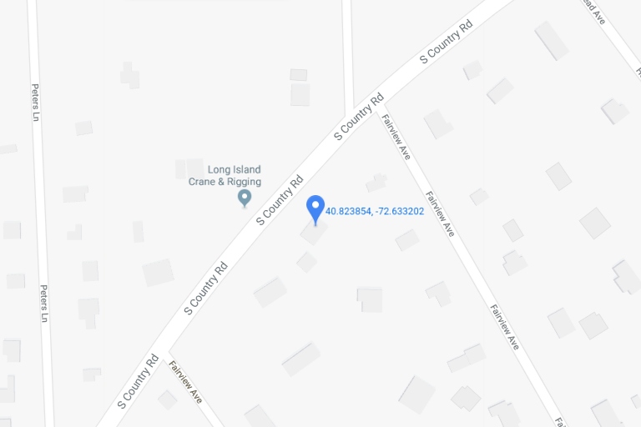
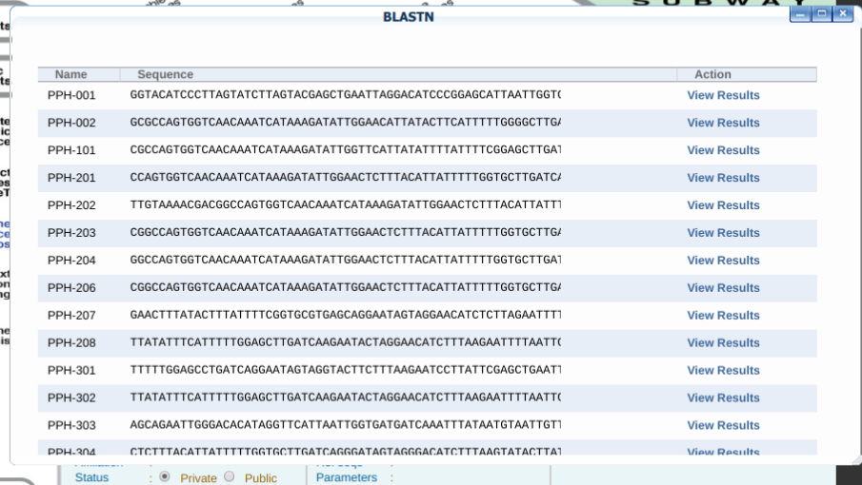
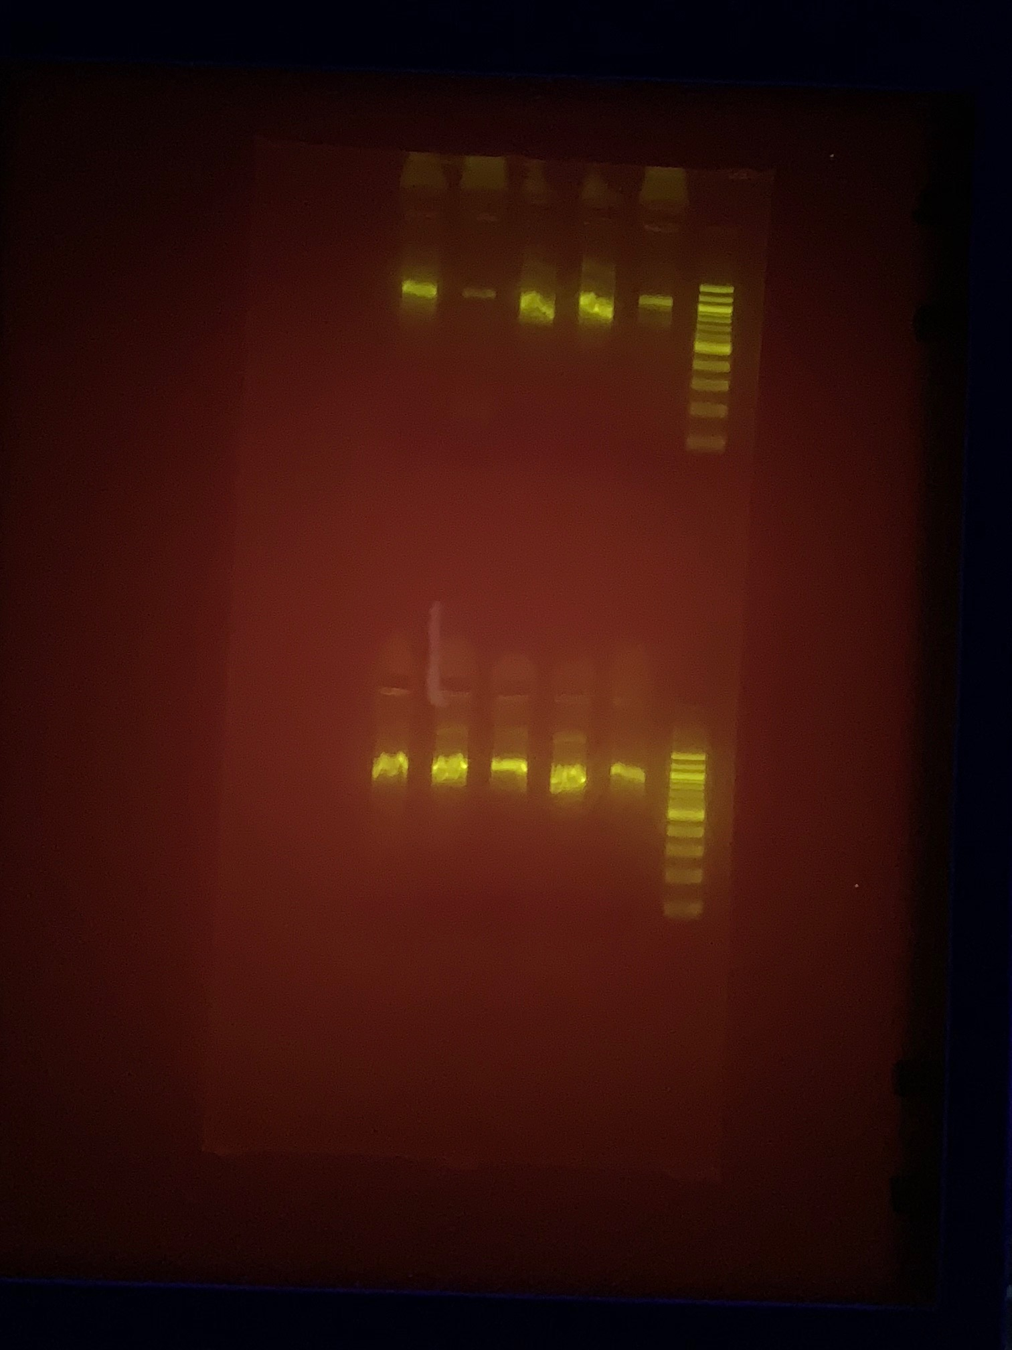
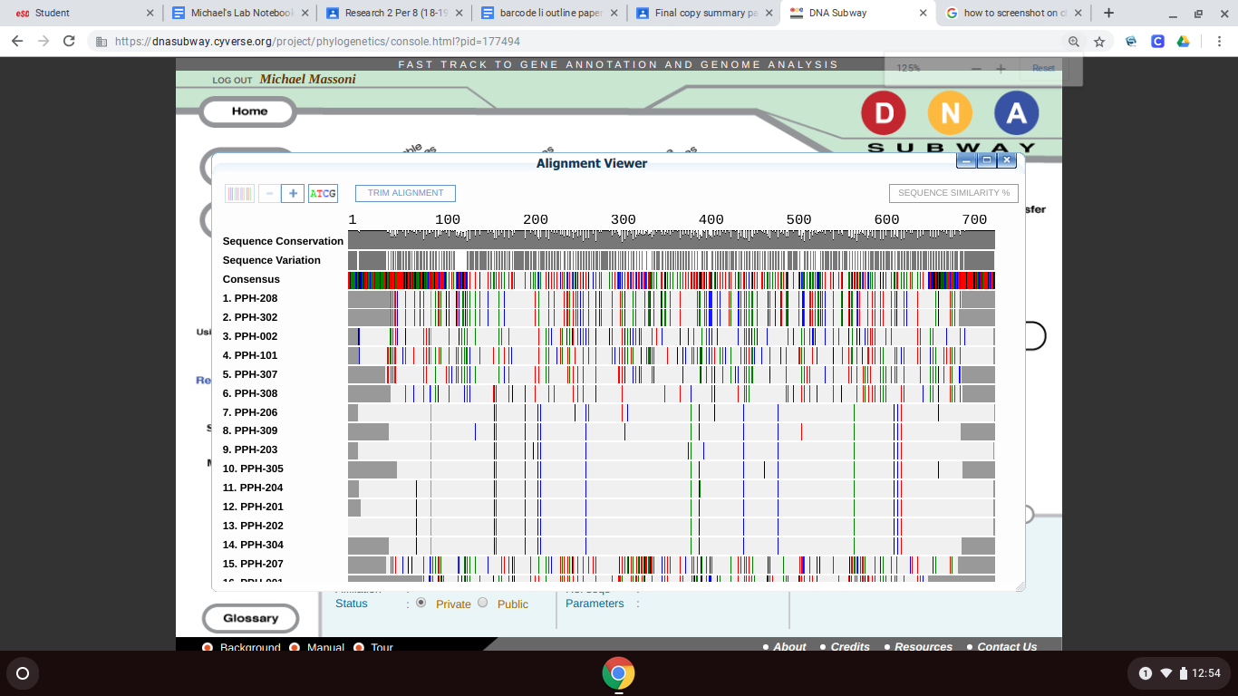
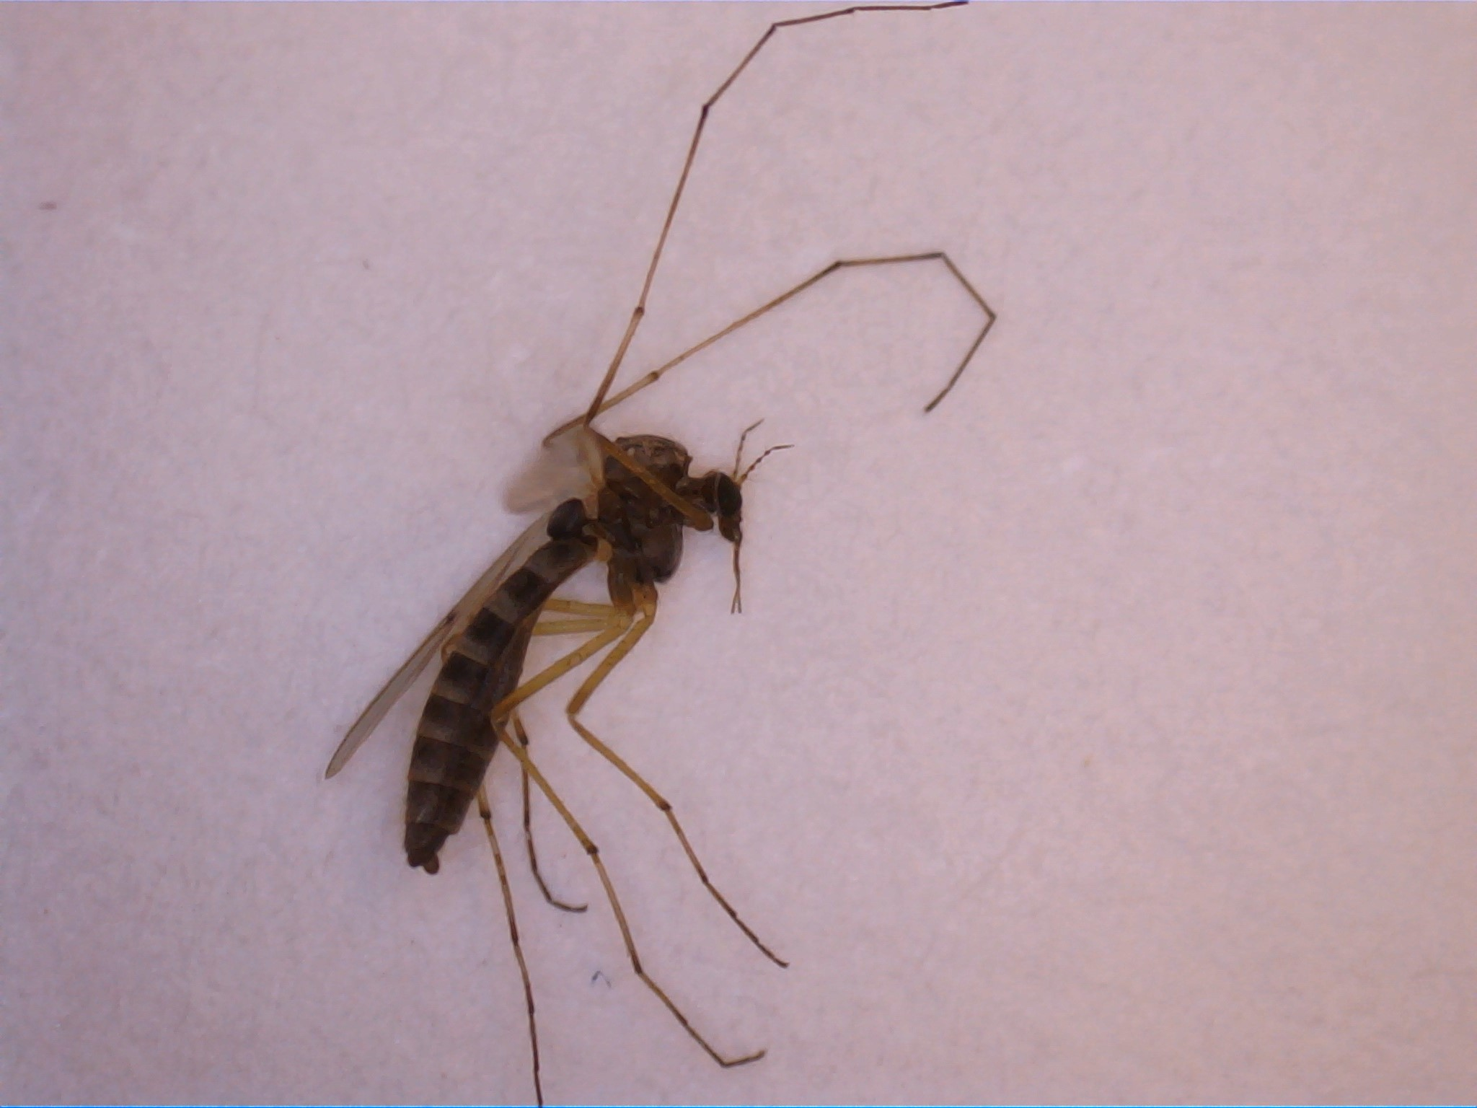
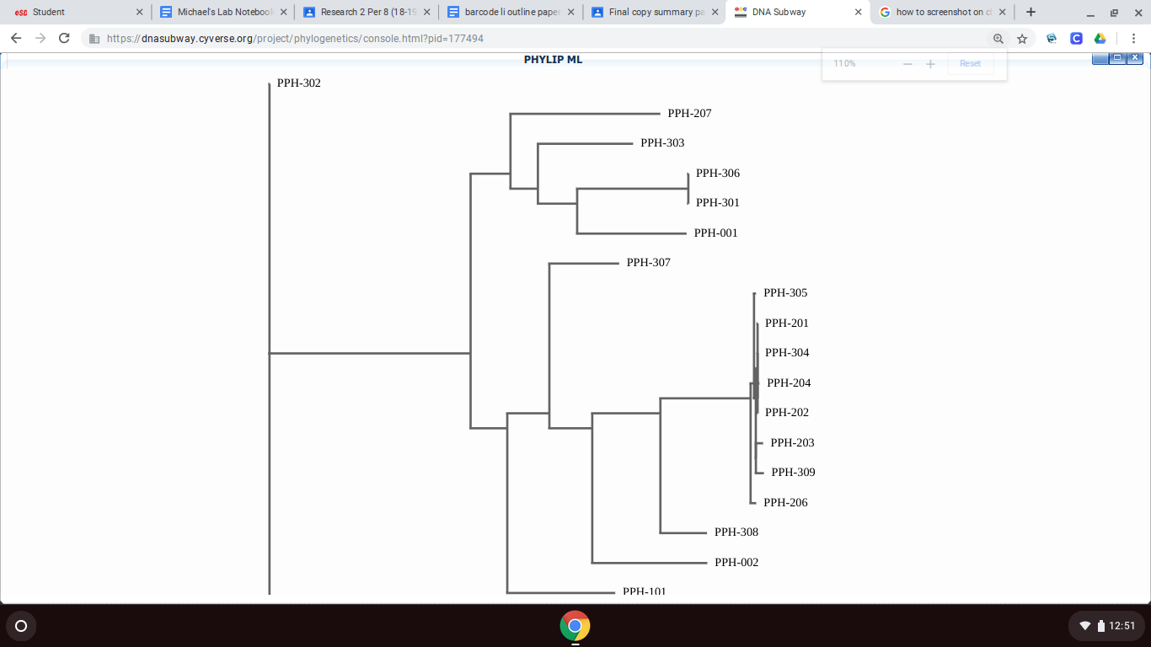
ARE REPELLENT BRACELETS EQUALLY EFFECTIVE AGAINST DIFFERENT SPECIES of MOSQUITOES?
Chris Dubinsky, Justice Coppiano, Michael Massoni , John Halloran
Tables & Figures
Abstract
The Goal of this project was to test the effectiveness of common mosquito repellents DEET and the lesser known “all-natural” products . Our purpose of the project was to identify the species of the mosquito that was caught by the traps in an effort to hopefully identify if the mosquito is known to carry deadly diseases such as West Nile or Zika.
Introduction
Mosquitoes are a common annoyance among many people because of the red bumps they leave and the diseases they spread. West Nile is a common disease spread by mosquitoes.There are bracelets that are known to repel mosquitoes .The most well-known mosquito repellent ingredient is DEET. DEET (N,N-diethyl-meta-toluamide) is the main ingredient in many repellent products (EPA 2017). Many people are concerned with the health risks that come with using DEET. A study conducted in the late 1980s on Everglades National Park employees to determine the effects of DEET found that a full one-quarter of the subjects studied experienced negative health effects that they blamed on exposure to the chemical(Scientific American, 2019). Effects included rashes, skin irritation, numb or burning lips, nausea, headaches, dizziness and difficulty concentrating (Scientific American, 2019). People have considered using “all-natural” repellents that do not use DEET, and their effectiveness can be considered questionable. We want to find if mosquito repellent bracelets repel all species of mosquitoes or only certain species of them. Hopefully by finding out which ones they repel, it could save people from buying a brand that doesn’t work against the deadly mosquitoes. The Asian Tiger or Aedes albopictus mosquito is an invasive species to Long Island(Kelly, 2017). This mosquito is known to carry the deadly Zika Virus and West Nile Virus. As of January 8, 2019, a total of 49 states and the District of Columbia have reported West Nile virus infections in people, birds, or mosquitoes in 2018 (CDC, 2019).
Materials & Methods
Discussion
References
1:Kelly, B. (2017, June 29). Asian Tiger Mosquito: Unwelcome guest to Long Island [cited 2019, May 21] https://tickcontrol.com/blog/asian-tiger-mosquito-unwelcome-guest-to-long-island/
2:EPA.(2017, June 14). DEET [cited 2019, May 21]
https://www.epa.gov/insect-repellents/deet
3: Scientific American: [2019, May 21] Is it true that the DEET used in most mosquito repellents is toxic? [cited 2019, May 21] www.scientificamerican.com/article/is-it-true-that-the-deet/.
Acknowledgements
Special thanks to each of the following people and organization(s):
Our teacher Mr. Halloran
Cold Spring Harbor
Barcode Long Island
Connetquot High School for providing us with this course
Based on the results most of all of our 19/20 samples that were barcoded turned out to be species of midges. The most common result was the Chironomus harpi a common species of non-biting midge. This is significant because most of the midges come from an area of Ontario, Canada, In addition, since this species is commonly found in Canada it can be assumed it can survive in cold weather as when we did our collection is fairly cold and either migrated to Long Island or there was already an existing subpopulation of the Chironomus genus. Given the cold temperature, mosquitoes do not commonly come out in cold weather as they are cold-blooded and prefer temperatures over 80 degrees Fahrenheit. Although we did not catch any mosquitoes for our experiment as initially planned, the effectiveness was still tested. .With these results it is evident that, the DEET repellent is more effective at keeping away bugs than the all-natural brand.
The Mosquitos were collected the 28th and 29th of April. They were then brought to the school and put into small conical tubes. Then, they were taken out of the tube and pictures were taken of each insect using a dissecting microscope and a camera that connects the microscope to the pc. The sample data, such as coordinates, location and time of collection, were all recorded on the barcoding website along with the respective pictures of each specimen. At this point, the mosquitos were placed in a lysis solution and ground up. They were then incubated for 10 minutes at 65 degrees celsius and placed into a centrifuge for 1 minute to mix it up after the incubation was completed. The supernatant was transferred to a fresh tube where silica resin was added and mixed and incubated for 5 minutes at 57 degrees celsius. The sample was then centrifuged for 30 seconds. The supernatant was again removed and wash buffer was added before it was vortexed and centrifuged once again for 30 seconds. This was repeated once more and then the supernatant was removed and water was added. It was mixed by pipetting the solution in and out of the tube. It was then incubated for 5 minutes at 57 degrees celsius. Then it was centrifuged for 30 more seconds and the supernatant was transferred to a fresh tube and stored at 20 degrees celsius. Later, the primer mix was added to the solution and the DNA was transferred to a PCR tube. The DNA was later amplified in a thermal cycler and then stored at 4 degrees celsius. The DNA was then stored long term at -20 degrees celsius. After this, the gel was poured into the tray and it was allowed to set for 20 minutes. After this the gel was loaded and the electrophoresis process occurred for 30 minutes at 130 volts.
Results
19/20 samples were barcoded. PPH-205 was rejected because it didn’t show good bands in the gel. The first night we caught 3 bugs. 2 in the control trap and 1 in the DEET trap. On the second night we caught 17 bugs. 8 in the natural band trap and 9 in the control trap. DEET proved to be more effective at repelling mosquitoes and the natural band was not effective compared to the control. After we sequenced the bugs we used DNA Subway to find if the sequences matched any bugs in the system that had already been submitted. When we used the BLAST program, the bugs came out to be non-biting midges and craneflies. The most common species was Chironomus Harpi which was mostly caught in the natural band and control.

Slide 2
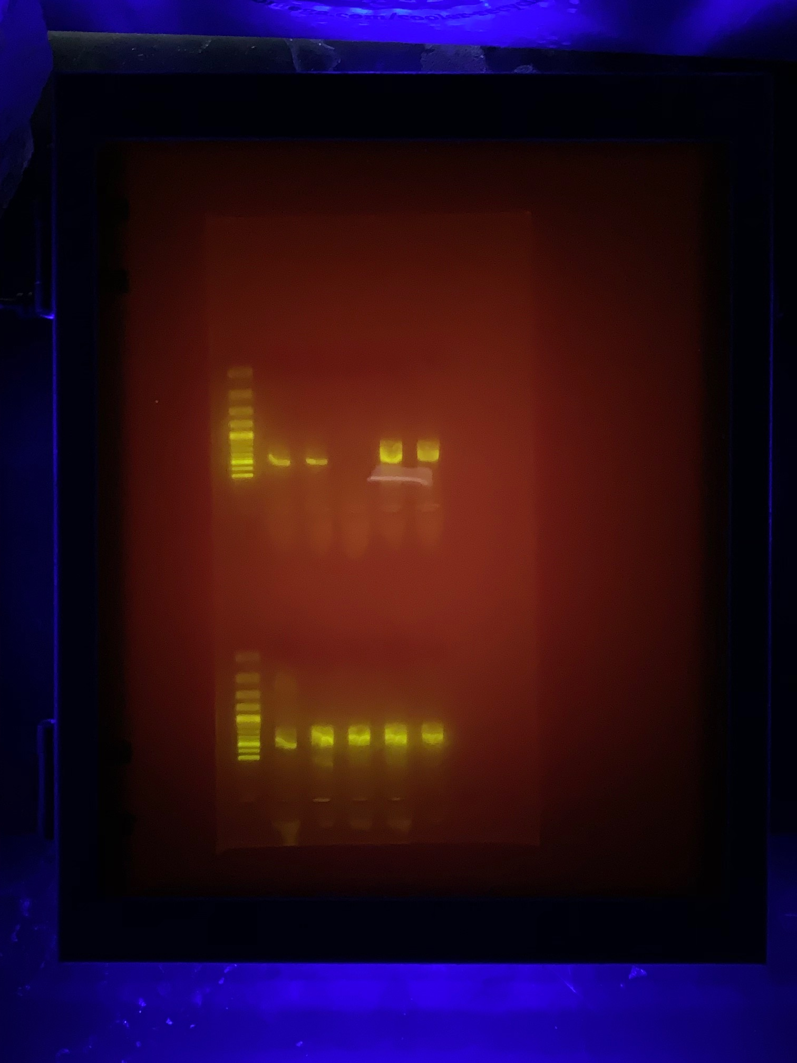
(204)
Gel 1
Gel 2
pictures

