Slide 1
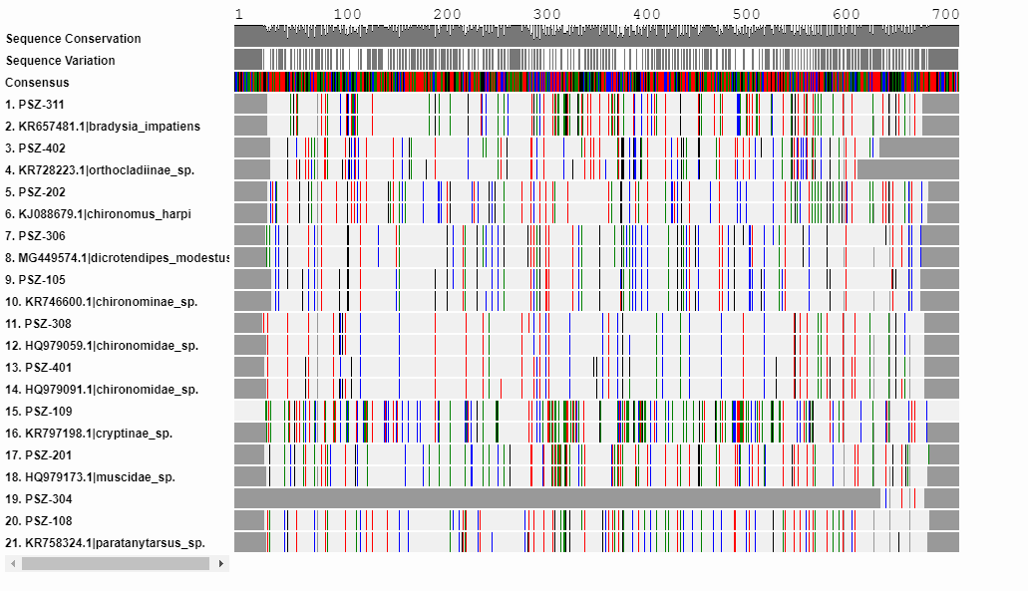
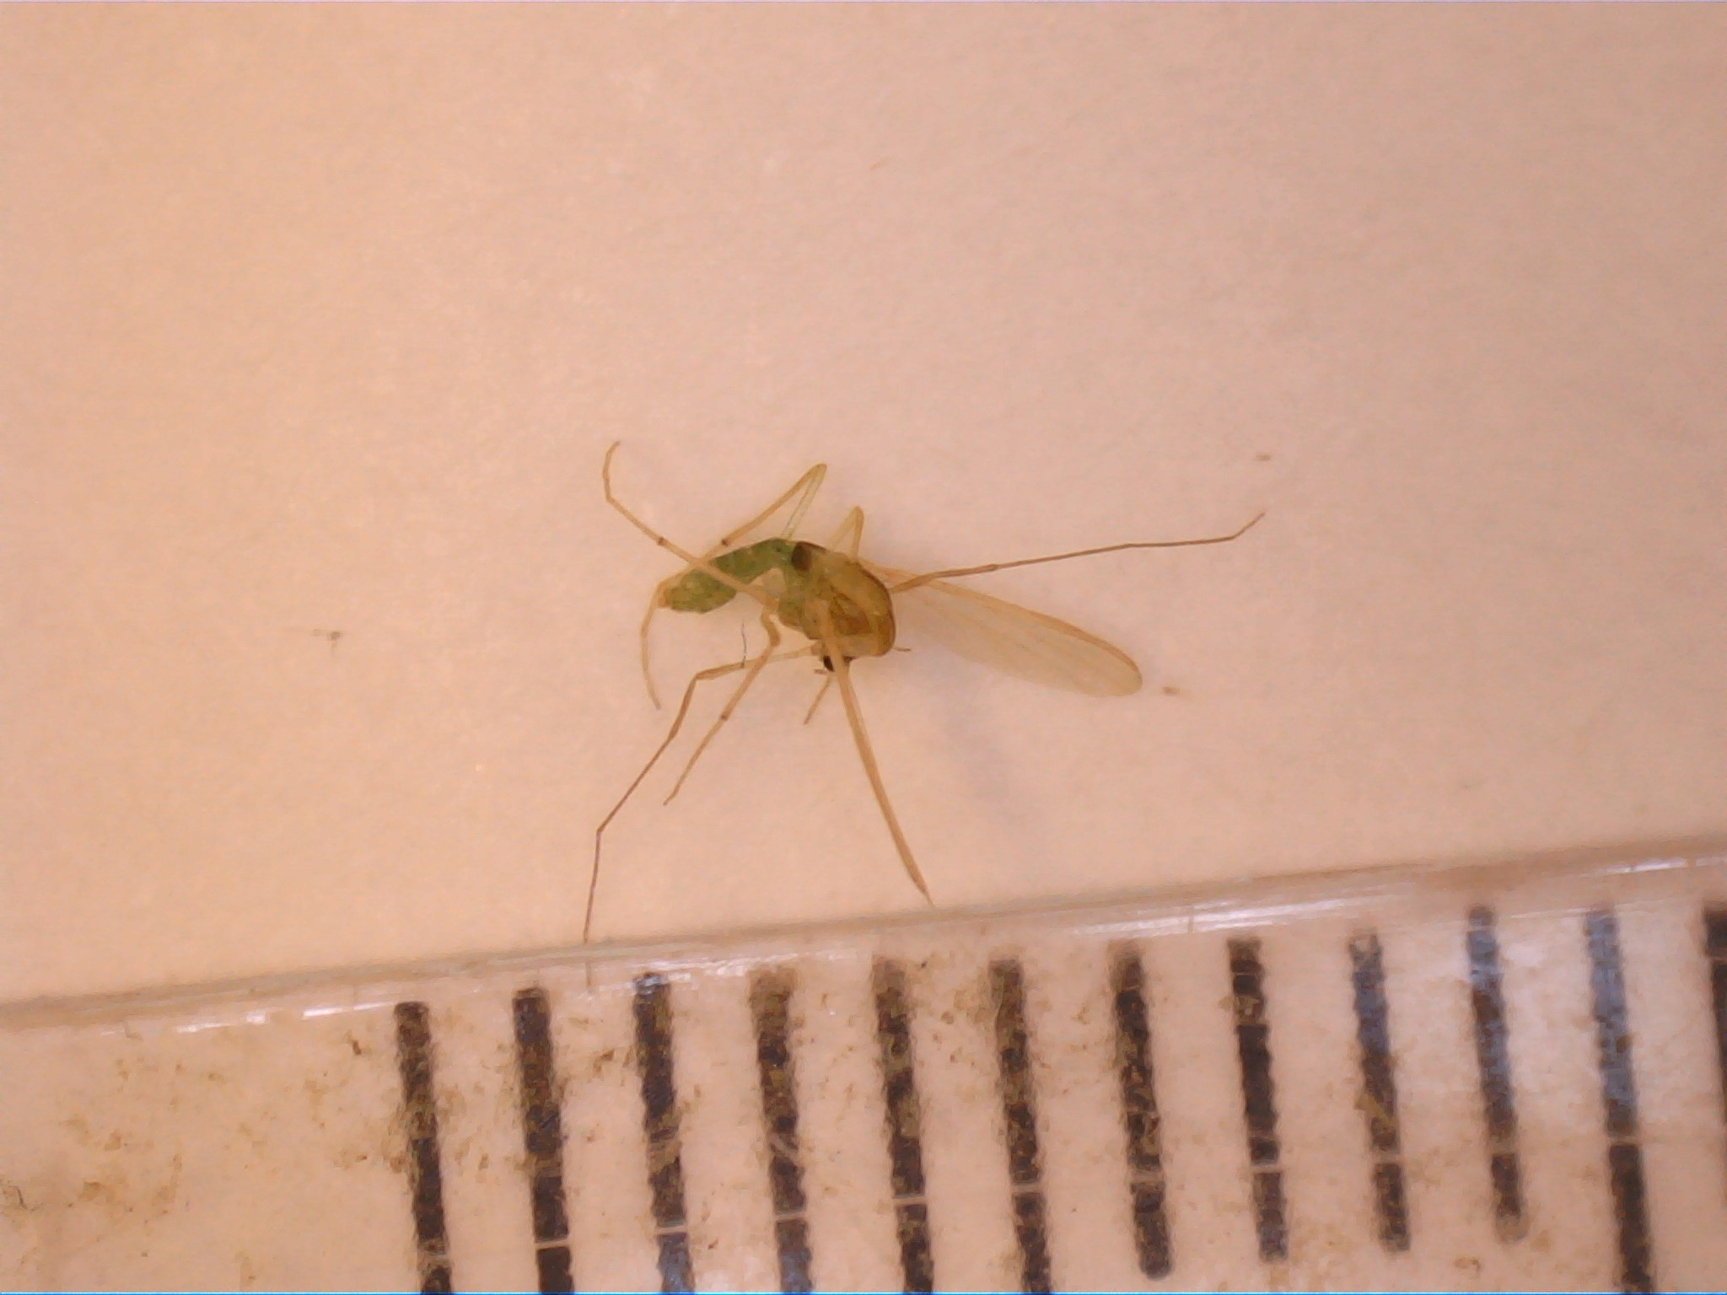
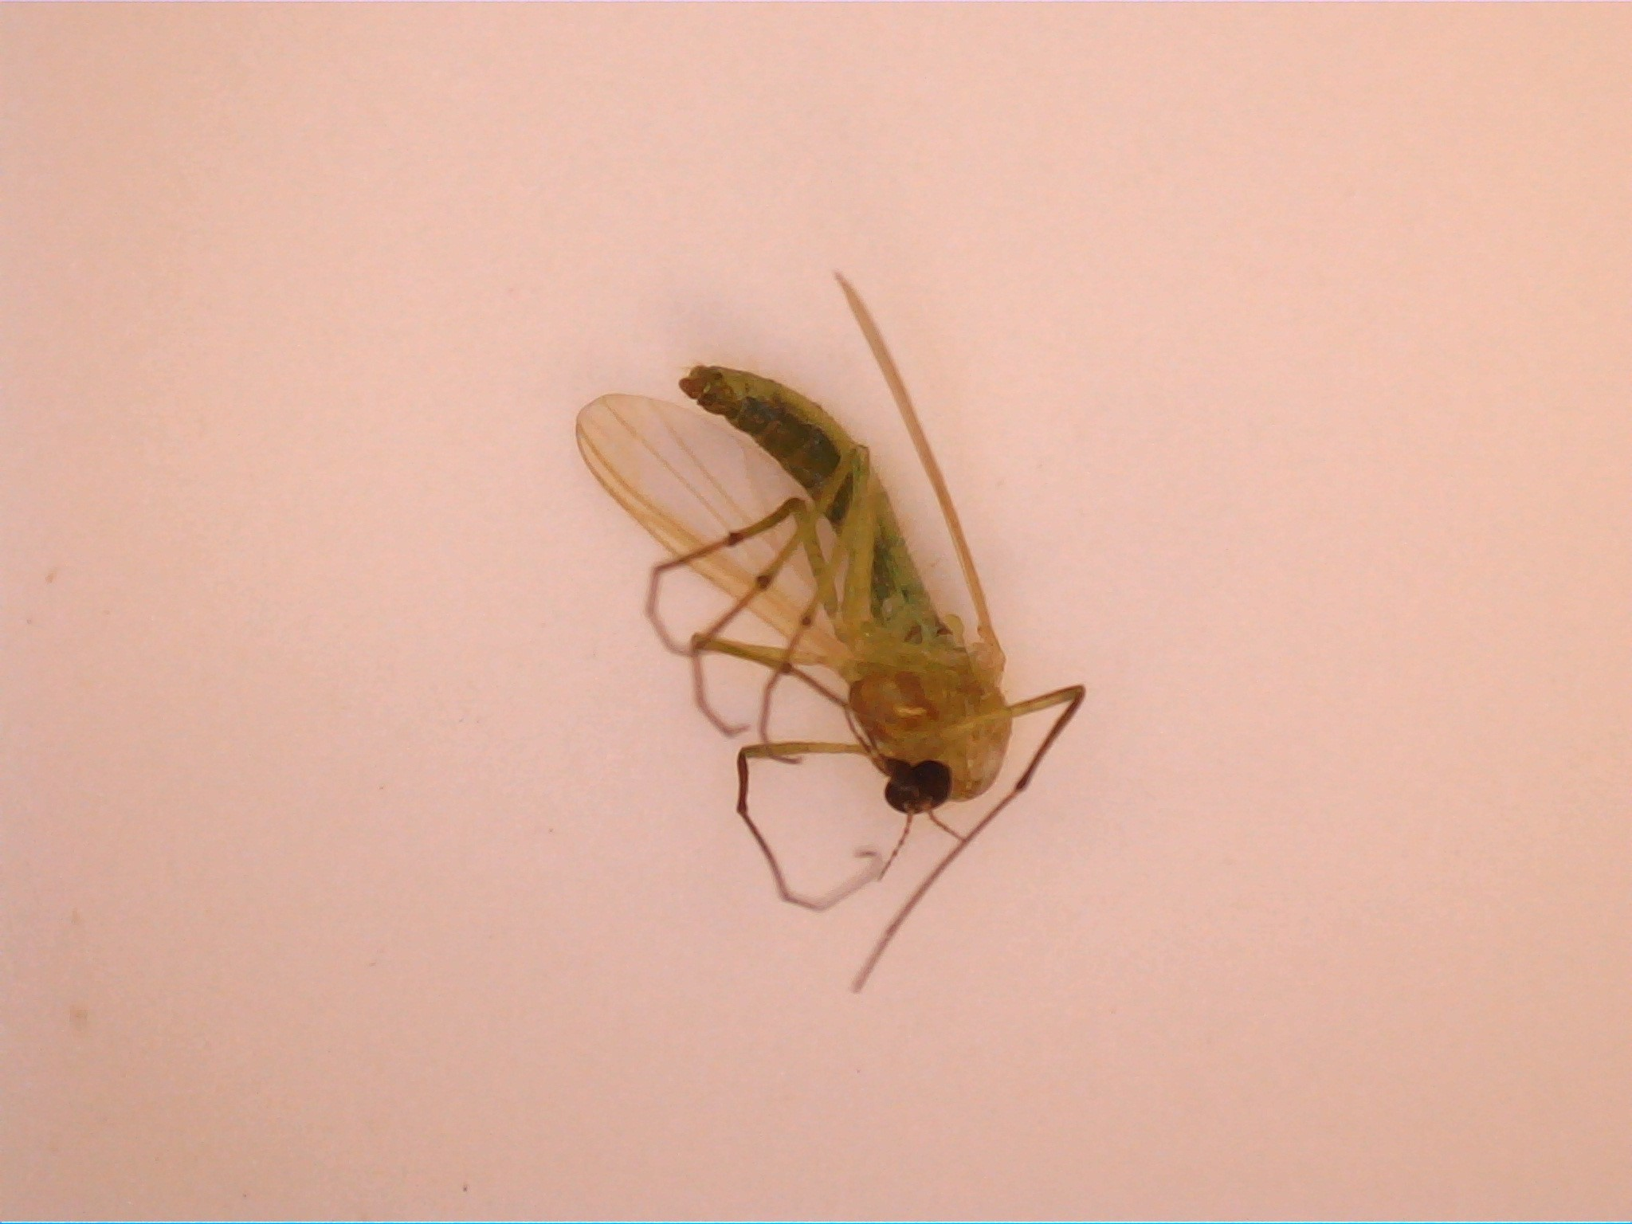
Barcoding of insects attracted to LED lights
Connor Hauser, Joseph DeRosa & John Halloran
Abstract
In this experiment, insects were collected using mosquito traps and LED . Then the insects were imaged and organized according to the LED lights. Insect DNA was then extracted using the silica method, and was sequenced for identification.
Introduction
For the residents of Long Island mosquitoes have become a reoccurring pest. This is concerning because many species of mosquitoes carry harmful and sometimes deadly diseases. This includes the Zika and West Nile virus. In addition, many invasive mosquitoes species are thriving. For example, the Asian Tiger Mosquito is an invasive species that is known to carry West Nile and other diseases. The distribution of the Asian Tiger mosquito is subtropical, with a temperature distribution in North America¹. In recent years there numbers have increased in the United states. Therefore, their population must be managed. However, the management of adult mosquito populations involves more than just insecticide. Their distribution on Long Island must be monitored by collection processes.
One method to use different light sources to attract mosquitos and other insects. The purpose of the experiment is to see what light sources attract the greatest number of insects and which light sources attract the least. This can help to determine which lights would be best for people to use in order to deter mosquitoes. To accomplish this BG sentinel traps were assembled to catch mosquitoes.
The BG sentinel trap widely used by mosquito specialists worldwide. The BG sentinel uses a combination of non-toxic substances found on human skin to attract mosquitoes. In addition, the BG sentinel is especially attractive to Yellow fever and Asian tiger mosquitos³. Therefore, the BG sentinel trap is a versatile tool for the research and monitoring of mosquitos. While the mosquito traps attracted the mosquitos, LED lights were used as deterrent to counteract the traps.
Methods
The LED lights used were blue, red, white and a combination of red and blue. The traps were placed outside at night with a different LED light each time. The traps were placed in a developed area in Westhampton Long Island in late April. The red LED had three total insects, the white light had ten total insects, the Blue had twelve total insects and the red-blue LED had three total insects. After the insect samples were collected they were frozen and organized into tubes. Then the insects were imaged to be identified using a Peterson field guide. The best 20 samples were then selected to be DNA barcoding by using the silica method. Therefore, the experiment also involved the use of DNA sequencing to potentially identify a species of invertebrate. The bugs were imaged and documented.Insect samples were placed in supernatant and were centrifuged.Cellular particles from the insect were separated from the nucleic acids (DNA) through various wash steps and incubation periods. Invertebrate COI primers were added to the samples. Then the silica was added to absorb the nucleic acids. PCR was then used to amplify the primers. The DNA was then submitted for sequencing for taxonomic identification of the samples.
PSZ- 306
Figure A
PSZ-105
Discussion
This Experiment showed that more insects were attracted to the blue LED light. In contrast, the red light attracted less insects then . However, the disparity between the insect numbers was insignificant. This is because there were not enough insects collected to make a valid observation about the effect of LED lights on the attraction of insects , specifically mosquitoes. However, the barcoding data from the silica method showed results through figure A.
Figure A shows each bug that was collected and how the differ from the consensus. It also shows the closest match to Each insect that was found in the database. This data helps to get an idea of the kind of insects that live around Long Island and can help to expand public knowledge. As the graph shows, the insects were all very similar to each other and the matching samples were also very accurate to their corresponding pairs. For example, there were similarities in data between PSZ-306 and PSZ-l05.
Both insect samples had corresponding pairs in the data and come from the family of Chironomidae. This family consist of a worldwide distribution of non-biting midges. These insects resemble mosquitoes, but they lack the wings and elongated mouthparts of the mosquito family ( Culicidae).
References
http://entnemdept.ufl.edu/creatures/aquatic/asian_tiger.htm
https://www.bg-sentinel.com/
https://www.ncbi.nlm.nih.gov/pmc/articles/PMC4097040/

