Slide 1
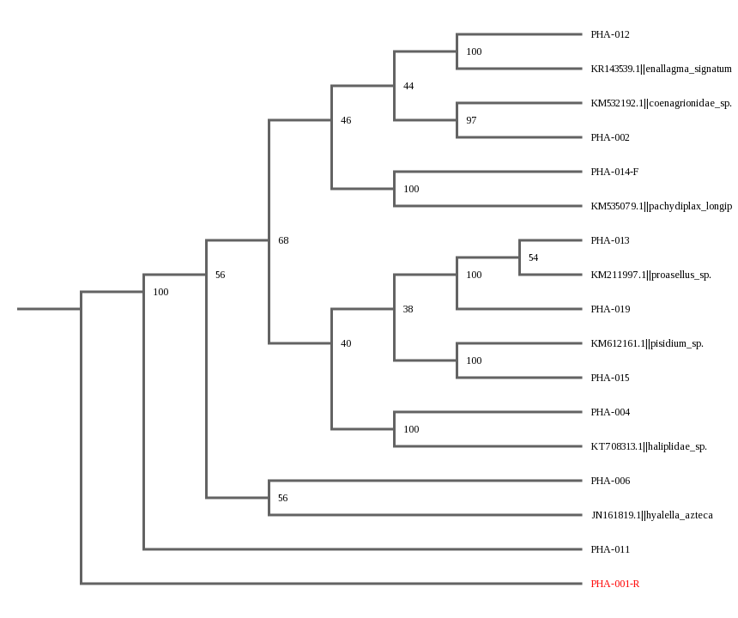
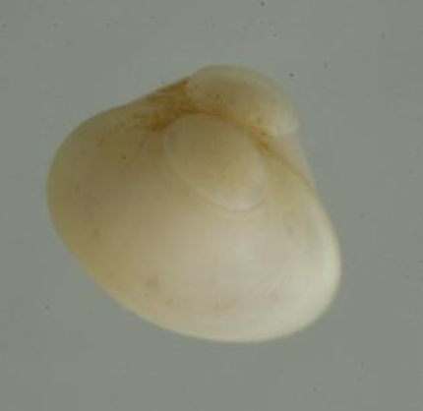
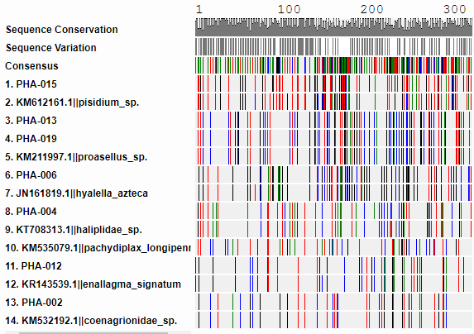
Use of Macroinvertebrates to Determine Biodiversity and the Health of the Connetquot River
Authors: Sabah Bari¹, Melissa Oz¹, Alex Yeung¹. Mentor: John Halloran¹
¹Connetquot High School
Results
The samples where gel electrophoresis had worked were samples 1, 2, 4, 6, 11, 12, 13, 14, 15, and 19. However, only samples 2, 4, 6, 12, 13, 15, and 19 had quality sequences that able to go through the Dna Subway programs were 1 R, ,. The BLAST results could range from PHA-002 being a Coenagrionidae; a damselfly to PHA-015 being a Pisidium; a freshwater clam. MUSCLE was performed several times on all samples.
Abstract
Barcoding is a way to classify species based on a gene within the species. It allows us to identify different species making it much easier for nonexperts to determine macroinvertebrate species. The aim of the project was to examine and determine the biodiversity of macroinvertebrates in Connetquot River and to also use the macroinvertebrates to determine the health of the river.
Some examples are PHA-002 is similar to the coenagrionidae, samples PHA-013 and PHA-019 are similar to proasellus, and PHA-015 is similar to Pisidium. PHA-015 is a potential novel species, given that its percent similarity is approximately 94%. For a sequence to be novel it must be under 95% in similarities to other species. PHA-015 is a novel sequence at 94.81% closest to KM612161.1||pisdimium_sp.
Introduction
The aim of the project was to examine and determine the biodiversity of macroinvertebrates in Connetquot River and to also to use the macroinvertebrates to determine the health of the river. The intentions of the experiment was to obtain macroinvertebrates with the permission of the park during late fall. We could use the diversity of macroinvertebrates to check for pollution. Generally, the types of organisms found in the water can tell how pristine the habitat is.
Discussion
Different species exhibit different tolerances to water pollution. Some have low tolerance and others have high tolerance dependent on how they can survive in the water: each macroinvertebrate is built to survive in different pollution states.¹ Macroinvertebrates such as Coenagrionidae, Haliplidae, and the Libellulidae can survive
Materials & Methods
Twenty samples were physically collected by placing dirt from the river into a bucket and were hand picked and put in test tubes. These test tubes contained ethanol and put into freezer at -20C to preserve the samples from deteriorating.¹ Then DNA was isolated using a silica based protocol provided by Cold Spring Harbor. ¹ PCR was done to amplify the DNA so the DNA could be sequenced to determine species
poor water quality most likely containing pollution which suggests that the quality of water is not good.¹ The novel sequence, PHA-015, is seemed to be a minute freshwater clam, more commonly known as a fat peaclam. The closest match on BLAST was pisidium, however on BOLD there were matches with more similarities, however they are inaccessible due to either being an early release or private.10 The fat Peaclam is native in Idaho, however it has been found in Long Island.
type. ¹ The primers used were (LCO1490/ HC02198), using the EdvoCyclerTM model #541.3 Gel electrophoresis was performed on the PCR product and the results were analyzed. Gel electrophoresis was used to determine if the PCR worked. BLAST, Basic Local Alignment Search Tool, is a program that uses an algorithm to compare biological sequences for determining other sequences near or exactly the sequence given. ² The blasted sequence along with the actual sequence were then placed in a MUSCLE, which depicts the differences and similarities with between two sequences side by side. ²
References
1. Using DNA Barcodes to Identify and Classify Living Things.
2. https://en.wikipedia.org/wiki/BLAST
3. Fast Track to Gene Annotation and Genome Analysis - DNA Subway. [accessed 2018 May 23].
4. https://dnasubway.cyverse.org/
Acknowledgements
We would like to thank our mentor, Mr. Halloran for his guidance, and Cold Spring Harbor for their generous support of our project

