Slide 1
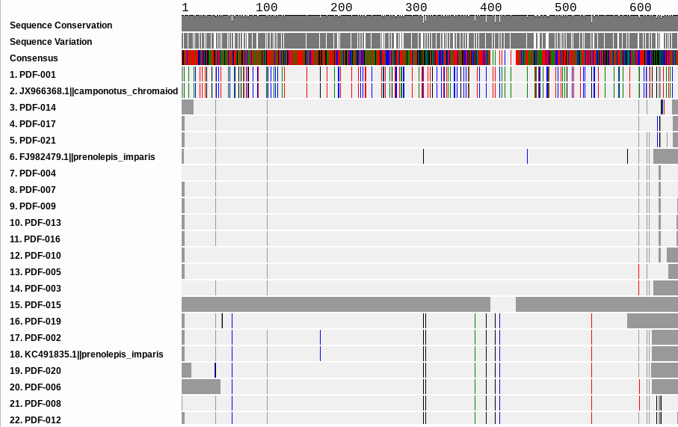
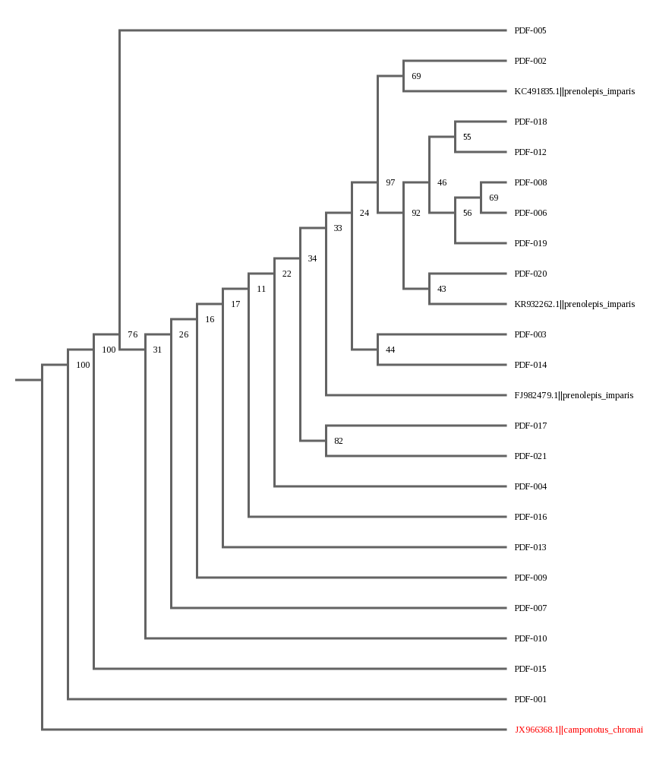
The Effect of Humans in The Environment
on Ant Biodiversity with FOOD
Bipro Das¹, Keith Grant¹, Atif Khan¹
Mentor- John Halloran¹
¹Connetquot High School
Abstract
Our hypothesis is ant colonies exposed to humans, will have a higher rate of biodiversity. We tested this hypothesis by collecting ants at secluded and domestic locations in three different parks through the use of specialized bait. We then proceeded to analyze their DNA by utilizing PCR, and barcoding the COI gene. Our results indicate the presence of 2 distinct subpopulations of Prenolepis impairs. These sub populations do not appear to be geographically distinct. We are in the process of comparing our findings with neighboring schools who have found the same subpopulations of ants.
Discussion
The data collected represents the fact that ants clearly are more biodiverse (as shown in the data tables representing ants collected) or at least there are more of them, in the human exposed areas as ants were very difficult to find in the non human exposed areas. It seems that our hypothesis was correct, and there was more biodiversity in the human exposed areas. Why this is so is the fact that it was quite cold outside at all the parks that were visited, and ants are ectotherms and do not like the cold ⁴. A large majority of our ants were Prenolepis imparis. After further research we discovered this was because this species of ant is one of the few that prefer cold weather⁵. In addition, regarding the metadata, it seems that ants slightly prefer the apple over the pecan sandie control, while there was only one outlier out of all the parks that went for the coffee. Regarding the twenty documented ants that we have collected, we had two distinct subpopulations since the ants were overwhelmingly different in two ways only. What is interesting about this is that the two subpopulations are not in their own area; they are scattered. The reliability of these results are quite high, as one could simply check figures 2 and 3; our Phred scores are all above 20 which means that there will only possibly be one in a hundred of the bases as a mistake. Possible future experiments would preferably include a larger sample size, both to gel electrophoresis and also could include collaboration with Patchogue - Medford since one of their teams have observed a similar phenomenon, but their subpopulations were neat and not with each other.
Introduction
DNA barcoding is quite a relatively new concept, and it was originally introduced to simplify the problem of organizing biological data.¹ It uses a similar concept to barcodes in a supermarket to easily archive various sequences of animals into one large genome of life.¹ We believe that if the ants are exposed to humans in their local environment, then they will have a higher biodiversity. The reason for choosing ants is because they are beneficial to the environment as ants act as decomposers by feeding on organic waste, insects or other dead animals. ² For the metadata of flavor preference, we will be using foods that have not already been used as well, such as chili flakes, coffee grounds, honey crisp apple slices. Pecan sandies will serve as our control as they are a commonly used bait.
Materials & Methods
Samples were collected from two different locations in three different parks. This was done by laying out 15.5g of chili flakes, 15.5g of an apple, 15.5g of coffee grounds, and one pecan sandies cookie all one meter away from an ant hill. This was setup at a secluded and domestic locations in each park. After an hour the bait was collected and the ants were removed and stored.
Gel electrophoresis was performed to ensure that the COI gene was amplified and to compare the gene to the ladder. The COI gene samples were sent to Genewiz and the raw data uploaded to DNA Subway. The barcodes were then analyzed and trimmed. In the DNA Subway, MUSCLE was used to create barcodes (figure 3).
Figure 3: DNA Barcodes
Results
We have caught a total of about 86 ants. Of these 86, 20 samples were used for further study, DNA extraction and photo documentation. The selection criteria was simply to use ants that looked different from each other. There was a higher yield of ants in the human exposed areas than in the forested area. The Phred scores of all our insects were above 20, as shown in figure 2, and the gel electrophoresis was bright, as shown in figure 4. If the Phred scores are above 20, then that means there is a 1 in a hundred chance of the analysis being incorrect. As shown by the chromatography graph. A total of 42 ants preferred the apple, 30 preferred pecans, and 1 preferred coffee as our metadata. All data is shown in figure 1.1 and 1.2.
Figure 4: Gels of samples 13 - 20
Figure 2: DNA chromatogram
Figure 5: Phylogenetic Tree
Citations
1. The ecological importance of ants. [accessed 2018 May 11]. http://espacepourlavie.ca/en/ecological-importance-ants
2. What is DNA Barcoding? [accessed 2018 May 11]. http://www.ibol.org/phase1/about-us/what-is-dna-barcoding/
3. Ecological Importance. [accessed 2018 May 11]. http://harvardforest.fas.harvard.edu/ants/ecological-importance
4. Do Ants Hibernate in Winter? | Terminix. [accessed 2018 May 11]. https://www.terminix.com/pest-control/ants/behavior/do-ants-hibernate/
5 Prenolepis imparis. [accessed 2018 May 11]. http://www.antwiki.org/wiki/Prenolepis_imparis
Ants from Bait (Overall Total)
Human Exposed V.S Isolated Ants (Including Ants not from Bait)
 | Pecan Sandies | Apple | Coffee | Chili Flakes | Total
Connetquot | 28 | 36 | 1 | 0 | 65
Lake Ronkonkoma | 2 | 6 | 0 | 0 | 8
 | Exposed | Isolated | Total
Connetquot | 65 | 9 | 73
Lake Ronkonkoma | 8 | 5 | 13
Acknowledgements
Special thanks to, of course, Mr. Halloran for introducing us to the concept of barcoding and BLI. Also, thanks to Connetquot State Park for allowing us to collect ants from their premises. Finally, thanks to the Dolan Learning Center and the Barcode LI team for giving us this opportunity.
Figure 1.2
Figure 1.1

