Slide 1
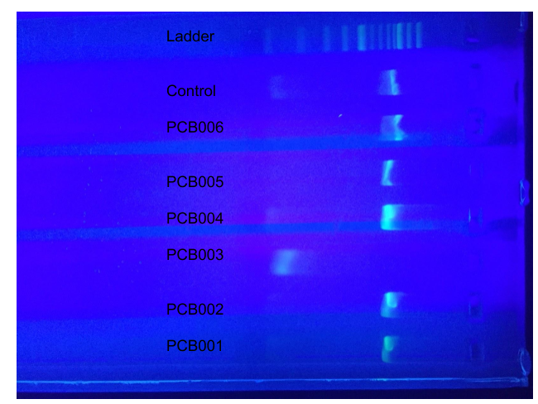
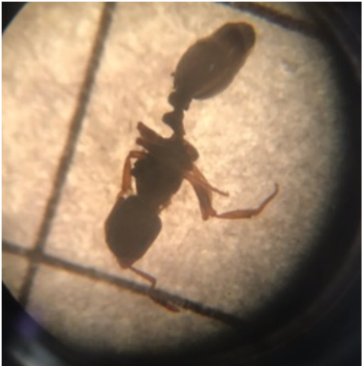
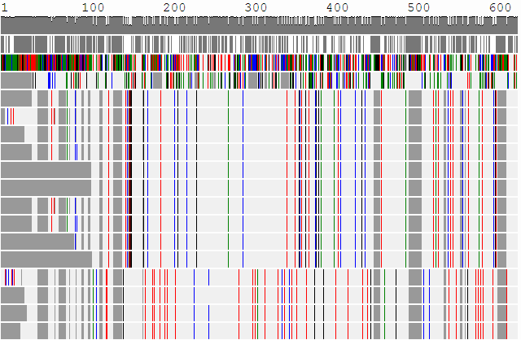
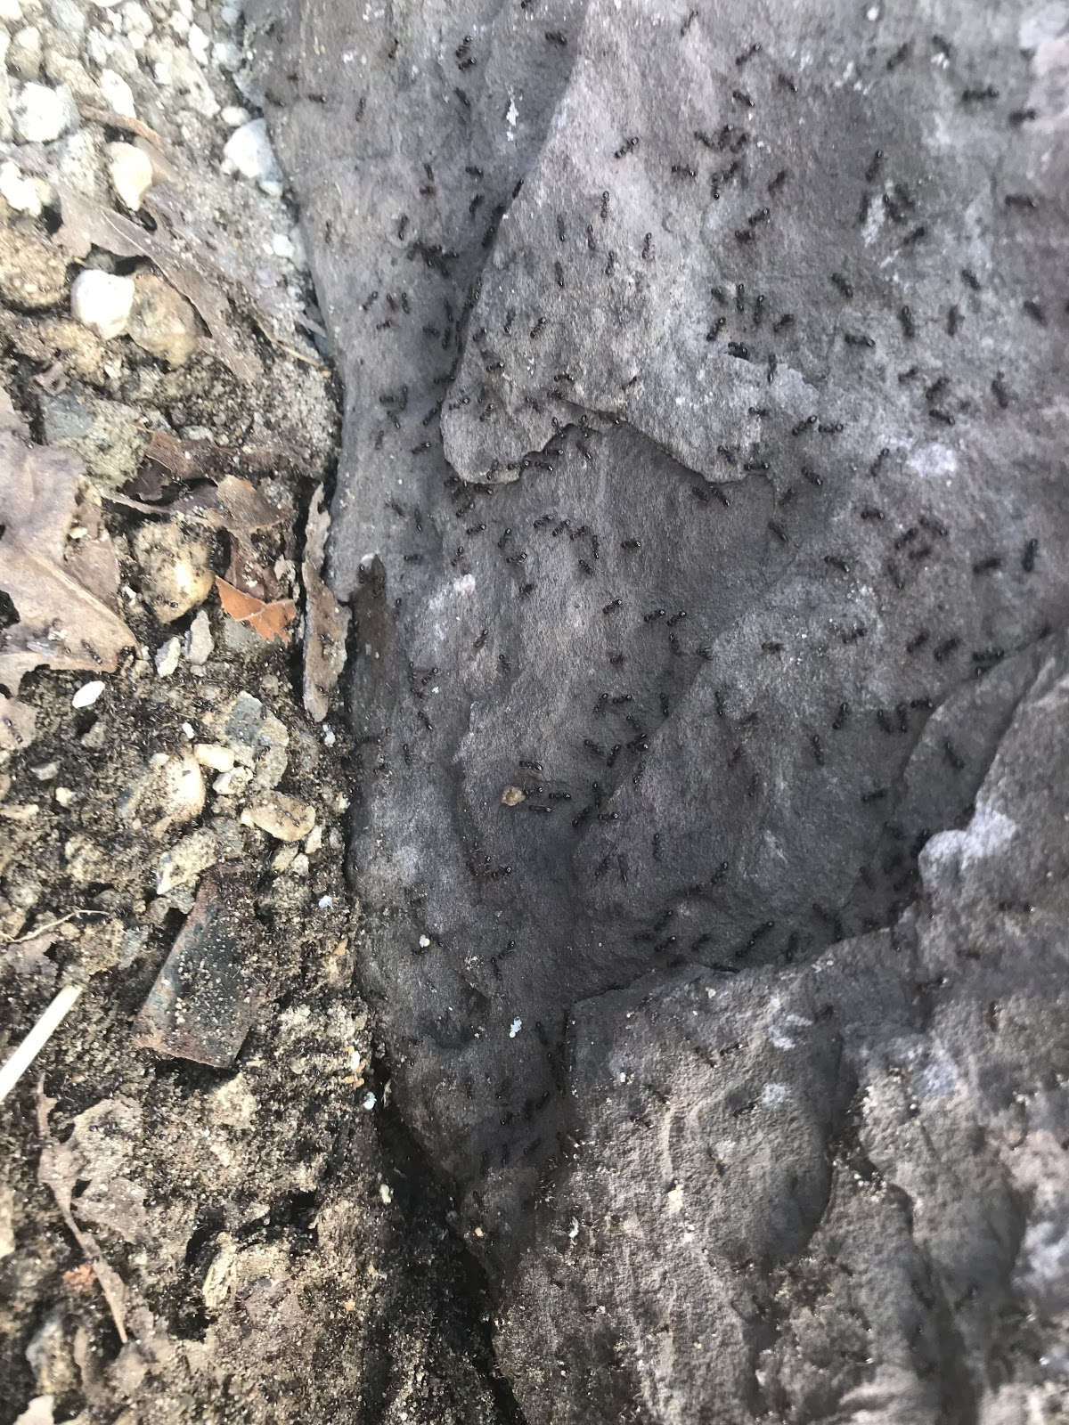
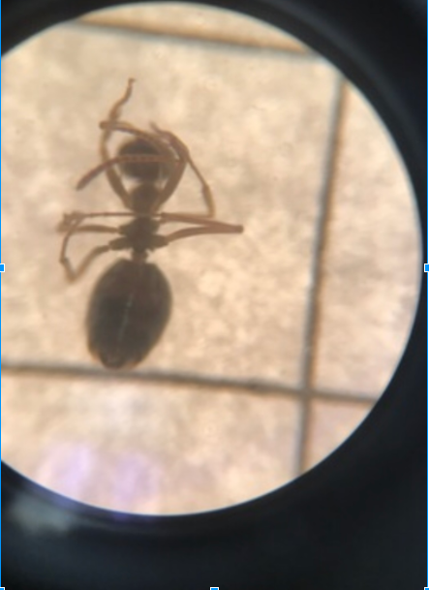
.
.
Using DNA Barcoding To Measure The Biodiversity in Ants in Residential Areas And Park Areas
Results
More than 20 ants were collected during the process. Only 17 of the ants had extractions and amplifications. The results at first, on the phred score from 10 to 60 was really bad because it was below 20; the borderline for sufficient. The blast results were somewhat different moving from 70 onward till towards the end the it is above 20 which is clearly good, because it shows progression and similarity in the species. There were some slight differences between the residential and park based ants. The results showed that there was 1 novel sequence.
Authors: Emily Augulis¹, Paige Dreher¹, Sarah Hussain¹
Mentor: John Halloran¹ Connetquot High School¹
Abstract
Our goal was to examine the biodiversity between ants located in a residential area to the ants that were located in Connetquot River State Park Preserve. Our hypothesis was that there would be more diversity in Connetquot State Park than in residential area. Our experiment was done by DNA barcoding. Our results that we found is that there was very little diversity in both areas.
Introduction
DNA barcoding is a taxonomic method that uses a short genetic marker in an organism's DNA to identify it as belonging to a particular species. DNA barcoding is faster and cheaper than traditional identification methods. The experiment was done to examine the difference in biodiversity. The importance of diversity is so if there is a disease that spread that is deadly it will not kill off all the ants⁵. Ants are important in our lives because they aerate the soil which is beneficial to the soil³. This is beneficial to humans in that good soil helps plants grow².
Figure 1: Gel Electrophoresis Residential Area
Figure 3: Ant 004 From State Park
Discussion Our hypothesis was not supported by the fact that the ants found in both areas were mostly the same. To help this data become better would to explore more residential areas and more throughout the park. If we looked at more areas throughout the park more diversity may have been found. This data can help to create a new experiment to achieve better results. Our results that we got is that there wasn’t much diversity in the park area and residential area. The main conclusion that we came up with is that ants usually appear in groups and that there is no diversity among the groups.
.
Figure 2: MUSCLE Results
Materials & Methods
A sample of ants was collected from both locations using “bait”, which consisted of water and part of a banana¹. Using water and mixing it with the banana it was then poured into the water bottle to capture the ants and the time was marked for when the traps were deployed, the bottles were left for 2 days. The ants were then preserved in 1.5 mL micro centrifuge tubes with 99 % ethanol and frozen once back in the lab. This was to make sure they were in good condition for when we took pictures of them. The ants were removed once for identification using a dissecting scope and digital camera. Species were then identified using a identification key⁴. After identification a silica based protocol, established by Cold Spring Harbor Lab was used to extract the DNA from the insects. Using specific primers, lco1490 will multiply the COI gene using a PCR machine Edvotek Model 541 using the primers . Then gel electrophoresis was performed to see if PCR was successful. The remaining PCR product from samples that had band sizes were sent to Genewiz for sequencing and we later compared the sequences in DNA subway using barcoding to see the biodiversity.
References
1.Baiting for Insects - Collecting Methods Mississippi Entomological Museum Home, mississippientomologicalmuseum.org.msstate.edu/collecting.preparation.methods/Baiting.htm.
2.“Humans Would Not Exist Without These 5 Animals.” One Green Planet, 17 Dec. 2014, www.onegreenplanet.org/animalsandnature/animals-that-help-us-to-survive/.
3.“Ants Have Big Impact on Environment as 'Ecosystem Engineers'.” ScienceDaily, ScienceDaily, 4 Feb. 2011, www.sciencedaily.com/releases/2011/01/110131133227.htm.
4.“Types of Ants.” Types Of Ants On Long Island, New York, www.suburbanexterminating.com/pest-identification/category/ants.
Stein, Eric D., et al. “Is DNA Barcoding Actually Cheaper and Faster than Traditional Morphological Methods: Results from a Survey of 5.Freshwater Bioassessment Efforts in the United States?” PLOS ONE, Public Library of Science, journals.plos.org/plosone/article?id=10.1371/journal.pone.0095525.
Figure 5: Ants at Connetquot State Park
Figure 4: Ant 205 Residential Area
Acknowledgements
Thank you to BNL for supporting our project and thank to Mr. Halloran for mentoring us during this project

