Slide 1
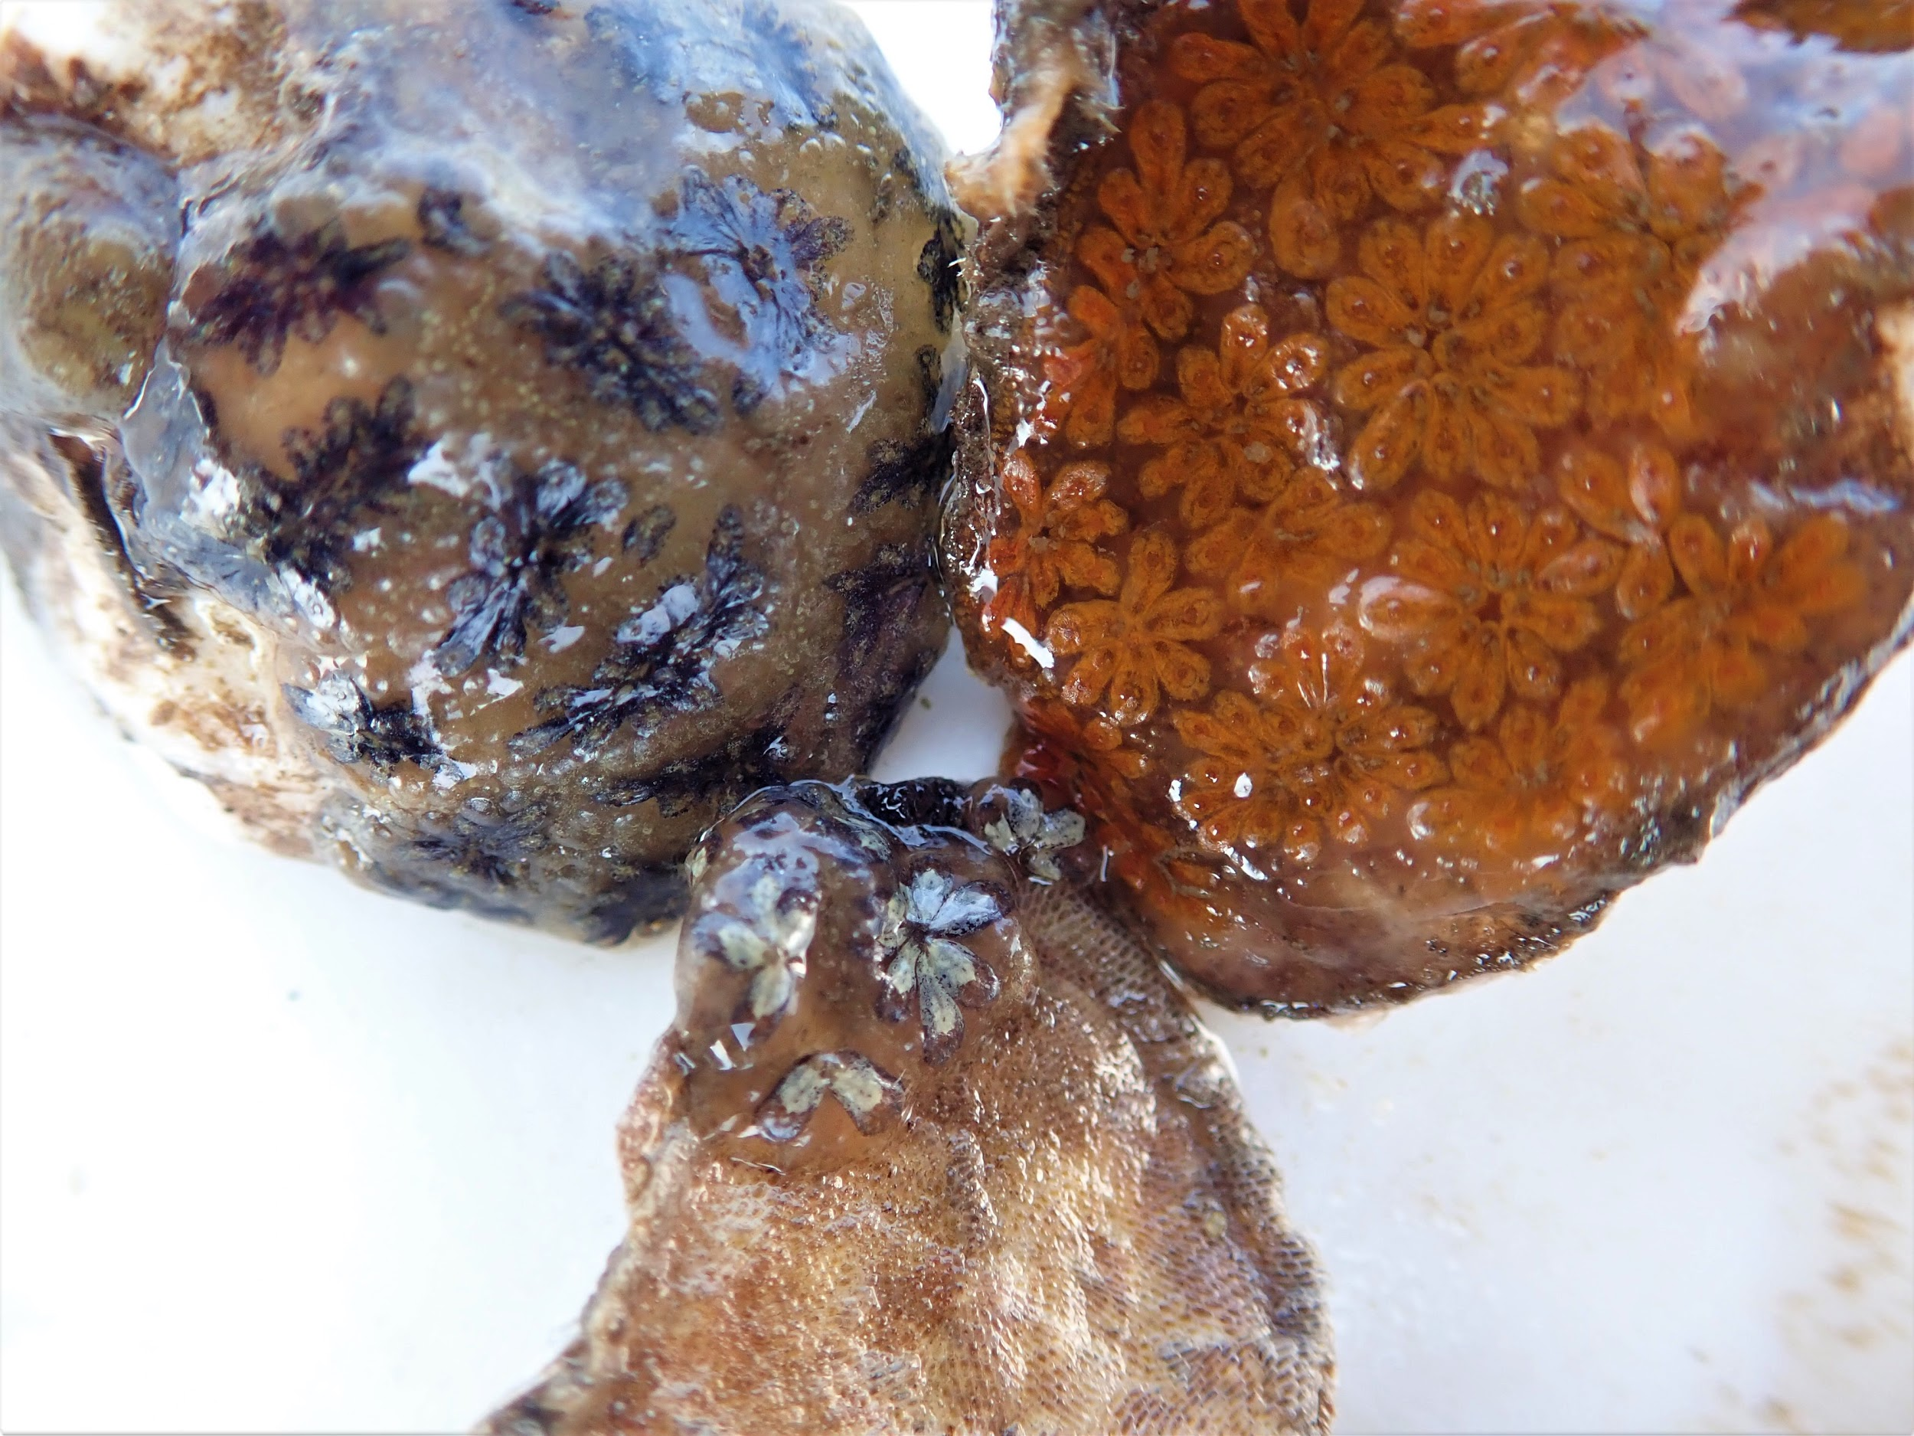
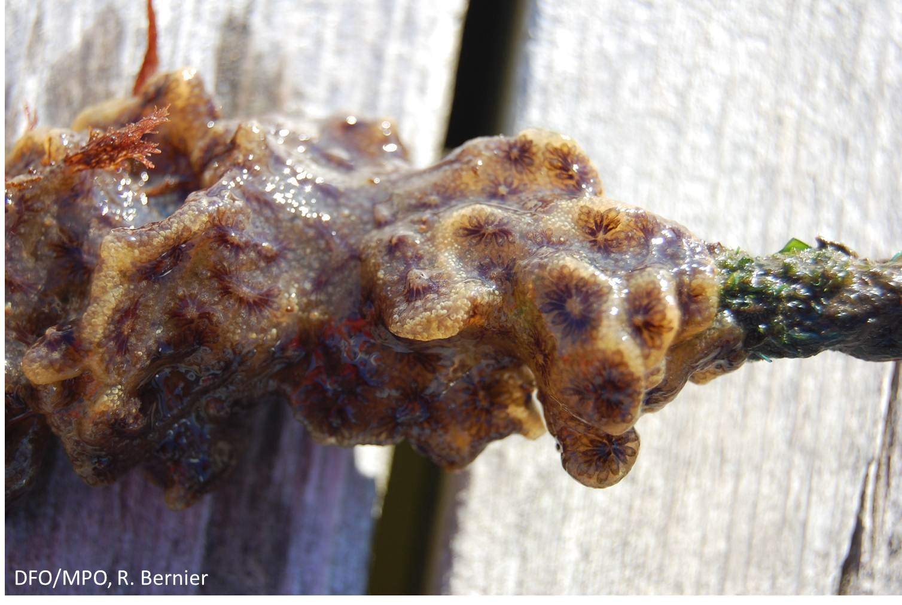
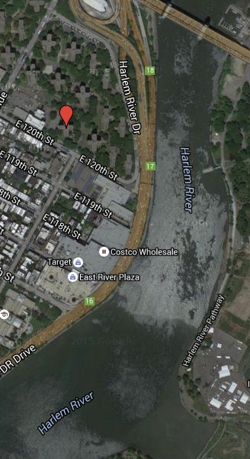
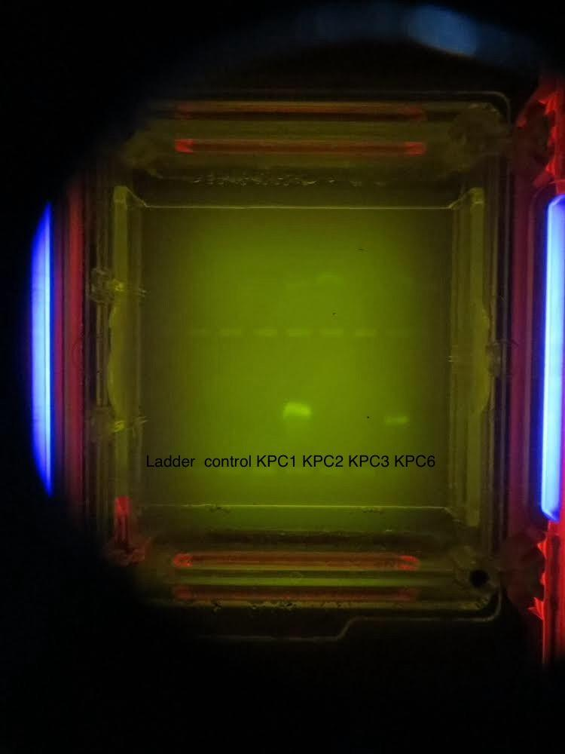
Barcoding Different Phenotypes of the Colonial Sea Squirt Botryllus schlosseri in the Hudson-Raritan Estuary
Lisette Mejia, Brian Mejia & Mentor Mauricio Gonzalez & Liz Burmester
Funded by the
Thompson Family Foundation
Introduction
The New York harbor is on the path of recovering from human impact and biodiversity in the estuary is a key factor because of its reflection on the stability of the ecosystem. Botryllus schlosseri is a colonial sea squirt whose phenotype can vary from different color to different shapes. For example, they may appear orange, yellow, red, greenish, violet, grey and black. Botryllus schlosseri can typically form a flat sheet of 3-4 mm thick and up to 10 cm across (Cohen, 2011). What makes it unique is the zooids which can arrange into different star-shaped systems.
Background
B. schlosseri can grow on a variety of surfaces including boat hulls, buoys, ropes, oyster cages, and pillings. B. schlosseri can grow quite well in polluted water (Manniot, 2009). It has been reported that its range has spread over the last 100 years to a nearly worldwide extent (Manniot, 2009). The star tunicate is not native to the U.S, but now occurs on both North American coasts. B. schlosseri can have the potential to compete with native species in an ecosystem. Fast growing B. schlosseri colonies may over grow neighboring organism and alter community’s dynamics. It can even outgrow the space with cultured oysters and mussels (Manniot, 2009). This can have a huge impact on the oyster population if B. schlosseri have the ability to outgrow oysters because oysters are used as filters in order to help clean up the New York Harbor.
Methods
Collecting samples
Extracting the DNA from the samples
Isolating the DNA from the samples
Amplify the DNA by PCR
Analyzing the PCR products
Analyze results
Hypothesis
It is hypothesized that the samples collected in the East River are indeed associated with the Botryllus schlosseri classification due to similar color and patterns.
Results
We were able to run a DNA extraction from all the 7 collected samples, amplify the DNA using the polymerase chain reaction, and analyze PCR products by gel electrophoresis. From the gel (see figure 4) we were able to find bands of possible DNA. The ladder and positive control bands were absent. We didn’t have the opportunity to sequence the DNA in order to run a the bioinformatics.
Discussion
The study may not have worked as the original hypothesis, due to multiple mistakes and difficulties. While working on the gel electrophoresis it did come to notice that we had bands showing up indicating that we could possibly have DNA. There were numerous mistakes (human error) that made supporting the hypothesis impossible. For example, there were difficulties managing time. With only two hours after school it was difficult to complete all the steps in a timely manner. Another time the Ladder, control, and Sybr green out of the fridge for too long. When running the PCR we could only complete 24 cycles. Then running the gel we could only run it for 5 minutes before having to leave For future studies we would like to continue working on Colonial tunicates and what they can tell us about the biodiversity in the estuary.
References
Cohen, A.N 2011. The Exotics Guide: Non-native Marine Species of the North America Pacific coast. Accessed 03/31/18
http://www.dnabarcoding101.org accessed 02/14/18
Monniot, C. 2009. Botryllus schlosseri (Palla, 1766). World of Marine species accessed 03/31/18
Acknowledgements
I would like to thank my mentors Mauricio Gonzalez, M.sc. and Liz Burmester, Ph.D. I would also like to thank Christine Marizzi and the Urban Barcode Project for giving us an opportunity to begin this project and providing us with the materials.
FIgure #1 Colonial Sea Squirts
Picture credit: Liz Burmester
Figure #2: A golden star tunicate which falls under the same family of Botryllus schlosseri
Figure #3: Sampling site along the East River
between E118st and E119st
Figure #4: Gel electrophoresis of samples

